Slide 1
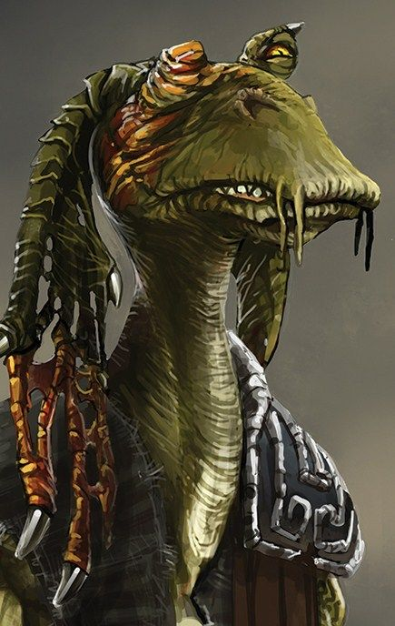
Jarex‘ powerpoint: Unnecessary Star wars lore
Who is Gar-Gar Glings?

Slide 2
Gar-Gar Glings
Is a Gungan
Appeared in a one-off comic in 2012
Fought alongside the 332nd clone Battalion during the battle of Geonosis
Lost an eye to a stray droideka shot
Canonically saved the life of Qui-gon Jinn twice

Slide 3
He is known for his famous quote, which is also his catchphrase:

Slide 4
„Yousa Gar-Gar-Gling on Deez NUTS“
Lmao gottem

Slide 5
Thank you for listening!

