Slide 1
How to make friends :)

Slide 2
Norime ideas
Go out
Get a hobbie
Take showers
But now to ideas that actually work

Slide 3
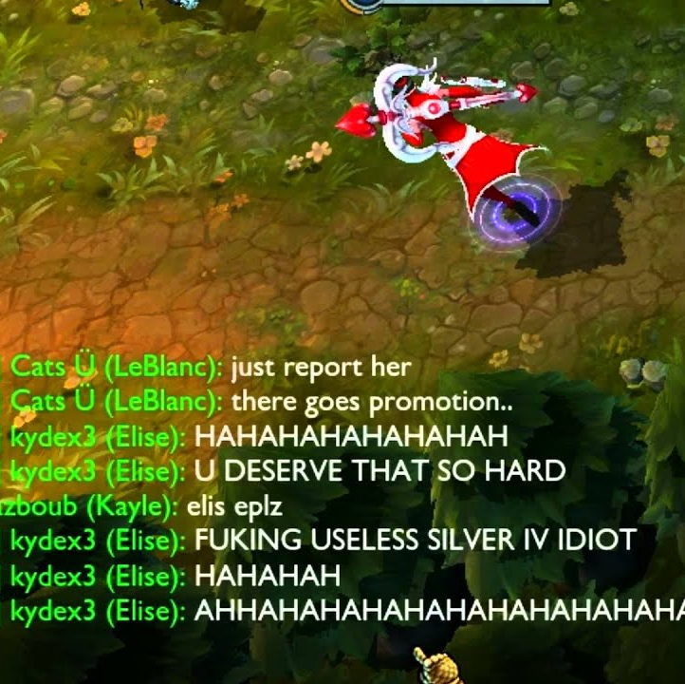
Be extra toxic to people in league
Leaves an impression
Be creative
Remeber that the worse the insult the more memorable you will be
Might even become eternalized as a meme

Slide 4
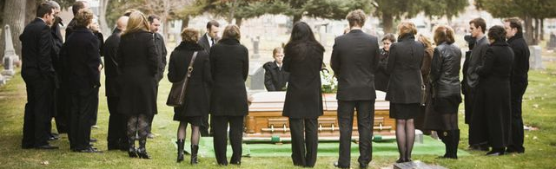
Kill a mutual
Might cost a friend but will pay out in the long time
People are greeving on funurals and easier to manipulate in to friendship
Come to think of it that also make it optimal to pick up someone special too :)

Slide 5
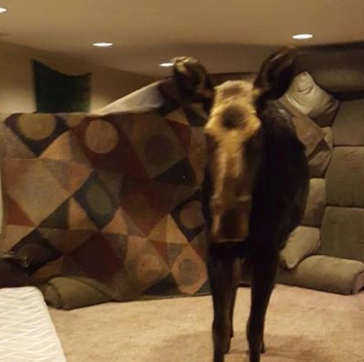
Last plan out: the basement solution
Can’t run
Noone will hear the screaming
Will probably play fun games like dnd for food

