Slide 1
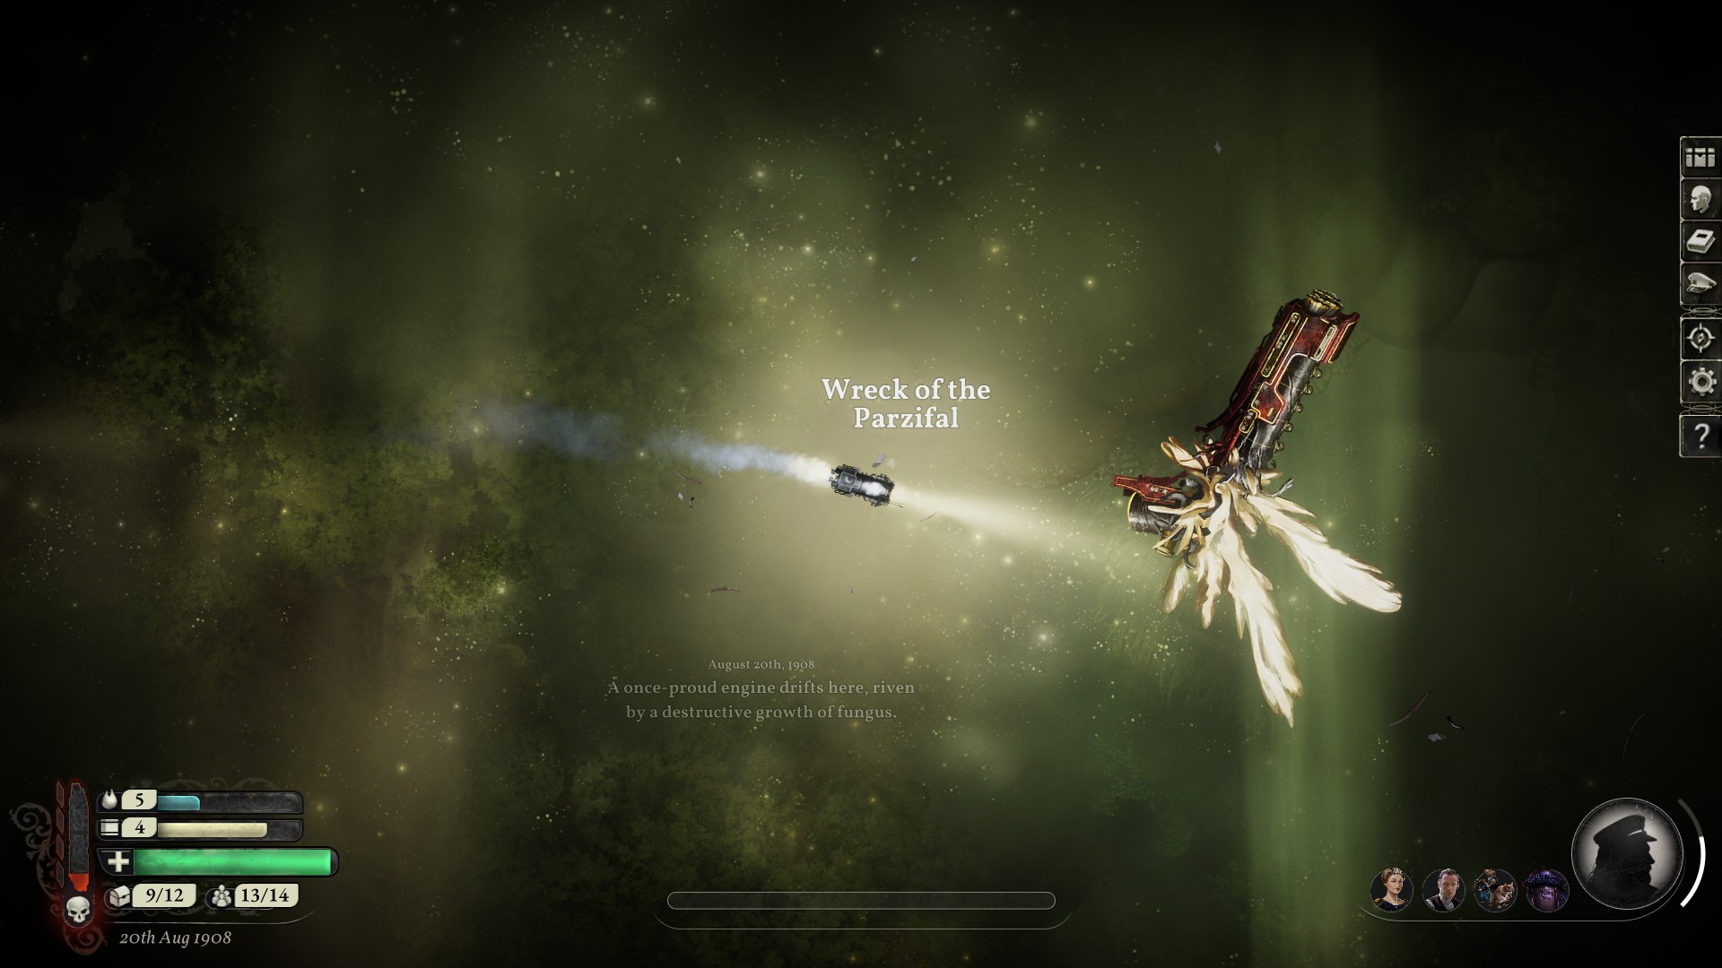
Sunless Skies: Your Journey
A crew, collected, renewed
Notes:
The people are the new crew, overthrew the old captain, and started a democracy in ruling! No more Captain, just the law of the people
You start with 1 fuel, 0 sanity, and 0 supplies
Started with 9: Ciri, Farris, Poke, Tony, Amber, Carmen, Derp, Lupus, Barth

Slide 2
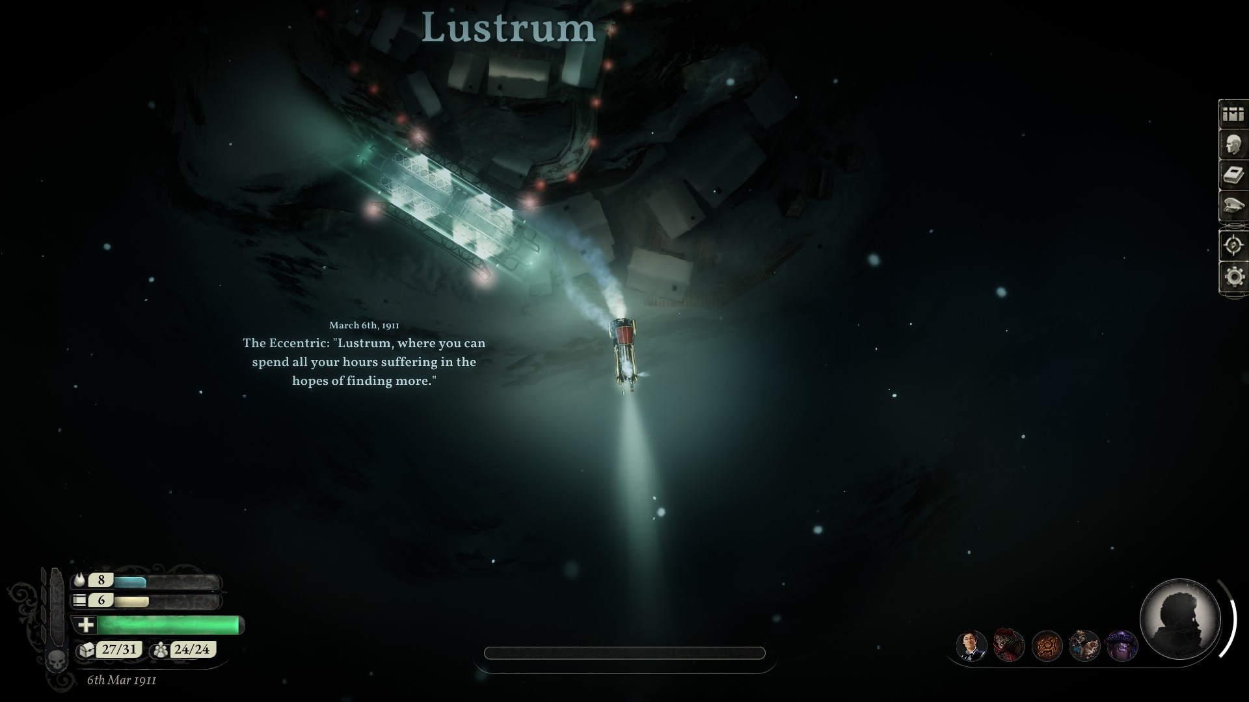
Old Miners, new workers?
Notes:
Accept the miners? If yes: +1 unnamed crew, but in dia 6 sanity check If no: nothing happens

Slide 3
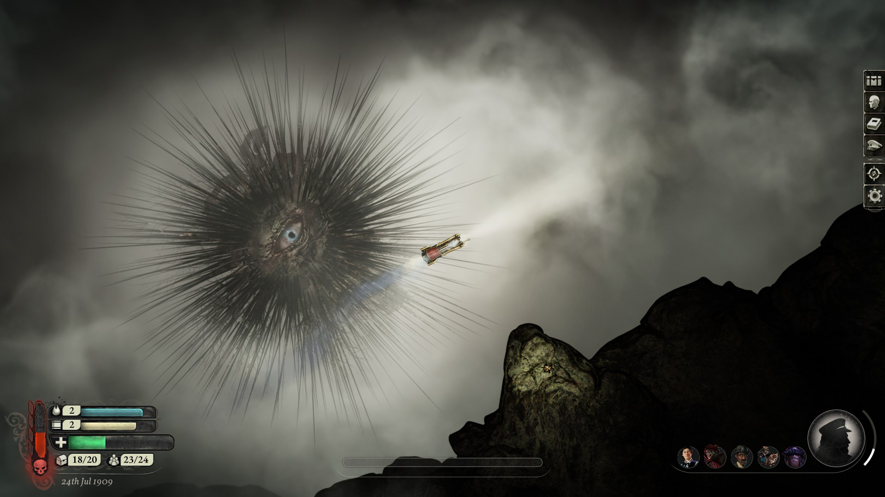
You face the horrors in the mist
Notes:
Your terror mounts
-1 sanity

Slide 4
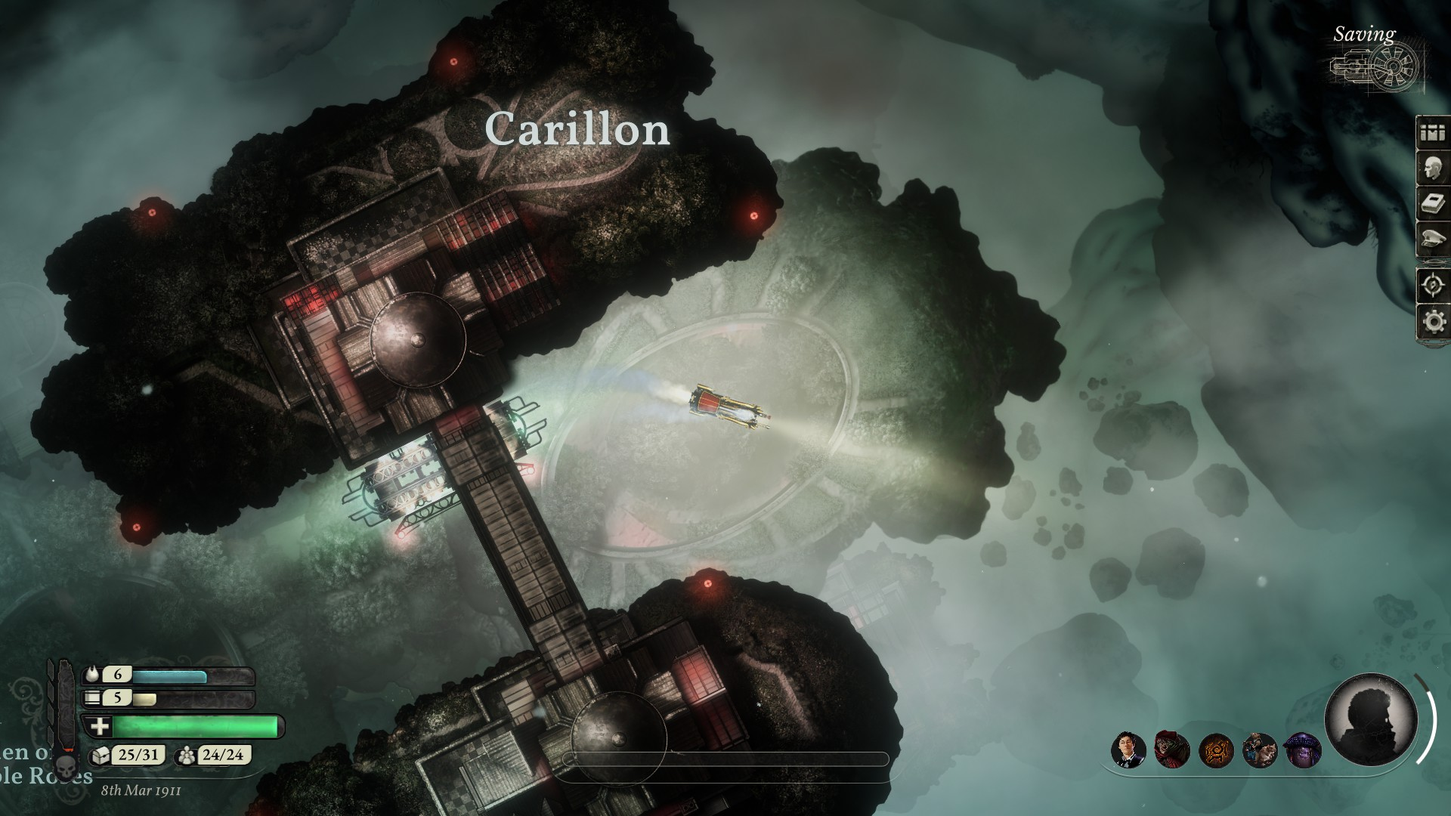
Let the devils cut away part of your souls?
Notes:
If yes: +1 to sanity if no: -1 to sanity

Slide 5
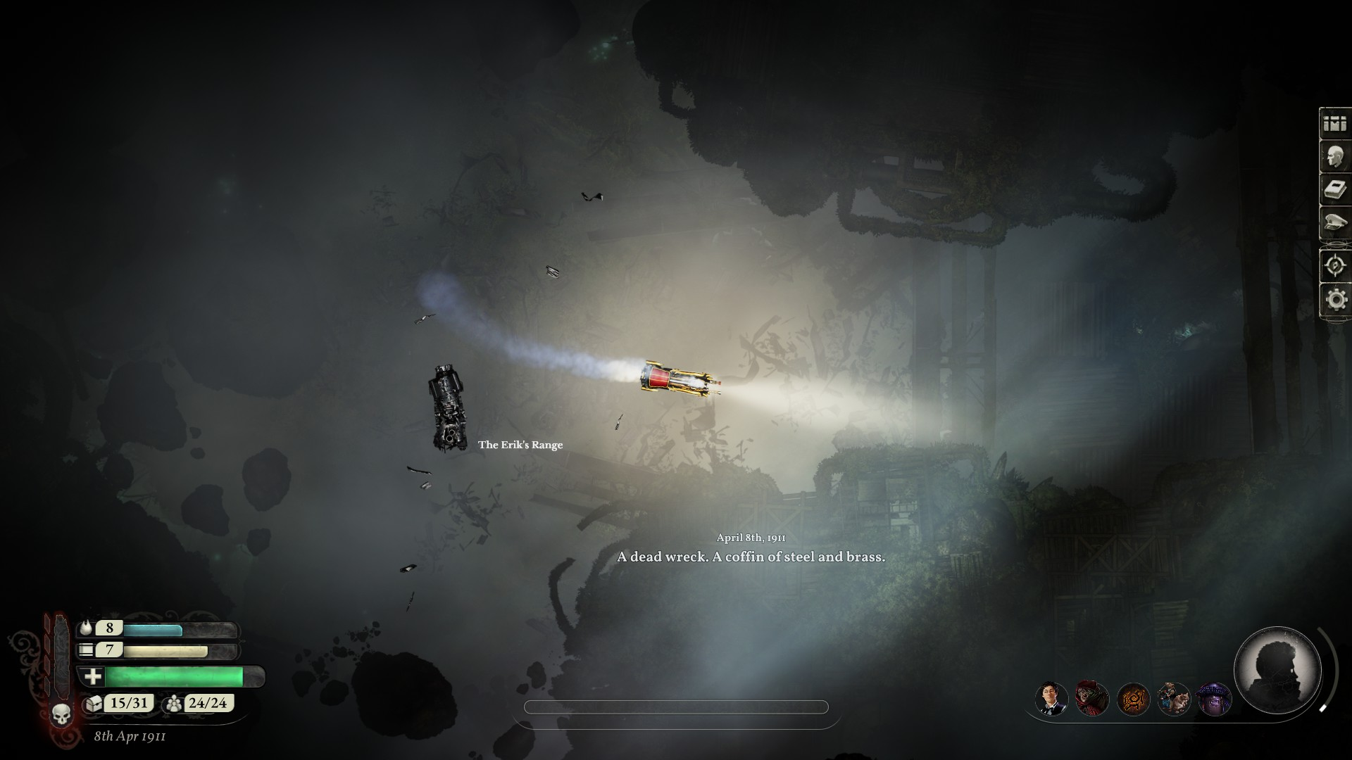
A dead wreck to explore, or to remember
Notes:
Explore: Lose 1 crew, gain enough supplies to prevent cannibalism
Remember: -1 sanity

Slide 6
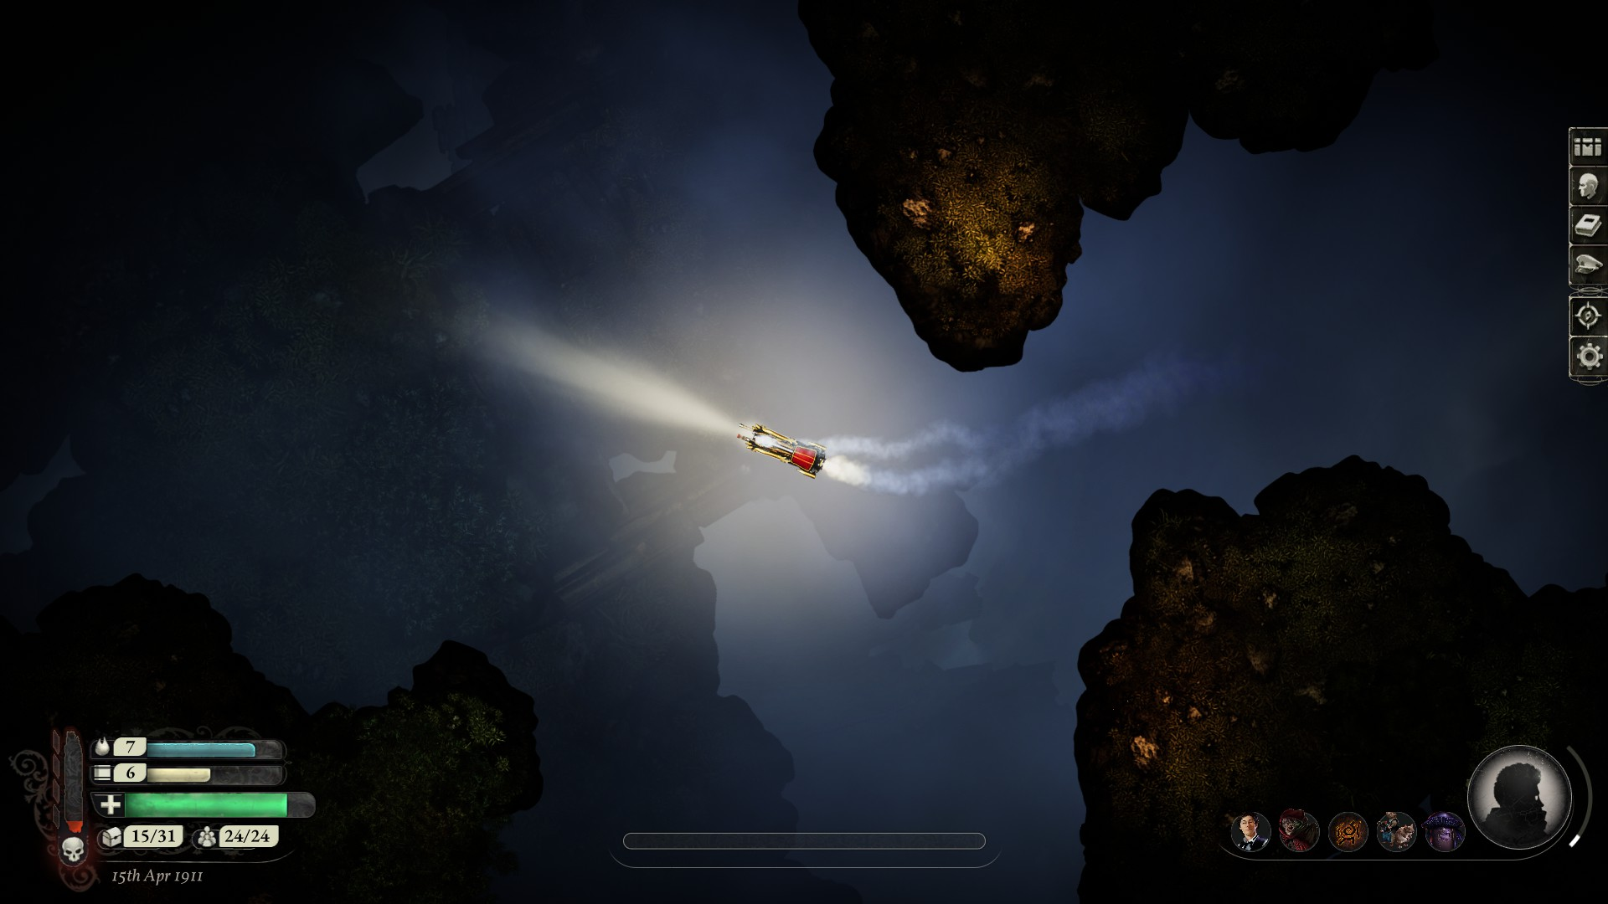
An empty bed, a used mug
Notes:
A bed is made, but nobody knows who it belongs to (sanity check) positive san: remember you got crew (+1) neutral: again on slide 11
Negative: lose 1 crew

Slide 7
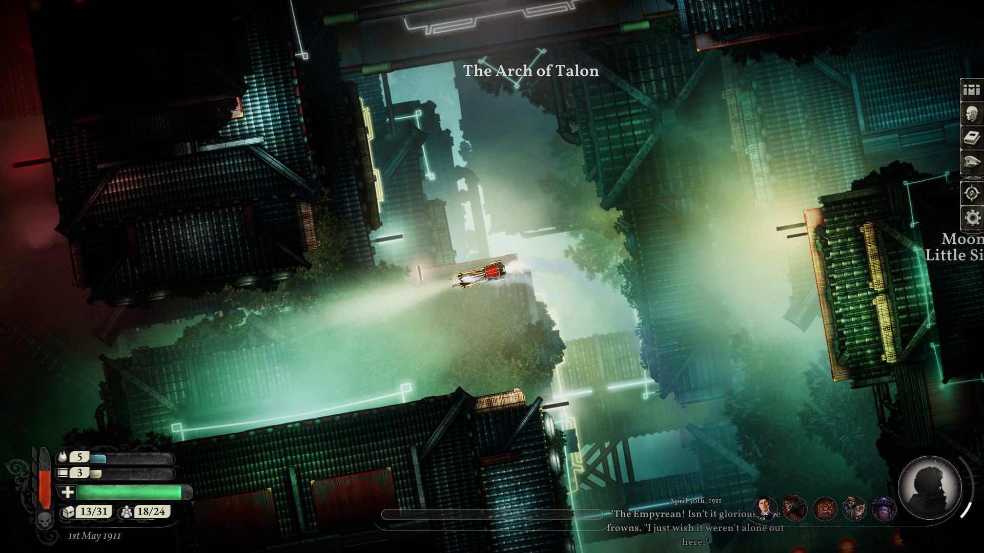
A celebration, in a foreign place
Notes:
Do you join the celebration Yes: +1 sanity No: nothing happens, the foreigners find you weird

Slide 8
You Hunger
Notes:
What do you eat? Do you have supplies? Yes: you eat the supplies, -1 supplies No: you eat, the supplies, -1 crew

Slide 9
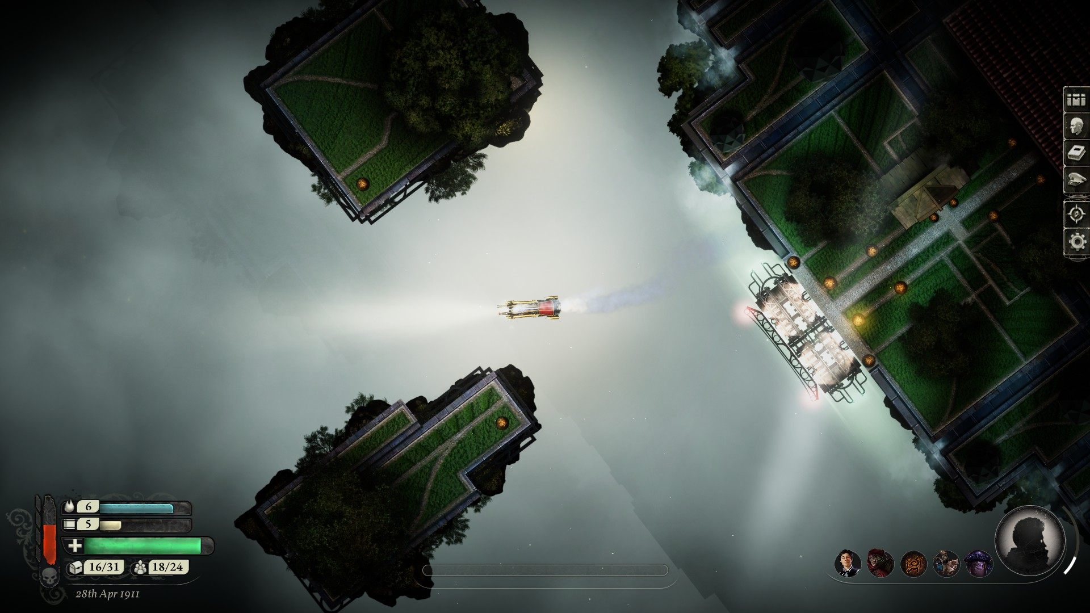
Time for Rest
Notes:
Do you take a short, or long rest?
Short: +1 sanity Long -1 sanity, +1 supply

Slide 10
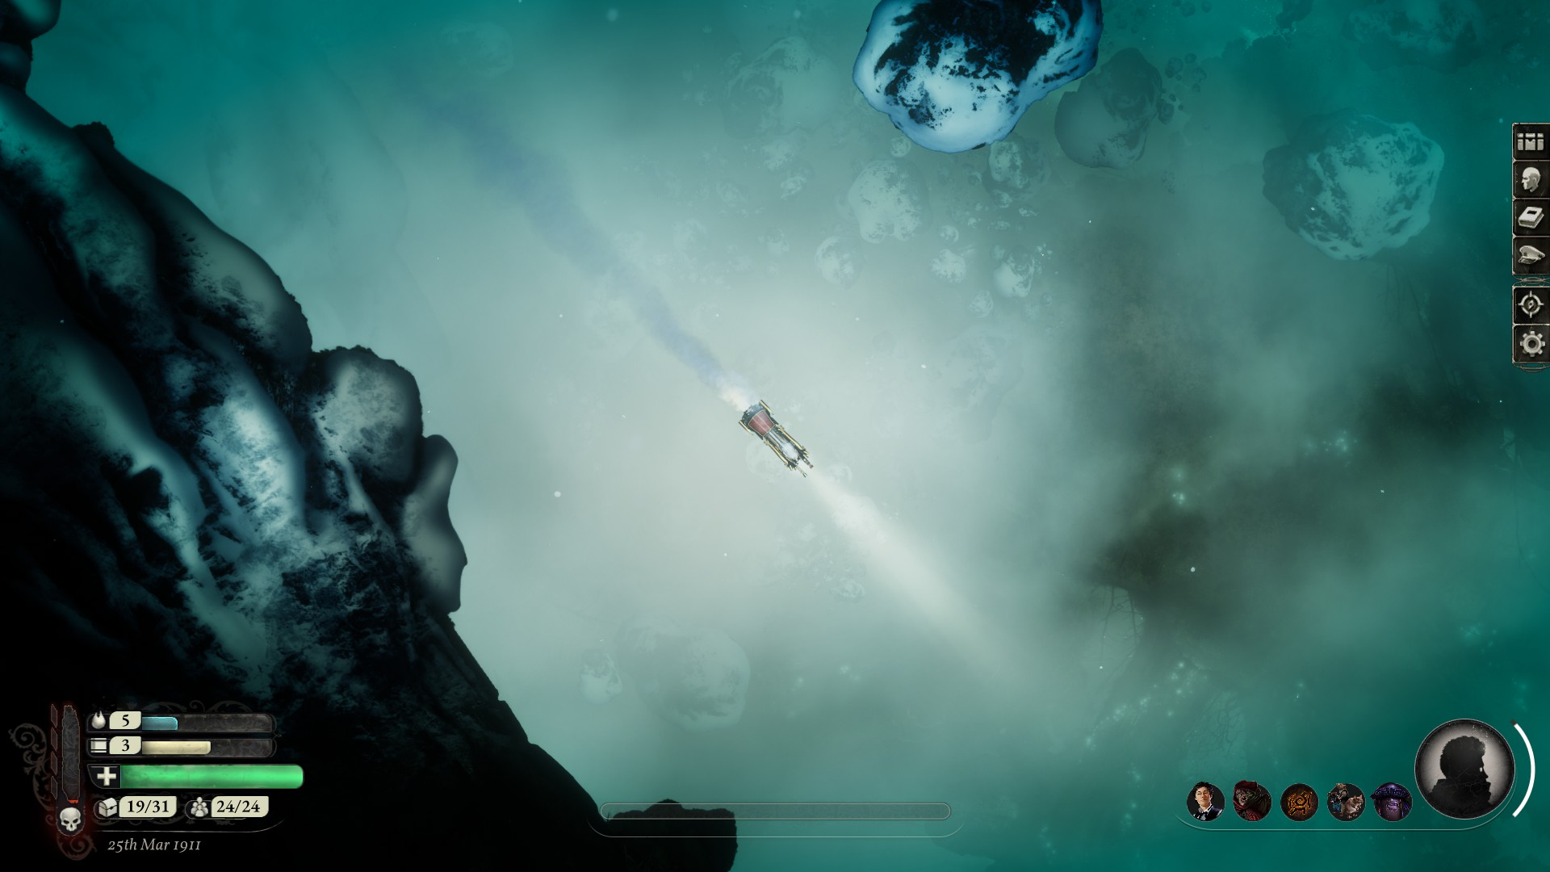
The Cold, Broken Windows, it gets through
Notes:
Do you send someone out to fix the windows? Yes: who (vote), that person gets Cold No: the cold kills (+1 supplies if eating someone before, -1 crew)

Slide 11
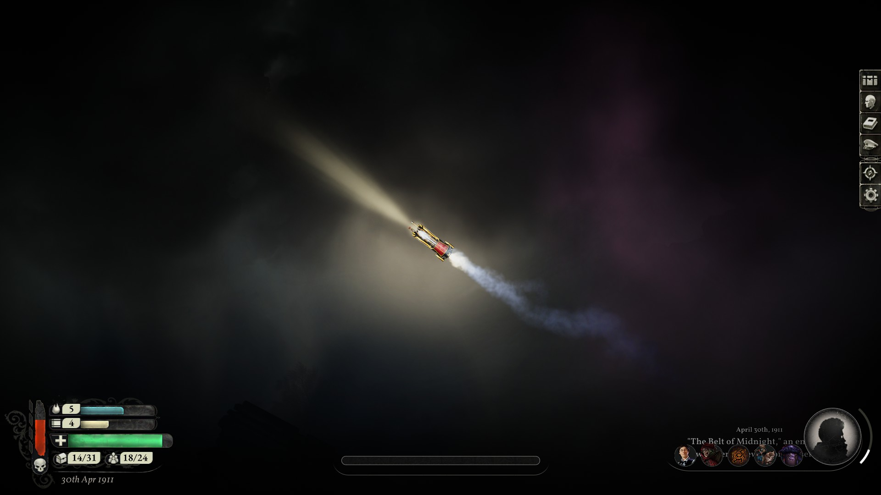
The Endless Dark
Notes:
Sanity check, burn 1 fuel to removed sanity loss penalty
Pos san: you remember the forgotten crew member (lose 1 supply, but if a player has died, you regain them) neutral: -1 supply, -1 san neg: -1 supply , -1 crew member, -1 san

Slide 12
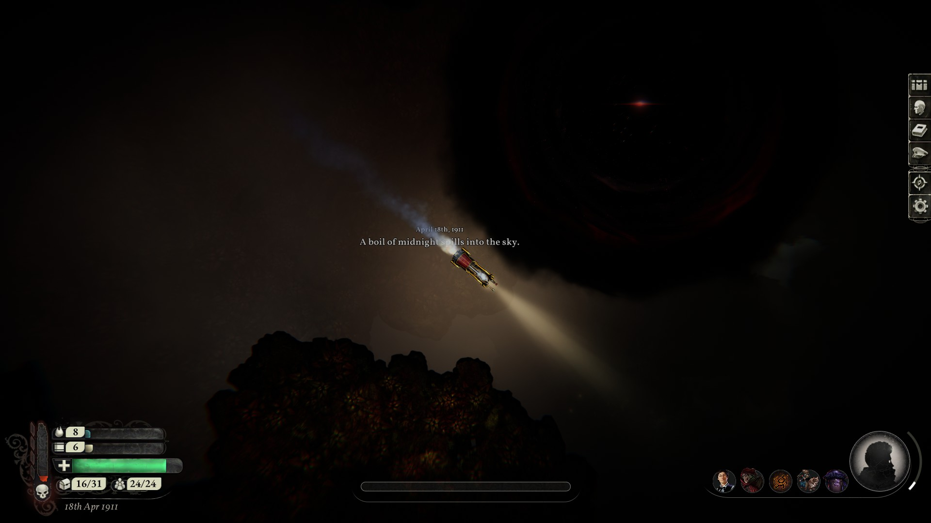
A hole in the sky
Notes:
Do you explore the hole? Yes: -1 sanity, +1 unknown horror/treasure
No: save 1 fuel

Slide 13
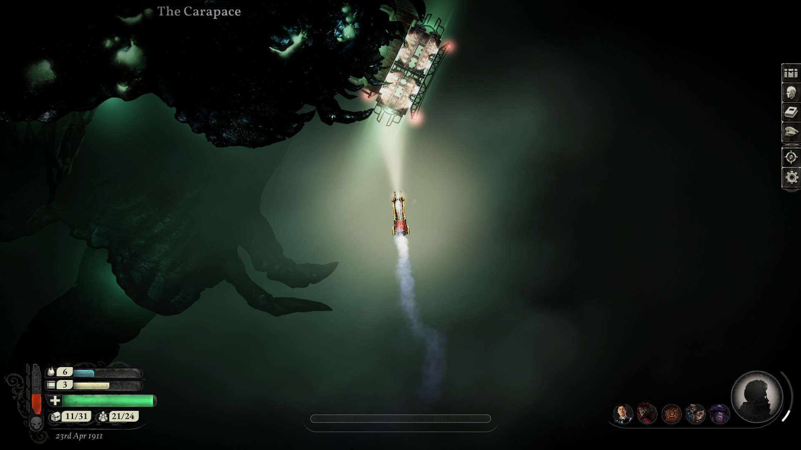
The Carapace
Notes:
If by 10, Cold touched, they can get 1 free fuel (if still alive)
Explore or not, yes: -1 san, +1 treasure no: +1 supply, +1 san

Slide 14
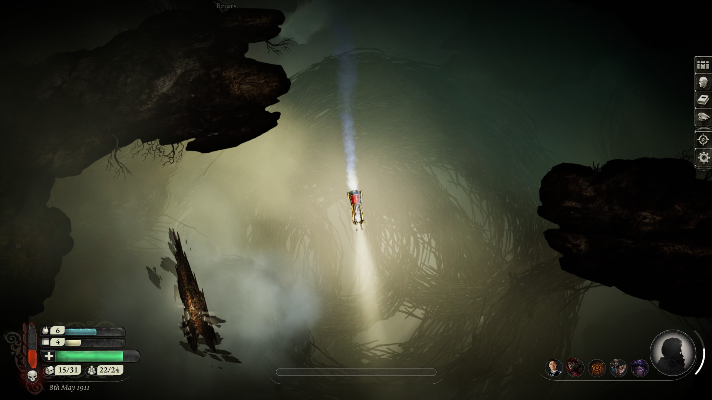
The wooden spurns
Notes:
You can try to collect wood for fuel, vote who goes out if you try: +1 fuel, -1 crew (the voted) if you stay inside: nothing happens

Slide 15
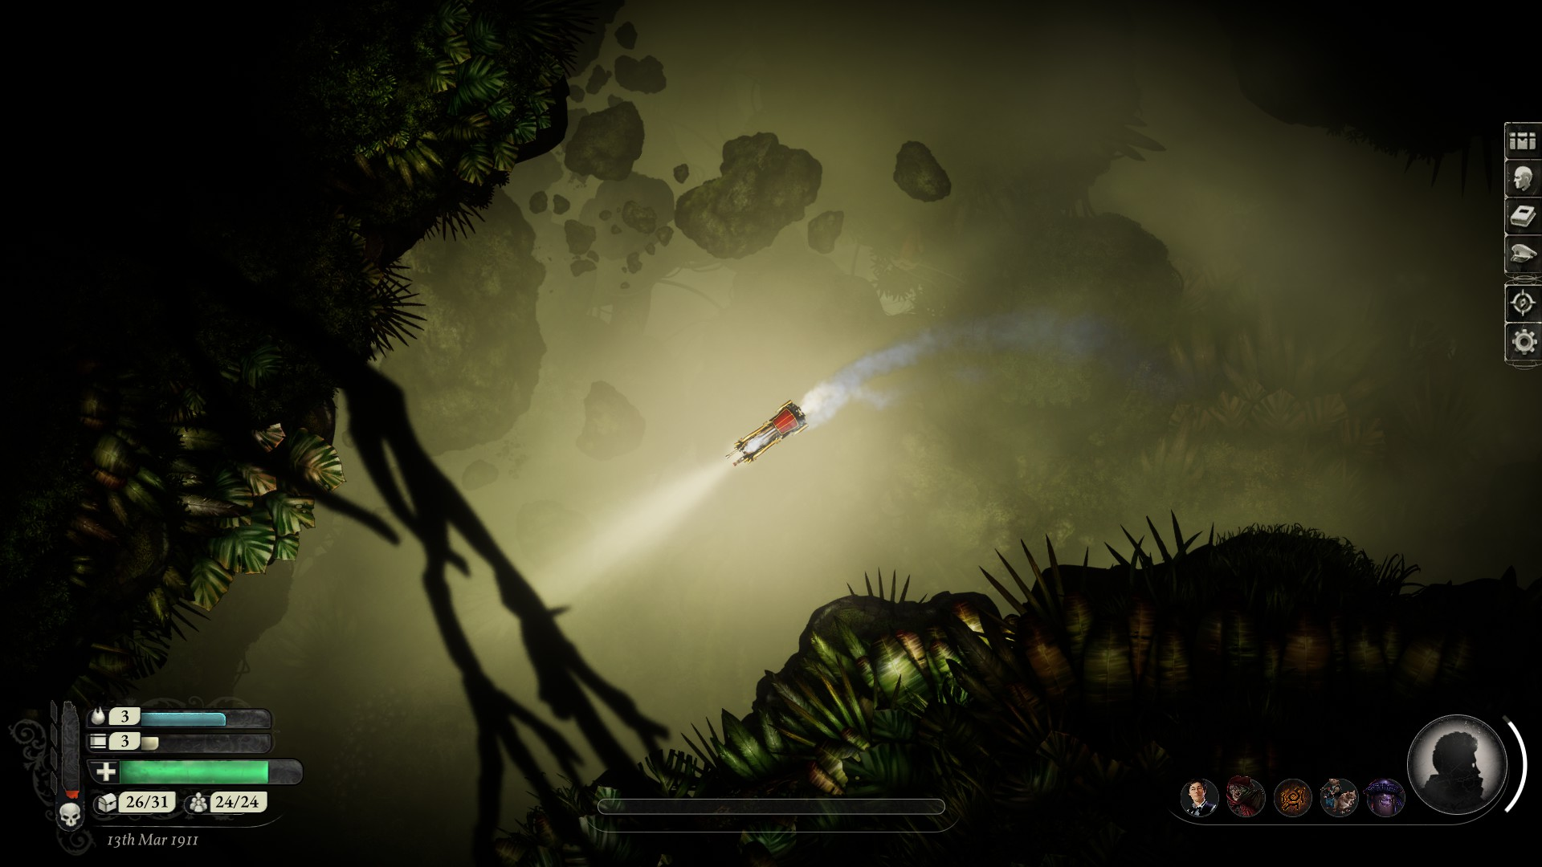
The Growling Trees
Notes:
The trees, they hunger
To gain passage, offer 1 supplies (or crew)
If the Cold one is sacrificed, another member has to be sacrificed.

Slide 16
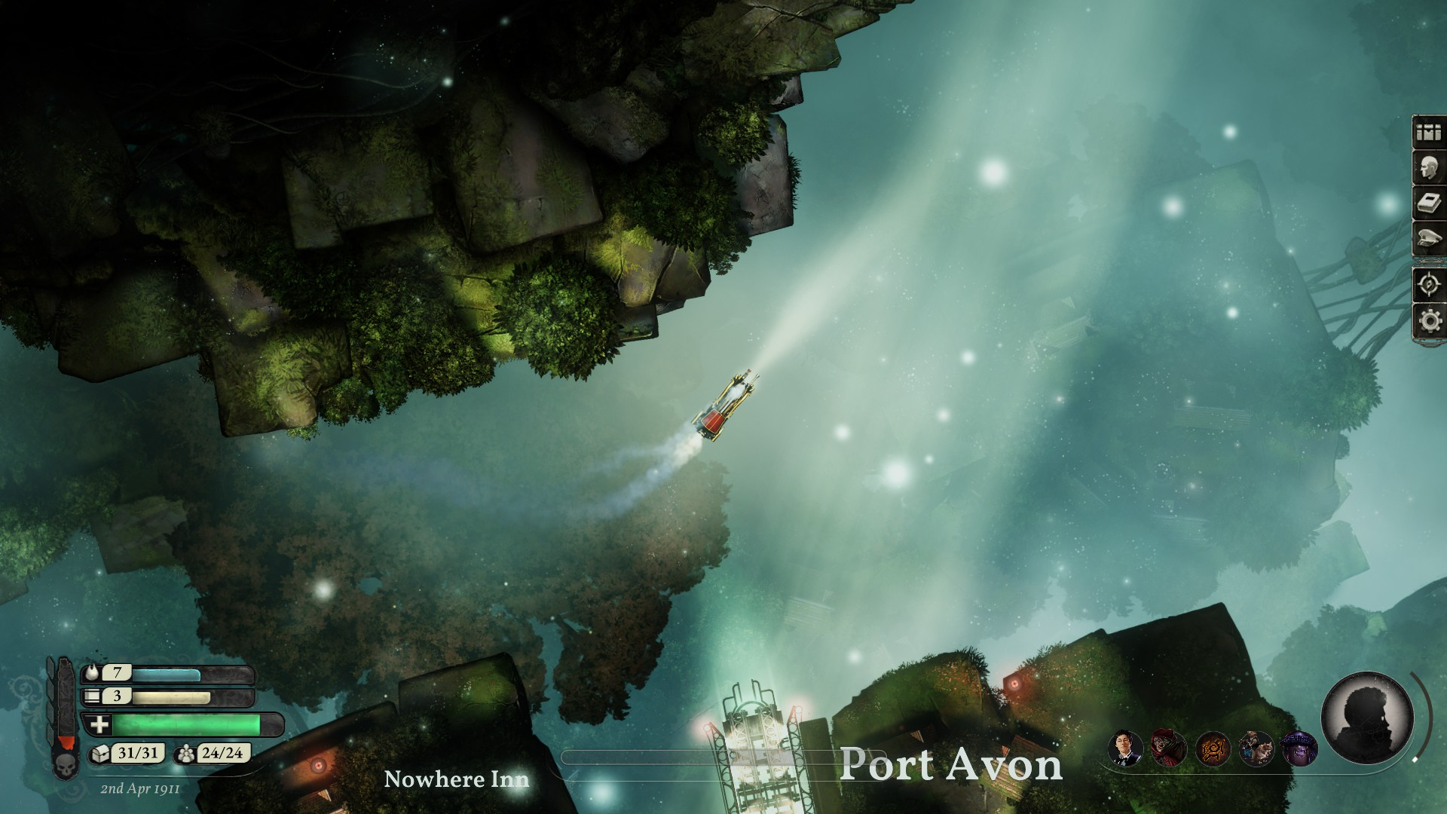
Port Avon, are you welcome?
Notes:
If you are welcome: +1 supply, +2 sanity, -1 treasure
If you are not: nothing

Slide 17
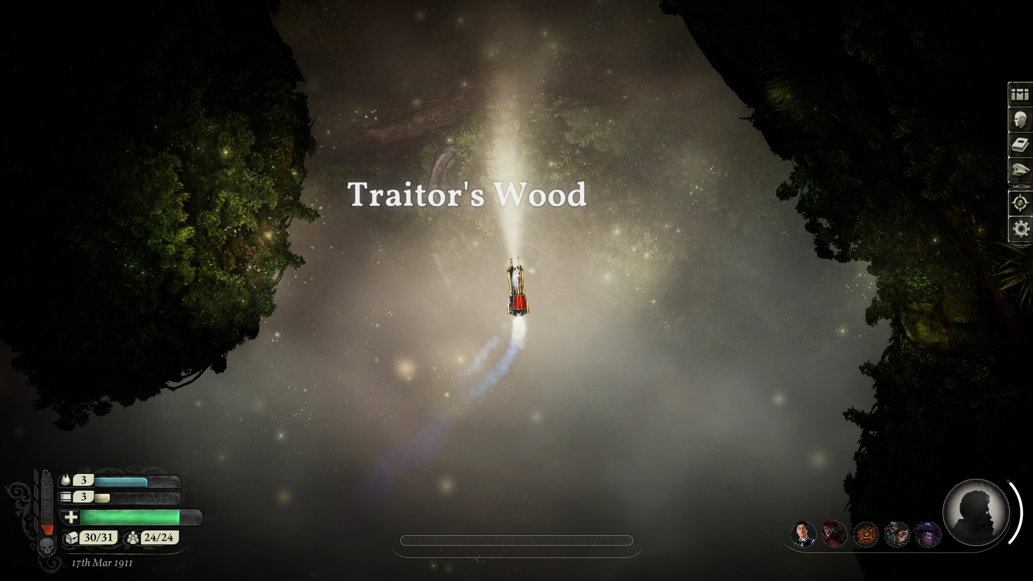
Are you named after the woods?
Or the woods after you?
Notes:
Final sanity check, final supply, final fuel check 0 suplies: who do you eat? (-1 crew) 0 fuel: you are stranded, but there, in the distance, another train! (‘restart’ of the story) Pos san: your bond has strengthened
0 san: there’s distrust, is everyone sitll the same
Neg san: -1 crew per neg sanity, who is left? (secret vote, self vote counts as an additional kill)
Left: Ciri, Amber, Barth

