Slide 1
Correlations between programming languages and beliefs about programming
Pierce Edmiston pedmiston@wisc.edu
1

Slide 2
My research questions
How is our ability to solve problems affected by the tools we use to solve them?
How do people solve the same problems using different programming languages?
2

Slide 3
This data blitz
Explore survey responses given by professional and academic programmers.
We asked them what languages they knew and their beliefs about programming.
Q1 Are some languages more influential than others?
Q2 Are some languages easier to master?
3

Slide 4
What languages did they know?
4

Slide 5
Language paradigms
[Lisp] has assisted a number of our most gifted fellow humans in thinking previously impossible thoughts.
– Dijkstra, 1972
5

Slide 6
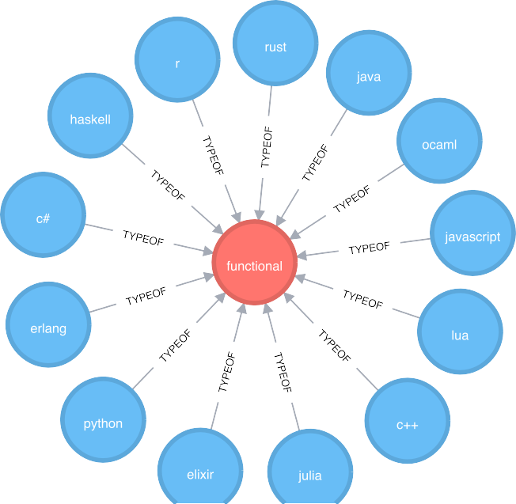
Functional languages
6

Slide 7
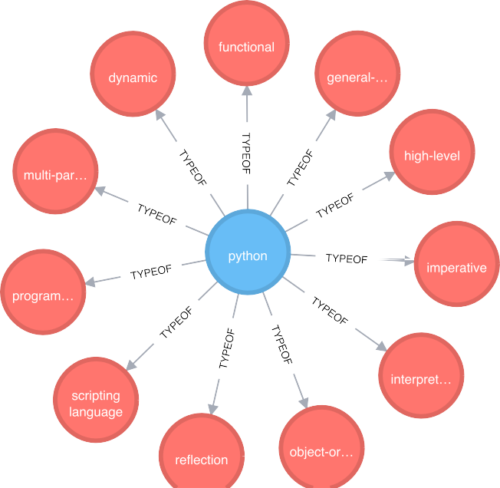
Programming languages have many paradigms
7

Slide 8
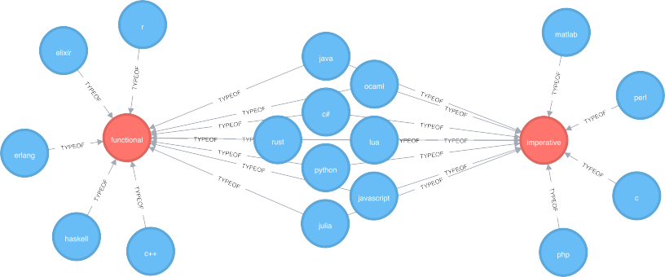
Functional versus imperative languages
8

Slide 9
Tower of Hanoi: Imperative versus functional
/* c */
void hanoi(int n, int a, int b, int c)
{
if (n > 0) {
hanoi(n - 1, a, c, b);
printf("Move disk from pole %d to pole %d\n", a, b); hanoi(n - 1, c, b, a);
}
}
-- haskell
hanoi :: Integer -> a -> a -> a -> [(a, a)]
hanoi 0 _ _ _ = []
hanoi n a b c =
hanoi (n-1) a c b ++ [(a,b)] ++ hanoi (n-1) c b a

Slide 10
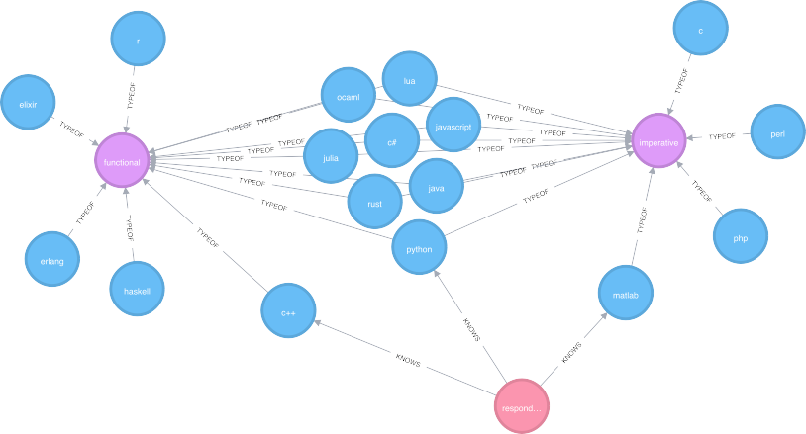
Complication: Programmers know multiple languages

Slide 11
Languages per programmer
Languages per person
125
100
75
count
50
25
0
3
n
1
2
4
5

Slide 12
Solutions to the multiple languages problem
Top language only.
Count all reported languages.
Weigh languages based on self reported proficiency.

Slide 13
Changed reasoning: Top language
Learning to program has changed how I reason about things outside of coding
functional
both
imperative
1
2
3
agreement
4
5

Slide 14







Changed reasoning: All languages
Learning to program has changed how I reason about things outside of coding
functional
both
imperative
1
2
3
agreement
4
5

Slide 15
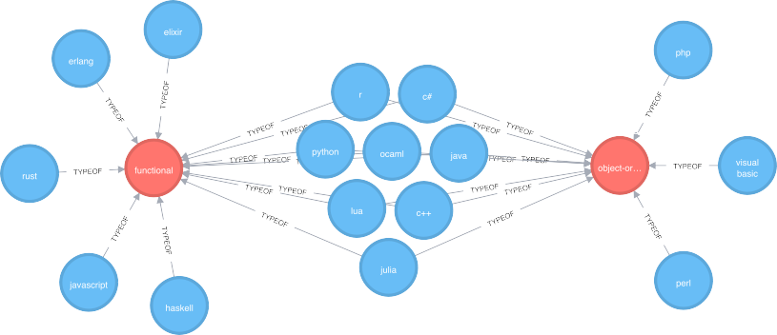
Functional versus object-oriented languages

Slide 16
Tower of Hanoi: Object-oriented
#import <Foundation/NSObject.h>
@interface TowersOfHanoi: NSObject { int pegFrom;
int pegTo; int pegVia; int numDisks;
}
-(void) setPegFrom: (int) from andSetPegTo: (int) to andSe
-(void) movePegFrom: (int) from andMovePegTo: (int) to and
@end

Slide 17





Changed reasoning: All languages
Learning to program has changed how I reason about things outside of coding
functional
both
object−oriented
1
2
3
agreement
4
5

Slide 18
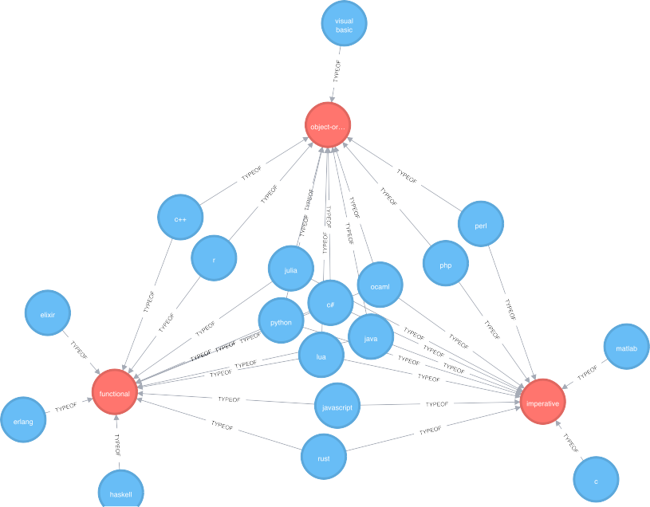
Full Venn Diagram

Slide 19
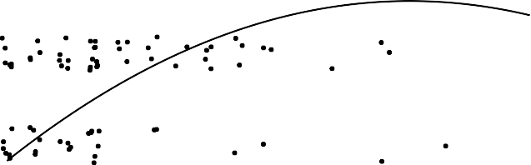
Language paradigms and years to proficiency
Python
5
Self−reported proficiency
4
3
2
1
0
5
10
Years used
15
20
20

Slide 20
Experience and proficiency
5
Self−reported proficiency
4
3
2
1
0
5
10
15
20
25
Years used

Slide 21
Conclusions
Programming languages are a great test bed for questions about human problem solving.
Pithy intuitions from computer scientists need to be tested with experimental work.
Maybe the differences between programming languages are overblown.

