Slide 1
Correlations between programming languages and beliefs about programming
Pierce Edmiston pedmiston@wisc.edu
1

Slide 2
My research questions
How is our ability to solve problems affected by the tools we use to solve them?
How do people solve the same problems using different programming languages?
This data blitz:
Explore survey responses given by professional and academic programmers.
We asked them what languages they knew and their beliefs about programming.
2

Slide 3
Who cares about programming languages?
Hundreds of different programming languages, but all are formally equivalent.
Computer scientists think a lot about the differences between languages.
Can we measure the impact of different programming languages on individual computer scientists?
3

Slide 4
Can we measure differences between programmers?
Of course! What should we predict and why does it matter?
H1 Functional languages are more transformative than other language paradigms.
H2 Languages with more paradigms are easier to master.
4

Slide 5
What languages did they know?
5

Slide 6
Language paradigms
[Lisp] has assisted a number of our most gifted fellow humans in thinking previously impossible thoughts.
– Dijkstra, 1972
6

Slide 7
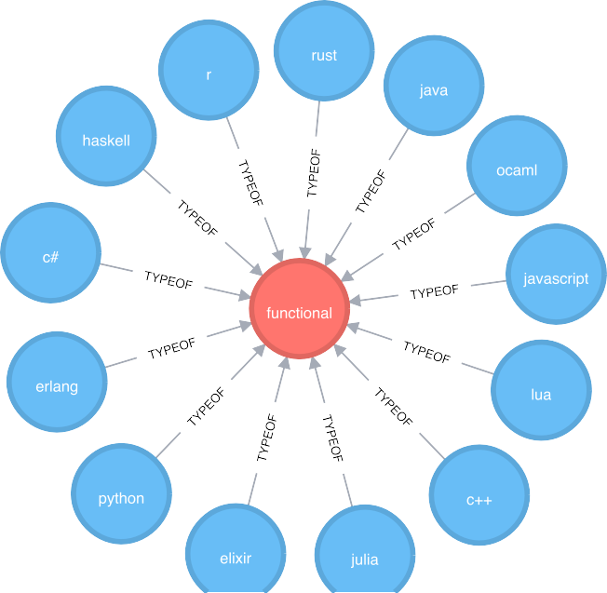
Functional languages
7

Slide 8
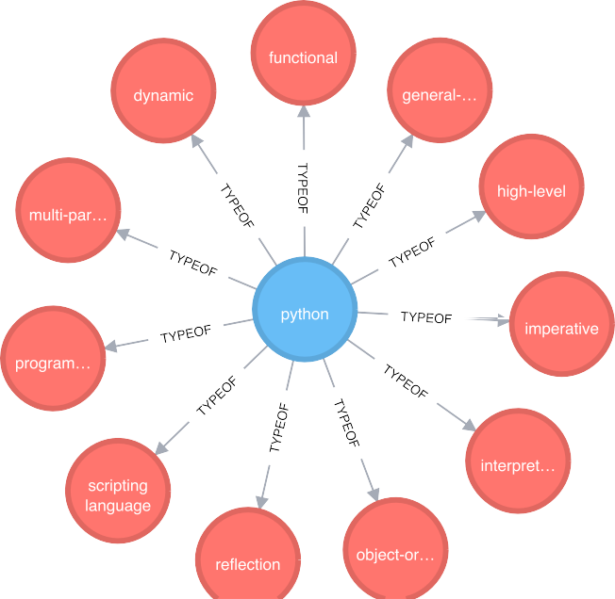
Programming languages have many paradigms
8

Slide 9
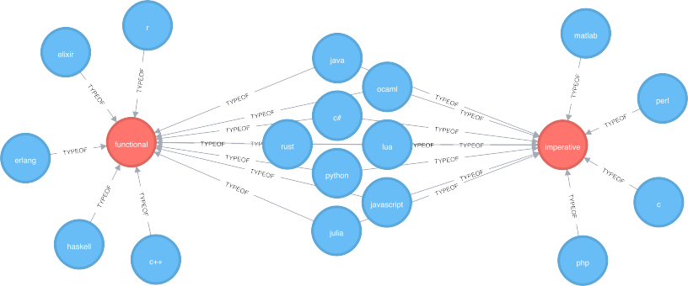
Functional versus imperative languages
9

Slide 10
Tower of Hanoi: Imperative versus functional
void hanoi(int n, int a, int b, int c)
{
if (n > 0) {
hanoi(n - 1, a, c, b);
printf("Move disk from pole %d to pole %d\n", a, b); hanoi(n - 1, c, b, a);
}
}
hanoi :: Integer -> a -> a -> a -> [(a, a)]
hanoi 0 _ _ _ = []
hanoi n a b c = hanoi (n-1) a c b ++ [(a,b)] ++ hanoi
(n-1

Slide 11
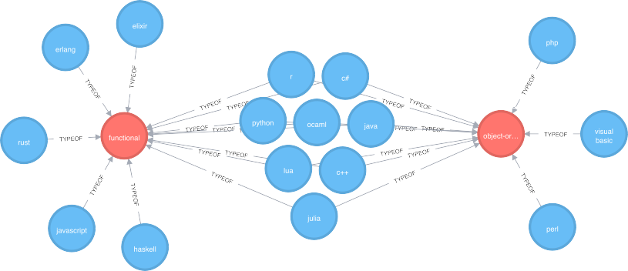
Functional versus object-oriented languages

Slide 12
Tower of Hanoi: Object-oriented
#import <Foundation/NSObject.h>
@interface TowersOfHanoi: NSObject { int pegFrom;
int pegTo; int pegVia; int numDisks;
}
-(void) setPegFrom: (int) from andSetPegTo: (int) to andSe
-(void) movePegFrom: (int) from andMovePegTo: (int) to and
@end

Slide 13
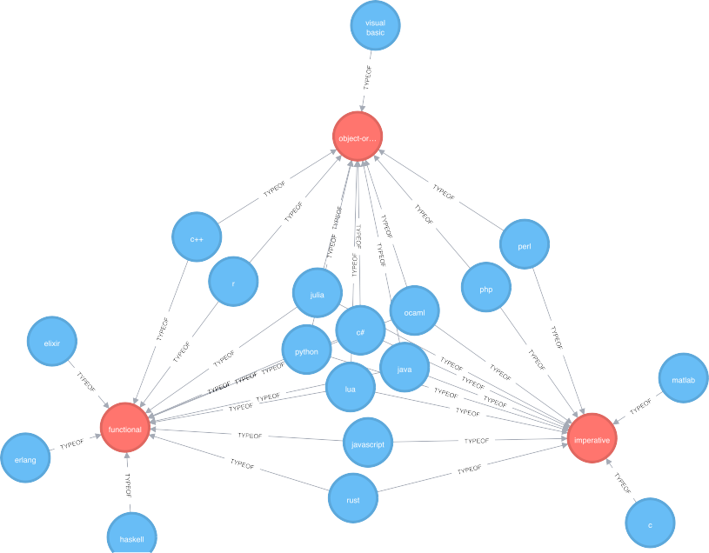
Full Venn Diagram

Slide 14
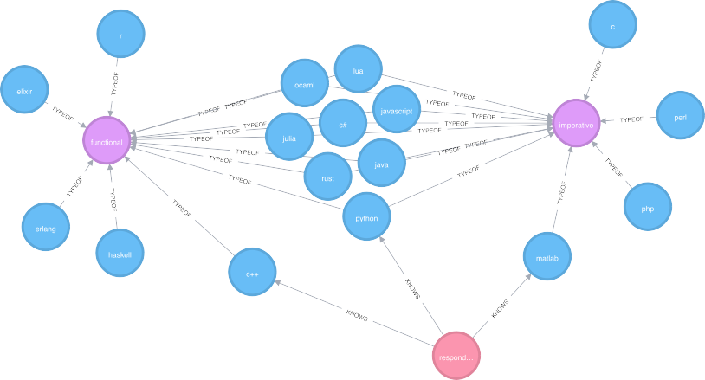
Complication: Programmers know multiple languages

Slide 15
Languages per programmer
Languages per person
125
100
75
count
50
25
0
3
n
1
2
4
5

Slide 16
Solutions to the multiple languages problem
Top language only.
Count all reported languages.
Weigh languages based on self reported proficiency.

Slide 17
Changed reasoning: Top language
Learning to program has changed how I reason about things outside of coding
functional
both
imperative
1
2
3
agreement
4
5

Slide 18







Changed reasoning: All languages
Learning to program has changed how I reason about things outside of coding
functional
both
imperative
1
2
3
agreement
4
5

Slide 19





Changed reasoning: All languages
Learning to program has changed how I reason about things outside of coding
functional
both
object−oriented
1
2
3
agreement
4
5

Slide 20
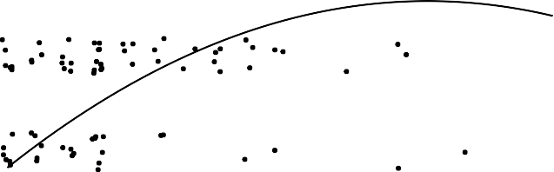
Language paradigms and years to proficiency
Python
5
Self−reported proficiency
4
3
2
1
0
5
10
Years used
15
20
20

Slide 21
Experience and proficiency
5
Self−reported proficiency
4
3
2
1
0
5
10
15
20
25
Years used

Slide 22
Conclusions
Programming languages are a test bed for questions about human problem solving.
Pithy intuitions from computer scientists need to be tested with experimental work.
Maybe the differences between programming languages are overblown.

