Slide 1
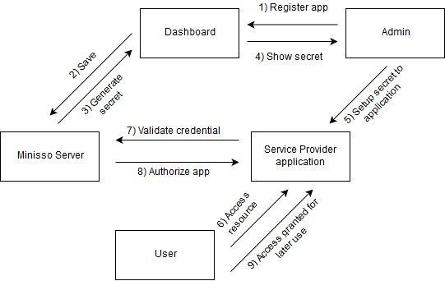
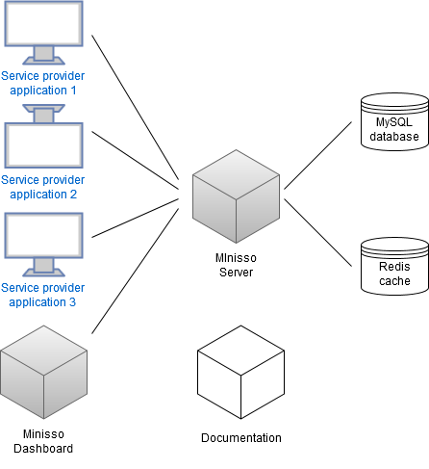
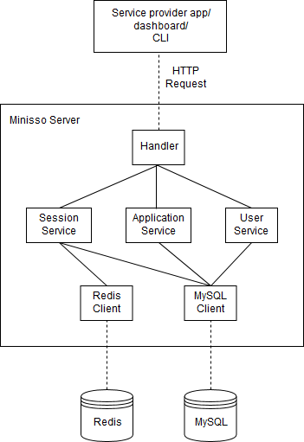
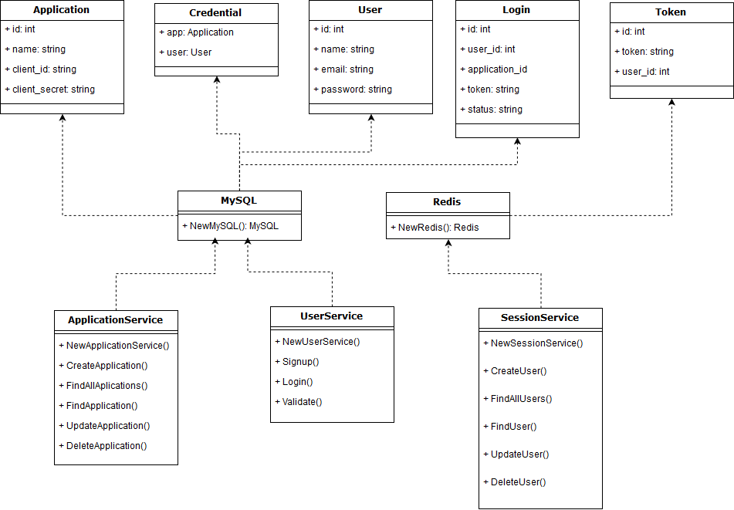
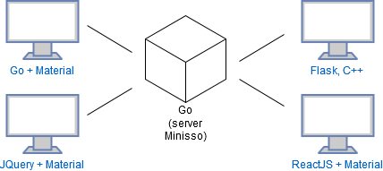
Single Sign-on Development for Token-based User Authentication
Luqman Arifin Siswanto / 13513024
l.arifin.siswanto@gmail.com
Adi Mulyanto, S.T., M.T.
adi@informatika.org
Problem
Single sign-on is now more popular with application era shifting to web-based application. But not all single sign-on tool is easy to integrate with existing applications.
Design
.
Testing
Tested with functional testing and integration testing.
Functional testing is using following requirement:
User registration.
User login.
User token validation.
App management for dashboard.
User management for dashboard.
In integration tests , SSO is integrated with following tech stacks.
All tests passed.
Conclusion
SSO can be implemented using HTTP to accomplish language-agnostic.
SSO should have these following characteristics: easy to integrate, has good documentation, has a working sample application, has dashboard for monitoring, open-source, self-hosted server, and inter-component communication is using secure transport.
API contract is important to standardize communication.
There are some differences in integrating back-end application and front-end application because of CORS issues.
Solution
Built a new single sign-on tool which preserve benefits of existing SSO tools, and eliminate weaknesses of existing SSO tools. Characteristics of proposed SSO is analyzed based on study of existing SSO tools.
Reference
Adabala, S., Matsunaga, A., Tsugawa, M., Figueiredo, R., & Fortes, J. A. B. Single Sign-On in In-VIGO: Role-based Access via Delegation Mechanisms Using Short-lived User Identities. ACIS Laboratory, University of Florida, Gainesville.
Jackson, Nic. (2017). Building Microservices with Go. Birmingham: Packt Publishing.
Kristanto, R. F. (2011). Otentikasi dan Otorisasi Terpusat pada Aplikasi Web di Lingkungan Informatika ITB. Program Studi Teknik Informatika, Institut Teknologi Bandung.

