Slide 1

Multivariate Approach to Forecast Rice Prices in Sri Lanka
Luqman Rumaiz
Supervised by: Mr. Gihan Liyanage
Informatics Institute of Technology

Slide 2
Agenda
Problem Background
Research Gap
Solution
Prototype Demo
Testing
Evaluation
Problems and Challenges
Novelty
Future Plan
Summary

Slide 3
Problem Background
The rice industry in Sri Lanka is a major contributor to the country's economy. It provides 7.4% of the GDP and 30% of Sri Lanka’s workforce belong to this field (Sri Lanka - Agricultural Sector, 2021).
However, the rice market is prone to fluctuations in price due to a variety of factors such as production costs, farm gate prices, weather conditions, government policies, etc.… (Hathurusingha, Abdelhamid and Airehrour, 2019).
Accurate price forecasting is essential for farmers and agricultural businesses to make informed decisions about their operations and for policy makers to better policies.

Slide 4
Research Gap
In the context of Sri Lanka, the current research on price forecasting models predominantly utilizes univariate models.
This however is not ideal as commodity prices are affected by a multitude of factors (Bowman and Husain, 2004).
There are a few multivariate models done on this domain but are not dynamic to Sri Lanka.
There is also a lack of research that utilizes Transfer Learning (Transformer Based Architectures) for commodity price forecasting.

Slide 5
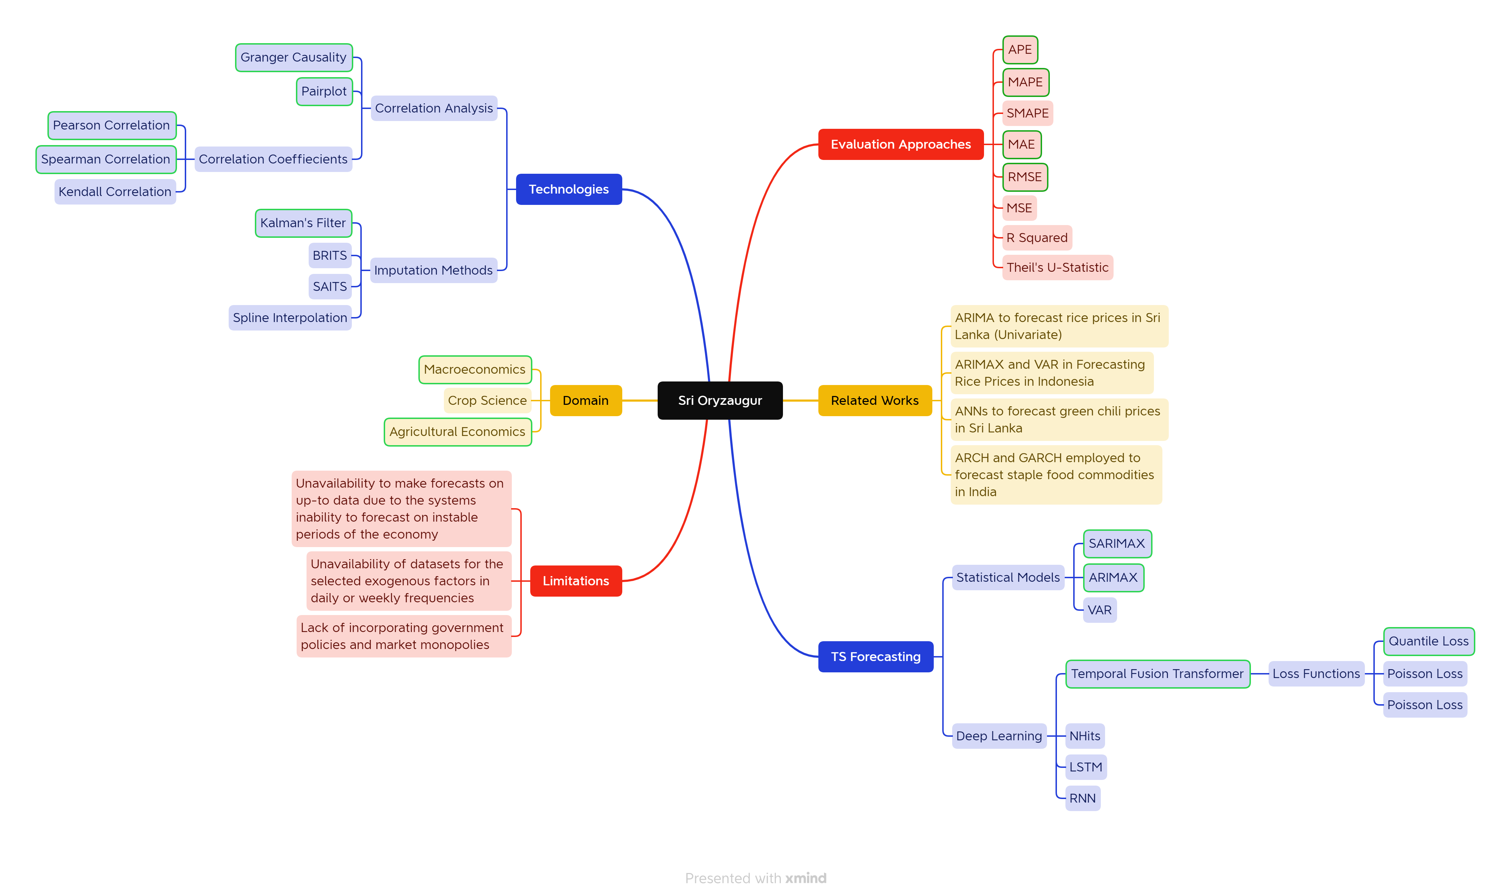
Concept Map

Slide 6
This study aims to develop and assess a multivariate time series model for forecasting rice prices in Sri Lanka.
Aim of SriOryzaugur
“
”

Slide 7
Proposed Solution
In this study, a comprehensive multivariate approach is proposed for forecasting rice prices in Sri Lanka.
This approach uses time series analysis and considers historical price data, paddy production levels, farm gate prices, fuel prices, exchange rates, and money supply in order to generate an accurate prediction of the future rice prices in the region.
The Temporal Fusion Transformer (TFT) model will be utilized as the core forecasting model to make more accurate and reliable rice price predictions, this is because it is highly effective capturing complex interdependencies and relationships between multiple input features. (Lim et al., 2020)

Slide 8
Models Built
Temporal Fusion Transformer (TFT)
TFT (Without External Regressor)
SARIMAX
ARIMAX
SARIMA
ARIMA

Slide 9
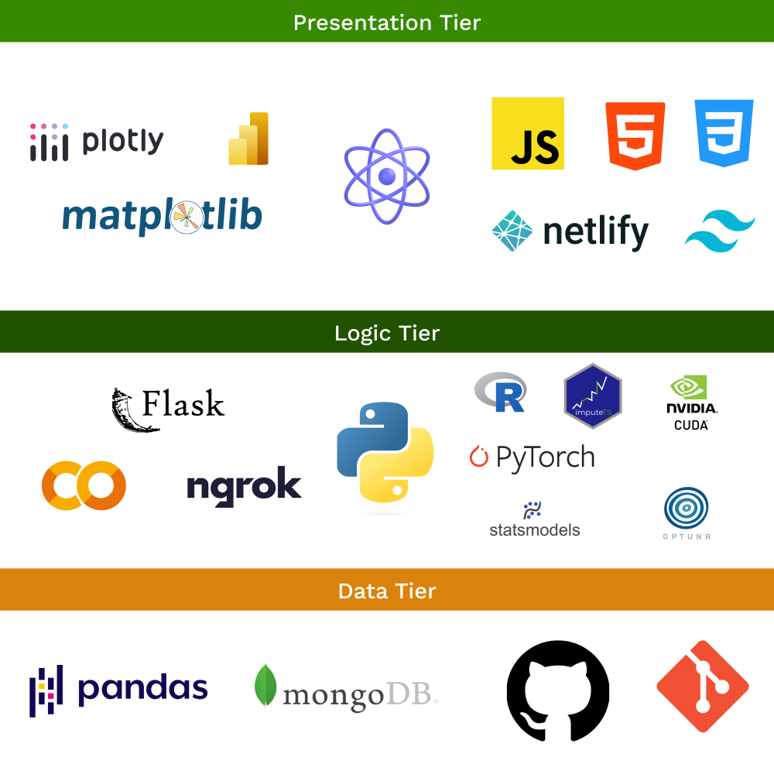
Tech-Stack

Slide 10
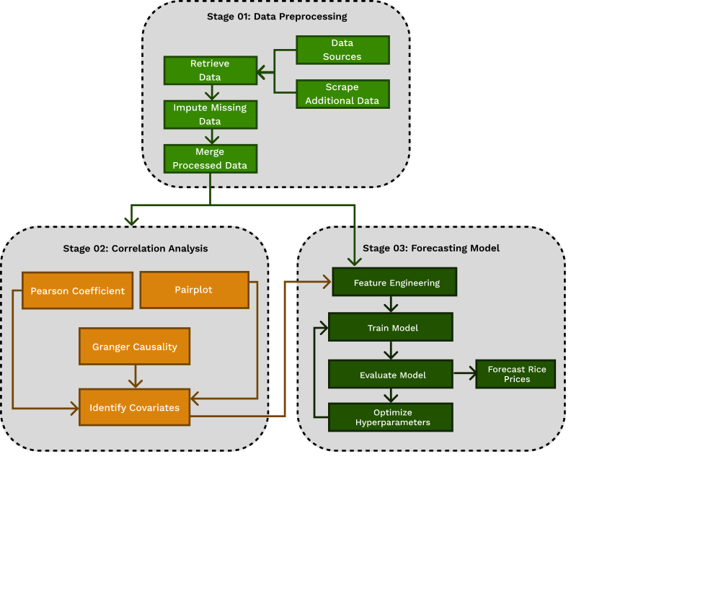
Architecture Diagram

Slide 11
Let's get straight into the Demo 😊

Slide 12
Testing Model Benchmarks
 | TFT 👑 | TFT (No Exog.) | SARIMAX | ARIMAX | SARIMA | ARIMA
MAPE | 2.52 | 7.62 | 2.98 | 3.93 | 5.35 | 4.07
MAE | 2.30 | 6.93 | 2.80 | 3.76 | 5.13 | 4.07
RMSE | 2.77 | 7.57 | 3.36 | 4.99 | 6.55 | 6.30

Slide 13
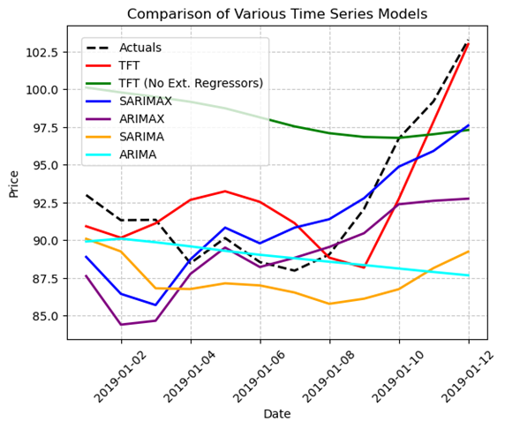
Testing Visualizing Forecasted Trends for all Models

Slide 14
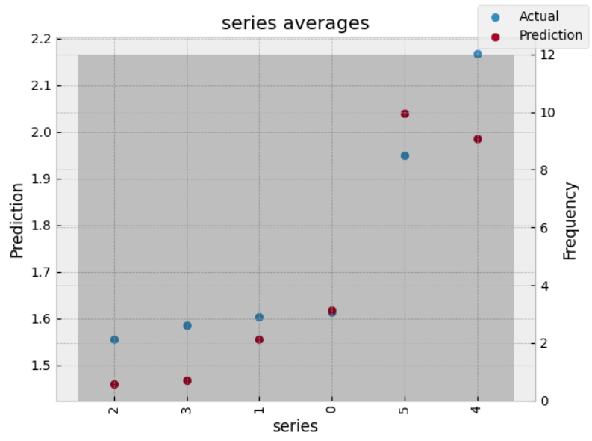
Testing Comparing Forecasted Averages for TFT

Slide 15
Evaluators
Name | Designation | Highest Academic Qualification
Mr. Dilshan Thambawita | Director – Software Engineering | MBA
Mr. M. Farshad Cader | Head of Correspondent Banking | Banking Diploma, BSc of Commerce
Miss. Sharmila Wijethunga | Assistant Director | ACMA (UK), CGMA
Mr. Fadil Iqbal | Graduate Research Assistant at IUPUI | MS, BSc in Computational Physics
Lasal Jayawardane | Data Scientist at 99x | BSc in AI and Data Science (Undergraduate)
Mohammed Hassen Abdul Cader | - | Part Qualified ACCA
Dhanush Sivasamy | Software Engineer at IFS R&D | BSc in Software Engineering
Ammar Raneez | Software Engineer at 99x | BSc in Computer Science (Undergraduate)
Nazhim Kalam | Software Engineer at Calcey | BSc in Computer Science (Undergraduate)
Anon. | Software Engineer at iTelaSoft | BSc in Software Engineering

Slide 16
Feedback Highlights
“The gap of existing solutions utilizing only a single
variable has been addressed extensively”
- Lasal Jayawardane
Data Scientist at 99x
“Agreed with the identified research gaps. The
current forecasting methodology lacks many factors
required to accurately forecast rice prices"
- Miss Sharmila Wijethunga
ACMA (UK), CGMA

Slide 17
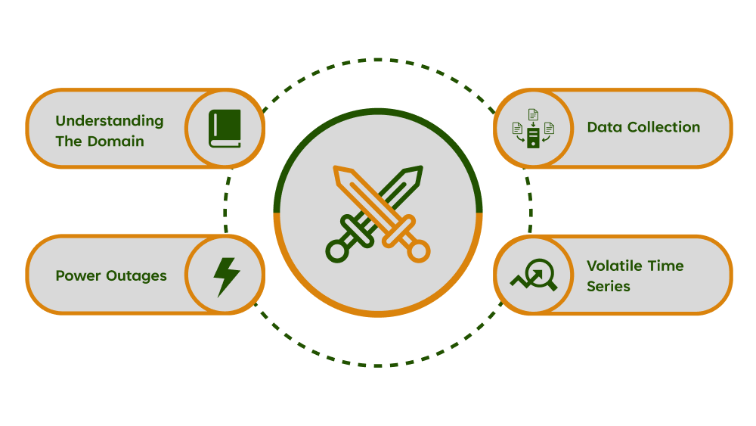
Problems & Challenges Faced

Slide 18
Conclusion Future Plans
A custom loss function that applies a penalty over the last 03 years of unstable prices due to government polices and an economic crisis (World Food Programme, 2022).
A daily or weekly granularity can help capture short-term patterns.
Extending the model to capture complexities such as government policies and the rice market monopoly in Sri Lanka.
Using series of other markets.

Slide 19
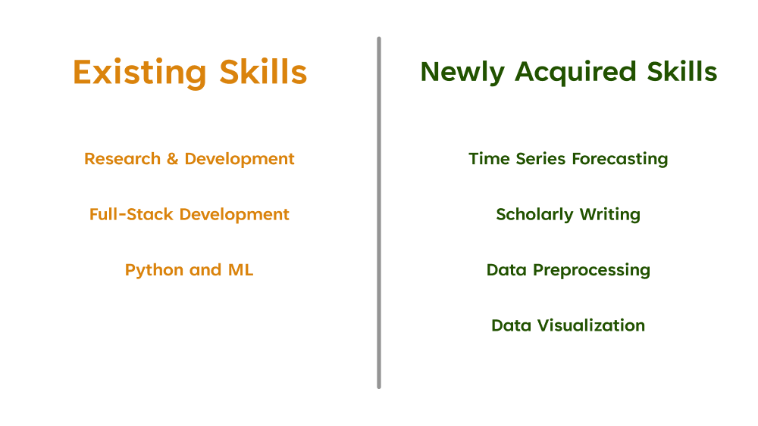
Conclusion Existing and Acquired Skills

Slide 20
Novelty & Contributions
Domain Contributions
The fulfillment of the lack of robust and accurate forecasting models for rice prices in Sri Lanka.
The feature importance for factors like the season, lags, month, and so forth.
Technical Contributions
The use of a powerful transformer model capable of handling the complexities in forecasting rice prices that has been configured dynamically to this domain.
The fulfillment of the absence of a multivariate approach to rice price forecasting in Sri Lanka.
Additional Contributions
A generalized class to that simplifies the implementation of the TFT model for monthly forecasting.
The comparison of metrics on statistical models and a deep learning model for the domain.
A web scraper for diesel prices in Sri Lanka.
Sri Lankan multivariate time series dataset for rice prices and potential covariates.

Slide 21
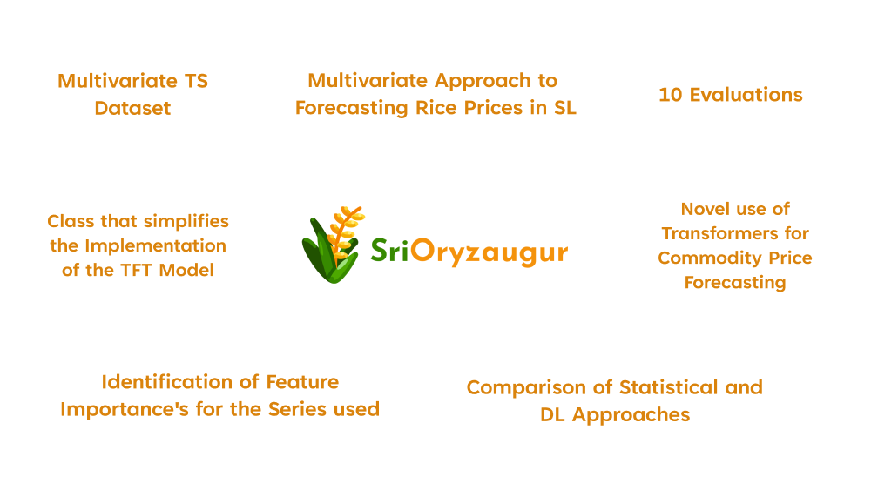

Slide 22
Thank you
Mohamed Luqman Farhat Rumaiz
luqman.rumaiz@gmail.com

Slide 23
References
International Trade Administration. (2021). Sri Lanka - Agricultural Sector. Available from https://www.trade.gov/country-commercial-guides/sri-lanka-agricultural-sector [Accessed 19 October 2022].
Hathurusingha, C., Abdelhamid, N. and Airehrour, D. (2019). Forecasting Models Based on Data Analytics for Predicting Rice Price Volatility: A Case Study of the Sri Lankan Rice Market. Journal of Information & Knowledge Management, 18, 1950006. Available from https://doi.org/10.1142/S0219649219500060.
Bowman, C. and Husain, A.M. (2004). Forecasting Commodity Prices: Futures Versus Judgment.
World Food Programme. (2022). Food crisis in Sri Lanka likely to worsen amid poor agricultural production, price spikes and ongoing economic crisis, FAO and WFP warn | World Food Programme. Available from https://www.wfp.org/news/food-crisis-sri-lanka-likely-worsen-amid-poor-agricultural-production-price-spikes-and-ongoing [Accessed 6 October 2022].

