Slide 1
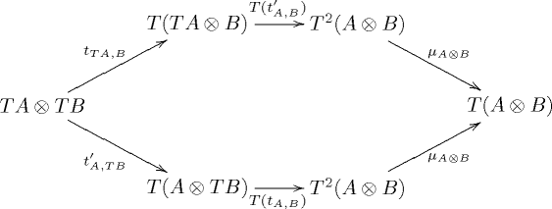
Monadic Programming
(in Haskell)

Slide 2
Outline
Motivation / Derivation
The Monad class
Example: List (nondeterminism)
Rolling your own control structures
Example: Suspend (coroutines)
Example: STM (transactional memory)

Slide 3
Outline
Motivation / Derivation
The Monad class
Example: List (nondeterminism)
Rolling your own control structures
Example: Suspend (coroutines)
Example: STM (transactional memory)

Slide 4
Haskell
Haskell was first created in 1987 as a “common lazy functional language”
By Wadler, Peyton-Jones, Hudak, Hughes, and others
Insane genius ubergeeks

Slide 5
Haskell
Haskell was first created in 1987 as a “common lazy functional language”
By Wadler, Peyton-Jones, Hudak, Hughes, and others
Insane idealist genius ubergeeks

Slide 6
Purity
Haskell is purely functional.
f :: Int -> Int
f x = x * currentTemperature
f x = if x == 0 then
launchMissiles; return 0
else
return (x-1)
f x = if x == 0 then 0 else pi*(x+1)/x

Slide 7
Purity
Haskell is purely functional.
f :: Int -> Int
f x = x * currentTemperature
f x = if x == 0 then
launchMissiles; return 0
else
return (x-1)
f x = if x == 0 then 0 else pi*(x+1)/x

Slide 8
The I/O Problem
Functions have no side-effects
How do we perform side-effects then?!
Have “main” return a data structure representing the side effects we want.

Slide 9
The IO data structure
data IO where

Slide 10
The IO data structure
data IO where
PutChar :: Char -> IO

Slide 11
The IO data structure
data IO where
PutChar :: Char -> IO
Sequence :: IO -> IO -> IO

Slide 12
The IO data structure
data IO where
PutChar :: Char -> IO
Sequence :: IO -> IO -> IO
main = Sequence (PutChar 'H')
(Sequence (PutChar 'e')
(Sequence (PutChar 'l')
(Sequence (PutChar 'l')
(PutChar 'o'))))

Slide 13
The IO data structure
data IO where
PutChar :: Char -> IO
Sequence :: IO -> IO -> IO
putStr str = foldr1 Sequence (map PutChar str)
main = putStr “Hello”

