Slide 1
The Sun and the North Wind
Renewable Energy at Home

Slide 3
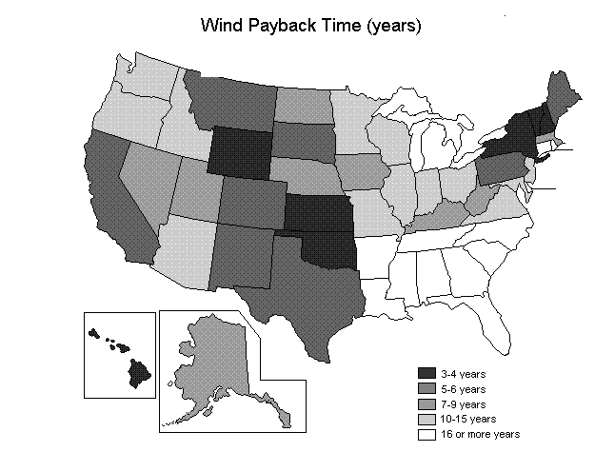
Wind Payback over the US

Slide 4
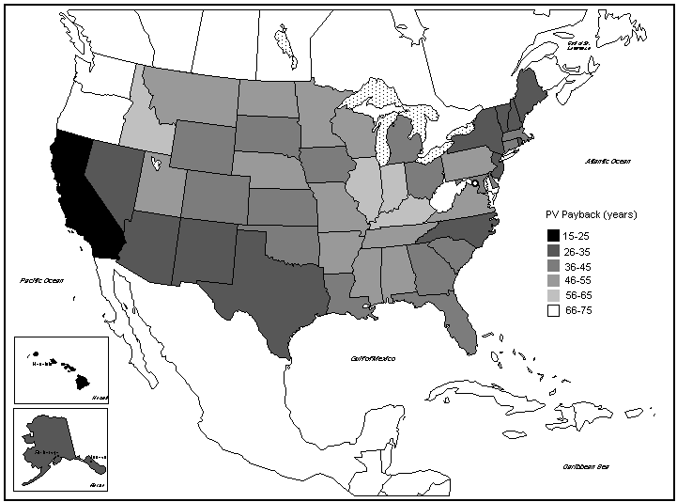
Solar Payback over the US

Slide 5
Clickers
If a particular solar panel costs $100 per square meter and delivers 20 watts per square meter (averaged over everything), what is the payback time for a 2-square-meter panel, assuming $0.10/kWh normal energy cost?
50 hours
50,000 hours
100,000 hours
10,000 hours
It never pays back

Slide 7
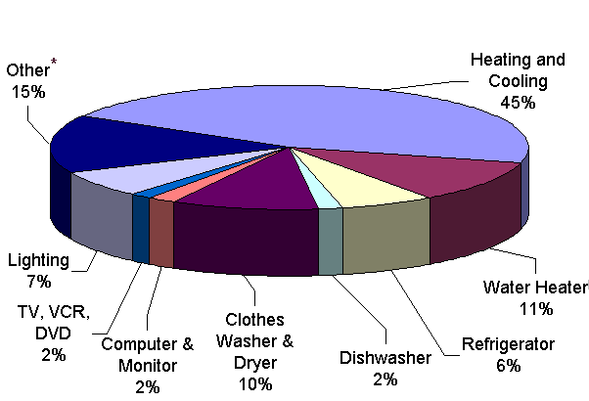
Energy Usage

Slide 9
Who Won?
The Sun
The North Wind
They were both idiots

