Slide 1
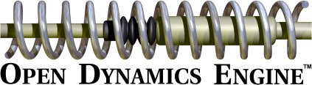
Easy physics for games

Slide 2
All of our games have some foundation in the real world.
That's why they're fun.
Many games involve bouncing balls, squishing springs, colliding asteroids.
Many game programmers aren't physicists.
That's why we need a physics engine.

Slide 3
Why ODE?
Doesn't using an open source library mean that my game has to be open source?
Sometimes...
But not this time.
ODE is LGPL.
If you make any changes to ODE itself, you have to distribute them.

Slide 4
Why ODE?
I've heard that ODE has numerical stability problems.
And it does, in a specific set of circumstances.
(We'll talk about which ones)
If you wrote your own engine, you'd have a much wider range of stability problems.

Slide 5
Why ODE?
ODE has been used in many mature projects:
  Amsterdam Taxi Madness
  Elite Heli Squad
  Hellforces
  And many other games that nobody's ever heard of.

Slide 6
Why ODE?
So we use ODE because it's (by far) the best that poor students like us can get.
And it works really well most of the time.

Slide 7
Installing ODE
On UNIX machines, ODE is dead simple to install.
But no gamers use UNIX.
Building ODE on Windows is a pain in the ass.
Fortunately, there's a binary release at ode.org (get the one called ode-bin-0.5-msvc-SINGLE-debug-trimesh.zip)

Slide 8
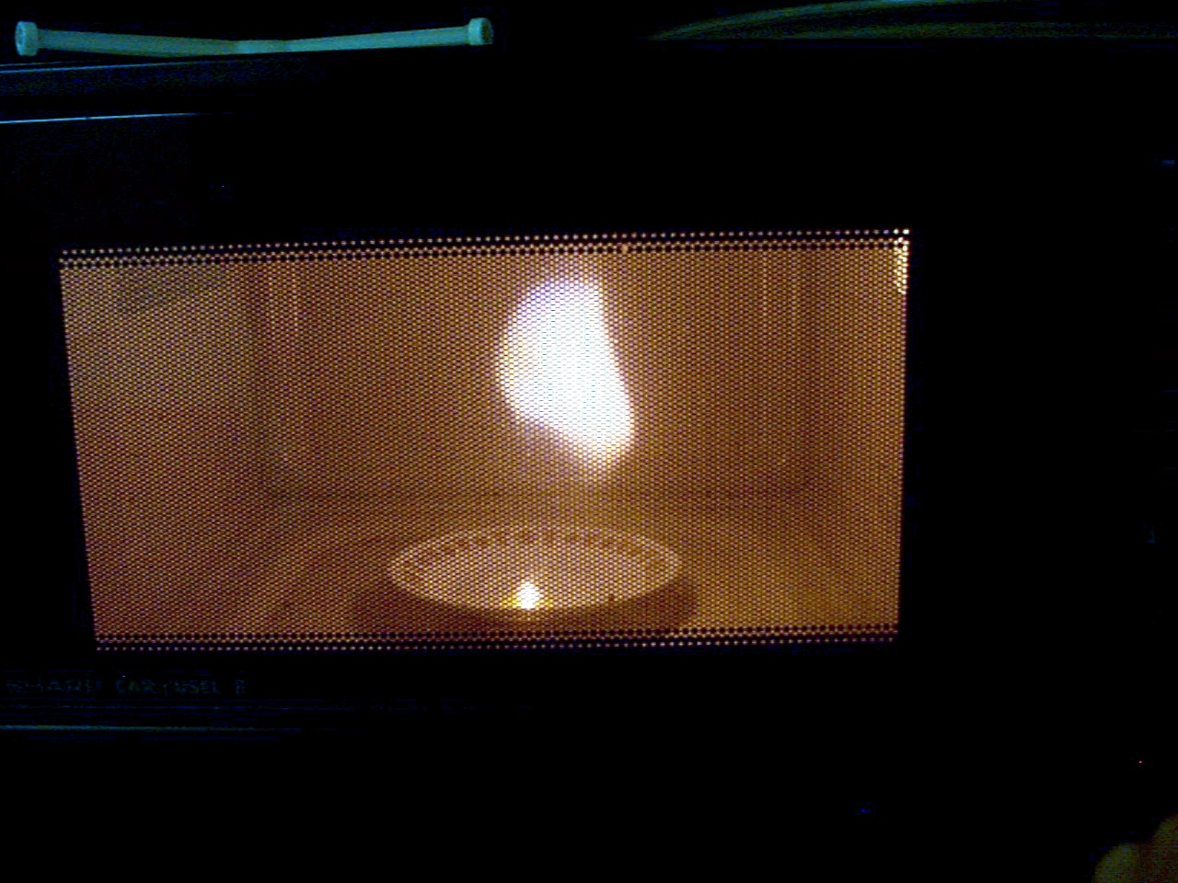
Let's do some physics!

Slide 9
Overview
Initialization and using rigid bodies
Force, torque, and mass
Collisions
Joints

Slide 10
Initializing ODE
Create a world:
dWorldID world = dWorldCreate();
Make this global; you'll need it everywhere.
That's it, we're done with the setup :-)

Slide 11
The Falling Ball
Let's create a ball that falls due to gravity.
dWorldSetGravity(world, 0, -9.8, 0);
Most functions that take a vector as input also take three float arguments.

Slide 12
The Falling Ball
Now let's create a body for our ball.
dBodyID ball = dBodyCreate(world);
dBodySetPosition(ball, 0, 0, 0);
Getting the hang of the naming convention now?

Slide 13
The Falling Ball
The last function you need for this exercise is:
dWorldQuickStep(world, 0.05);
The argument is the number of seconds to step.
Do not use a variable step size! It causes major instability!

Slide 14
The Falling Ball
Let's look at the complete code.

Slide 15
Applying Forces
Use the dBodyAddForce procedure.
dBodyAddForce(body, -1.0, 0, 0);
Add one newton of force to the left.
Let's look at an example of that:

Slide 16
Applying Torques
You can apply a torque directly using dBodyAddTorque
But a much more practical method is provided for adding torques:
dBodyAddForceAtPos
Let's see an example.
(Don't forget to talk about quaternions)

Slide 17
Using Mass
The dMass object includes more information than just a number:
  The scalar mass
  The 3-dimensional momenta of inertia
It is possible to specify the entire mass-inertia tensor.
Let's not do that.

Slide 18
Using Mass
Just use dMassSetSphere
Sure, things will rotate like spheres
Nobody will be able to tell the difference.
We'll see an example of masses soon.
In order to notice the effect of mass, we need...

Slide 19
Collision Detection
Every body that will participate in detection needs a “geom”
Every geom needs to be put in a “space”
dSimpleSpaceCreate
dCreateBox

Slide 20
Collision Detection
You also need a “joint group” in which to put contact points.
Now you pretend you read the documentation and copy their code example into your project.
Like so.

