Slide 1
Transactional Memory

Slide 2
Goals
Locking sucks...
...both performance-wise and language-wise
They mess with scheduling priorities (priority inversion)
They can cause your process to cease responding (deadlock)
And they're just a pain to use.

Slide 3
Goals
Transactional memory theoretically allows you to treat any operation as atomic
In this paper, an implementation is discussed that allows this...
...for certain definitions of any

Slide 4
Userland
Six instructions are provided:
LT (Load), LTX (Load exclusive), ST (Store)
COMMIT, ABORT, VALIDATE
If any of the touched data has been written since you started a transaction, the commit (or validate) fails.
Presumably in this case you retry the transaction.

Slide 5
Userland
VALIDATE is the only slightly tricky one
It allows you to check whether an open transaction has already aborted
If you have logic that depends on data earlier in the transaction, that data could be in an inconsistent state.
Use VALIDATE to check that the data is consistent before you use tricksy logic.

Slide 6
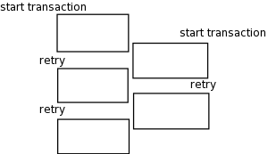
Backoff
This implementation requires that transactions be “small and fast”
If transactions are too long, then a sort of deadlock can occur:

Slide 7
Backoff
The authors suggest an “adaptive backoff” to handle these degenerate cases
int backoff = BACKOFF_MIN;
for (;;) {
/* do transaction */
if unsuccessful {
unsigned int wait = random() % (1 << backoff);
while (wait--); /* spin some cycles away */
if (backoff < BACKOFF_MAX) backoff++;
}
}
But why random()?

Slide 8
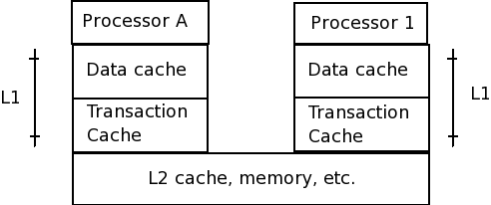
Implementation

Slide 9
Implementation
Each line in the transaction cache has one of the following tags:
  EMPTY
  NORMAL
  XCOMMIT – discard on commit
  XABORT – discard on abort (transaction local)

Slide 10
Implementation
If a request for ownership comes in on the cache on a cache line marked XABORT, then the transaction aborts.
This sets all XABORT entries to EMPTY and XCOMMIT entries to NORMAL.

Slide 11
Implementation
Whenever a process requests exclusive access to a location, the cache coherency protocol revokes any other shared read lines on that location
When this happens, it also aborts the current transaction wherever the read line was revoked.

Slide 12
Example
Node* head = LT(&Head);
newnode->next = LTX(&head->next);
ST(&head->next, newnode);
COMMIT();
TACTIVE
False
TSTATUS
True
Address
Tag
Data
&Head
EMPTY
&Head->next
EMPTY

Slide 13
Example
Node* head = LT(&Head);
newnode->next = LTX(&head->next);
ST(&head->next, newnode);
COMMIT();
TACTIVE
True
TSTATUS
True
Address
Tag
Data
&Head
XABORT
head of list
&Head->next
Empty
&Head
XCOMMIT
head of list

Slide 14
Example
Node* head = LT(&Head);
newnode->next = LTX(&head->next);
ST(&head->next, newnode);
COMMIT();
TACTIVE
True
TSTATUS
True
Address
Tag
Data
&Head
XABORT
head of list
&Head->next
XABORT
2nd element
&Head
XCOMMIT
head of list
&Head->next
XCOMMIT
2nd element

Slide 15
Example
Node* head = LT(&Head);
newnode->next = LTX(&head->next);
ST(&head->next, newnode);
COMMIT();
TACTIVE
True
TSTATUS
True
Address
Tag
Data
&Head
XABORT
head of list
&Head->next
XABORT
newnode
&Head
XCOMMIT
head of list
&Head->next
XCOMMIT
2nd element

Slide 16
Example
Node* head = LT(&Head);
newnode->next = LTX(&head->next);
ST(&head->next, newnode);
COMMIT();
TACTIVE
False
TSTATUS
True
Address
Tag
Data
&Head
NORMAL
head of list
&Head->next
NORMAL
newnode
&Head
EMPTY
&Head->next
EMPTY

Slide 17
The good news
Their simulation performed really well compared to locking on their simple benchmarks
There is an argument why it would perform even better on more complex stuff:
For larger data structures, you need to have many locks if you want any performance
But acquiring more locks means more memory accesses, which are slow.

Slide 18
More good news
But that doesn't really matter, because for more complex stuff, the simplicity of STM would totally make up for it if it were slower
(When Pugs switched from locks to STM, the code got simpler and smaller, and all of our threading bugs vanished!)

Slide 19
The bad news
They didn't cover how to make this work for multiple processes on the same CPU
You'd either have to have one transaction cache for each process, or you'd have to mark cache lines with the process they are associated with
Which is probably okay in a multi-way cache, however

Slide 20
The bad news
You could only have as many open transactions as your cache's associativity
So there is a limit to the size and the number of transactions
Arbitrary limits are bad for programmers.
And it's really really painful to kick it back to software on overflow (the software would have to interact with the cache on every bus cycle)

