Slide 1
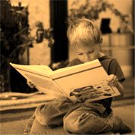
Formal Languages
And Not-so-formal Languages

Slide 2
1957
Chomsky wrote about 4 classes of languages:
Regular ⊂ Context-free ⊂ Context-sensitive ⊂ Unrestricted
(Math geeks also know the latter by “recursively enumerable”)

Slide 3
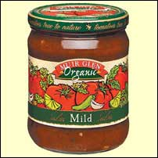
Mildly wordy
A simpler class for natural languages:
The lexicalized tree-adjoining grammars generating the mildly context-sensitive languages.
“Mildly context-sensitive” is a technical term.

Slide 4
Enough formality
There are several parallels between formal languages and children's language learning.
Each more parallel than the last.

Slide 5
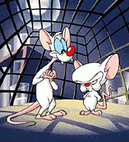
Outline
Regular languages
Context-free languages
Mildly context-sensitive languages
Kids and brains

Slide 6
REGULAR LANGUAGES
A regular language is either:
  A single character
  A concatenation (one after the other) of two regular languages.
  A union of two regular languages
  An possibly infinite repetition of two regular languages.

Slide 7
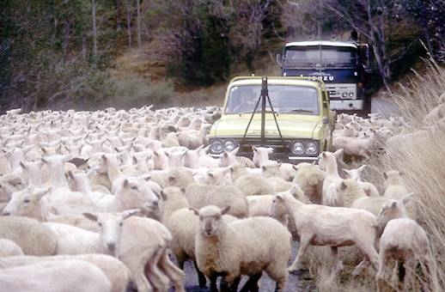
Sheeps
/baa(b|a)*/
“baa” followed by any number of b's or a's (ignore slashes)
/b/ is regular, /a/ is regular, so /baa/ is regular (concatenation).
So is /b|a/ (union), and thus so is /(b|a)*/ (infinite repetition).

Slide 8
Enough of that
Did you follow that?
Good.
That was three weeks of a computer science course.
Those guys are dumb.
(Reminder: Duck!)

Slide 9
CONTEXT-FREE LANGUAGES
A context-free language is generated by a context-free grammar.
Wasn't that helpful?
A context-free grammar specifies rewrite rules to rewrite strings.
Here's an example:

Slide 10
Simple Sentences
S: NP VP
NP: Name | “the” Noun
Name: “John” | “Sally”
Noun: “cat” or “dog”
VP: NP
Verb: “runs”
(Do an example on the board)
(Don't forget)

Slide 11
Simple Sentences
Get it?
Good.
That was another three weeks of a computer science course.
Are you philosophy guys thinking about switching yet?
Nah, philosophy is still easier.

Slide 12
Parse Trees
Let me show you a parse tree of the example I remembered to do on the board.

Slide 13
LEXICALIZED TREE-ADJOINING GRAMMARS AND THE MILDLY CONTEXT-SENSITIVE LANGUAGES THEY GENERATE
The parse tree you just saw can be the generator for its own sort of grammar, which is used in the tree-adjoining grammars which are a better fit for natural languages than the context-free languages.

Slide 14
...
That's better.
The parse tree that you just saw can be its own sort of grammar.
Specify tree patterns.
And “auxiliary trees”.
Basically they're capable of turning “I like peanuts” to “I really like peanuts” by adjoining the subtree “like”.

Slide 15
Enough technical nonsense already!
Okay, let's move on to Pinky and the Brain.

Slide 16
Ordering of utterance
Children who can say sentences later in this list will always be able to say sentences earlier:
  They're taking a vacuum cleaner to wipe and the puppy dog is running. (Conjunction)
  Tell Iris that I went to bed. (Complementation)
  I'm calling the man who fixes the door. (Relativization)

Slide 17
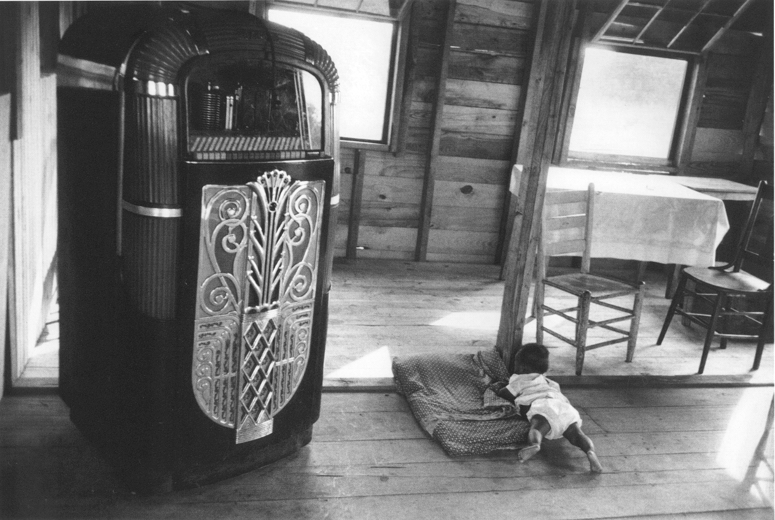
Complexity measure
So somehow sentences later in that list are “more complex” than earlier ones.
But how?
Robert Frank (1921)
Robert Frank (2000) has an answer.

Slide 18
Regular old conjunctions
For the conjunctive case:
I like bananas and the puppy dog is running and computer scientists are dumb but philosophers are lazy.
There is a linear structure:
[I like bananas] and [the puppy dog is running] and [computer scientists are dumb] but [philosophers are lazy].

Slide 19
Regular old conjunctions
This can be modeled by a regular language:
/(<sentence> and)* <sentence>/
(One or more sentences separated by “and”)

Slide 20
Irregular Compliments
Complementation has a recursive structure:
My mother knows that I hate fruits and vegetables
My mother knows that [I hate [fruits] and [vegetables]].
Regular languages can't model such recursion.
But context-free-languages can!

Slide 21
It's all relative
Relativization has an even more complex structure:
I like bananas. -> I like bananas that are ripe and yellow.
This “adjoins” a clause on to the already-complete tree.
Context-free languages can't do this (lexically).
But mildly context-sensitive ones can!

Slide 22
Kids are computers
Frank says that kids aren't learning new grammatical structure
They are becoming mature enough to do certain kinds of grammatical computations!

Slide 23
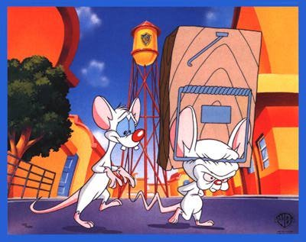
The End

