Slide 1
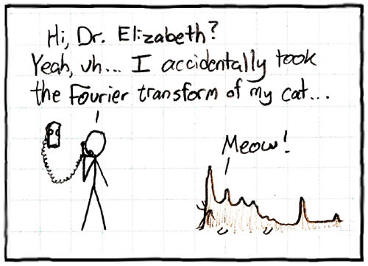
Interpolating between
sound samples
Luke Palmer
2006-10-30

Slide 2
Outline
Motivation
The smooth interpolator transform
Usage of SIT
Sounds
Continuing work

Slide 3
Motivation
Reducing number of instrument samples.
Simulating a slide on e.g. a violin.
Creating cool effects (as always).

Slide 4
Smooth interpolator
We have two functions, f(w) and g(w)
We want a function h(w,a) such that h(w,0)=f(w) and h(w,1)=g(w)
Also, it should do “something reasonable” for a in (0,1).
Linear interpolation is no good.

Slide 5
Smooth interpolator
Linear Interpolation:
a=0
a=1/2
a=1
“Smooth” interpolation:
a=0
a=1/2
a=1

Slide 6
Smooth interpolator
How about this?
(Hey Luke, explain that)

Slide 7
Process
Now that we have the interpolator, how do we do sound interpolation?
Take fourier transform of the sounds to get their frequency spectra
Interpolate the spectra (expensive)
Transform back

Slide 8
Sounds
Listen.

Slide 9
What happened?
I don't know.
My guess is that the interpolator isn't behaving as nicely as I'd like it to.
Notice:
Interpolating f(w) with f(w) does not give f(w) back.
Similarly, interpolating f(w) with f(w+k) does not give f(w+ak); it just has the same-ish shape.

Slide 10
Future directions
Respecify interpolator
Axiomatic, rather than intuitive, approach
See what happens from there

Slide 11
