Slide 1
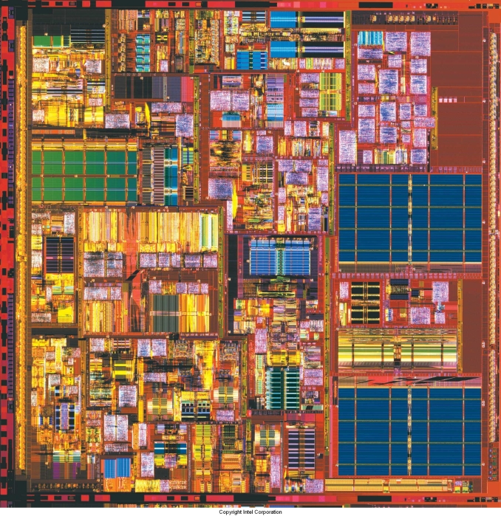
Optimizing Cache Usage

Slide 2
Outline
Overview
Software prefetching
Hardware prefetching

Slide 3

Overview
IA-32 provides facilities to fetch from memory to the cache before it is needed.
Two common cases:
  Temporal: multiple uses. “Temporally local.”
  Non-temporal: one use.
Two methods:
  Hardware prefetch.
  Software prefetch.

Slide 4

Outline
Overview
Software prefetching
Hardware prefetching

Slide 5
Software Prefetch
If we are eg. traversing a linked list, software can give good hints to the processor.
(Alexander & Kedem propose a “data trace cache” that could do that without hints)
To do this, we use the SSE prefetch instructions: prefetchnta, prefetcht#

Slide 6
SSE Prefetch instructions
prefetchnta - non-temporal fetch, will access data once
prefetcht# - fetch into #th-level cache
Paper says prefetchnta fetches into L1 cache on PIII, but the IA-32 reference manual suggests differently (external nta buffer).

Slide 7
Example: “Prefetch concatenation”
for (i = 0; i < 100; i++) {
for (j = 0; j < 32; j += 8) {
prefetch a[i][j+8];
computation a[i][j];
}
}
Short inner loop
Falsely prefetches once each time through the outer loop.

Slide 8
Example: “Prefetch concatenation”
for (i = 0; i < 100; i++) {
for (j = 0; j < 24; j += 8) {
prefetch a[i][j+8];
computation a[i][j];
}
prefetch a[i+1][0];
computation a[i][j];
}
Unroll last iteration
Unroll the last iteration to make it prefetch the correct value.

Slide 9
Example: Strip mining
while (nvtx < MAX_NUM_VTX) {
// vertex = [x,y,z,nx,ny,nz,tu,tv]
prefetchnta 4 vertices
// use only x,y,z,tu,tv
computation A on those 4 vertices
nvtx += 4;
}
while (nvtx < MAX_NUM_VTX) {
prefetchnta 4 vertices
// use x,y,z,nx,ny,nz
computation B on those 4 vertices
}
Loading same data from memory twice

Slide 10
Example: Strip mining
while (nstrip < NUM_STRIPS) {
while (nvtx < MAX_NUM_VTX_PER_STRIP) {
// vertex = [x,y,z,nx,ny,nz,tu,tv]
prefetchnta 4 vertices
// use only x,y,z,tu,tv
computation A on those 4 vertices
nvtx += 4;
}
while (nvtx < MAX_NUM_VTX_PER_STRIP) {
// use x,y,z,nx,ny,nz
computation B on those 4 vertices
}
}

Slide 11
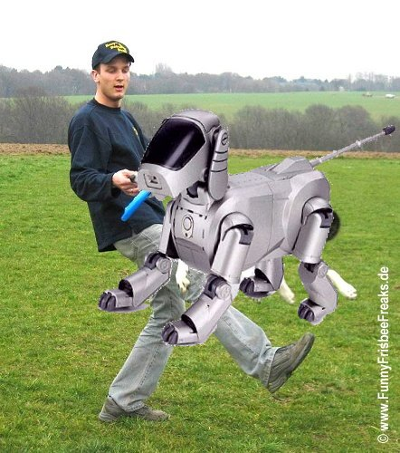
Outline
Overview
Software prefetching
Hardware prefetching

Slide 12
Hardware Prefetch
Two successive misses (in highest level) trigger hardware prefetch...
If they are closer than the “prefetch trigger distance.”
Which is seemingly impossible to recover.
Speeds up processing of big arrays.

Slide 13
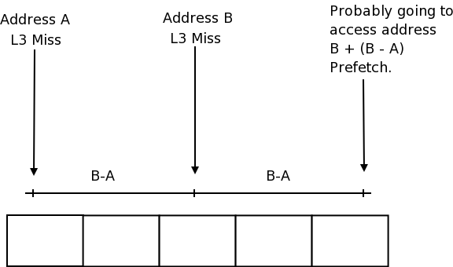
Hardware Prefetch

Slide 14
Example: Transpose of a matrix
for (i = 0; i < NUMCOLS; i++) {
for (j = 0; j < NUMROWS; j++) {
dest[i*NUMROWS+j] = src[j*NUMROWS + i];
}
}
Causes a large-stride
cache miss every time.

Slide 15
Example: Transpose of a matrix
They suggest:
for (i = 0; i < NUMCOLS; i += tilewidth) {
for (j = 0; j < NUMROWS; j++) {
for (k = 0; k < tilewidth; k++) {
dest[(i+k)*NUMROWS+j] = src[j*NUMROWS + (i+k)];
}
}
}
Small-stride miss, prefetcher
can predict.

Slide 16
Example: Transpose of a matrix
But what about:
for (j = 0; j < NUMROWS; j++) {
for (i = 0; i < NUMCOLS; i++) {
dest[i*NUMROWS+j] = src[j*NUMROWS + i];
}
}
Small-stride miss, prefetcher
can predict.

