Slide 1
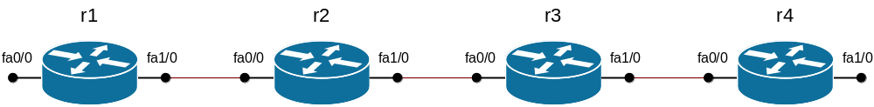
Топология сети

Slide 2
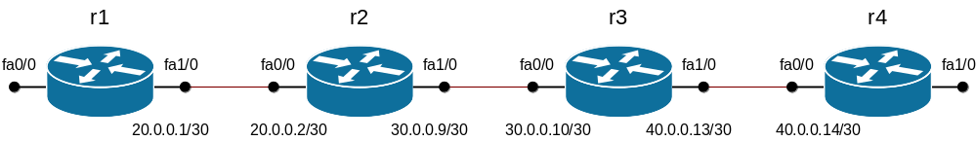
Адресный план: этап 1

Slide 3
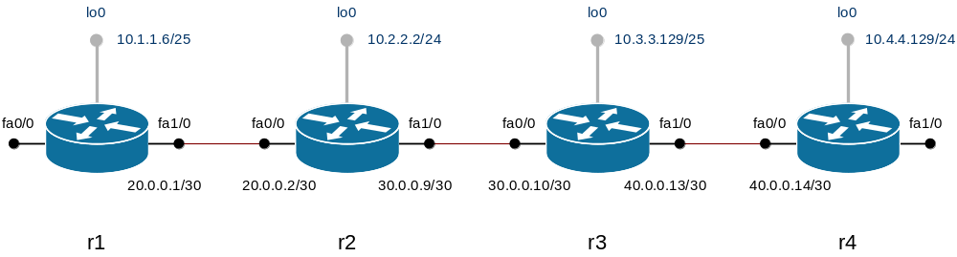
Адресный план: этап 2

Slide 4
Статическая маршрутизация
ip route 10.2.2.0 255.255.255.0 20.0.0.2
ip route 10.3.3.128 255.255.255.128 20.0.0.2
ip route 10.4.4.0 255.255.255.0 20.0.0.2
ip route 30.0.0.8 255.255.255.252 20.0.0.2
ip route 40.0.0.12 255.255.255.252 20.0.0.2
ip route 10.1.1.0 255.255.255.128 40.0.0.13
ip route 10.2.2.0 255.255.255.0 40.0.0.13
ip route 10.3.3.128 255.255.255.128 40.0.0.13
ip route 20.0.0.0 255.255.255.252 40.0.0.13
ip route 30.0.0.8 255.255.255.252 40.0.0.13
ip route 10.1.1.0 255.255.255.128 20.0.0.1
ip route 10.3.3.128 255.255.255.128 30.0.0.10
ip route 10.4.4.0 255.255.255.0 30.0.0.10
ip route 40.0.0.12 255.255.255.252 30.0.0.10
ip route 10.1.1.0 255.255.255.128 30.0.0.9
ip route 10.2.2.0 255.255.255.0 30.0.0.9
ip route 10.4.4.0 255.255.255.0 40.0.0.14
ip route 20.0.0.0 255.255.255.252 30.0.0.9

