Slide 1

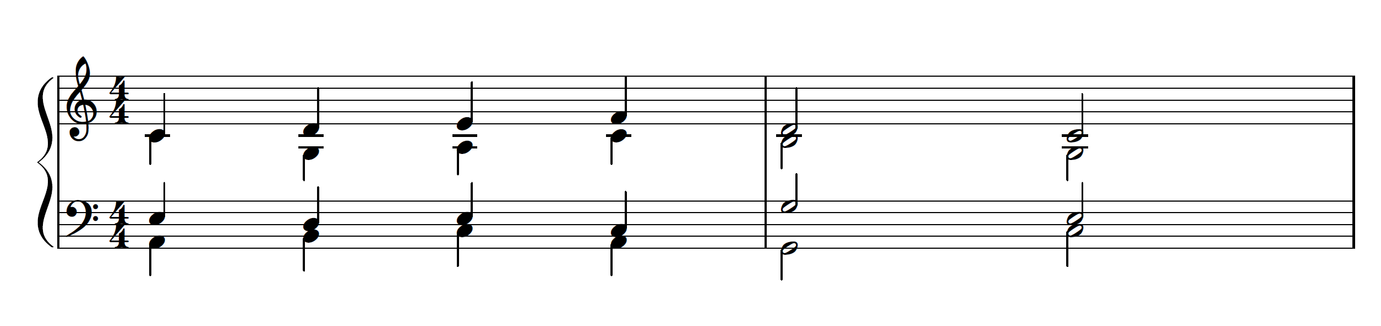
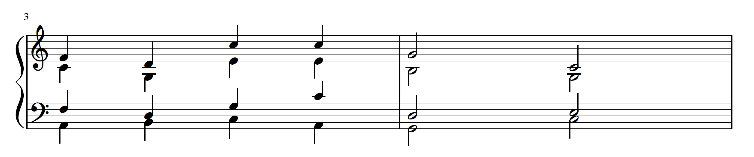
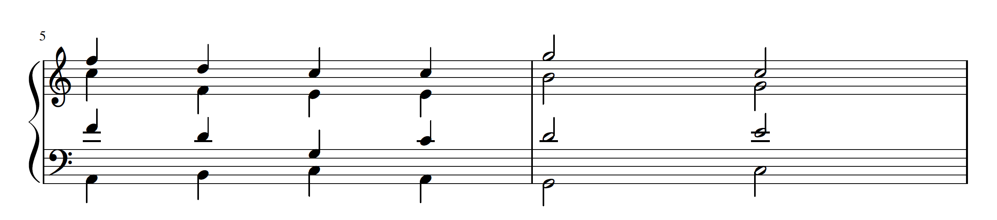
Bringing AI Bach: Four-Part Voice Leading CSPs
Joanna Chung, Luran He, Handong Park
joannachung@college.harvard.edu, lhe@college.harvard.edu, handongpark@college.harvard.edu
CS 182: Artificial Intelligence
Fall 2017
Introduction
We implement automatic SATB voice leading by solving a CSP. We hand-picked constraints to voice-lead in the style of Bach, but it is straightforward to pick other constraints to voice-lead in other styles. The results are fairly convincing, and frequently demonstrated unexpected compositional talent in ways that we had not explicitly specified.
For generations, audiences and musicians alike have enjoyed the works of classical composers, including those of the most well-known Baroque composer, Johann Sebastian Bach. Part of Bach’s most famous repertoire includes the many chorales he wrote for four voices. However, we know that Bach’s own chorale writing was mostly limited by the voice leading conventions of his day, which gave musical rules for how to write songs for choruses with four parts: bass, tenor, soprano, and alto. Knowing that these rules existed, we set out to ask our main question – could an AI agent, equipped with the right set of rules and principles that Bach and other baroque composers abided by, create a beautiful Bach chorale for four voices if given an arbitrary bassline?
blah blah blah
Data
In terms of how quickly our program was able to generate working solutions, we found that one choral voicing of around 7-10 chords could be found reliably within 2-3 milliseconds on average (over 60000 trials). In all of these trials using Bach bass lines, we found solutions that obeyed thee voice-leading rules that we implemented.
In order to test how well our Baroque AI would do, we decided to test its abilities on bass lines that Bach himself used in his chorales. We repeatedly tried different bass lines to see how our CSP solver gave similar or different results to that of Bach himself, using these results to gauge the kinds of solutions that our CSP would return as chorales. We utilized excerpts from Bach chorales which we transposed into C Major for testing. We initially tried running the chorale voicings without any constraints on large jumps between notes, and then with a constraint on large jumps.
Conclusions
While it is difficult to replicate the Bach’s genius with a fixed number of constraints, it is possible to generate working solutions quickly and accurately that abide by the same rules that Bach and other Baroque composers heeded. Our work shows the effectiveness of implementing a solution to this problem as a CSP – because the rules are well-defined and quite restrictive, we can quickly generate solutions for a bassline. One aspect that we hope to fully implement in the future is possibly adding MIDI output to our work. We are also considering possible heuristics for local search in terms of minimizing large jumps that voices have to make between any two chords.
Approach
Results
We first worked with Glee Club Resident Conductor Nathan Reiff and student composer Brandon Snyder to research the most important rules that governed Baroque composers’ four-part choral writing. These principles were:
At any time, the four voices’ notes must together form a complete triad chord of three notes, within the key of the piece (C Major for our purposes).
The root of each chord should be doubled (except in cases of inverted chords where another note must be doubled).
Two voices may not move parallel to each other in octaves or in fifths.
The chord progression must follow one of the pre-determined possibilities allowed by classical musical theory and end in a proper final cadence.
The upper three voices must be properly spaced (within one octave of each other.)
Our voices must not be forced to extend outside of the typical voice range for each part.
We then implemented those principles as the constraints in a Constraint Satisfaction Problem (CSP).
blah blah blah
We have successfully found solutions for every Bach bassline we’ve tried so far. Here is one of Bach’s chorales (BWV 318), which we transposed to C Major:
Figure 1. Condensed Bach excerpt.
Citations and Links
And here is our AI-generated solution:
Billam, Peter. 2006. Forty Bach Chorales. http://www.pjb.com.au/mus/arr/us/satb_chorales.pdf
Chung, Joanna C., Luran J. He & Handong Park. 2017. Interview of Brandon Snyder.
He, Luran J. and Handong Park. 2017. Interview of Nathan Reiff.
Figure 2. Our solution, no rules against jumping within voice lines.
After adding constraints on overly large jumps within voice lines, we avoid making as many large jumps:
Figure 3. Our solution, with constraints on large jumps.
John A. Paulson School of Engineering and Applied Sciences

