Slide 1
Uncertainty analysis in fisheries science – an interdisciplinary approach
Laura Urbisci
December 5, 2018
Dissertation Defense

Slide 2
PhD Committee
Dean Steve Gaines, chair
Professor Wendy Meiring from PSTAT Department
Doctor Kevin Piner from NOAA’s Southwest Fisheries Science Center

Slide 3
Introduction
Some background on my work…

Slide 4

Notes:
Most models focus on an individual stock and fall under the category of a single-species model. The simplest single-species models look only at abundance and are referred to as biomass dynamic or production models.

Slide 5
Notes:
However if sufficient data is unavailable to model the individual species dynamics, a common workaround is to cluster the targeted species in a fishery into a complex and model their dynamics in one production model. Doing this though, comes with a set of assumptions that when invalidated can have drastic consequences on the sustainability of some or all of the targeted species.

Slide 6
Notes:
Ecosystem models: they exist, lots of types,

Slide 7
Notes:
My approach and intro…

Slide 8
Chapter 1: Tangled is the web we weave
Meta-analysis on transfer efficiency

Slide 12
Chapter 2: Untangling uncertainty in food web analysis
Monte Carlo simulations for multiple scenarios

Slide 13
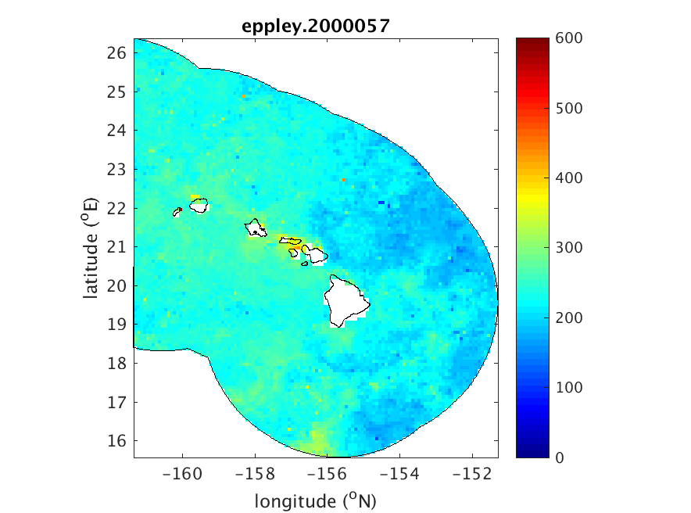

Slide 14
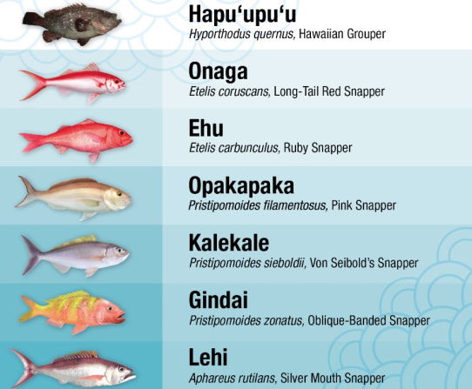

Slide 15
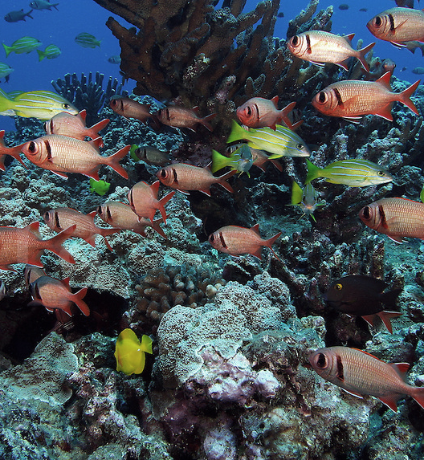
Primary production
Transfer efficiency
Life history traits
Trophic Biomass

Slide 16
Primary production
Transfer efficiency
Life history traits
Trophic Biomass

Slide 17
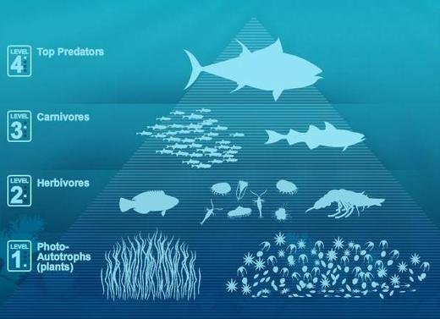

Slide 18
Chapter 3: Ecosystem knowledge in Bayesian surplus production models—what can it tell us?
Bayesian surplus production models

Slide 19
Acknowledgments
Funding sources:

Slide 20
Questions?

Slide 21
Additional slides

