Slide 1
A Novel Gene Selection Technique Using Wrapper Approach On Microarray Gene Expression Data
May 15th, 2018

Slide 2
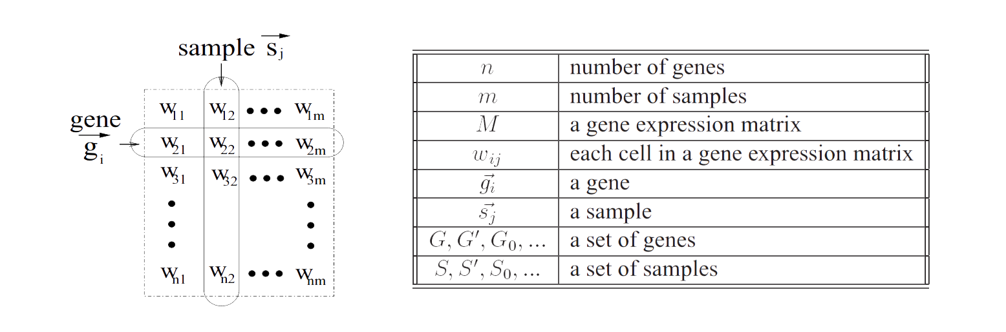
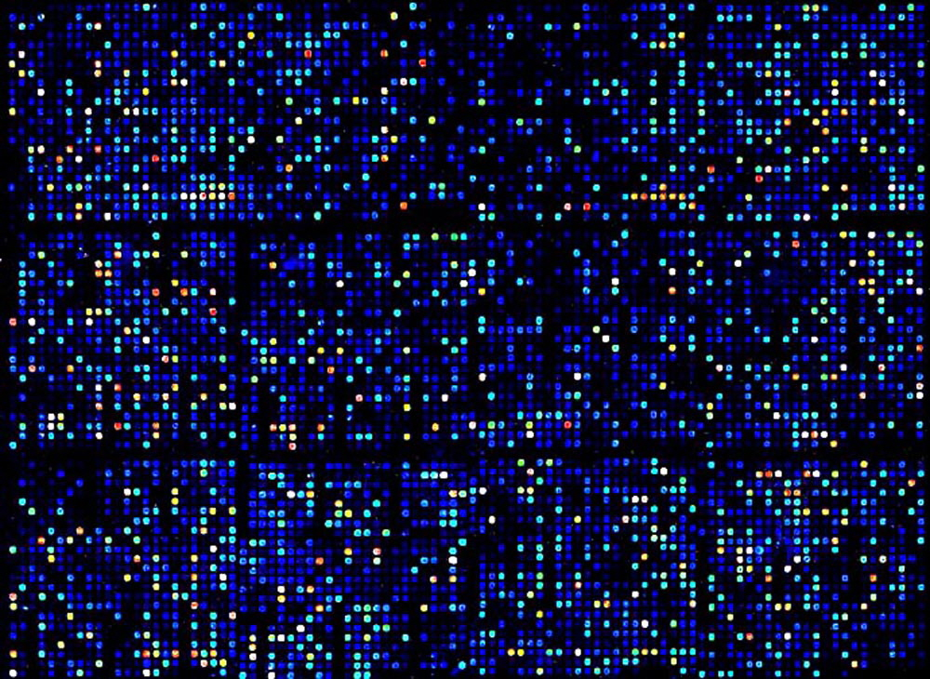
Introduction to MicroArray technology
Microarrays are established technology which shows the the excitation level of many genes in a single reaction. It typically assesses a large number of DNA sequences. A gene expression data set from a microarray experiment can be represented by a real-valued expression matrix where the rows form the expression patterns of genes, the columns represent the expression profiles of samples. [1]

Slide 3
Why Gene Selection ?

Slide 4
Dimension Reduction
Redundant Data
Overfitting
Gene Selection is used to reduce dimensions of the Data-Set, which might contain (N x M) dimensions for processing.
Data Sets may contain several Redundant Features which do not contribute to the training and increases training time.
Overfitting happens when a model learns the noise in the training data such that it negatively impacts the performance of the model. [2]
Feature Dimension > Sample Dimension
Underfitting
When sufficient features are not selected for training purpose, then the machine erroneously classifies the data and leads to poor results. [2]
Gene Expression Data-Sets have higher Feature Dimensions than the sample dimensions which need to be reduced to optimise performance

Slide 5
Types of Feature
Selection

Slide 6
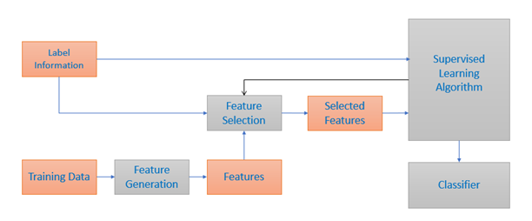
Supervised Feature Selection
The accessibility of the class labels permits supervised feature selection algorithm to successfully choose discriminative features to differentiate samples from various classes. Features are first produced from training data. Rather than utilizing each and every data to train the supervised learning model, supervised feature selection will initially choose a subset features and after that process the data with the chosen features to the learning model.

Slide 7
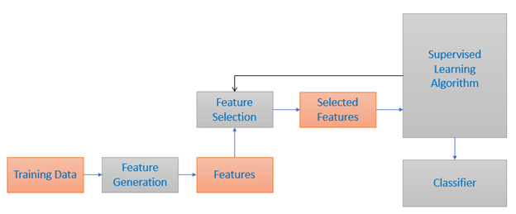
Unsupervised Feature Selection
Unsupervised Feature Selection is generally utilized for clustering tasks.Unsupervised learning is where you only have input data (X) and no corresponding output variables.
The goal for unsupervised learning is to model the underlying structure or distribution in the data in order to learn more about the data.

Slide 8
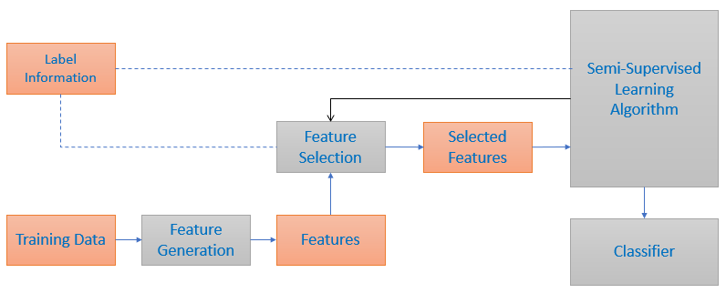
Semi-Supervised Feature Selection
In many real-world applications, collecting labeled data is difficult, while abundant unlabeled data are easily accessible. This motivates researchers to develop semi-supervised feature selection methods which use both labeled and unlabeled data to evaluate feature relevance.

Slide 9
Common Approaches

Slide 10
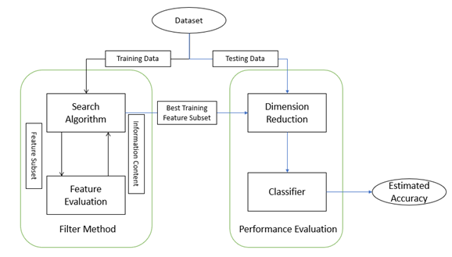
Filter: It is used to evaluate how much the features are relative to the problem by checking properties of the data. In most cases a feature relevance score is calculated, and the low scoring features are removed. Afterwards, high ranked features are presented as input to the classification algorithm. [2]

Slide 11
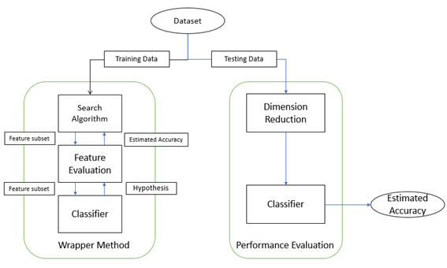
Wrapper: This technique evaluates subsets of features according to how informative they are to a given predictor. The method conducts a search for a good subset using the learning algorithm itself as part of the evaluation function. The problem boils down to a problem of stochastic state space search. [2]

Slide 12
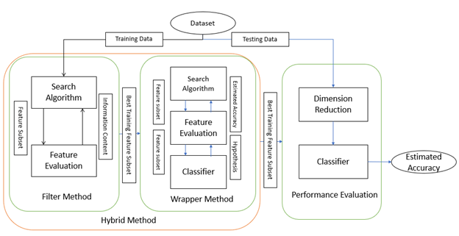
Hybrid: Hybrid method can be either formed by merging two distinct methods (e.g. Filter and wrapper), two methods of the similar criteria, or two feature selection approaches. Hybrid method tries to acquire the advantages of both methods by combining their corresponding strengths [2]

Slide 13
Unsupervised Gene Selection

Slide 14
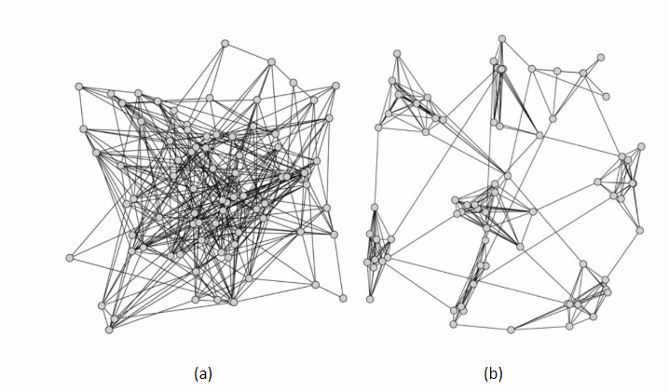
Clustering: An introduction
Clustering is the process of grouping data objects into a set of disjoint classes, called clusters, so that objects within a class have high similarity to each other, while objects in separate classes are more dissimilar.

Slide 15
Types of Clustering
Partitioning Algorithm
Hierarchical Clustering
Graph-Partitioning Clustering
They are iterative relocation algorithm. This method divides the data objects into non overlapping clusters such that each data object is in exactly one subset. Several methods which are used, such as: (a) K-medoids, (b) K-means, (c) Probabilistic. [1]
In contrast to partition-based clustering, which attempts to directly decompose the data set into a set of disjoint clusters, hierarchical clustering generates a hierarchical series of nested clusters which can be graphically represented by a tree, called dendrogram.[1]
It depends on finding the minimum cut or minimum cliques in the proximity graph G. Many other graph partitioning algorithms depends on eigenvectors and eigenvalues also.[1]

Slide 16
Proposed Framework

Slide 17
Start
Microarray Gene Expression Data
Clustering using K-means and Pearson Correlation as distance metric
Classifier
Cluster data
Support Vector Machine
Wrapper Method
Accuracy
Classification data
Primary Cluster centroids chosen (1 for each cluster)
Gaussian Naive Bayes Classifier
Accuracy
Cluster data
Representatives Added one by one to the previous data
Accuracy Evaluation
K-Nearest Neighbour Classifier
Accuracy
No
Accuracy increased?
Yes
Representative added
No
Representative number fulfilled?
Yes
Training & Testing
Stop

Slide 18
Step 1:
Implemented K-means Algorithm to cluster relevant genes from the given dataset. Using distance metric as Pearson Correlation.
Step 2:
Select the centroid from the clusters, i.e. the point which is most correlated to the mean centroid of the cluster.
Step 3:
Select the next representative from the cluster and run a classifier to check if the selected feature increases, decreases or does not alter the accuracy of the final result. The feature is selected if and only if it increases the accuracy of the resultant subset.
Step 4:
The above step 3 is repeated till the number of representatives required is satisfied or further addition or representative does not alter the accuracy of the result. This is the subset with reduced dimension we are looking for.

Slide 19
Classifiers and Classification Procedure

Slide 20
Classifiers Used :
K-Nearest Neighbours
Support Vector Machine
Naive Bayes Classifier (Gaussian and Multinomial)
Training Method :
The training dataset is trained using Leave But One method. This is achieved by K-fold Algorithm, a specific number of folds is given algorithm, which then uses (n-1) folds out of n to train and the remaining one to test and goes until all the folds are tested at least once. So if the number of folds is equal to number of samples, then each sample is tested at least once.
Result Generation :
The result is generated on the basis of number of correct predictions made by the classifier. Suppose the classifier predicts 8 out of 10 correctly then the accuracy is 80%. This way the result table is made with the various classifiers on various datasets.
Variation of Number of Clusters and Number of Representatives :
The number of clusters and number of features is varied starting from 1 cluster with 1 representative to 50 clusters with 30 representatives each. Cluster variation ( 1,5,10,20,30,40,50), number of representative variation (1,2,3,4,5,10,15,20,25,30).

Slide 21
The Whys

Slide 22
Why Unsupervised Clustering?
Clustering helps reduce the volume of information to manageable groups. Performing unsupervised clustering allows the unlabelled data to be grouped according to the pattern we want, into similar data clusters. Here, we grouped it according to positively correlated genes.
Instead of performing supervised classification on an entire dataset, it is more efficient to select representatives from clusters as most data points in a cluster behave similarly and only a few can represent the entire cluster, thus removing the irrelevant features and significantly reducing the training time of the dataset.

Slide 23
Why K-Means?
K-means algorithm is computationally less expensive. Using K-medoid would produce a single representative of a cluster which is not necessary for the functioning of our framework as multiple representatives are selected from a single cluster
K-means is unsupervised clustering algorithm, so as in our case, we could cluster at a low computational cost, after which the wrapper method is applied to find the best possible subset of the dataset.

Slide 24
Why Pearson Correlation?
Pearson Correlation, gives us the correlation between the genes, as the data is of patterned genes which are correlated to each other we are using Pearson Correlation. Moreover, this can cluster the positively correlated in one cluster, negatively in another cluster, thereby reducing the computational load and taking into consideration the negatively correlated genes also.
When this is used as a distance metric along with K-means, we can cluster patterned data easily in an unsupervised manner, with low computational cost.

Slide 25
Why Wrapper Method?
Filter method gives us only one subset of the data based on few ranking and/or class level indications (which in our case we will not use). As a result the subset generated may not be efficient enough to provide the best result, as there maybe another subset which can produce more better result than the subset chosen.
Wrapper method ensures that the feature subset selected is the best possible subset of the dataset. This is done with the help of a classifier, which tests the accuracy everytime a new feature is selected to represent the cluster of the dataset. As a result, the generated feature subset is the best possible subset of the dataset.

Slide 26
Results

Slide 27
Result Calculation
The datasets which are used to test the algorithm proposed are tabulated in the next page, which is namely, colon [11], lung [12], leukaemia [13], breast [14] and prostate [15]. The classifiers or the machine learning algorithms used here are K-Nearest Neighbours (KNN), Support Vector Machine (SVM), Gaussian Naïve Bayes (G-NBC), and Multinomial Naïve Bayes (M-NBC). As Multinomial Naïve Bayes doesn’t take up negative values in some of the percentage accuracy result table Multinomial Naïve Bayes (M-NBC) classifier might not be present.
Name | Dimension | Source
Breast cancer | 7129 x 49 | [11]
Colon cancer | 2000 x 62 | [12]
Lung cancer | 12533 x 181 | [13]
Leukaemia | 7070 x 72 | [14]
Prostate cancer | 12600 x 136 | [15]

Slide 28
Consolidated Results
1. Breast Cancer Dataset [3]:
Classifier | No. of Clusters | No. of Cluster Representatives | Accuracy | Full Dataset Accuracy
KNN | 20 | 1 | 85% | 75%
SVM | 1 | 1 | 82% | 82%
G-NBC | 10 | 15 | 89% | 45%

Slide 29
2. Colon Cancer Dataset [4]:
Classifier | No. of Clusters | No. of Cluster Representatives | Accuracy | Full Dataset Accuracy
KNN | 50 | 10 | 85% | 55%
SVM | 5 | 1 | 65% | 63%
G-NBC | 40 | 2 | 65% | 67%
M-NBC | 50 | 3 | 90% | 65%

Slide 30
3. Leukaemia Dataset [5]:
Classifier | No. of Clusters | No. of Cluster Representatives | Accuracy | Full Dataset Accuracy
KNN | 40 | 25 | 94% | 80%
SVM | 5 | 1 | 65% | 63%
G-NBC | 40 | 3 | 100% | 65%

Slide 31
4. Lung Cancer Dataset [6]:
Classifier | No. of Clusters | No. of Cluster Representatives | Accuracy | Full Dataset Accuracy
KNN | 10 | 10 | 98% | 91%
SVM | 1 | 1 | 82% | 82%
G-NBC | 20 | 5 | 100% | 85%

Slide 32
5. Prostate Cancer Dataset [7]:
Classifier | No. of Clusters | No. of Cluster Representatives | Accuracy | Full Dataset Accuracy
KNN | 40 | 5 | 85% | 60%
SVM | 1 | 1 | 57% | 57%
G-NBC | 5 | 1 | 58% | 55%

Slide 33
Comparison With Existing Algorithms

Slide 34
Datasets | Classifiers | Algorithm Accuracy (ACA) [8] | Algorithm Accuracy (mRMR) [8] | Full Dataset Accuracy | Our Algorithm Accuracy | Our Full Dataset Accuracy
Breast Cancer | SVM KNN NB | 81.6 % 81.6 % 81.6 % | 85.7% 89.8 % 89.8% | 91.8 % 73.5 % 51.0 % | 82 % 85 % 89 % | 82 % 75 % 45 %
Colon Cancer | SVM KNN NB | 72.6 % 77.4 % 64.5 % | 83.9 % 83.9 % 83.9 % | 82.3 % 74.2 % 64.5 % | 65 % 85 % 90 % | 63 % 55% 65%
Leukaemia | SVM KNN NB | 82.4 % 82.4 % 88.2 % | 90.3 % 93.1 % 94.4 % | 98.6 % 76.4 % 65.3 % | 65 % 94 % 100 % | 63 % 80 % 65 %
Lung Cancer | SVM KNN NB | 82.9 % 82.9 % 65.2 % | 97.8 % 97.8 % 97.8 % | 98.9 % 87.9 % 57.1 % | 82 % 98 % 100 % | 82 % 91 % 85 %
Prostate Cancer | SVM KNN NB | 71.3 % 71.3 % 50.7 % | 71.3 % 80.9 % 84.6 % | 91.9 % 74.2 % 56.6 % | 57 % 85 % 58 % | 57 % 60 % 55 %

Slide 35
Bibliography and References
“Cluster Analysis for Gene Expression Data: A Survey ” Daxin Jiang, Chun Tang, Aidong Zhang (Department of Computer Science and Engineering State University of New York at Buffalo, Email: djiang3, chuntang, azhang@cse.buffalo.edu)
Wikipedia (https://en.wikipedia.org)
U. Alon, N. Barkai, D. A. Notterman, K. Gish, et al., “Broad patterns of gene expression revealed by clustering analysis of tumor and normal colon tissues probed by oligonucleotide arrays,” in Proc. National Academy of Science, USA, vol. 96, no. 12, 1999, pp. 6745–6750.
P. Maji and S. K. Pal, “Fuzzy-rough sets for information measures and selection of relevant genes from microarray data,” IEEE Trans. Syst. Man. Cybern. B. Cybern, vol. 40, no. 3, pp. 741–752, 2010.
T. R. Golub, D. K. Slonim, P. Tamayo, C. Huard, et al., “Molecular classification of cancer: Class discovery and class prediction by gene expression monitoring,” Science, vol. 286, pp. 531–537, 1999.
G. J. Gordon, R. V. Jensen, L.-L. Hsiao, S. R. Gullans, J. E. Blumen stock, S. Ramaswamy, W. G. Richards, D. J. Sugarbaker, and R. Bueno, “Translation of microarray data into clinically relevant cancer diagnostic tests using gene expression ratios in lung cancer and mesothelioma,” Cancer Res., vol. 62, pp. 4963–4967, 2002.
D. Singh, P. G. Febbo, K. Ross, D. G. Jackson, J. Manola, C. Ladd, P. Tamayo, A. A. Renshaw, A. V. D’Amico, J. P. Richie, E. S. Lander, M. Loda, P. W. Kantoff, T. R. Golub, and W. R. Sellers, “Gene expression correlates of clinical prostate cancer behaviour,” Cancer Res., vol. 1, pp. 203–209, 2002.
Pradipta Maji and Chandra Das “Relevant and Significant Supervised Gene Clusters for Microarray Cancer Classification”, IEEE TRANSACTIONS ON NANOBIOSCIENCE, VOL. 11, NO. 2, JUNE 2012

Slide 36



The Team
Md Nasirul Haque
Mahasheta Kundu
Ankan Banerjee

