Slide 8


Slide 9


Slide 10


Slide 11


Slide 12


Slide 13
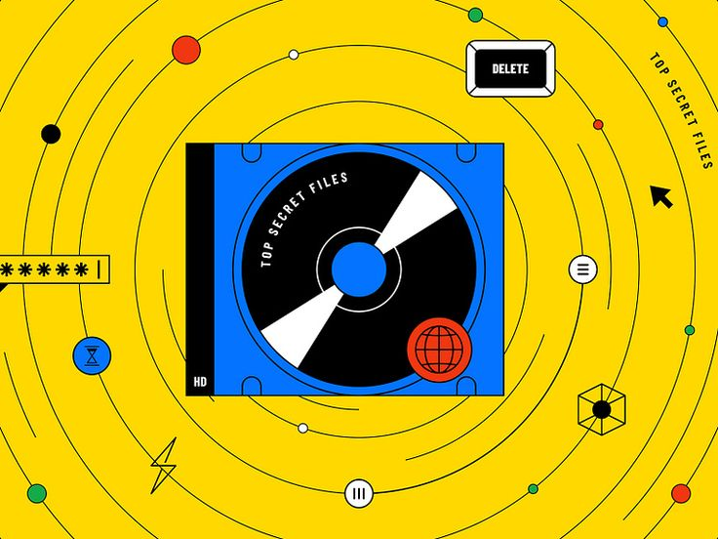

Slide 14
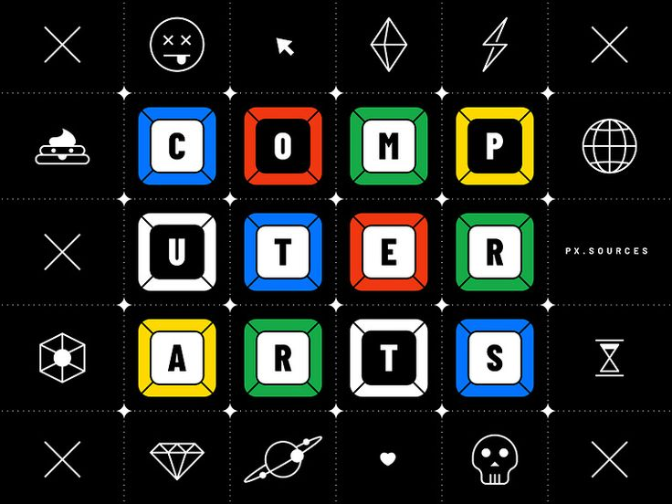

Slide 15
csdcsdcds

