Slide 1



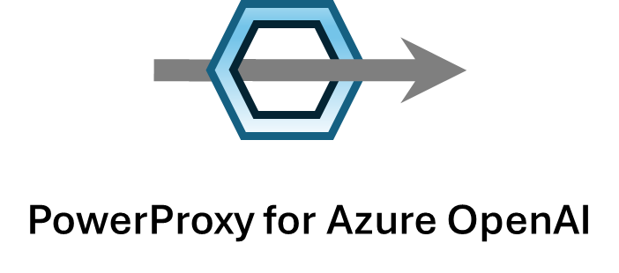






Usage with API Key Authentication
connection to PowerProxy as if it was Azure OpenAI
using team-specific PowerProxy key as Azure OpenAI key for authentication and identification of team/project
Team or Project 1
optional:
secrets from Key Vault
Key Vault
Azure OpenAI key
(only known to administrators)
Azure OpenAI Service
Team or Project [...]
transparent server,
running on arbitrary host, for example: autoscaling Container Apps
example,
customizable via plugins
Team or Project n
Log Analytics
Power BI

Slide 2
Usage with Azure AD/Entra ID Authentication
Token acquired from Azure AD
for specific user
Token acquired from Azure AD
for specific user
URL is specific for team/project 1
Team or Project 1
team/project is fixed per proxy instance
traffic processed by plugins, eg. to log to Log Analytics
Azure OpenAI Service
Token acquired from Azure AD
for specific user
Token acquired from Azure AD
for specific user
URL is specific for team/project 2
Team or Project n
team/project is fixed per proxy instance
traffic processed by plugins, eg. to log to Log Analytics

Slide 3

Team or Project 1
AOAI Endpoint/Deployment (PTU or PAYG)
...
...
Team or Project n
AOAI Endpoint/Deployment (PTU or PAYG)
PowerProxy

Slide 4
incoming request
AOAI Endpoint or
Deployment 1
example: Managed PTU, region 1
capacity for streaming requests
capacity for streaming + non-streaming requests
on non-streaming request: "roll dice" and decide if request is passed to
next endpoint/deployment or not (configurable ratio), to reserve capacity
for streaming requests
on 429, 500 or if endpoint/deployment is known to be at capacity,
else return result to client
AOAI Endpoint or
Deployment 2
example: PayGo, region 1
capacity for streaming requests
on non-streaming request: "roll dice" and decide if request is passed to
next endpoint/deployment or not (configurable ratio), to reserve capacity
for streaming requests
capacity for streaming + non-streaming
on 429, 500 or if endpoint/deployment is known to be at capacity,
else return result to client
AOAI Endpoint or
Deployment 3
example: PayGo, region 2
capacity for streaming + non-streaming
Note: Some features like the Assistants API require all deployments to be placed in one single AOAI workspace because the workspace might hold a state.
return a 429 if none of the endpoints/deployments was available to handle the request,
else return result to client

Slide 5

✔️ Spike demands handled
✔️ Managed PTU before PAYG
✔️ Realtime before Batch
✔️ Across endpoints
✔️ Across deployments
PAYG Deployment 3
PAYG Deployment 2
PAYG Deployment 1
Tokens per Minute
streaming + non-streaming
streaming
Managed PTU Deployment
Time

