Slide 1

Hackathon *** The Energy Sources
Gohar Artenyan
Lusine Artenyan

Slide 2
The Energy Sources
Macronutrients - protein, fat, and carbohydrate are the energy sources in the human diet.
When eaten in the right ratios, these three macronutrients can improve the weight, health and overall physical well-being. In general, most adults should target their diets to comprise of
45-65% Carbohydrates, 10-35% Protein and 20-35% Fat.
Dairy, Poultry and Grains are rich in all these three nutrients, that’s the reason we took deeper research in these categories.

Slide 3
The Source of Dataset
We obtained the dataset for 2020, last updated April 2020 from the website of U.S. DEPARTMENT OF AGRICULTURE
https://fdc.nal.usda.gov/download-datasets.html
There are two data types—Foundation Foods and Experimental Foods—provide data that have never previously been available.
We selected Foundation Foods
• Foundation Foods include values for nutrients and other food components on a diverse range of foods and ingredients as well as extensive underlying metadata.

Slide 4
The Sections of the Chart
These data Sample includes the number of samples, analytical approaches used, and if appropriate, agricultural information such as genotype and production practices.
FDC_ID - ID of the food in the food table registered with USDA
Food Code – Food Cope registered with USDA
WWEIA Code – What We Eat In America Code registered with USDA
Food Type – Dairy, Non-Dairy, Poultry, Grains
Type -Subdivision of the Food Type-Milk, Yogurt, Cheese, Meat, Pork, Ham, Lamb, Goat, Veal, Chicken, Turkey, Fish, Seafood, Egg, bread,
Description of the Food - Provides the name of the food
Protein Value – Shows how much protein is in grams
Fat Value – Shows how much fat is in grams
Carbohydrates Value - Shows how much carbohydrates is in grams
Measurement -1 cup or 100 grams was used as a measurement to find out the quantity

Slide 5
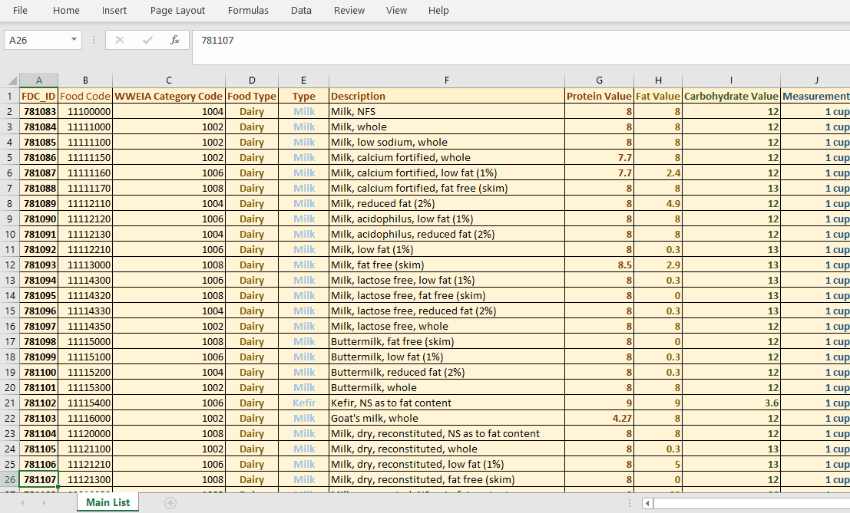
The Cleaned DATA

Slide 6
Collecting, Cleaning, preparing, analyzing the DATA
We solved real world data science problem with python.
We took a data set, did initial processing and cleaning the data in Excel.
After preparing and polishing the data we explored and did some analysis to get answers for questions that arouse.
To find the values for the Protein, Fat and Carbohydrate we did manual search and research for every food in the list.

Slide 7
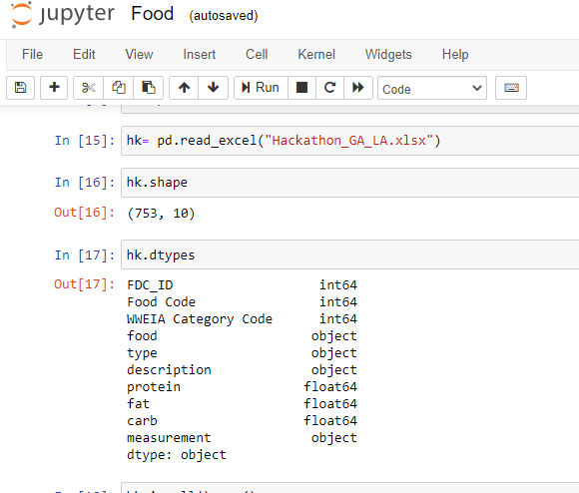
Python
We checked with Python to see if we can see what columns we have and how many.
We checked with Python, it showed we have 10 columns, 753 rows.
It also shows the type of the value for our columns.

Slide 8
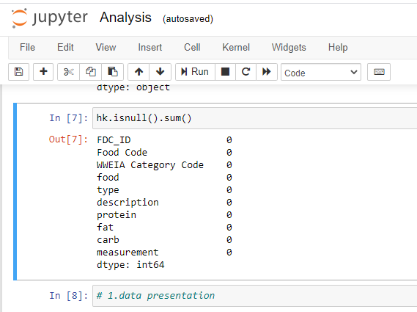
We checked if there is any information missing. There was not any blank cell.
If there was a missing data, in front of the column names would be the number of missing values. If there is a “0”, then there is no information missing.

Slide 9
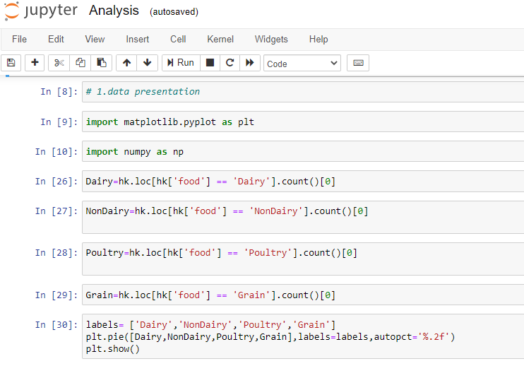

Slide 10
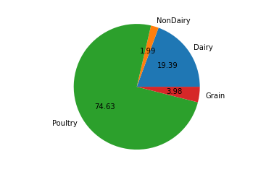
Based on data, we have created a Pie-Chart with the help of Python.
It gives us idea how much in percentages we have in our dataset for every type of food.

Slide 11
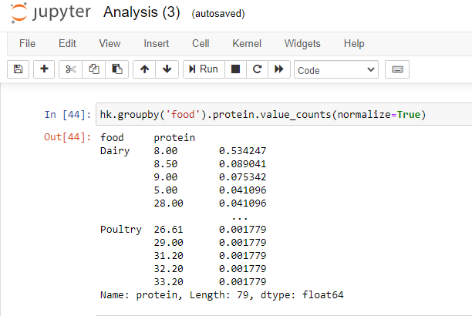
Protein

Slide 12
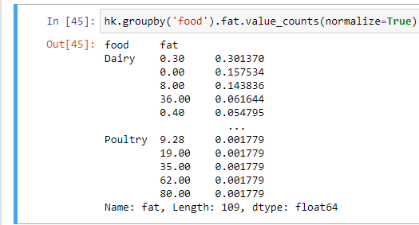
Fat

Slide 13
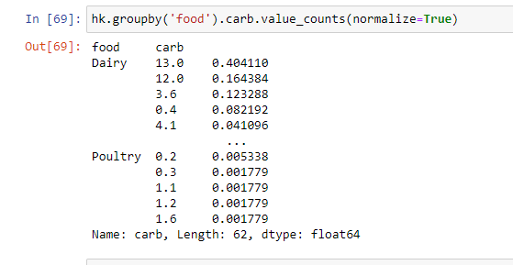
Carbohydrates

Slide 14
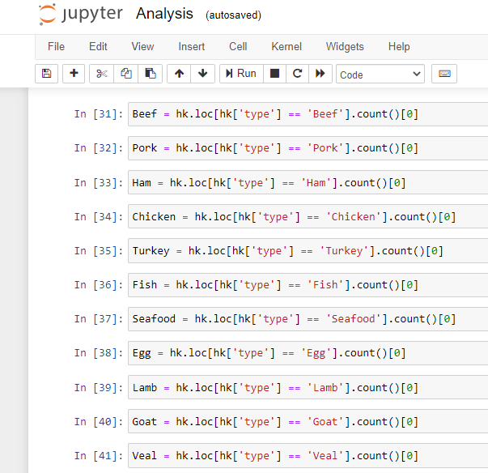
Now we wanted to see how much in percentages we have in each type group within the poultry.
For creating the Pie Charts, we used Pandas Commands as loc, count, plt.show.

Slide 15
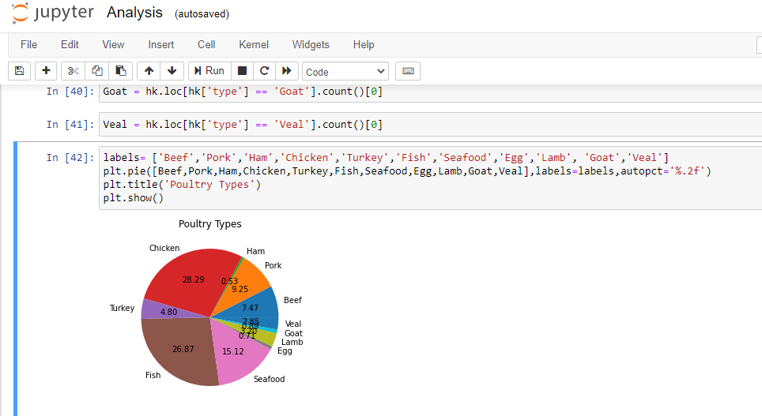

Slide 16
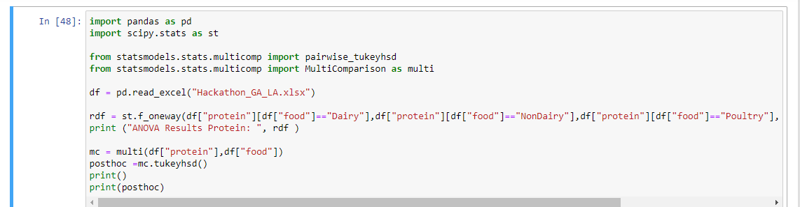
ANOVA for Protein

Slide 17
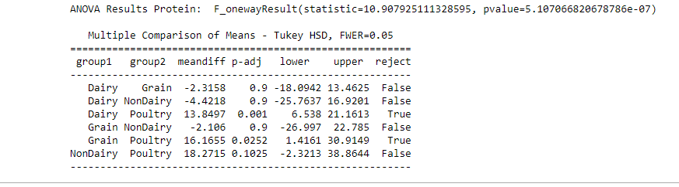
ANOVA Chart for Protein

Slide 18
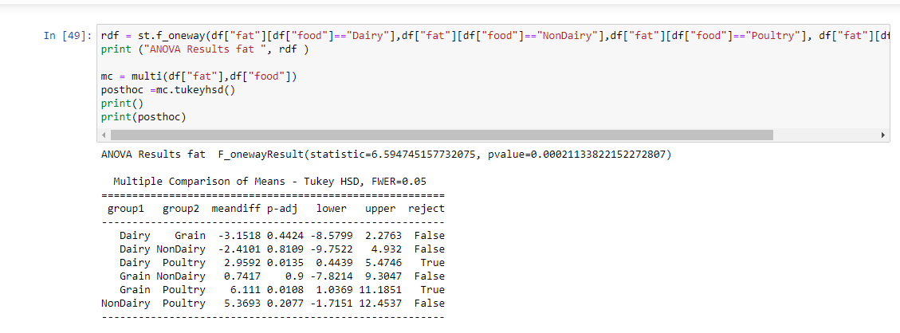
ANOVA for Fat

Slide 19
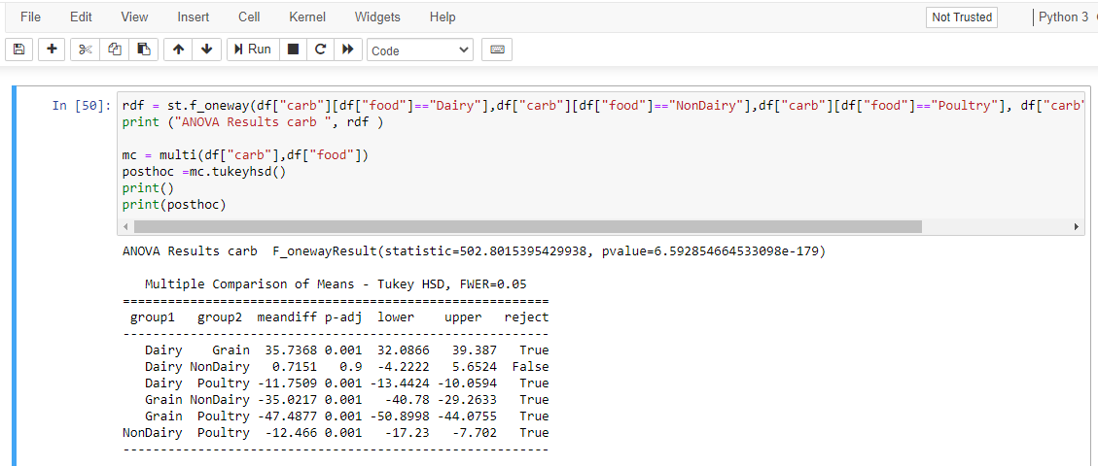
ANOVA for Carbohydrates

Slide 20
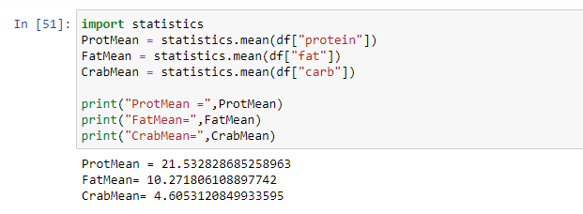
Mean for Protein, Fat and Carbohydrates

Slide 21
Nutrients allowance per day for a Healthy Diet if consumed 2000 calories a day
 | Protein Allowance per | Fat Allowance per day | Carbohydrates Allowance per day
Per Day | 56 | 77 | 325
Per Serving | 14 | 19.25 | 81.25
It is counted as 4 serving per day as a part of a Healthy Nutrition.

Slide 22
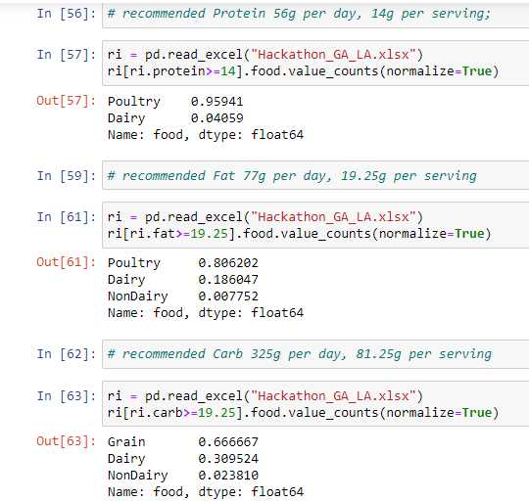
Recommended Portion of Nutrients per Serving

Slide 23
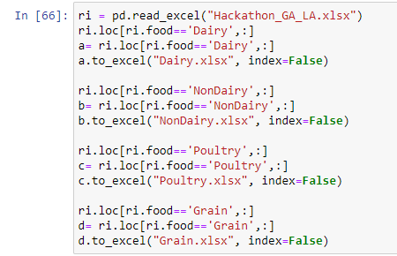
We Sorted data Dairy, Non – Dairy, Poultry, and Grains and created Excel Files.

Slide 24
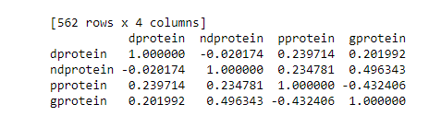
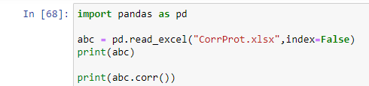
Correlation Protein

Slide 25

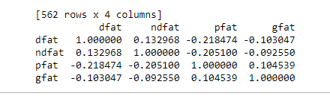
Correlation Fat

Slide 26
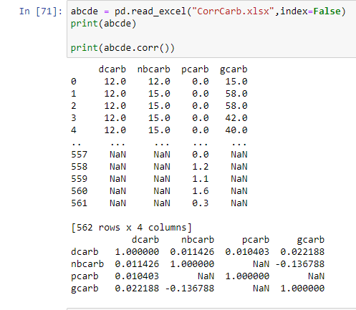
Correlation Carbohydrates

Slide 27
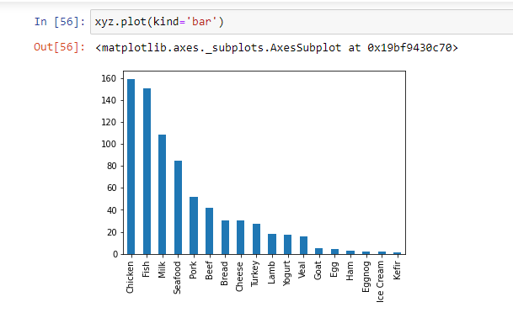
Chart Based on Dataset

Slide 28
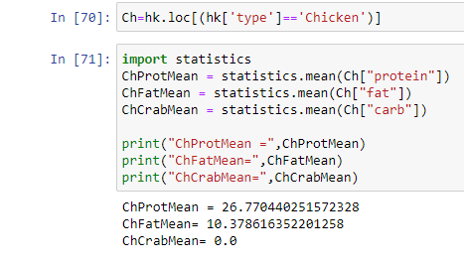
Protein Mean Value for Chicken

Slide 29
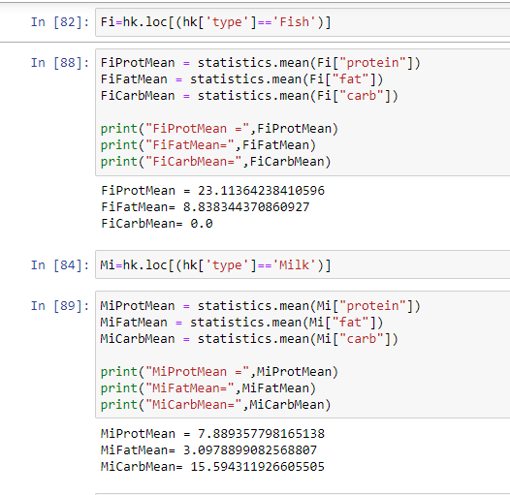
Protein Mean Value for Fish
Protein Mean Value for Milk

Slide 30
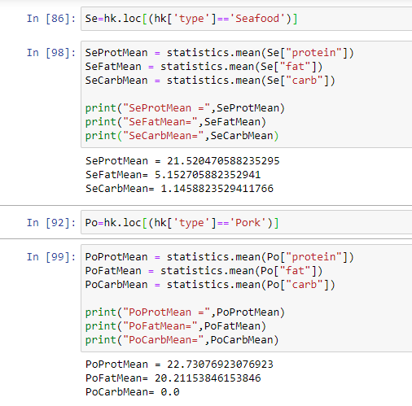
Protein Mean Value for Seafood
Protein Mean Value for Pork

Slide 31
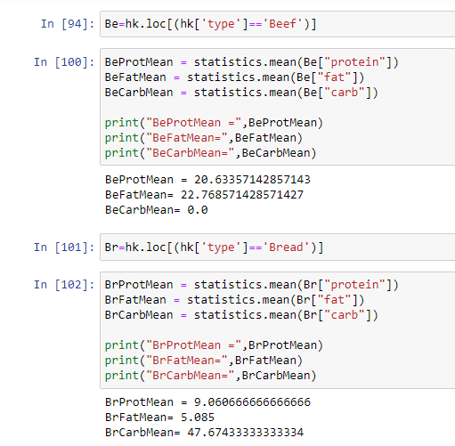
Protein Mean Value for Beef
Protein Mean Value for Bread

Slide 32
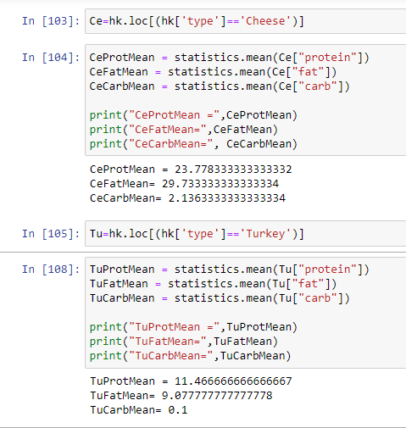
Protein Mean Value for Cheese
Protein Mean Value for Turkey

Slide 33
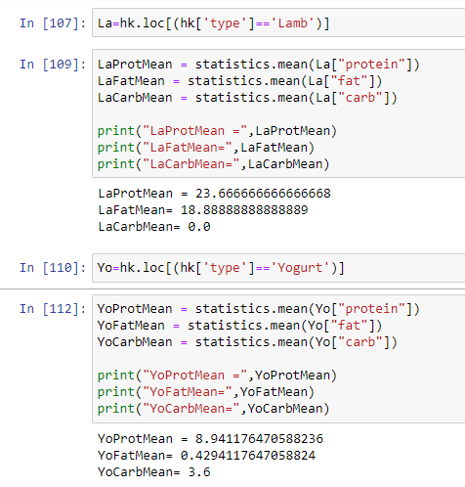
Protein Mean Value for Lamb
Protein Mean Value for Yogurt

Slide 34
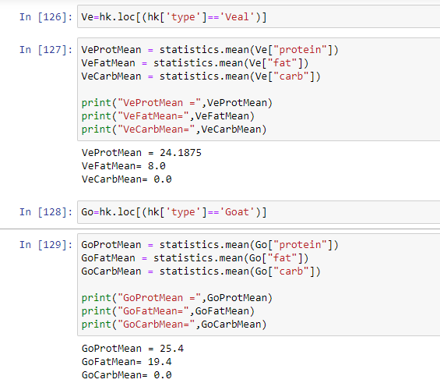
Protein Mean Value for Veal
Protein Mean Value for Goat

Slide 35
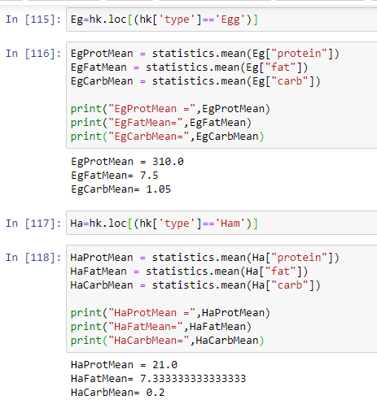
Protein Mean Value for Egg
Protein Mean Value for Ham

Slide 36
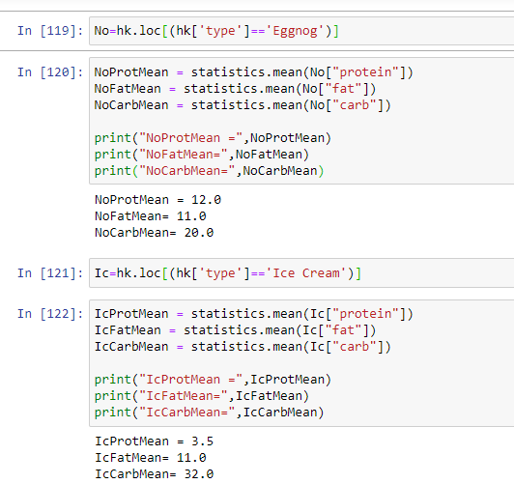
Protein Mean Value for Eggnog
Protein Mean Value for Ice Cream

Slide 37
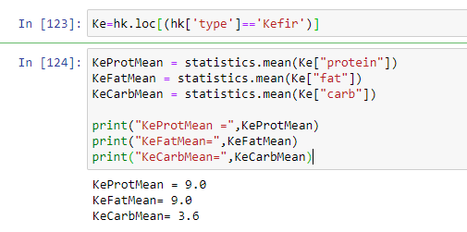
Protein Mean Value for Kefir

Slide 38
Thank you for your Attention!
It was exciting to be part of Hackathon and the Class of Data Science!
We are beginners in Python. We took our first class in August 2020.
We would like to express our gratitude for the exceptional opportunity for exploring data analyzes, evolving our knowledge in Python and Machine Learning…
We are looking forward to deepen our knowledge in Data Science and get to expand the possibilities…
Thank you for your attention!
Gohar Artenyan
Lusine Artenyan
Class: 374788: Data Science Fundamentals (INTENSIVE)COM SCI-X 450.00

