Slide 1
Adaptive Time Stepping
Luke Sellmayer
APPM 4610
April 29, 2024

Slide 2
Why Vary Step Size?
By making the step size as small as possible, we reduce local truncation error (and therefore global error)
But, smaller step size means more mesh points, meaning more computational work
By varying the step size, we can minimize the number of mesh points used while keeping the local truncation in check
I.e. how can we get the most bang for our buck?

Slide 3

Variable Step Size for One Step Taylor Methods
$$w_{0}=α$$
$$w_{i+1}=w_{i}+hφ\left(t_{i}, w_{i}, h\right)$$

Slide 4
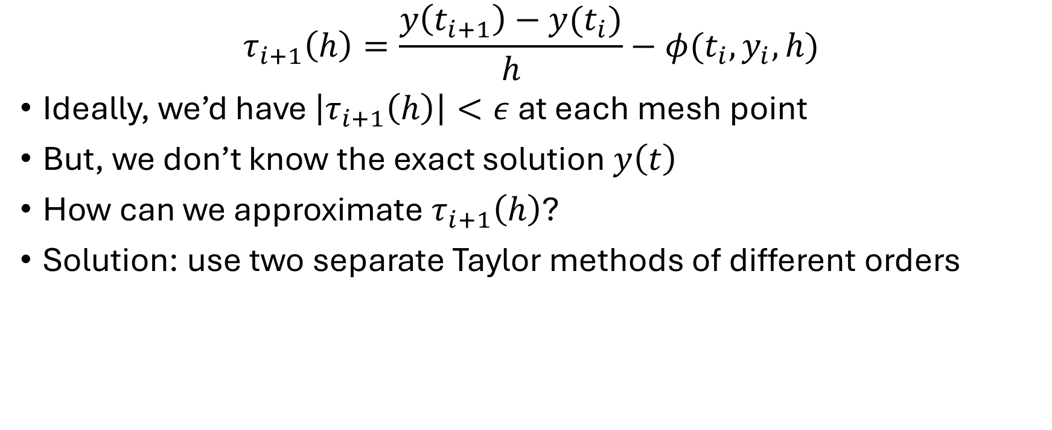
Local Truncation Error (LTE)
$$τ_{i+1}\left(h\right)=\frac{y\left(t_{i+1}\right)−y(t_{i})}{h}−φ(t_{i}, y_{i}, h)$$
Ideally, we’d have $\left|τ_{i+1}\left(h\right)\right|<ε$ at each mesh point
But, we don’t know the exact solution $y\left(t\right)$
How can we approximate $τ_{i+1}\left(h\right)$?
Solution: use two separate Taylor methods of different orders

Slide 5
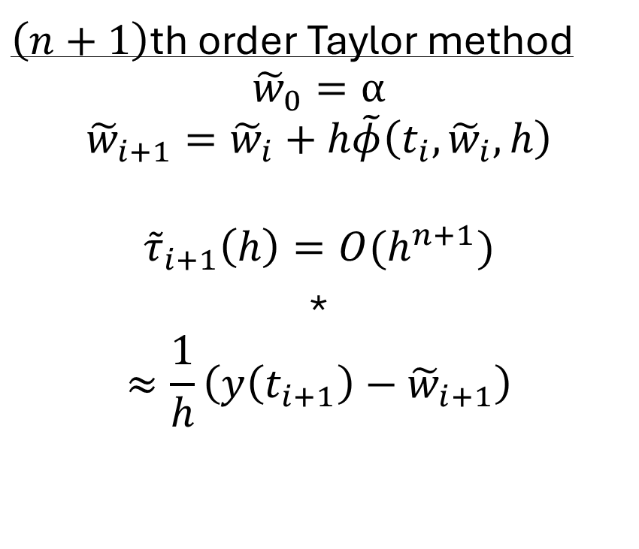
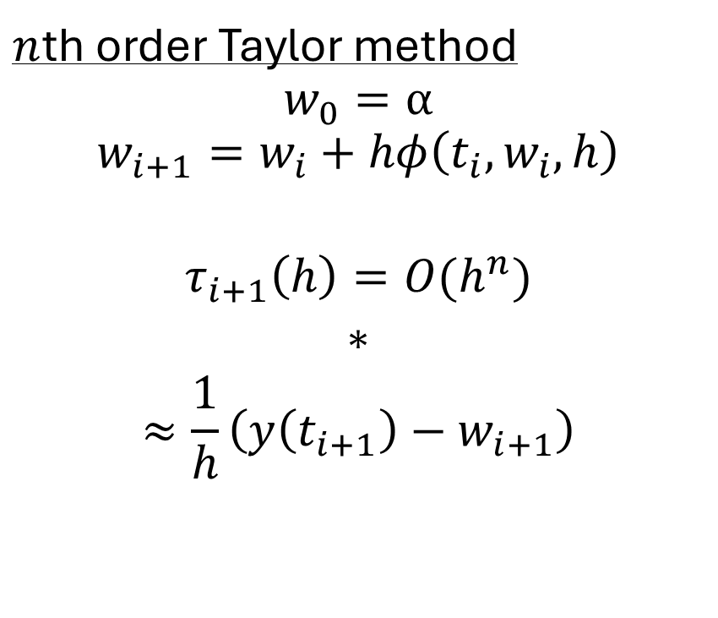
Approximating LTE
$n$th order Taylor method
$$w_{0}=α$$
$$w_{i+1}=w_{i}+hφ\left(t_{i}, w_{i}, h\right)$$
$$τ_{i+1}\left(h\right)=O(h^{n})$$
*
$$≈\frac{1}{h}\left(y\left(t_{i+1}\right)−w_{i+1}\right)$$
$\left(n+1\right)$th order Taylor method
$${\tilde{w}}_{0}=α$$
$${\tilde{w}}_{i+1}={\tilde{w}}_{i}+h\tilde{φ}\left(t_{i},{\tilde{w}}_{i}, h\right)$$
$${\tilde{τ}}_{i+1}\left(h\right)=O(h^{n+1})$$
*
$$≈\frac{1}{h}\left(y\left(t_{i+1}\right)−{\tilde{w}}_{i+1}\right)$$
*assuming $y\left(t_{i+1}\right)≈w_{i+1}$, $y\left(t_{i+1}\right)≈{\tilde{w}}_{i+1}$

Slide 6

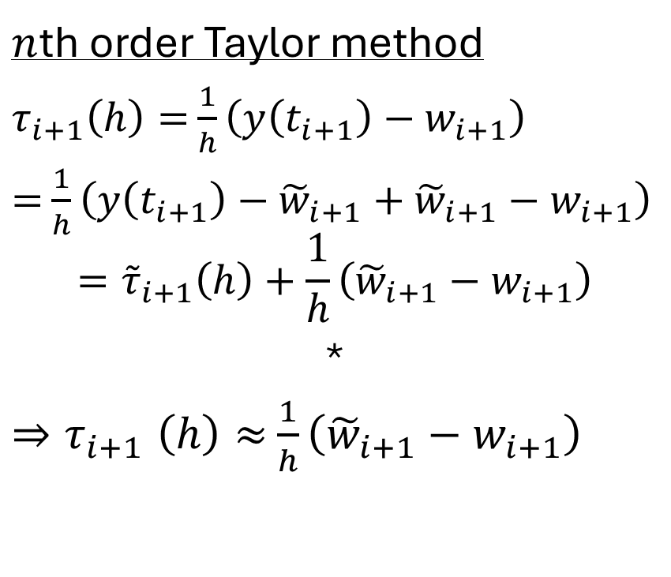
Approximating LTE
$n$th order Taylor method
$τ_{i+1}\left(h\right)=$ $\frac{1}{h}\left(y\left(t_{i+1}\right)−w_{i+1}\right)$
$=$ $\frac{1}{h}\left(y\left(t_{i+1}\right)−{\tilde{w}}_{i+1}+{\tilde{w}}_{i+1}−w_{i+1}\right)$
$$={\tilde{τ}}_{i+1}\left(h\right)+\frac{1}{h}\left({\tilde{w}}_{i+1}−w_{i+1}\right)$$
*
${⇒τ}_{i+1}\left(h\right)≈$ $\frac{1}{h}\left({\tilde{w}}_{i+1}−w_{i+1}\right)$
$\left(n+1\right)$th order Taylor method
$${\tilde{τ}}_{i+1}\left(h\right)=\frac{1}{h}\left(y\left(t_{i+1}\right)−{\tilde{w}}_{i+1}\right)$$
*since ${\tilde{τ}}_{i+1}\left(h\right)=O(h^{n+1})$ while $τ_{i+1}\left(h\right)=O(h^{n})$

Slide 7
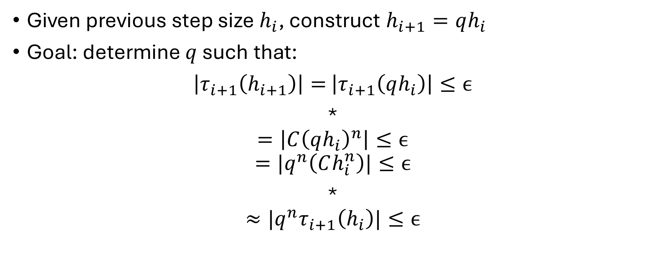
Varying the Step Size
Given previous step size $h_{i}$, construct $h_{i+1}=qh_{i}$
Goal: determine $q$ such that:
$\left|τ_{i+1}\left(h_{i+1}\right)\right|=$ $\left|τ_{i+1}\left(qh_{i}\right)\right|≤ϵ$
*
$$=\left|C{\left(qh_{i}\right)}^{n}\right|≤ϵ$$
$$={|q}^{n}\left(Ch_{i}^{n}\right)|≤ϵ$$
*
$$≈{|q}^{n}τ_{i+1}\left(h_{i}\right)|≤ϵ$$
*assuming $τ_{i+1}\left(h\right)=Ch^{n}$ since $τ_{i+1}\left(h\right)=O(h^{n})$

Slide 8

Varying the Step Size
$$\left|τ_{i+1}\left(h_{i+1}\right)\right|≈{|q}^{n}τ_{i+1}\left(h_{i}\right)|≤ϵ$$
*
$$≈\left|q^{n}\frac{{\tilde{w}}_{i+1}−w_{i+1}}{h}\right|≤ϵ$$
*from the approximation $τ_{i+1}\left(h\right)≈$ $\frac{1}{h}\left({\tilde{w}}_{i+1}−w_{i+1}\right)$

Slide 9

Varying the Step Size
$$\left|τ_{i+1}\left(h_{i+1}\right)\right|≈\left|q^{n}\frac{{\tilde{w}}_{i+1}−w_{i+1}}{h}\right|≤ϵ$$
So, we choose $q$ such that*
$$q≤{\left(\frac{εh_{i}}{|{\tilde{w}}_{i+1}−w_{i+1}|}\right)}^{\frac{1}{n}}$$
*algebra!

Slide 10
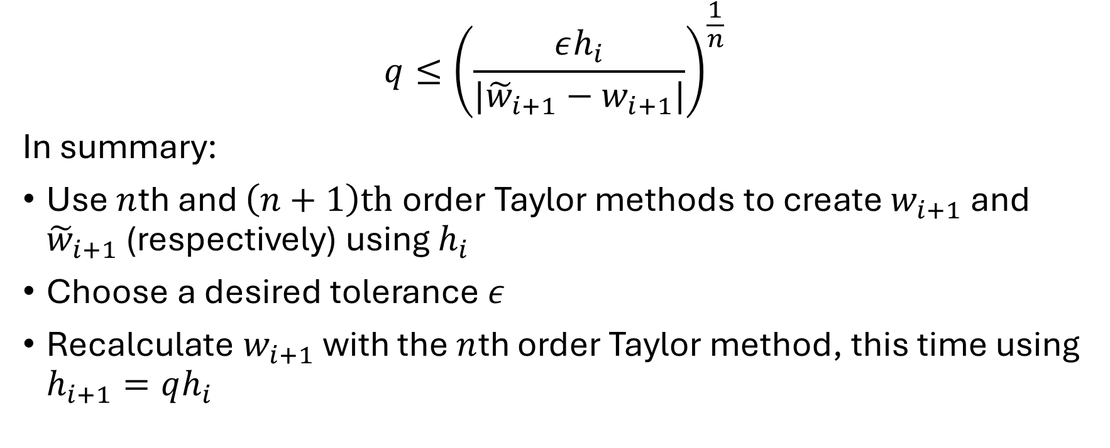
Varying the Step Size
$$q≤{\left(\frac{εh_{i}}{|{\tilde{w}}_{i+1}−w_{i+1}|}\right)}^{\frac{1}{n}}$$
In summary:
Use $n$th and $\left(n+1\right)th$order Taylor methods to create $w_{i+1}$ and ${\tilde{w}}_{i+1}$ (respectively) using $h_{i}$
Choose a desired tolerance $ε$
Recalculate $w_{i+1}$ with the $n$th order Taylor method, this time using $h_{i+1}=qh_{i}$

Slide 11

Example: Runge-Kutta Methods
$$1≤t≤2$$
$$y^{′}=t+y$$
$$y\left(1\right)=1$$
Exact solution: $y=3e^{t−1}−t−1$

Slide 12
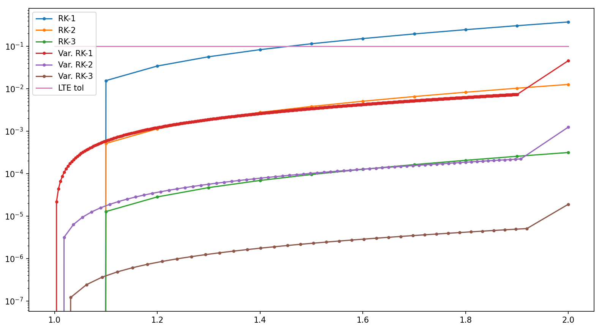

Example: Runge-Kutta Methods
$$ε=0.1$$
$$h_{0}=0.1$$

Slide 13
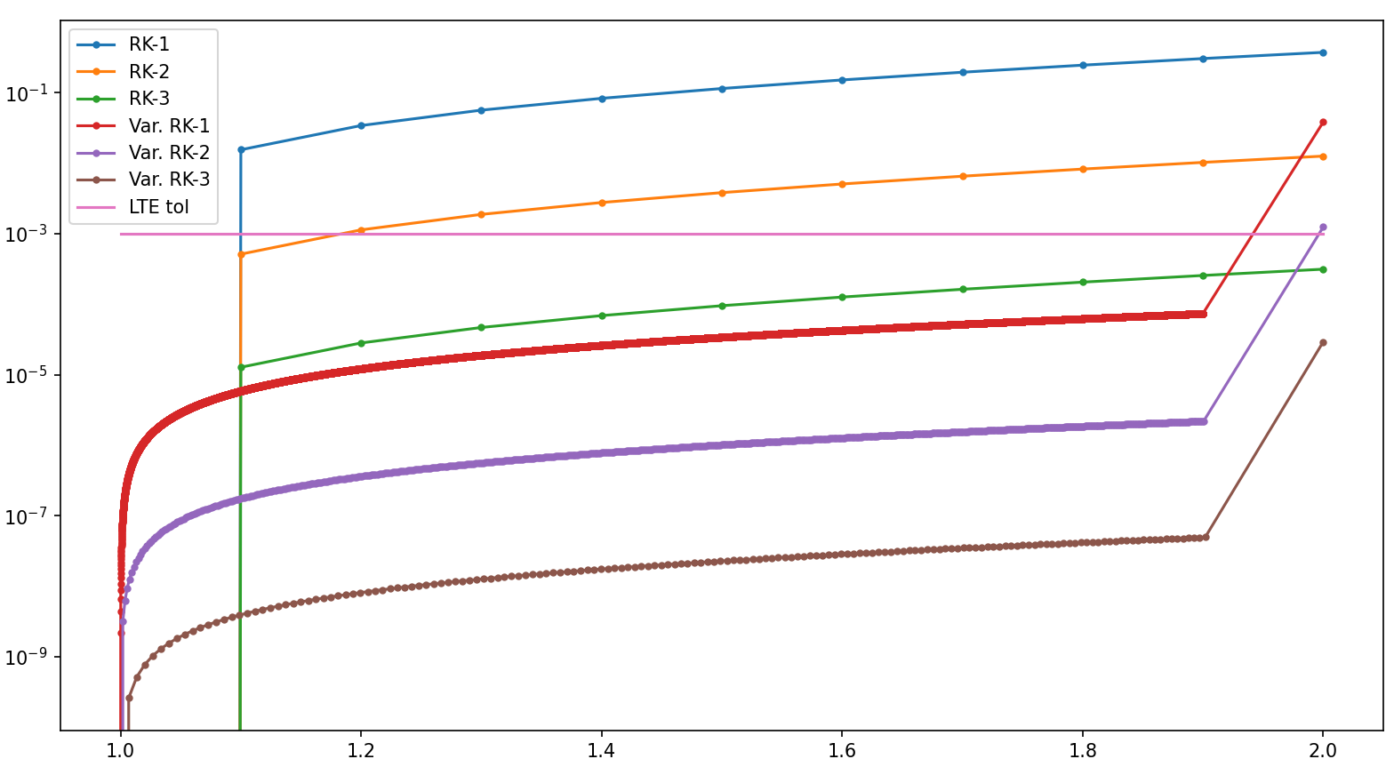

Example: Runge-Kutta Methods
$$ε=0.001$$
$$h_{0}=0.1$$

Slide 14
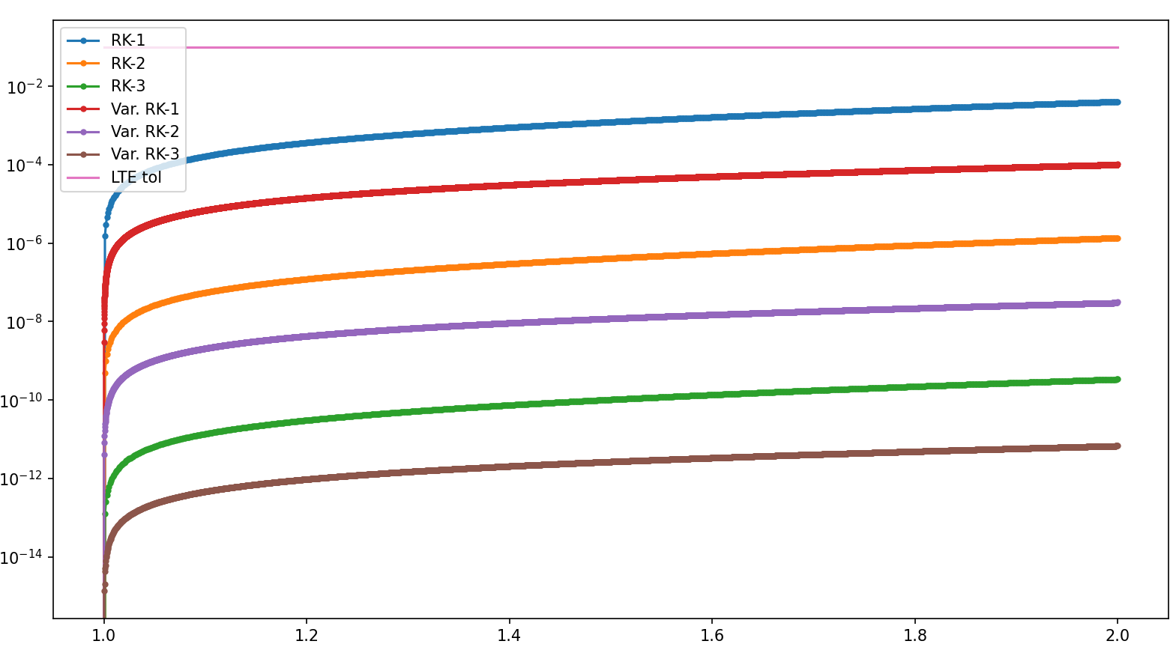
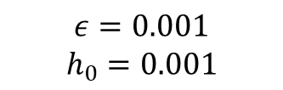
Example: Runge-Kutta Methods
$$ε=0.001$$
$$h_{0}=0.001$$

Slide 15
Independent Extension: The DASSL Algorithm

Slide 16
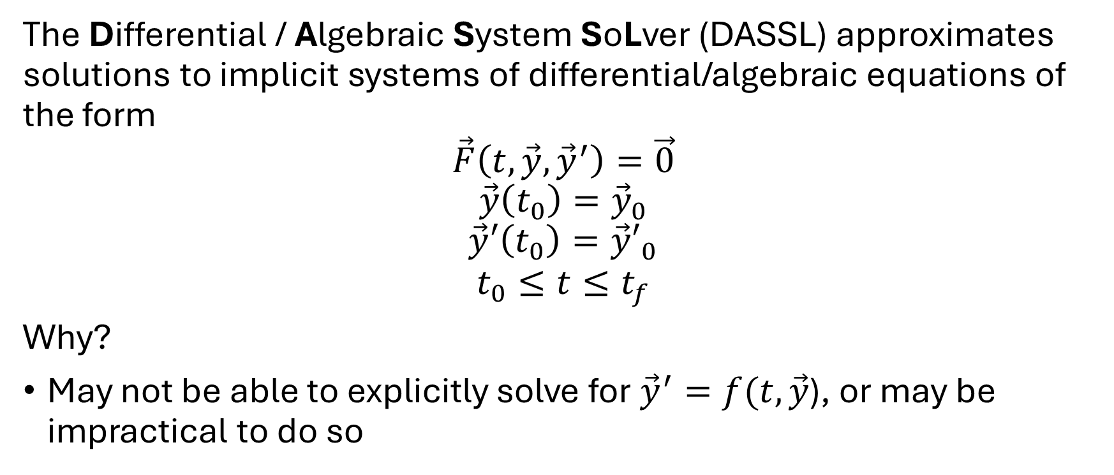
Overview
The Differential / Algebraic System SoLver (DASSL) approximates solutions to implicit systems of differential/algebraic equations of the form
$$\vec{F}\left(t, \vec{y}, {\vec{y}}^{′}\right)=\vec{0}$$
$$\vec{y}\left(t_{0}\right)={\vec{y}}_{0}$$
$$\vec{y}′\left(t_{0}\right)={\vec{y}′}_{0}$$
$$t_{0}≤t≤t_{f}$$
Why?
May not be able to explicitly solve for ${\vec{y}}^{′}=f(t, \vec{y}$), or may be impractical to do so

Slide 17
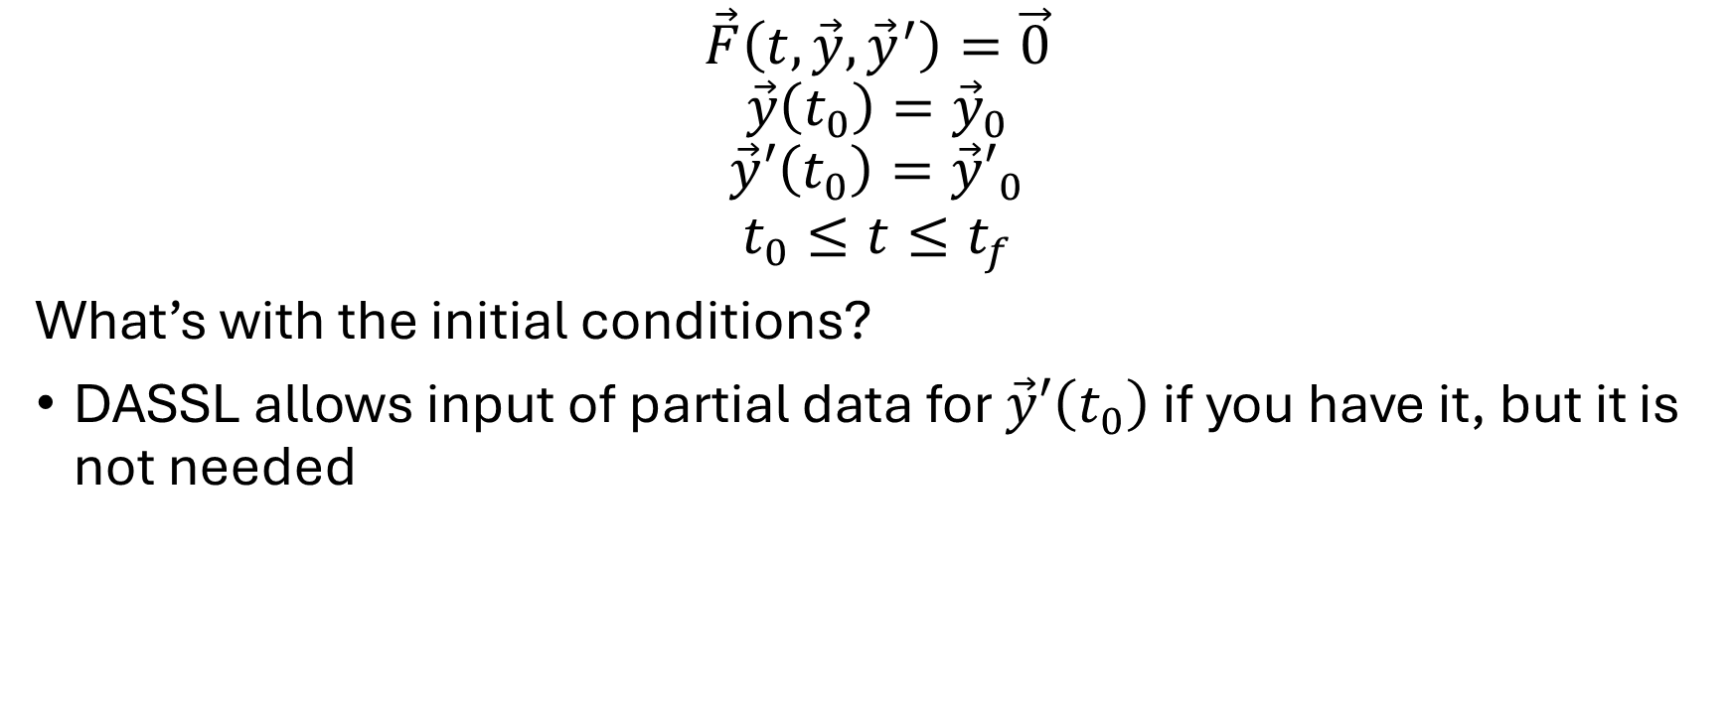
Overview
$$\vec{F}\left(t, \vec{y}, {\vec{y}}^{′}\right)=\vec{0}$$
$$\vec{y}\left(t_{0}\right)={\vec{y}}_{0}$$
$$\vec{y}′\left(t_{0}\right)={\vec{y}′}_{0}$$
$$t_{0}≤t≤t_{f}$$
What’s with the initial conditions?
DASSL allows input of partial data for $\vec{y}′\left(t_{0}\right)$ if you have it, but it is not needed

Slide 18
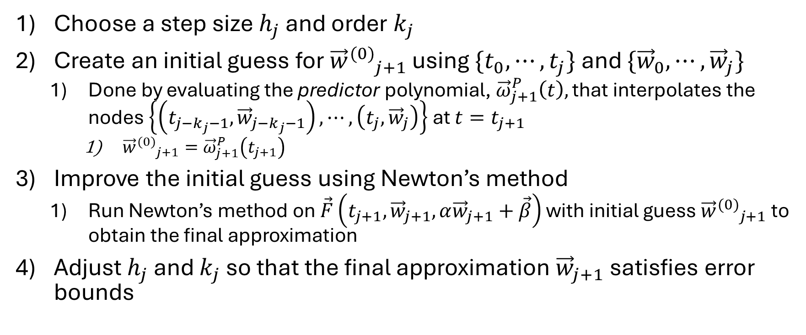
Basic Algorithm Outline
Choose a step size $h_{j}$ and order $k_{j}$
Create an initial guess for ${{\vec{w}}^{(0)}}_{j+1}$ using $\{t_{0}, ⋯, t_{j}\}$ and $\{{\vec{w}}_{0}, ⋯,{\vec{w}}_{j}\}$
Done by evaluating the predictor polynomial, ${\vec{ω}}_{j+1}^{P}\left(t\right),$ that interpolates the nodes $\left\{\left(t_{j−k_{j}−1},{\vec{w}}_{j−k_{j}−1}\right), ⋯, \left(t_{j},{\vec{w}}_{j}\right)\right\}$ at $t=t_{j+1}$
${{\vec{w}}^{(0)}}_{j+1}={\vec{ω}}_{j+1}^{P}\left(t_{j+1}\right)$
Improve the initial guess using Newton’s method
Run Newton’s method on $\vec{F}\left(t_{j+1},{\vec{w}}_{j+1},α{\vec{w}}_{j+1}+\vec{β}\right)$ with initial guess ${{\vec{w}}^{(0)}}_{j+1}$ to obtain the final approximation
Adjust $h_{j}$ and $k_{j}$ so that the final approximation ${\vec{w}}_{j+1}$ satisfies error bounds

Slide 19
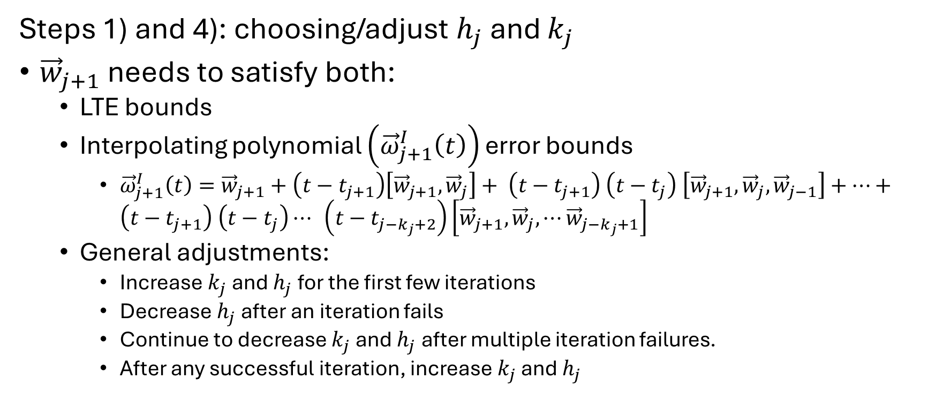
Basic Algorithm Outline
Steps 1) and 4): choosing/adjust $h_{j}$ and $k_{j}$
${\vec{w}}_{j+1}$ needs to satisfy both:
LTE bounds
Interpolating polynomial $\left({\vec{ω}}_{j+1}^{I}\left(t\right)\right)$ error bounds
${\vec{ω}}_{j+1}^{I}\left(t\right)={\vec{w}}_{j+1}+\left(t−t_{j+1}\right)\left[{\vec{w}}_{j+1}, {\vec{w}}_{j}\right]+ \left(t−t_{j+1}\right) \left(t−t_{j}\right) \left[{\vec{w}}_{j+1}, {\vec{w}}_{j}, {\vec{w}}_{j−1}\right]+⋯+ \left(t−t_{j+1}\right) \left(t−t_{j}\right)⋯ \left(t−t_{j−k_{j}+2}\right)\left[{\vec{w}}_{j+1}, {\vec{w}}_{j}, ⋯{\vec{w}}_{j−k_{j}+1}\right]$
General adjustments:
Increase $k_{j}$ and $h_{j}$ for the first few iterations
Decrease $h_{j}$ after an iteration fails
Continue to decrease $k_{j}$ and $h_{j}$ after multiple iteration failures.
After any successful iteration, increase $k_{j}$ and $h_{j}$

Slide 20
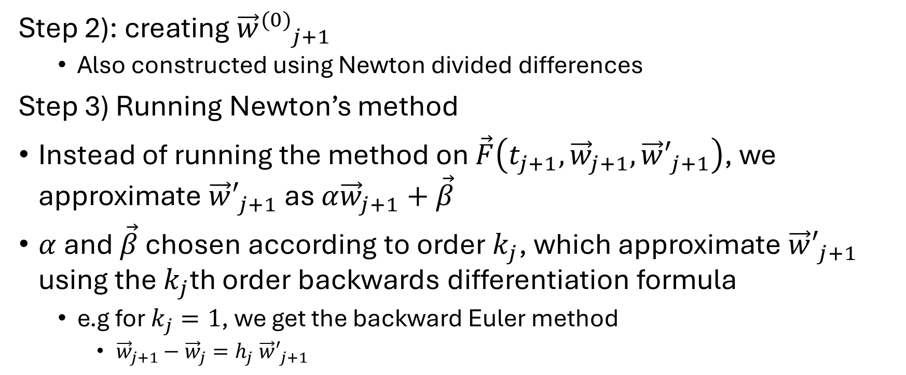
Basic Algorithm Outline
Step 2): creating ${{\vec{w}}^{(0)}}_{j+1}$
Also constructed using Newton divided differences
Step 3) Running Newton’s method
Instead of running the method on $\vec{F}\left(t_{j+1},{\vec{w}}_{j+1},{\vec{w}′}_{j+1}\right)$, we approximate ${\vec{w}′}_{j+1}$ as $α{\vec{w}}_{j+1}+\vec{β}$
$α$ and $\vec{β}$ chosen according to order $k_{j}$, which approximate ${\vec{w}′}_{j+1}$ using the $k_{j}$th order backwards differentiation formula
e.g for $k_{j}=1$, we get the backward Euler method
${\vec{w}}_{j+1}−{\vec{w}}_{j}=h_{j}$ ${\vec{w}′}_{j+1}$

Slide 21
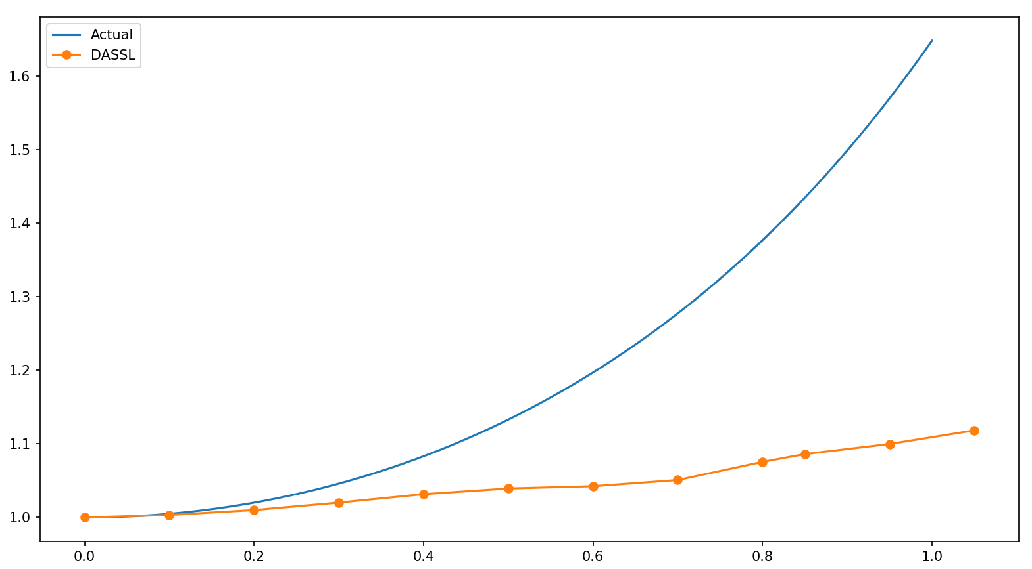
Some Disappointing Results :(

Slide 22
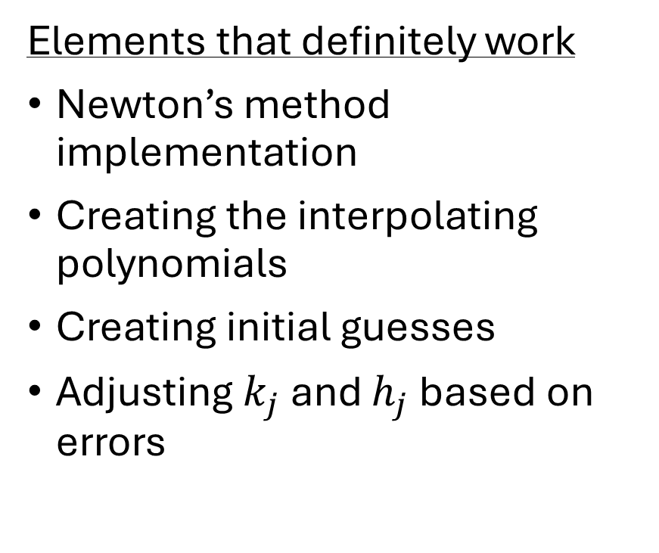
What’s Going Wrong?
Elements that definitely work
Newton’s method implementation
Creating the interpolating polynomials
Creating initial guesses
Adjusting $k_{j}$ and $h_{j}$ based on errors
Elements that probably don’t work
Finding the LTE
Finding the interpolation error

Slide 23
References
[1] K. E. Brenan, S. L. Campbell, and L. R. Petzold, Numerical solution of initial-value problems in differential-algebraic equations, 14, SIAM, 1996.
[2] Richard L. Burden, J. Douglas Faires, and Annette M. Burden, Numerical analysis, tenth edition, Cengage Learning, 2014.
[3] Fred T. Krogh, Recurrence relations for computing with modified divided differences, Mathematics of Computation 33 (1979), no. 148, 1265–1271.
[4] Linda Petzold, A description of dassl: A differential/algebraic system solver, 01 1982.

