Slide 1

2012 Derby Night
CCIC-TV

Slide 2

2/3 (Friday) Derby kick off
2/25(Sat.) 1:00-4:00 pm Workshop at CCIC-NV
3/3(Sat.) 1:00-4:00 pm Workshop at CCIC-NV
3/8(Thur.) 5:00-10:00 pm Weight in & Test run at CCIC-NV
3/9(Friday) 7:30 pm Derby Night

Slide 3
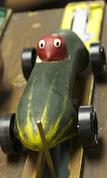
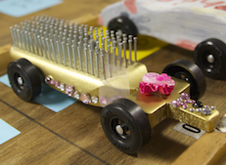
How to make a Derby car?

Slide 4
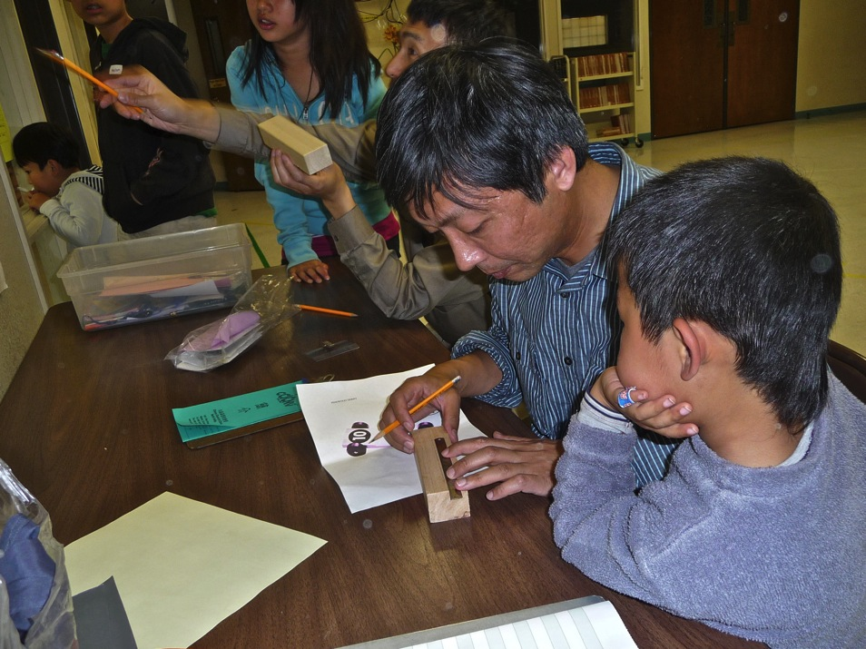
1. Design

Slide 5
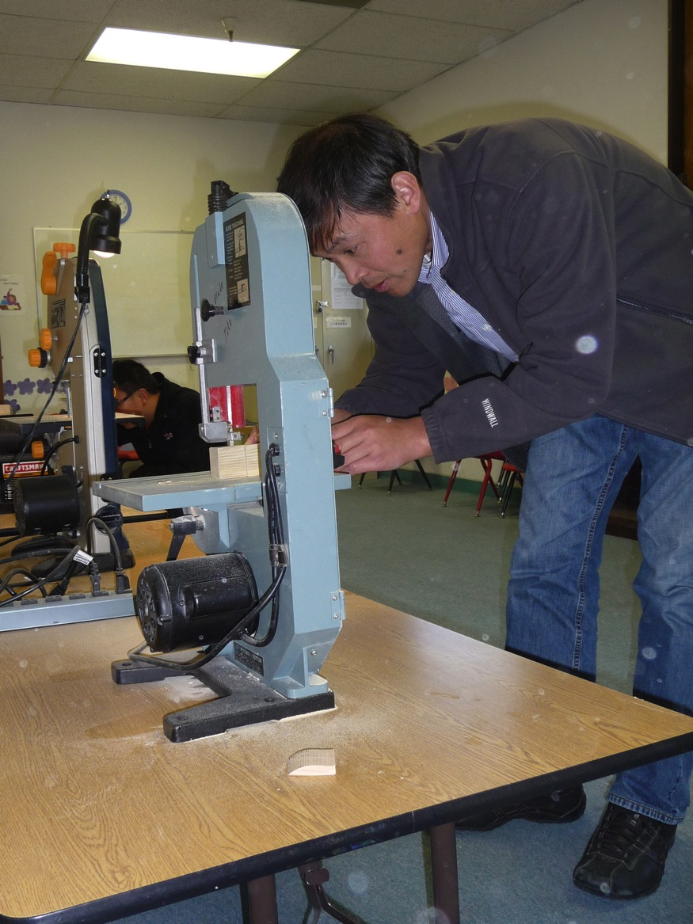
2. Cut

Slide 6
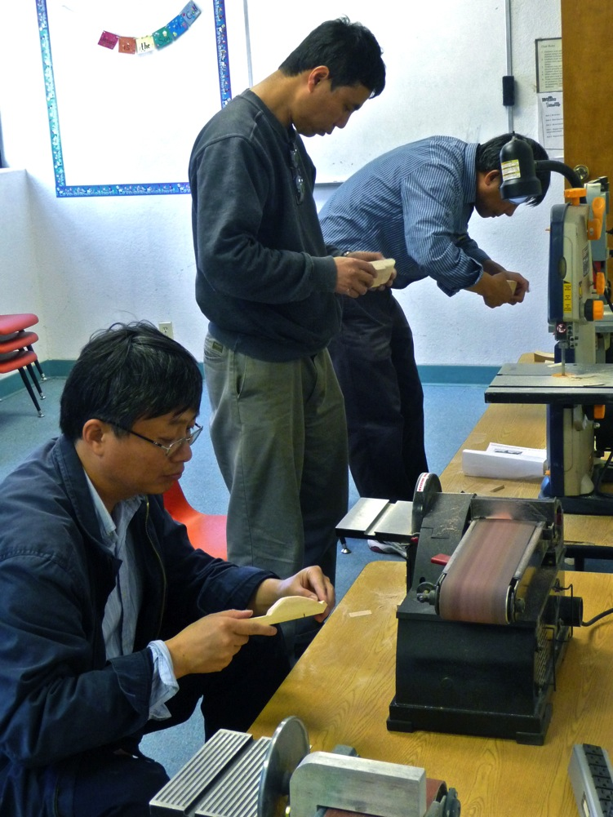
3. Sand

Slide 7
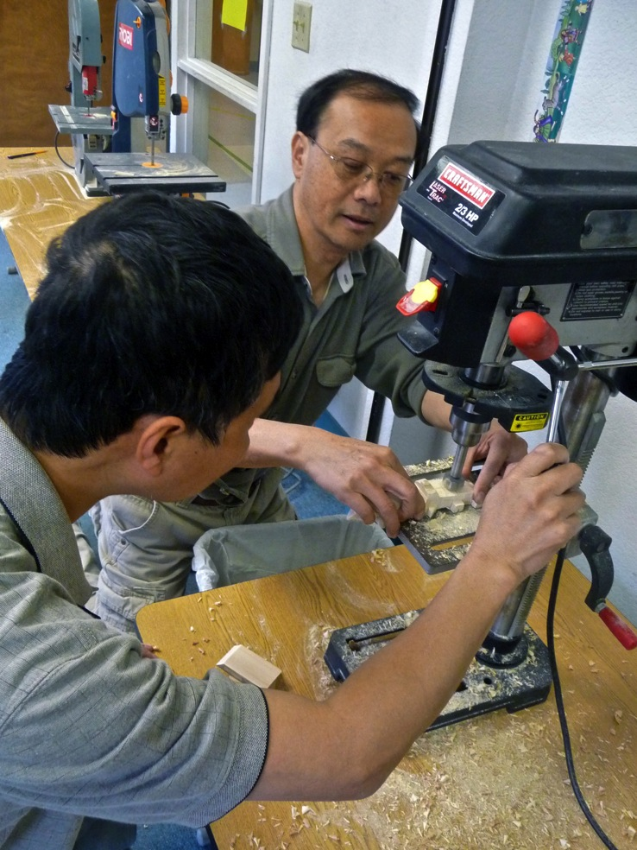
4. Drill

Slide 8
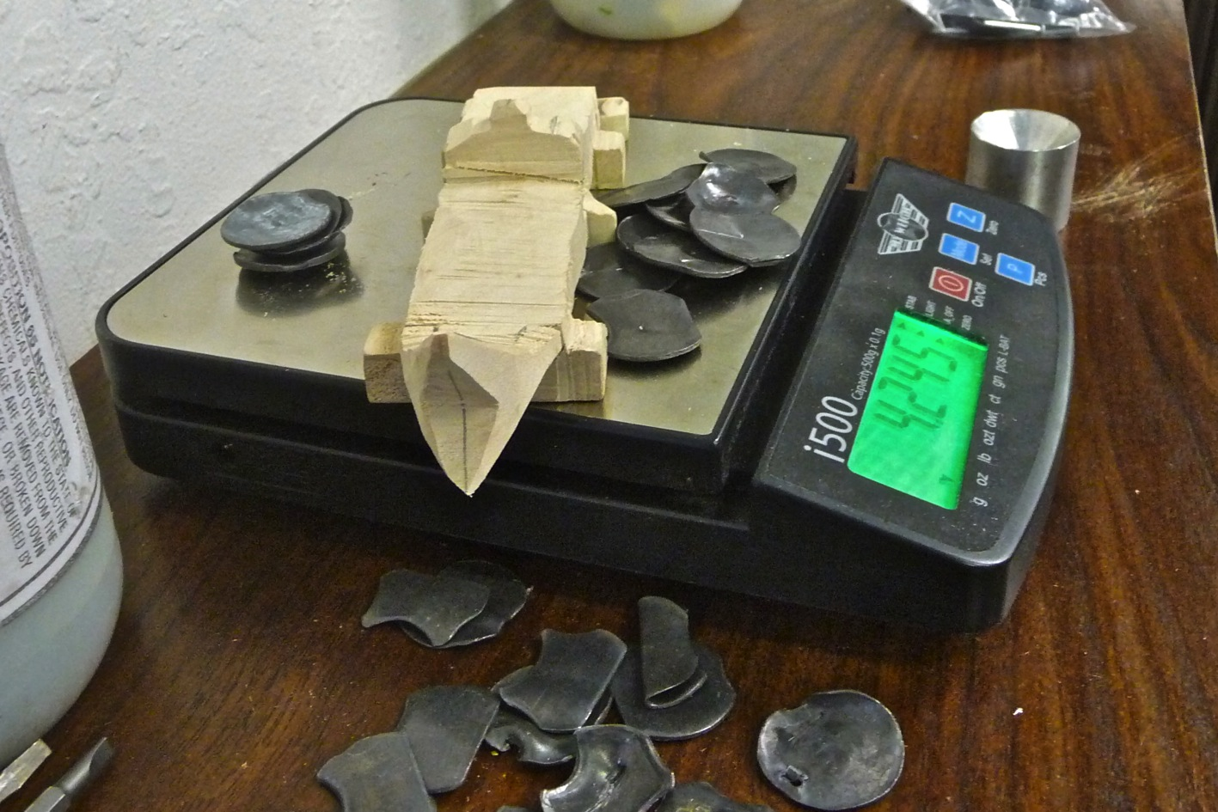
5. Add weight

Slide 9
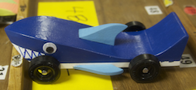
6. Paint

Slide 10
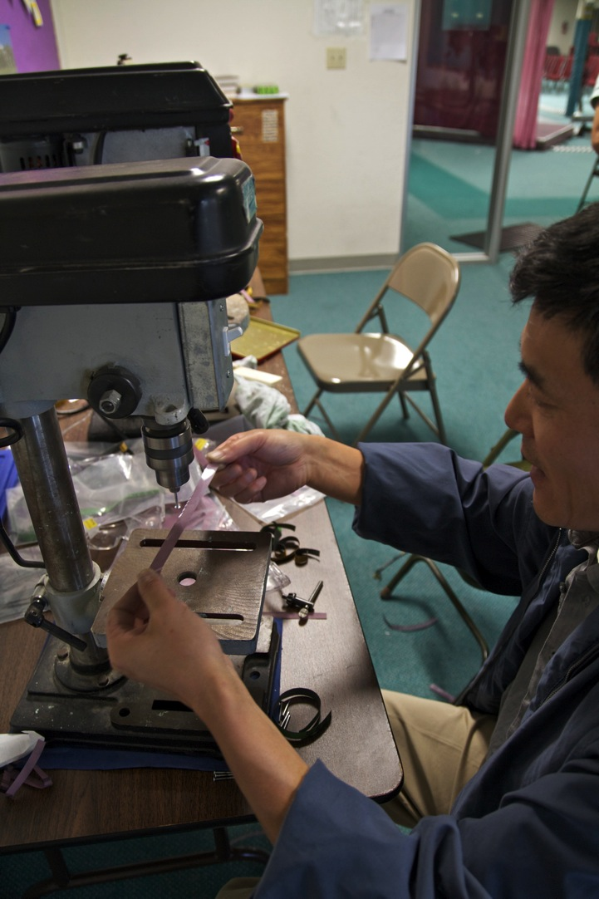
7. Polish axles

Slide 11
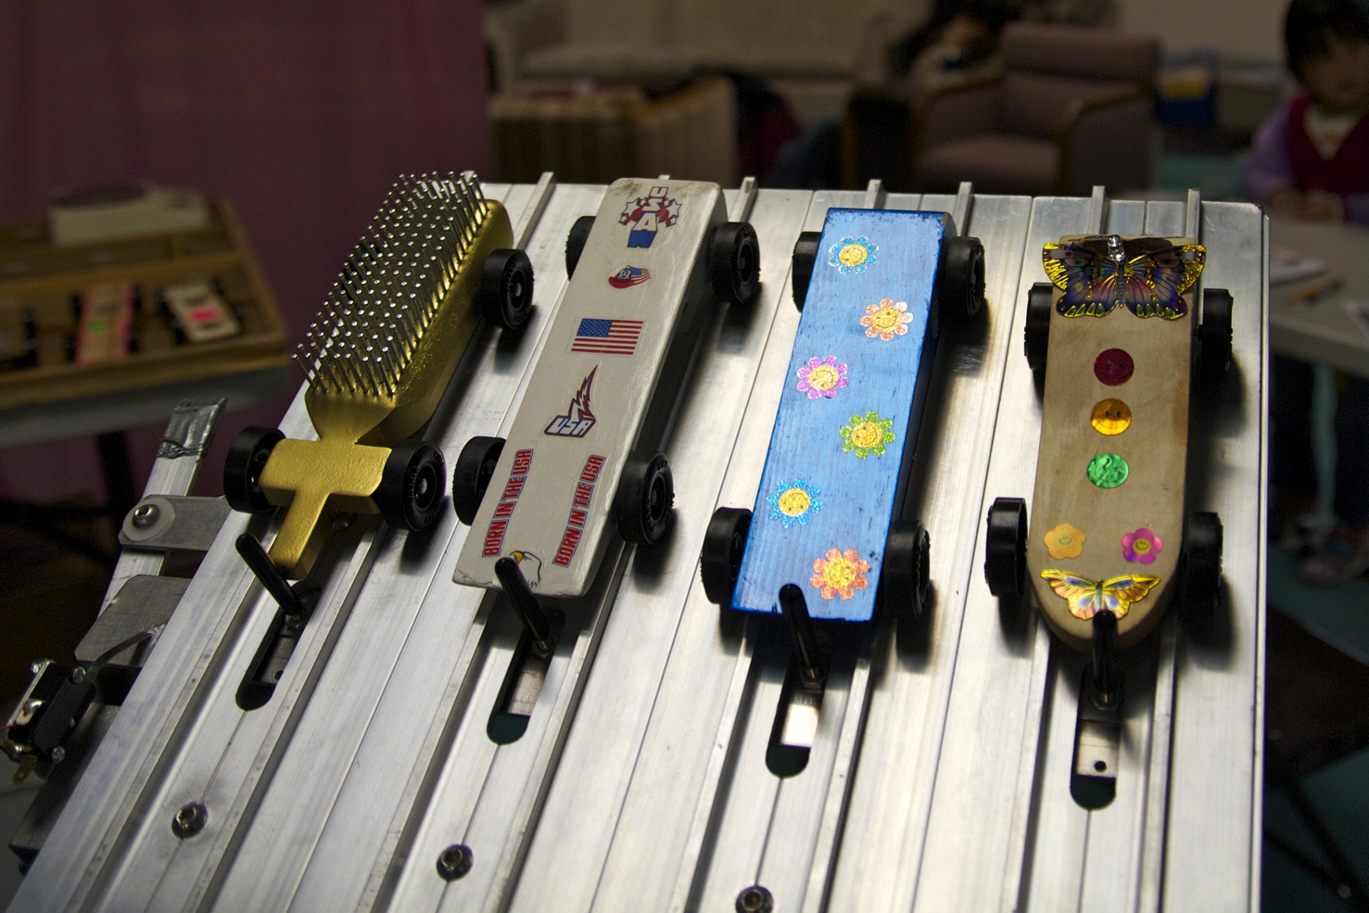
8. Add wheel & Test Run

Slide 12
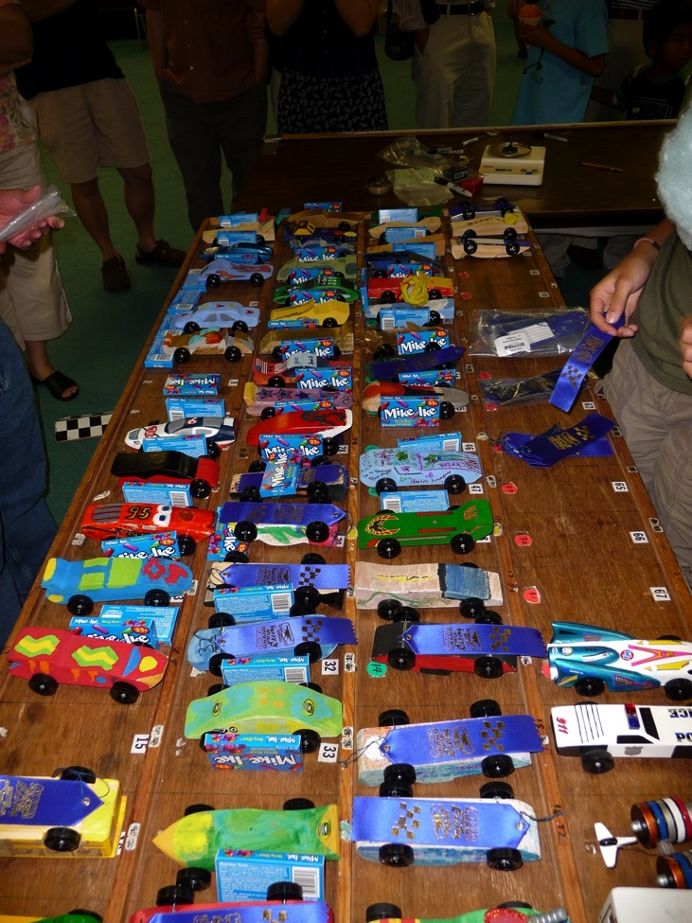
Derby Tips
for Speed

Slide 13
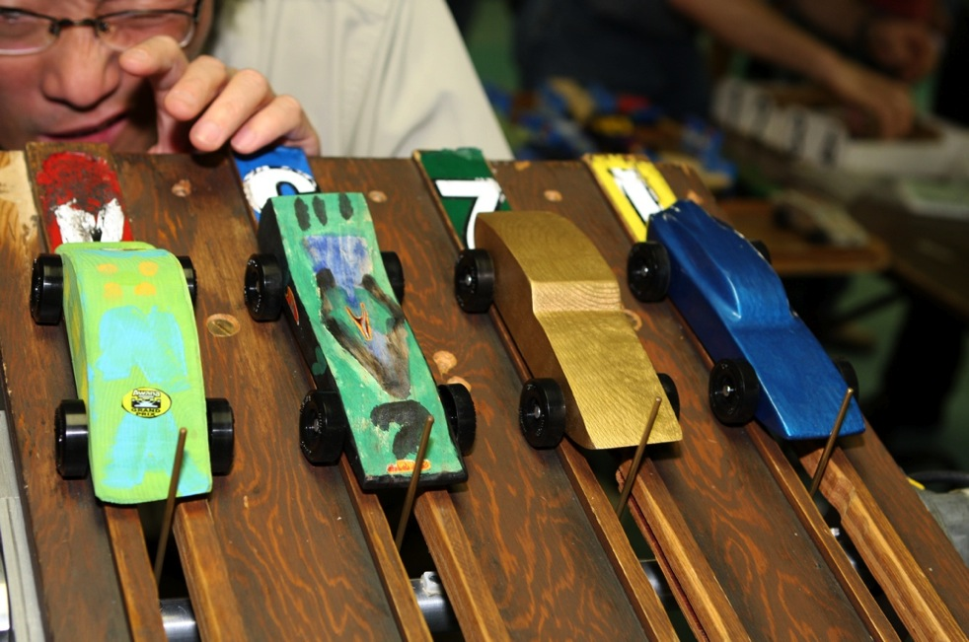

Weight
Maximum Weight - 5.0 oz.
Add weight toward the end of the car

Slide 14
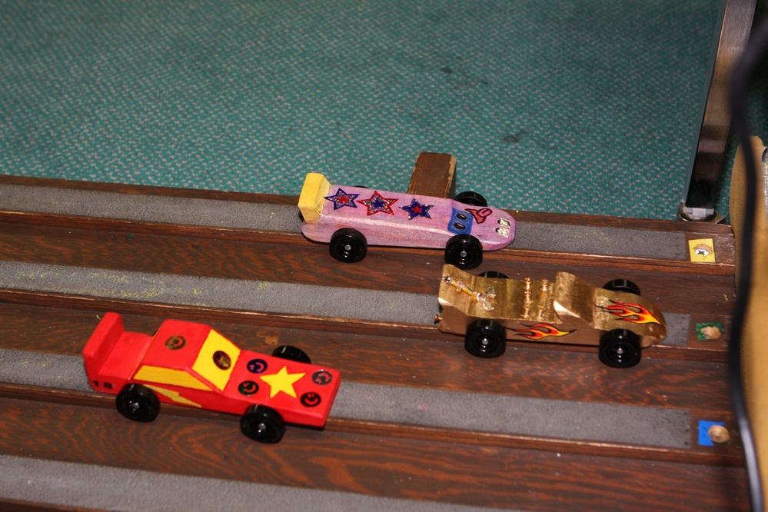
Balance
Put wheels and axles on straight!
Drill hole in the center

Slide 15
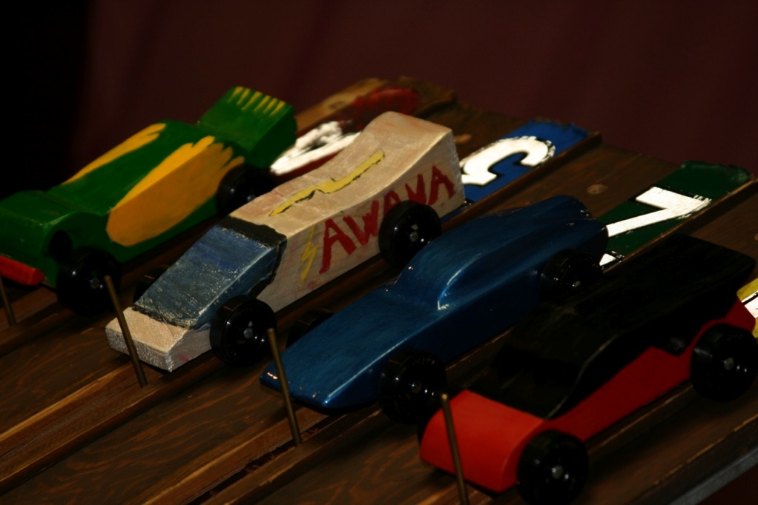
Reduce Friction
Polish axles and all rubbing surfaces
Use Pledge as lubricant

Slide 16

And more...
Increase the wheel base
Minimize wind resistance
Ride on 3 wheels

