Slide 1
Project Management Tool
1/34
End-to-End Training Guide Value Stream Driven | 18 Tabs | 8 Roles Configurable Workflows | Role-Based Access 📥 Demand → 📋 Requirement → 📁 Project → ⚡ Epic → 📝 Story → 🚀 Release
Project Management Tool — Training Guide

Slide 2
What is the Project Management Tool?
2/34
A comprehensive platform for managing the full delivery lifecycle from demand intake through to production release. 📥 Demand Intake — anyone can submit a demand against an application 🔄 Configurable Workflow — each Value Stream defines its own approval process 📁 Project Management — pipeline tracking with governance checkpoints ⚡ Agile Delivery — Epics & User Stories with story points 🚀 Release Management — sprint tracking & signoff workflow 📊 Portfolio View — holistic view across all value streams 👤 Role-Based Access — 8 roles with tailored dashboards 📋 18 Tabs — each role sees only their relevant pages
Project Management Tool — Training Guide

Slide 3
How to Read This Guide
3/34
This training guide is organized by ROLE — find your role and review your responsibilities, tabs, and actionable items. 👤 Who You Are → What You See → What You Can Do Slides 4-5: Role matrix & dashboard actions Slides 6-13: Individual role deep-dives Slides 14+: Feature & page walkthroughs 💡 TIP: Use the role selector in the app header to switch between roles and see the tool from different perspectives. (Header dropdown → selected role persists in localStorage)
Project Management Tool — Training Guide

Slide 4
Role Access Matrix
4/34
Tab/Feature Adm VSPMO VSO PO DL BA RM ITSO ──────────────────────────────────────────────────── 📊 Dashboard ✅ ✅ ✅ ✅ ✅ ✅ ✅ ✅ 📈 Portfolio ✅ ✅ ✅ ✅ ✅ ✅ ✅ ✅ 📥 Demand ✅ ✅ ✅ ✅ ✅ ✅ — — 🎯 Capabilities ✅ ✅ ✅ — ✅ ✅ — — 📦 Products ✅ ✅ ✅ ✅ ✅ ✅ ✅ ✅ 📁 Projects ✅ ✅ ✅ ✅ ✅ ✅ ✅ ✅ 📋 Requirements ✅ ✅ ✅ ✅ ✅ ✅ ✅ ✅ ⚡ Epics ✅ ✅ ✅ ✅ ✅ ✅ ✅ ✅ 📝 Stories ✅ ✅ ✅ ✅ ✅ ✅ ✅ ✅ ⚠️ Risks ✅ ✅ ✅ ✅ ✅ ✅ ✅ ✅ 🔗 Dependencies ✅ ✅ ✅ ✅ ✅ ✅ ✅ ✅ 🚀 Releases ✅ ✅ ✅ ✅ ✅ ✅ ✅ ✅ 📋 Sprint Board ✅ ✅ ✅ ✅ ✅ ✅ ✅ ✅ ✅ Governance ✅ ✅ ✅ ✅ ✅ ✅ ✅ ✅ 👥 Resources ✅ ✅ ✅ — ✅ ✅ — — 👤 Users ✅ — — — ✅ — — — 🧪 Test ✅ — — — — — — — ⚙️ Config ✅ — — — — — — — ──────────────────────────────────────────────────── Tab Count 18 15 14 13 16 14 12 12 🔒 Lock/Unlock Project ✅ ✅ ✅ — — — — — 📦 Backlog (Unlink) ✅ ✅ ✅ — — — — —
Project Management Tool — Training Guide

Slide 5
Dashboard Action Items by Role
5/34
What each role sees on their Dashboard Action Items panel: 👑 Admin: All pending demands (Triage/Assess/Approve/Convert) + Pending release signoffs + project completion stats 🏢 Value Stream PMO: Demands to Approve + Pending Signoffs (oversees all value streams, unfiltered views) 🌊 Value Stream Owner: Demands to Approve + Pending Signoffs (filtered to their assigned value streams) 📦 Product Owner: Demands to Approve + Pending Signoffs 🚀 Delivery Lead: Demands to Triage/Assess/Convert + Pending Signoffs 📊 Business Analyst: Submitted Demands (view only) 🔖 Release Manager: Pending Signoffs only 🔒 ITSO: Assessed + PSC Review demands (security review) 💡 Each card auto-navigates to the relevant tab on click
Project Management Tool — Training Guide

Slide 6
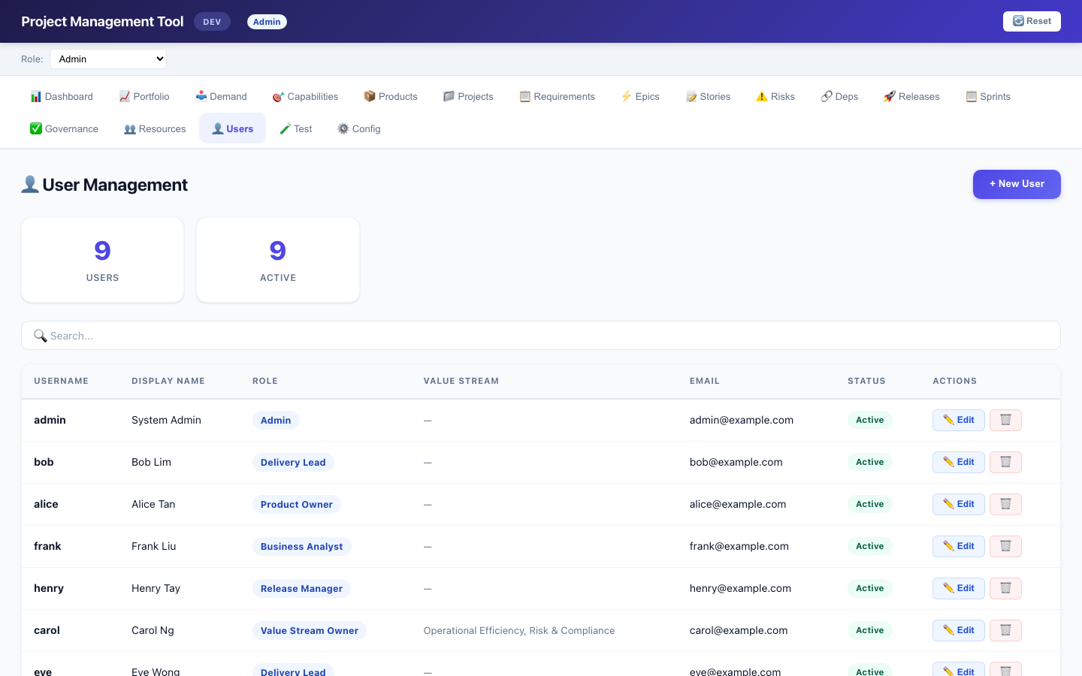
👑 Admin — System Administrator
Full access — all 18 tabs, all actions
6/34
RESPONSIBILITIES: • Configure the entire system via ⚙️ Config tab • Manage users and their roles (👤 Users tab) • Approve demands, manage releases, oversee governance • 🔒 Can lock/unlock projects (prevents new requirements + edits) • 📦 Can move requirements back to Backlog TABS: All 18 — Dashboard, Portfolio, Demand, Capabilities, Products, Projects, Requirements, Epics, Stories, Risks, Dependencies, Releases, Sprints, Governance, Resources, Users, Test, Config KEY ACTIONS: • 📥 Demand: Full workflow — Triage, Assess, Approve, Convert, Reject • 🚀 Release: Full lifecycle — Create, Open, Review, Complete, Signoff • ✅ Governance: Full edit (status, owner, dates) • 👤 Users: Create/Edit/Delete users, assign roles • ⚙️ Config: Add/edit/remove configuration entries DASHBOARD: All pending items across every entity
Project Management Tool — Training Guide

Slide 7
🏢 Value Stream PMO
Cross-VS oversight — like Admin without Config/Users
7/34
RESPONSIBILITIES: • Cross-VS oversight — sees all value streams unfiltered • Approve demands across any value stream • Manage resources and review governance • 🔒 Can lock/unlock projects • 📦 Can move requirements back to Backlog TABS (15): Dashboard, Portfolio, Demand, Capabilities, Products, Projects, Requirements, Epics, Stories, Risks, Dependencies, Releases, Sprints, Governance, Resources KEY DIFFERENCES FROM ADMIN: • ❌ Cannot access Config tab • ❌ Cannot manage users • ❌ No Test tab access • ✅ Everything else same as Admin DASHBOARD: Demands to Approve + Pending Signoffs across all VS
Project Management Tool — Training Guide

Slide 8
🌊 Value Stream Owner (VSO)
Owns one or more value streams — approves demands within their VS
8/34
RESPONSIBILITIES: • Oversee demands across their assigned value streams • Approve demands that have been assessed (Assessed → Approved) • Review Portfolio and Sprint views filtered to their VS • Monitor risks, dependencies, and governance for their VS products • 🔒 Can lock/unlock projects within their VS • 📦 Can move requirements back to Backlog within their VS TABS (14): Dashboard, Portfolio, Demand, Products, Projects, Capabilities, Requirements, Epics, Stories, Risks, Dependencies, Releases, Sprints, Governance KEY ACTIONS: • 📥 Demand: Approve + Reject demands • 🚀 Release: Signoff pending stories • 📈 Portfolio: Sees only their assigned value stream products • 📋 Sprints: Sees only their assigned VS products • ✅ Governance: Full edit CONFIG: Assign value streams via 👤 Users tab (pm_valuestream field — comma-separated VS config IDs)
Project Management Tool — Training Guide

Slide 9
📦 Product Owner (PO)
Owns specific products — approves demands, signs off releases
9/34
RESPONSIBILITIES: • Product-level demand approval (Assessed → Approved) • Sign off on release items (✍️ Signoff button) • Review epics and stories for their products • ❌ Cannot lock/unlock projects • ❌ Cannot move requirements to Backlog TABS (13): Dashboard, Portfolio, Demand, Products, Projects, Requirements, Epics, Stories, Risks, Dependencies, Releases, Sprints, Governance KEY ACTIONS: • 📥 Demand: Approve + Reject (only these two workflow actions) • 🚀 Release: Signoff pending stories (✍️ Signoff button) • ✅ Governance: Can edit items • 📦 Products: View, edit, manage product details NOTE: Cannot create/edit demands, cannot triage or assess DASHBOARD: Demands to Approve + Pending Release Signoffs
Project Management Tool — Training Guide

Slide 10
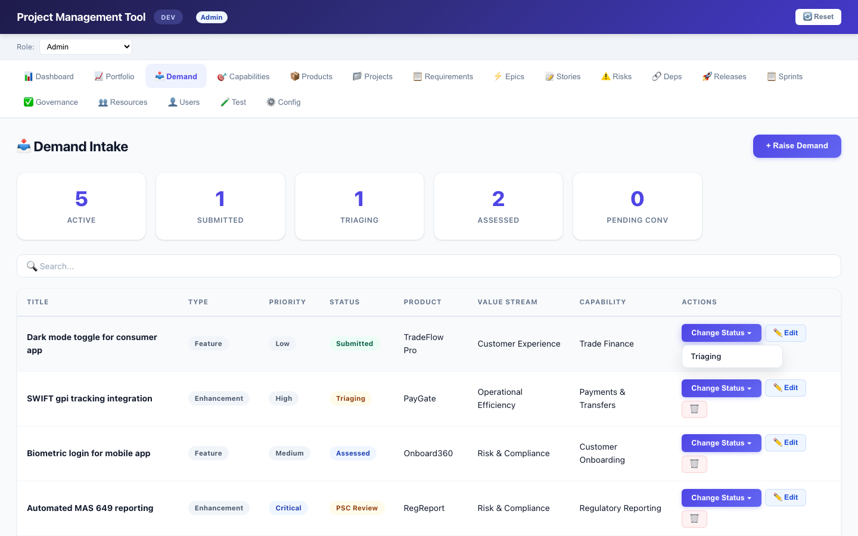
🚀 Delivery Lead (DL)
Manages delivery — projects, epics, resources, releases
10/34
RESPONSIBILITIES: • Own demand workflow: Triage → Assess → Convert • Manage projects, epics, stories, resources • Register stories into releases • Review governance checklists • ❌ Cannot lock/unlock projects • ❌ Cannot move requirements to Backlog TABS (16): Dashboard, Portfolio, Demand, Products, Projects, Capabilities, Requirements, Epics, Stories, Risks, Dependencies, Releases, Sprints, Governance, Resources, Users KEY ACTIONS: • 📥 Demand: Triage, Assess, Convert, Reject (+ Raise Demand) • 🚀 Release: Register stories (+ Create/Edit/Delete releases) • ✅ Governance: Full edit all items • 👥 Resources: Full CRUD • 👤 Users: Can manage users and their roles DASHBOARD: Demands to Triage/Assess/Convert + Pending Signoffs
Project Management Tool — Training Guide

Slide 11
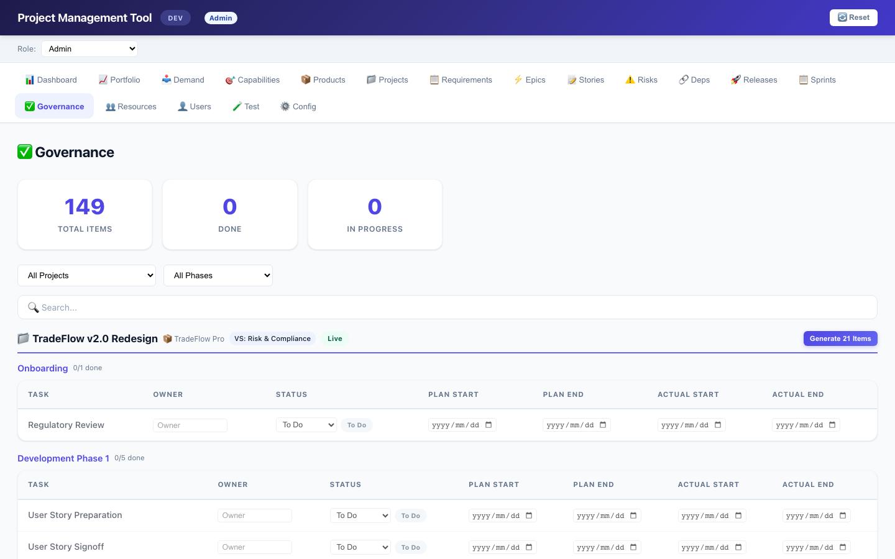
📊 Business Analyst (BA)
Raises demands, analyzes requirements — read-only on most views
11/34
RESPONSIBILITIES: • Raise new demands (+ Raise Demand button) • View demand status and track progress • Review requirements and products • ❌ Cannot edit existing items (except own demands) • ❌ Cannot lock/unlock projects • ❌ Cannot move requirements to Backlog TABS (14): Dashboard, Portfolio, Demand, Products, Projects, Capabilities, Requirements, Epics, Stories, Risks, Dependencies, Releases, Sprints, Governance KEY ACTIONS: • 📥 Demand: Can raise new demands (Submit) • ❌ Cannot edit existing demands / Triage/Assess/Approve/Reject • ✅ Governance: READ-ONLY (inputs disabled, Generate hidden) • All other views: READ-ONLY DASHBOARD: Submitted demands only SPRINT BOARD: Only shows products linked to their demands
Project Management Tool — Training Guide

Slide 12
🔖 Release Manager (RM)
Manages release lifecycle and signoffs
12/34
RESPONSIBILITIES: • Full release lifecycle: Create → Open → Review → Complete • Sign off on release items • Register stories into releases • ❌ No access to 📥 Demand tab • ❌ Cannot lock/unlock projects • ❌ Cannot move requirements to Backlog TABS (12): Dashboard, Portfolio, Products, Projects, Requirements, Epics, Stories, Risks, Dependencies, Releases, Sprints, Governance KEY ACTIONS: • 🚀 Release: ALL actions — Create, Open, Review, Complete, Signoff, Register • ✅ Governance: Can edit items • All other tabs: View-only DASHBOARD: Pending signoffs only
Project Management Tool — Training Guide

Slide 13
🔒 ITSO — IT Security Officer
Reviews demands and risks from a security perspective
13/34
RESPONSIBILITIES: • Security review of demands in Assessed or PSC Review status • Monitor risks and dependencies across all products • Review requirements for security compliance • ❌ Cannot create/edit/change status on demands • ❌ Cannot lock/unlock projects TABS (12): Dashboard, Portfolio, Products, Projects, Requirements, Epics, Stories, Risks, Dependencies, Releases, Sprints, Governance KEY ACTIONS: • 📥 Demand: READ-ONLY (cannot create/edit/change status) • ⚠️ Risks & 🔗 Dependencies: View-only • ✅ Governance: READ-ONLY • ❌ No Demand tab access (uses Dashboard for security review) DASHBOARD: Demands in Assessed + PSC Review status (for security review purposes)
Project Management Tool — Training Guide

Slide 14
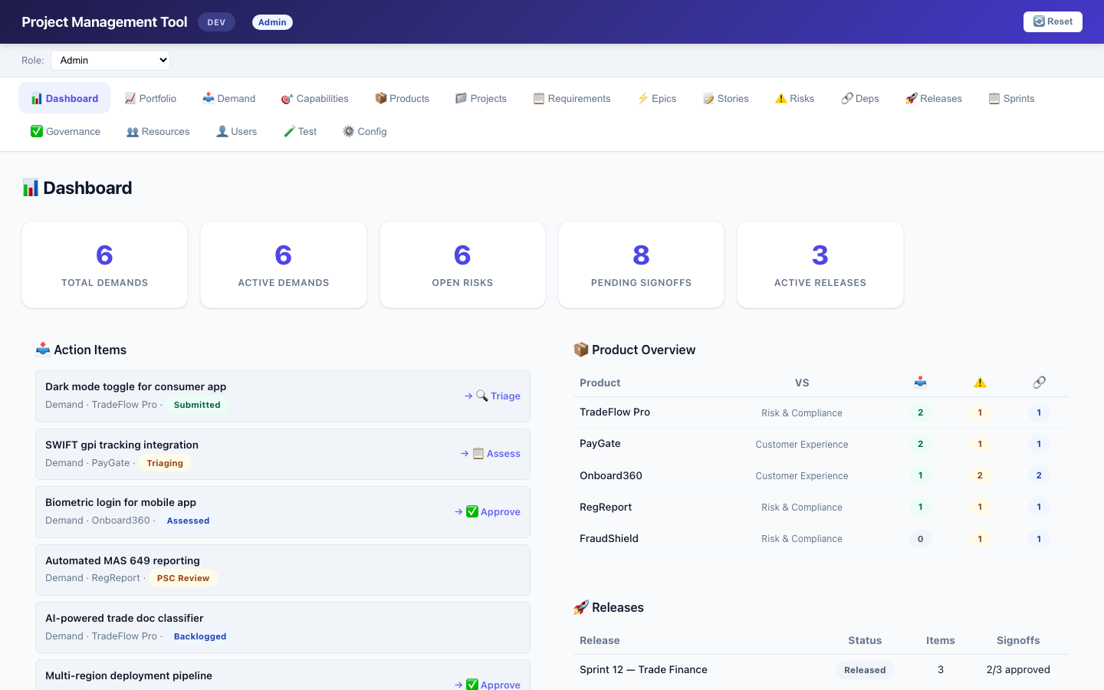
📊 Dashboard
Role-filtered action items and key metrics
14/34
PURPOSE: Central landing page showing each user's actionable items based on their role. COMPONENTS: • Action Items panel — role-filtered demands requiring attention (e.g., Admin sees all pending; VSO sees only their VS demands) • Product Health — status of all products • Releases Snapshot — upcoming and in-review releases • Clickable cards — clicking navigates to the relevant tab ROLE FILTERING: • Each role sees different action items (see Slide 5) • Items auto-navigate to the relevant view for deeper action ACCESS: All 8 roles
Project Management Tool — Training Guide

Slide 15
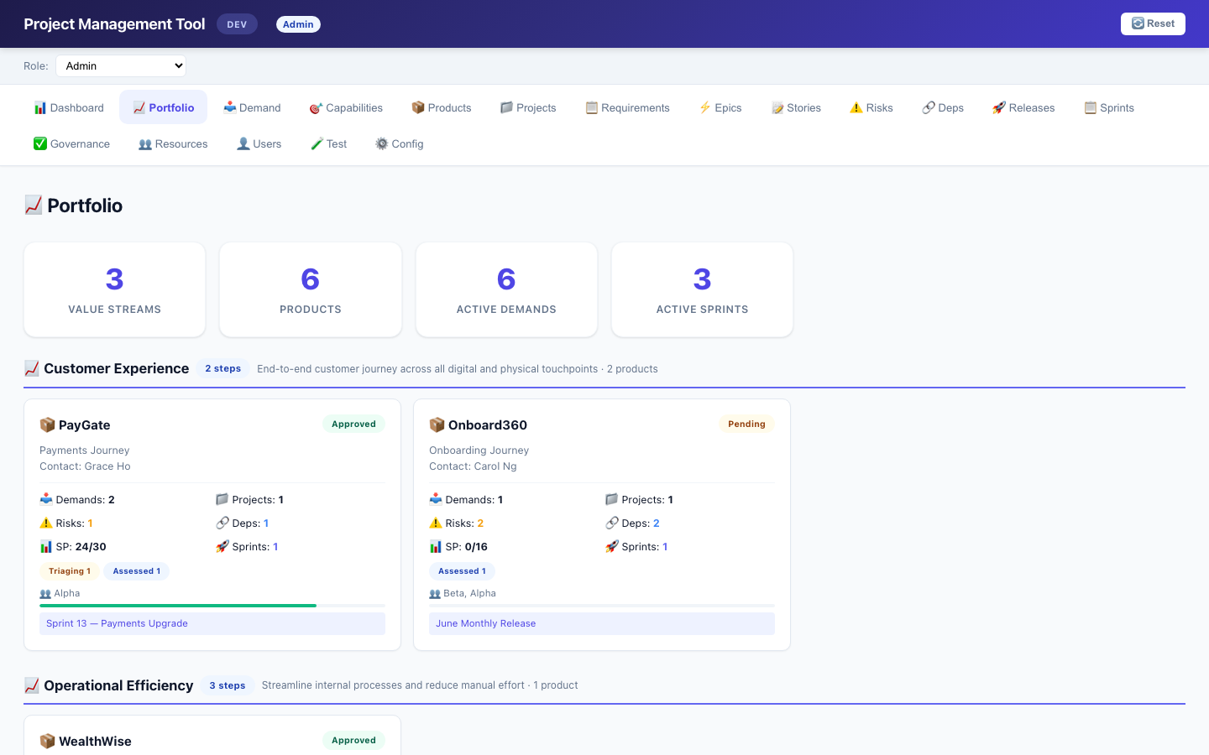
📈 Portfolio View
Value Stream grouped product cards with holistic metrics
15/34
PURPOSE: Executive-level view of products grouped by Value Stream. PER-PRODUCT CARD: • Demand count with status breakdown (Submitted/Triaging/etc.) • Project count (active vs live) • Story Points: done/total with progress bar • Teams involved (derived from assignment chain) • Active sprints count • Risk & dependency counts VALUE STREAM HEADER: • Flow step count badge (e.g. '3 steps') • Product count within that VS ROLE FILTERING: • VSO: only their assigned value stream products • All others: full view Click any card → navigates to Products tab
Project Management Tool — Training Guide

Slide 16
📥 Demand Intake
Configurable workflow per Value Stream
16/34
PURPOSE: Submit & manage demands through configurable approval flows. HOW TO RAISE: 1. Click + Raise Demand 2. Fill Title, Detail, Type, Priority 3. Select Value Stream (determines workflow steps) 4. Select Product 5. Save → status set to first flow step WORKFLOW BY VALUE STREAM: • Customer Experience: Submitted → Triaging (2 steps) • Operational Efficiency: Submitted → Triaging → Assessed (3 steps) • Risk & Compliance: Submitted → Triaging → Assessed → PSC (4 steps) STATUS CONTROL: • Intermediate steps: popup shows only flow progression options • Final step: popup shows ✅ Approve, 📥 Backlog, ❌ Reject ⚙️ CONFIG: Edit demand_flow entries in Config tab
Project Management Tool — Training Guide

Slide 17
📥 Demand Workflow Diagram
Flow steps → terminal actions → convert
17/34
Workflow Patterns by Value Stream
Customer Experience (2 steps)
✅ Approve
Submitted
Triaging
📥 Backlog
Operational Efficiency (3 steps)
Submitted
Terminal >>
Triaging
Assessed
❌ Reject
Risk & Compliance (4 steps)
Submitted
Triaging
Terminal >>
Assessed
PSC Review
Convert Modal
Terminal >>
Flow Step
Approve
Backlog
Reject
Convert
Requirement (linked) or Backlog (unlinked)
💡 At intermediate steps: only flow progression options shown. At the FINAL step: terminal actions appear (Approved / Backlog / Reject). Convert creates a Requirement (linked to project) or Backlog item (unlinked).
Project Management Tool — Training Guide

Slide 18
🎯 Capabilities
Business capability catalog
18/34
PURPOSE: Define and manage business capabilities that link products, demands, and requirements together. FEATURES: • Create/Edit/Delete capabilities • Each capability has: Name, Description, Type, Cost • Capability Type sourced from config (capability_type) • Capability-Product links via linking table (one capability can serve multiple products) USAGE IN WORKFLOW: • Demands reference a capability • Requirements reference a capability • Capabilities bridge business needs to product delivery ACCESS: Admin, VSPMO, VSO, DL, BA (5 roles)
Project Management Tool — Training Guide

Slide 19
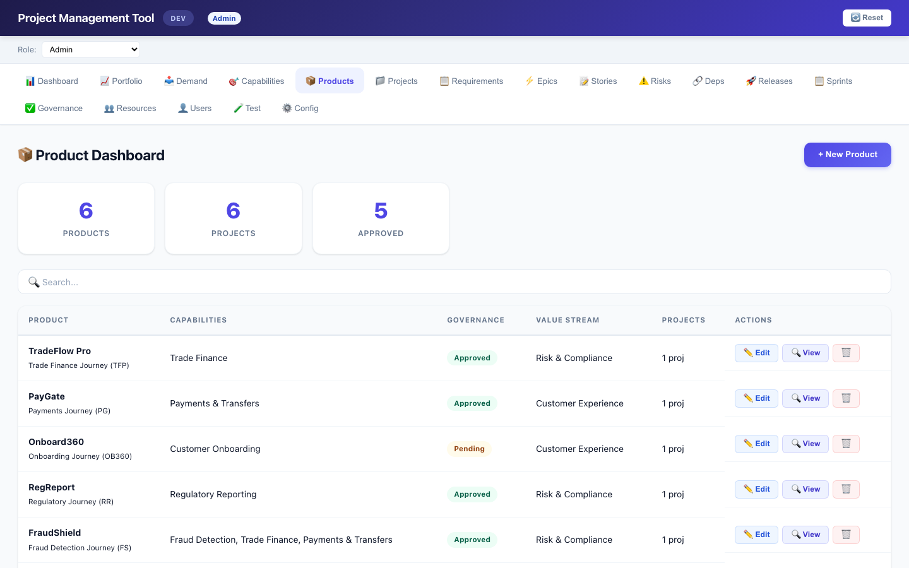
📦 Products
Application catalog linked to Value Streams
19/34
PURPOSE: Manage the product/application portfolio. FEATURES: • Create/Edit/Delete products • Each product has: Name, Short Name, Journey Name • Linked to a Value Stream (drives governance template) • Governance Status and Contact fields • Capability-Product links (assign capabilities to products) RELATIONSHIPS: • Products are the target of Demands (pm_product) • Projects are linked to products (pm_productname) • Governance templates auto-detect from product's VS ACCESS: All 8 roles (editing limited by role permissions)
Project Management Tool — Training Guide

Slide 20
📁 Projects
Pipeline tracking with lock/unlock and governance
20/34
PURPOSE: Manage delivery projects with pipeline status and scope control. FEATURES: • Create/Edit/Delete projects • Pipeline Board view (PipelineBoard component) • Each project has: Name, Product, Status, Completion %, Enhancement Type, Priority, Scope, Year/Quarter • Gov Template override (auto-detect from VS or explicit) • 🔒 Lock/Unlock button (Admin/VSPMO/VSO only) — Locked: no new requirements, no edits to existing ones — Unlinked requirements can still be moved out (descope) EXPAND ROW: Shows linked requirements with status badges ACCESS: All 8 roles (lock/unlock restricted)
Project Management Tool — Training Guide

Slide 21
📋 Requirements (Backlog)
All/Linked/Backlog modes with priority and project linking
21/34
PURPOSE: Manage requirements — both unlinked (Backlog) and linked to projects (Requirements). SAME TABLE: pm_requirement serves double duty: • No pm_projectname → Backlog (status: Prioritized) • Has pm_projectname → Requirement (status: Linked) VIEW MODES: All | Linked | Backlog ACTIONS: • Link to Project — dropdown on backlog items → sets project + Linked (locked projects are hidden from the dropdown) • 📦 Backlog/Unlink — moves requirement back to backlog (Admin/VSPMO/VSO only; works even on locked projects) • ✏️ Edit — inline modal (blocked if project is locked) • Priority column for backlog ranking Expanded row shows linked epics and assignments
Project Management Tool — Training Guide

Slide 22
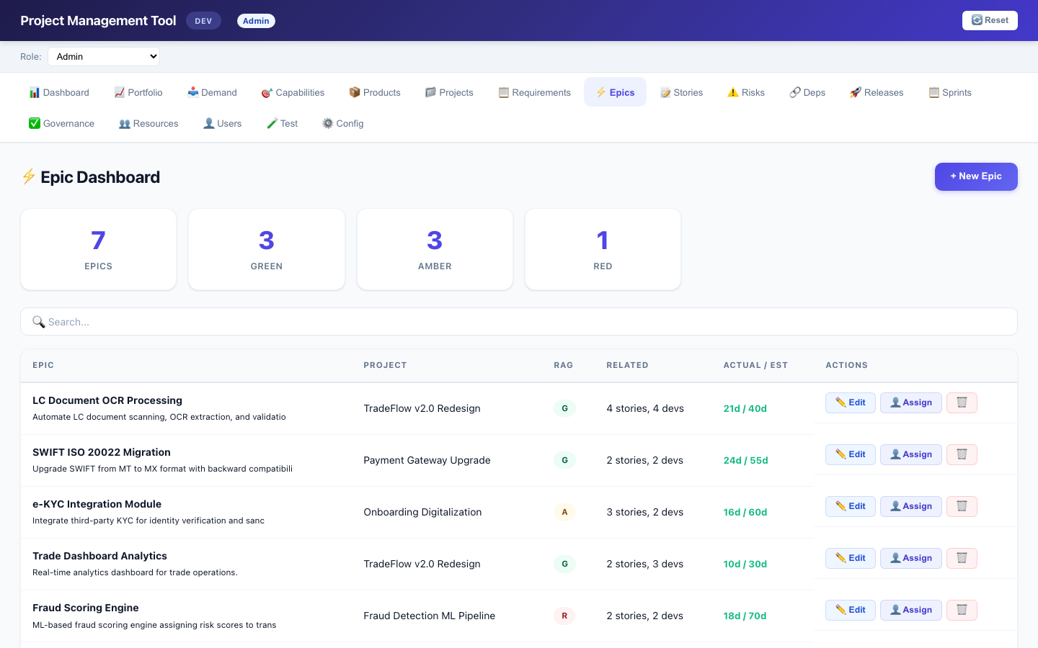
⚡ Epics
Project breakdown with effort estimation and RAG status
22/34
PURPOSE: Break down projects into manageable epics. FEATURES: • Create/Edit/Delete epics • Each epic has: Title, Detail, Project link • Jira Link for external tracking • Estimated Effort (days) • Release Date, Start Date, Completed Date • RAG Status (G/A/R) for health tracking RELATIONSHIPS: • Epics belong to a project • User Stories belong to an epic • Resource Assignments target epics (team membership derived from assignment→resource→team) ACCESS: All roles (except RM/ITSO cannot edit)
Project Management Tool — Training Guide

Slide 23
📝 User Stories
Detailed requirements with acceptance criteria and story points
23/34
PURPOSE: Detailed work items within epics. FEATURES: • Create/Edit/Delete user stories • Each story has: Detail, Epic link • Acceptance Criteria (UAC) — multi-line text • Story Points for estimation RELATIONSHIPS: • Stories link to epics (which link to projects) • Stories are registered into releases (via Release Items) • Sprint Board tracks story points per team×product USAGE IN SPRINT BOARD: • Completed story points = progress tracking • Acceptance criteria shown in sprint cards (truncated) ACCESS: All roles (edit restricted by role permissions)
Project Management Tool — Training Guide

Slide 24
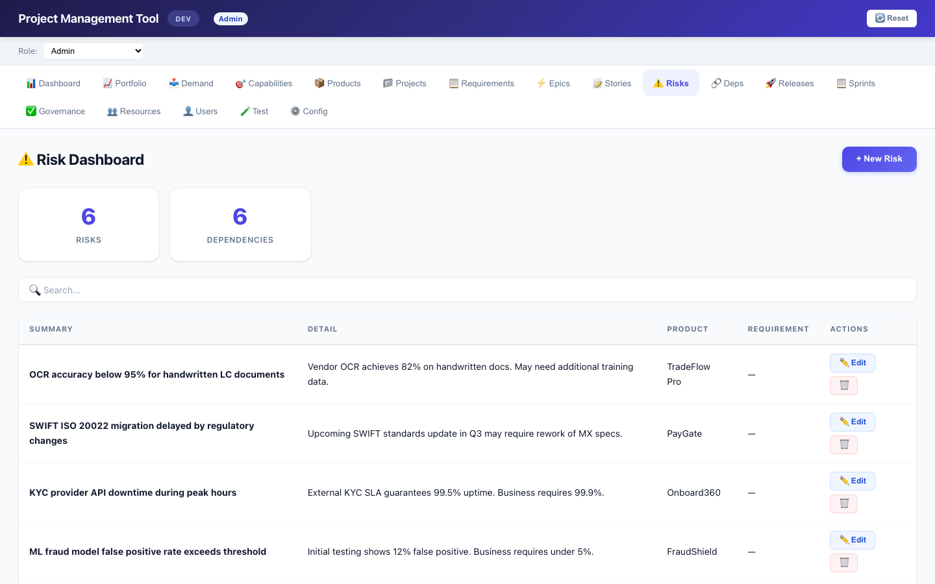
⚠️ Risks
Track risks linked to products and requirements
24/34
PURPOSE: Identify and monitor project risks. FEATURES: • Create/Edit/Delete risks • Each risk has: Summary, Detail • Linked to a Product • Optionally linked to a Requirement DASHBOARD INTEGRATION: • Risk counts shown on Portfolio product cards • Project rows show risk count in Related column ACCESS: All roles (edit restricted by role permissions)
Project Management Tool — Training Guide

Slide 25
🔗 Dependencies
Cross-product dependency tracking
25/34
PURPOSE: Track dependencies between products and requirements. FEATURES: • Create/Edit/Delete dependencies • Each dependency has: Summary, Detail • Linked to a Product • Optionally linked to a Requirement DASHBOARD INTEGRATION: • Dependency counts shown on Portfolio product cards • Helps identify cross-team blockers ACCESS: All roles (edit restricted by role permissions)
Project Management Tool — Training Guide

Slide 26
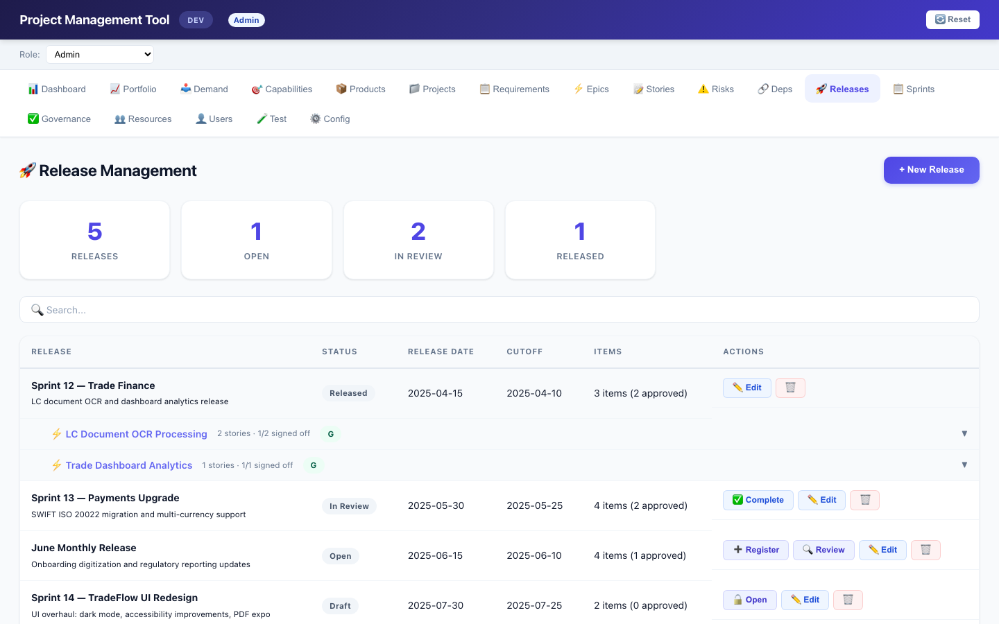
🚀 Release Management
Epic-grouped with signoff workflow
26/34
PURPOSE: Manage the release lifecycle from draft to released. LIFECYCLE: Draft → Open → In Review → Released (workflow buttons appear based on current status) REGISTERING STORIES: • Click ➕ Register on an Open release • Select unregistered user stories (grouped by epic) • Two-level expand: Release → Epics → Stories SIGNOFF WORKFLOW: • Individual story signoff: Pending → Approved / Rejected • ✍️ Signoff modal: Decision + Note • Signoff recorded with by/date metadata Click any row → expands epics → expands stories ACCESS: All roles (edit restricted)
Project Management Tool — Training Guide

Slide 27
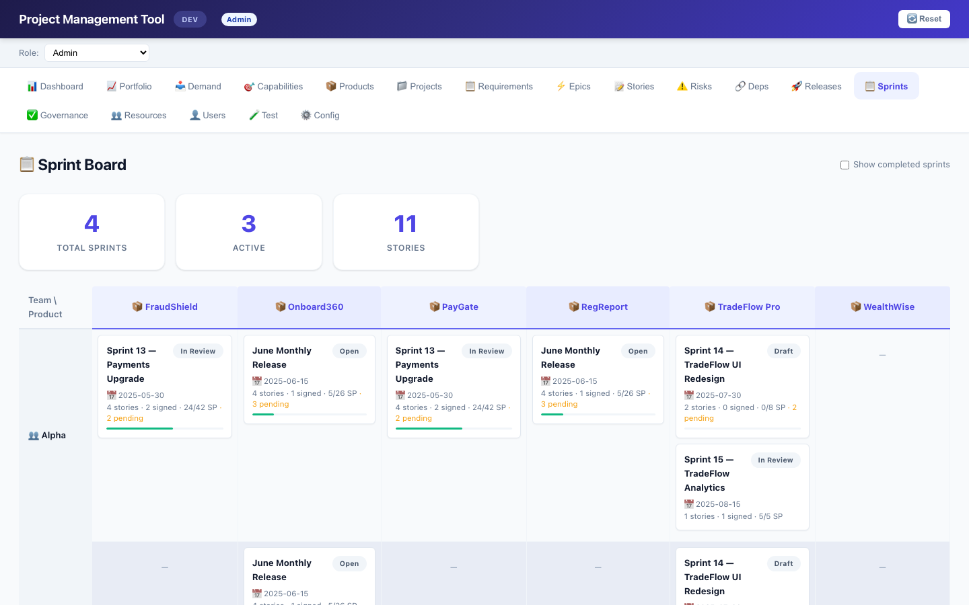
📋 Sprint Board
Team × Product matrix with SP tracking
27/34
PURPOSE: Visual grid showing teams vs products with sprint progress. HOW IT WORKS: • Teams (rows) derived from resource assignments → epics • Products (columns) from release items → stories → epics → projects → products SPRINT CARD SHOWS: • Sprint name & status badge • Release & cutoff dates • Story count & signoff progress • Story Points: completed/total (e.g., 21/26 SP) • Progress bar for pending signoffs FILTERS: • ☑ Active only toggle (hide Released sprints) • VSO: sees only their VS products • BA: sees only products with active demands Click card → navigates to Releases tab with auto-expand
Project Management Tool — Training Guide

Slide 28
✅ Governance Checklist
Config-driven phases and tasks per project
28/34
PURPOSE: Per-project governance tracking with configurable phases. TEMPLATE SYSTEM: • Each project has a governance template (auto-detect or explicit) • Template determines phases (from project_phase config) • Each phase has checklist items (from project_checklist config) • VS-specific or default templates available EDITING: • Status dropdown: To Do / In Progress / Done / N/A • Owner, Plan Start/End, Actual Start/End — inline editable • Config-only items auto-create on first edit • 'Generate N Items' creates all missing items at once FILTERS: • Project dropdown + Phase dropdown + Search bar ROLE: VSO sees only their VS projects; BA sees demand-linked projects; edit restricted to Admin/DL/VSO/PO/RM/VSPMO
Project Management Tool — Training Guide

Slide 29
👥 Resources
People management with team and department tracking
29/34
PURPOSE: Manage human resources / team members. FEATURES: • Create/Edit/Delete resources • Each resource has: Name, Role, Department, Team • Email, Joined/Leave dates • Cost (monthly) for budgeting • Status (Active/Inactive/On Leave) RELATIONSHIPS: • Resources assigned to epics via pm_assignment (allocation %, start/end dates) • Team derived from resource → determines Sprint Board rows ACCESS: Admin, VSPMO, DL, BA (plus Users tab for DL)
Project Management Tool — Training Guide

Slide 30
👤 Users & Roles
User management with role assignment
30/34
PURPOSE: Manage who can access the system and what they can do. FEATURES: • Create/Edit/Delete users • Each user has: Username, Display Name, Email • Role assignment (single role per user) • VSO users: assign value streams via checkboxes (pm_valuestream = comma-separated VS config IDs) • Status field (active/inactive) ROLES AVAILABLE: • Admin, Value Stream PMO, Value Stream Owner, Product Owner, Delivery Lead, Business Analyst, Release Manager, ITSO ROLE SELECTOR: • Header dropdown to switch roles (DEV mode) • Persisted in localStorage • Tab visibility and edit permissions change accordingly ACCESS: Admin, DL
Project Management Tool — Training Guide

Slide 31
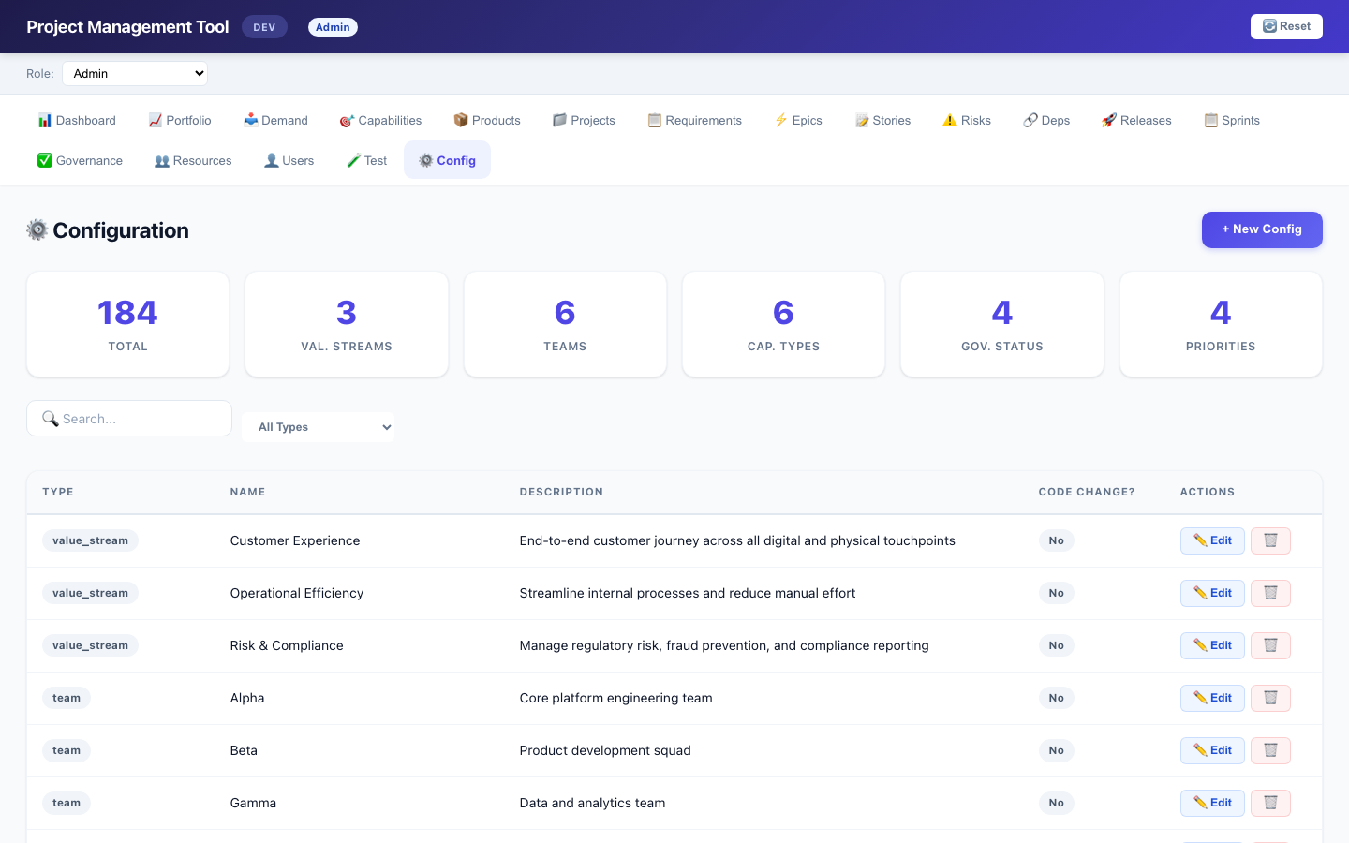
⚙️ Configuration
Manage all dropdown options and workflow definitions
31/34
PURPOSE: Central configuration for all configurable values. CONFIG TYPES (21): • value_stream, team, department, enhancement_type • capability_type, governance_status, priority • rag_status, requirement_status, psc_approval_status • signoff_status, resource_status, project_status • release_status, yes_no, tool, demand_type • demand_flow (workflow definitions) • user_role, project_phase, project_checklist WHAT YOU CAN DO: • Add new config entries (e.g., new priority level) • Edit existing entries • Delete unused entries • Change workflow steps (demand_flow) • Add/remove governance phases and checklist items 💡 Changes take effect immediately — no code changes needed ACCESS: Admin only
Project Management Tool — Training Guide

Slide 32
🔒 Project Lock & 📦 Requirement Unlink
Scope control — freeze and descope
32/34
PROJECT LOCK (🔒): • Toggle button on each project row in 📁 Projects • When locked (pm_locked = 'Yes'): — No new requirements can be linked to this project — Existing requirements cannot be edited — Locked projects hidden from 'Link to Project' dropdowns • 🔒 icon shown next to locked project names everywhere REQUIREMENT UNLINK (📦 Backlog): • Button on each linked requirement in 📋 Requirements • Clears pm_projectname, sets status to 'Prioritized' • Item returns to Backlog pool • Works even on locked projects (for descoping) WHO CAN DO IT: • 🔒 Lock/Unlock project: Admin, Value Stream PMO, Value Stream Owner • 📦 Move to Backlog: Admin, Value Stream PMO, Value Stream Owner
Project Management Tool — Training Guide

Slide 33
Getting Started — Quick Reference
33/34
1️⃣ RAISE A DEMAND: 📥 Demand → + Raise Demand → Select Value Stream (determines workflow) 2️⃣ ADVANCE WORKFLOW: Click Change Status on a demand → Last step (Approved) creates a Requirement 3️⃣ CREATE A PROJECT: 📁 Projects → + New Project → Assign a Governance Template if needed 4️⃣ MANAGE EPICS & STORIES: Break down requirements → Assign resources to epics (determines Sprint Board teams) 5️⃣ GOVERNANCE CHECKLIST: ✅ Governance → Generate Items or edit items individually 6️⃣ CREATE A RELEASE: 🚀 Releases → + New Release → Register stories, sign off when ready 7️⃣ VIEW SPRINTS: 📋 Sprint Board for Team×Product grid → Toggle 'Active only' as needed 8️⃣ CHECK PORTFOLIO: 📈 Portfolio for holistic VS view 9️⃣ LOCK PROJECT: 📁 Projects → 🔒 Lock button → Admin/VSPMO/VSO only 🔟 UNLINK REQUIREMENT: 📋 Requirements → 📦 Backlog → Moves item back to backlog pool 👤 SWITCH ROLE: Use role dropdown in header (DEV mode) 🔄 RESET DATA: Click 🔄 Reset in header to clear all seed data
Project Management Tool — Training Guide

Slide 34
Q&A
Thank You!
34/34
Key Concepts to Remember: • Workflows are CONFIGURABLE — edit in ⚙️ Config, no code changes • Roles determine WHAT you see and WHAT you can do • Dashboard shows only YOUR actionable items • Sprint Board shows team assignments via resource chain • Governance checklist is per-project with VS-specific templates • Demand → Requirement conversion happens on Approved status • Lock/Unlock is restricted to Admin/VSPMO/VSO roles • Unlink works even on locked projects (for descoping) Questions? Contact your system administrator.
Project Management Tool — Training Guide

