Slide 1
Project Management Tool
Training Guide
1/16
Value Stream Driven | 17 Tabs | 8 Roles | Configurable Workflows
Project Management Tool — Training Guide

Slide 2
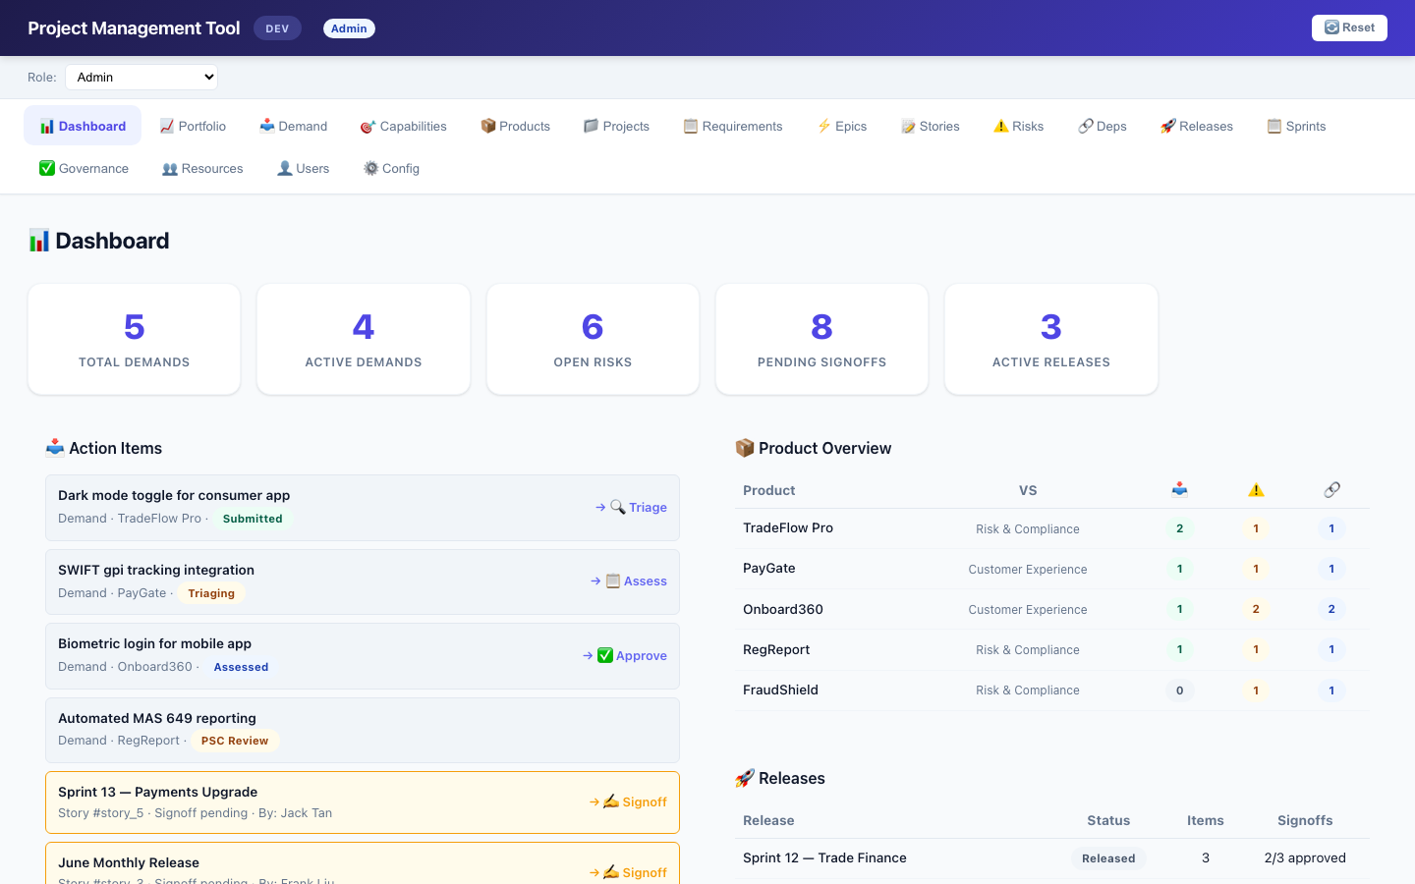
Overview
2/16
• 17 tabs covering the full delivery lifecycle • 8 roles with tab-level access control • 3 value streams with configurable workflows • Demand → Requirement → Project → Epic → Story → Release
Project Management Tool — Training Guide

Slide 3
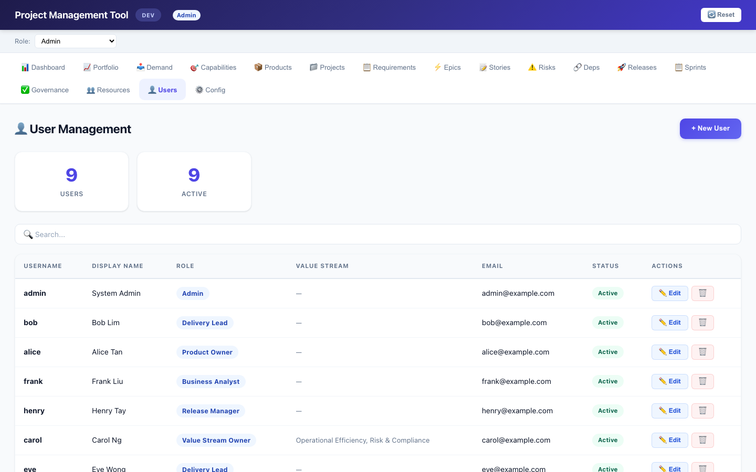
Roles & Access Control
3/16
• 8 roles: Admin, VS PMO, VSO, PO, DL, BA, RM, ITSO • Tab visibility per role (Admin 17, VSO 12, RM 12) • Role selector in header for DEV testing • Dashboard action items filtered by role • Governance edit permissions gated by role
Project Management Tool — Training Guide

Slide 4
Dashboard
4/16
• Stats cards: Total Demands, Active, Risks, Signoffs, Releases • Action Items: demands needing your attention (role-filtered) • Product Overview: per-product demand/risk/dep counts • Releases Snapshot: status, items, signoff progress • Click any item → navigates to that tab with auto-expand
Project Management Tool — Training Guide

Slide 5
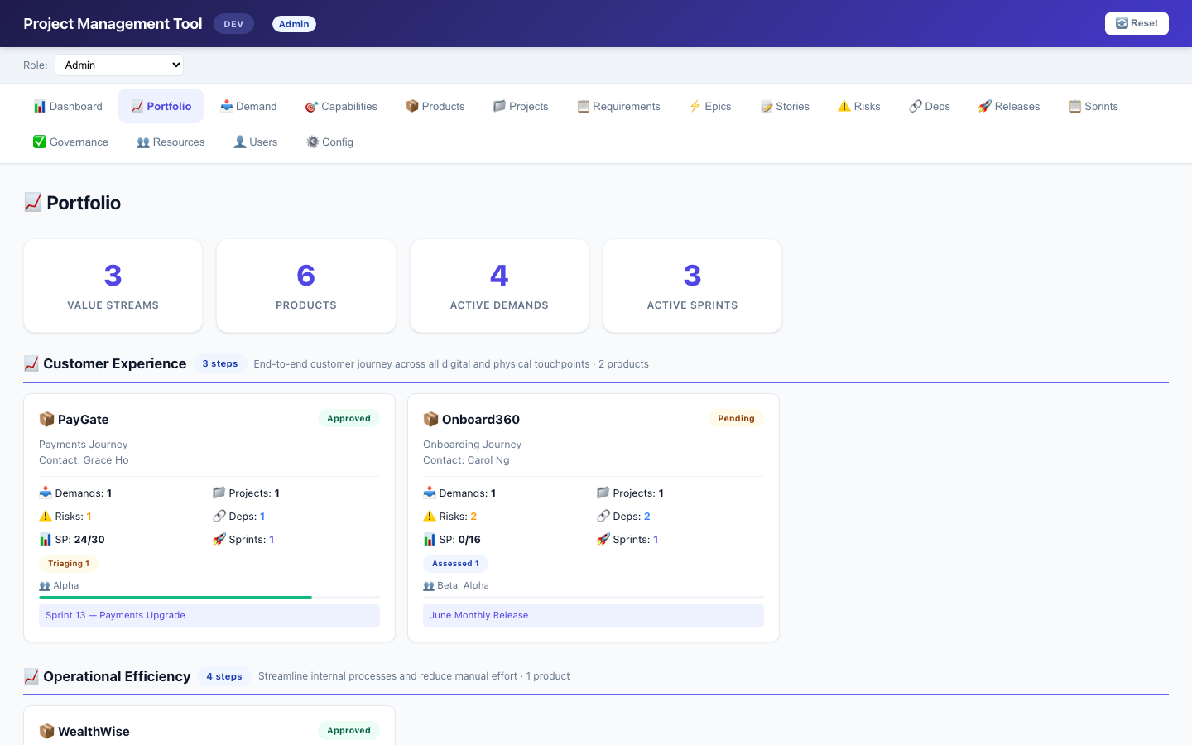
Portfolio View
5/16
• Value stream grouped product cards • Per product: demand count & status breakdown • Story Points: done/total with progress bar • Active sprints & teams involved • Demand flow step count per VS • VSO-filtered (only assigned value streams)
Project Management Tool — Training Guide

Slide 6
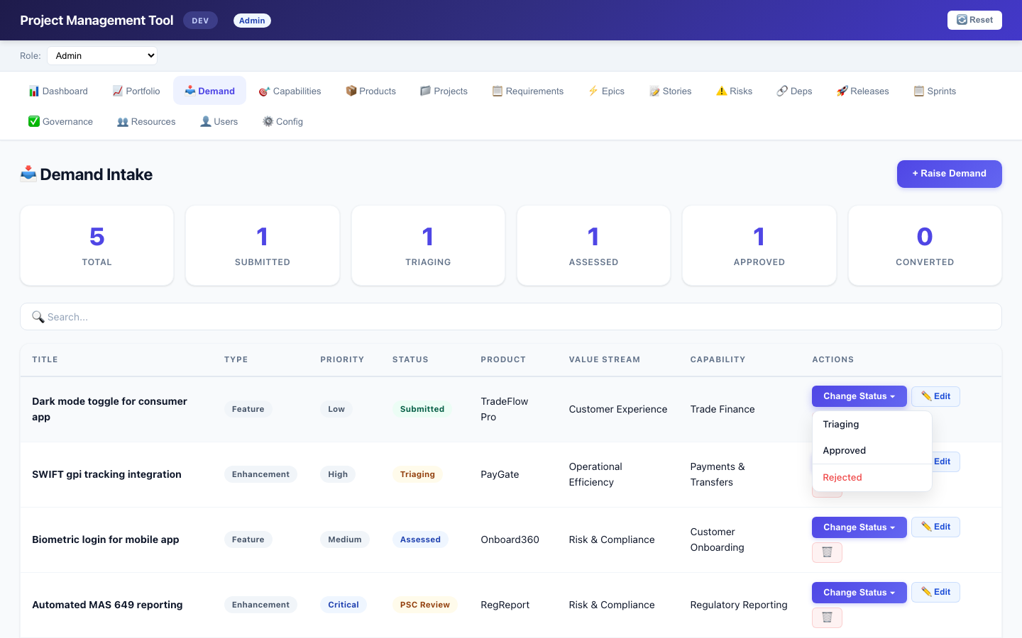
Demand Intake
6/16
• Submit demand against a Product (app) • Value Stream determines workflow steps • Change Status dropdown: all next steps from config • Approved = final step → opens 'Convert to Requirement' • Rejected always available • Fully configurable per value stream
Project Management Tool — Training Guide

Slide 7
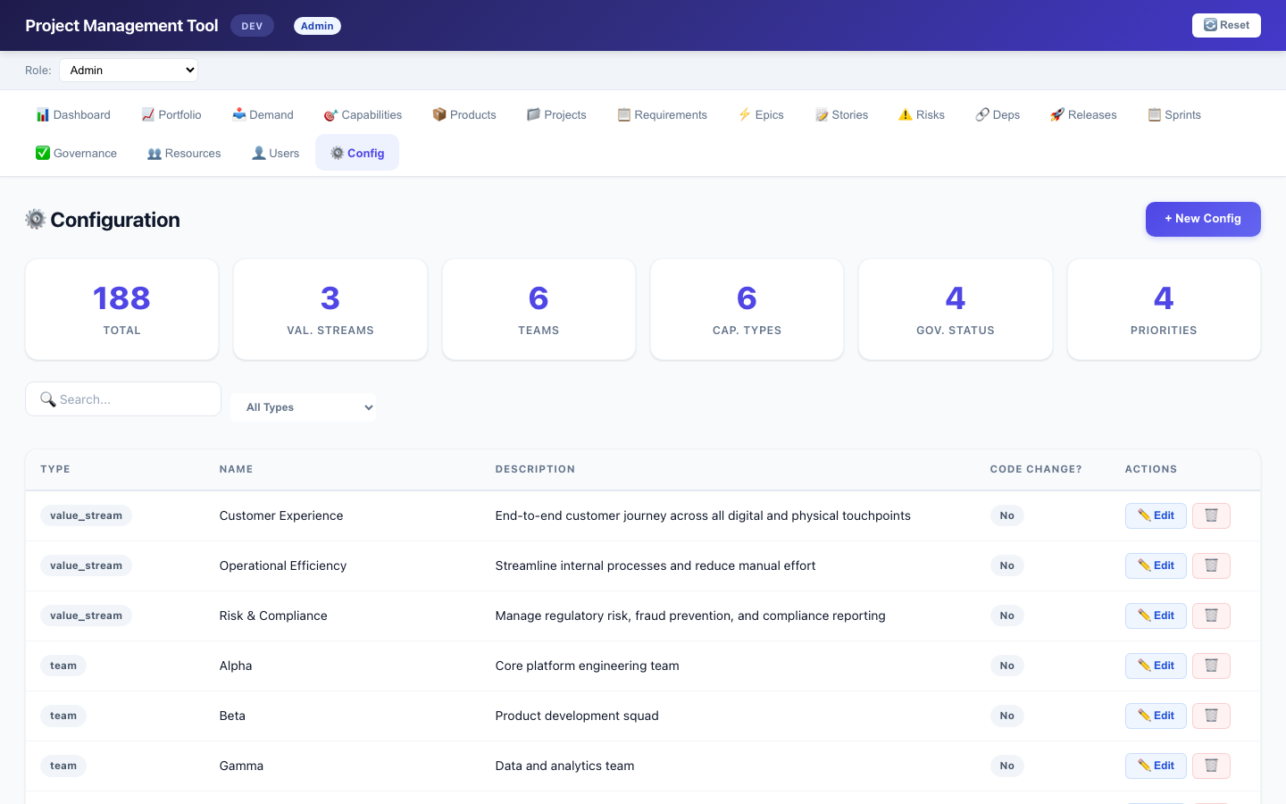
Demand Workflow (Config)
7/16
• Customer Experience: 4-step (Submitted→Triaging→Approved) • Operational Efficiency: 5-step (+Assessed) • Risk & Compliance: 6-step (+Assessed, +PSC Review) • Configured in demand_flow config • Add/remove steps without code changes • Status dropdown updates live when VS changes
Project Management Tool — Training Guide

Slide 8
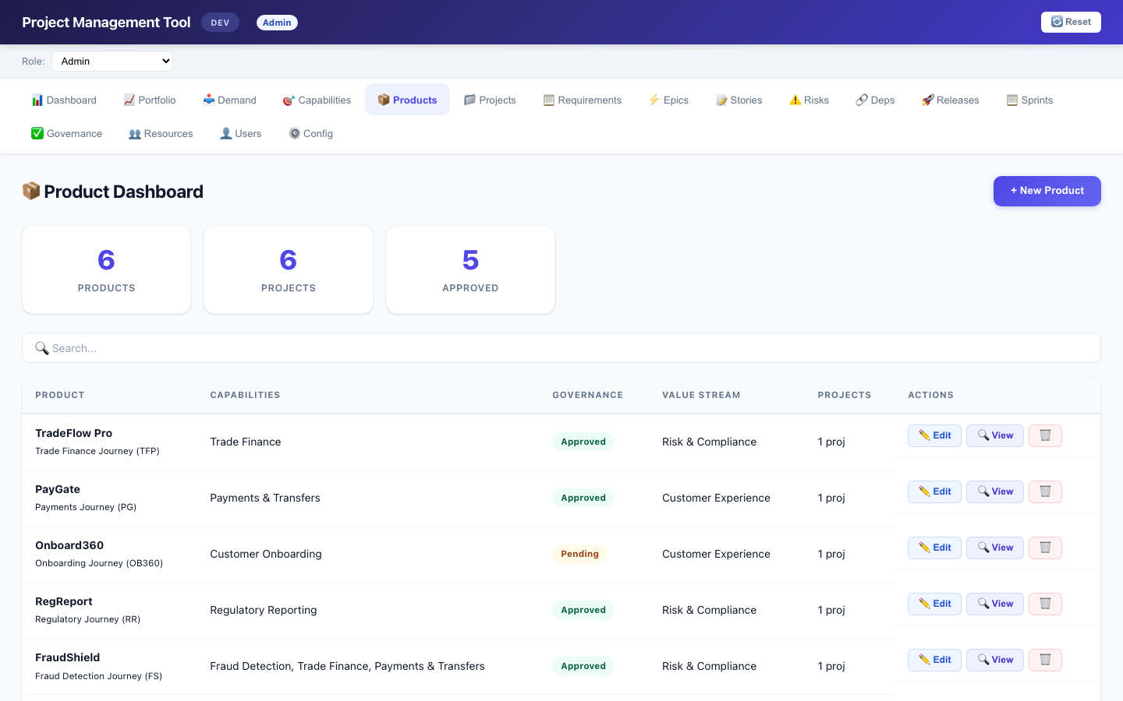
Products & Projects
8/16
• Products assigned to Value Streams • Products linked to Capabilities • Projects have pipeline: Onboarding→Dev1→Dev2→Review→Live • Pipeline board for visual status management • Expandable rows showing child items
Project Management Tool — Training Guide

Slide 9
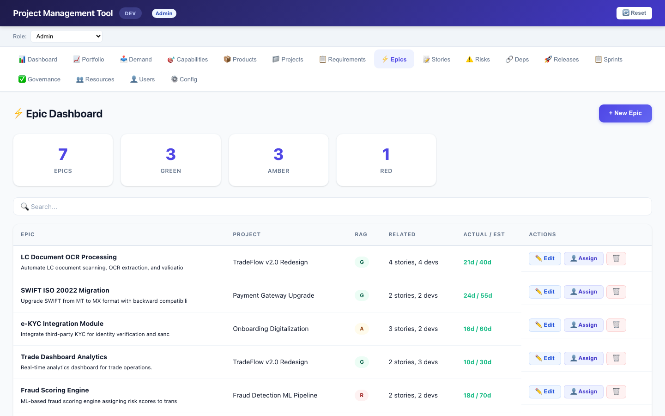
Epics & User Stories
9/16
• Epics link to Projects with RAG status (G/A/R) • Stories under Epics with Story Points (1pt = 1 manday) • Effort tracking: estimated vs actual • Jira link field on Epics • Assignment of resources (teams) to epics
Project Management Tool — Training Guide

Slide 10
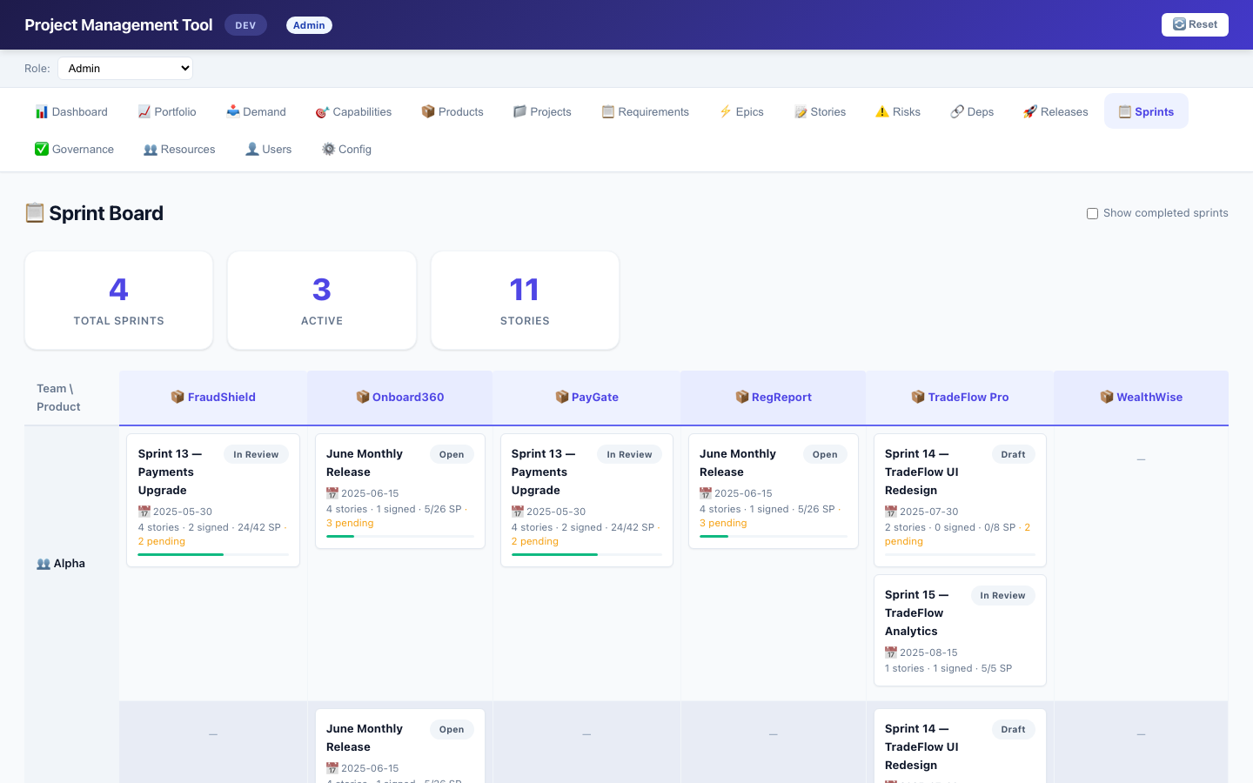
Sprint Board
10/16
• Team × Product grid view • Sprint cards: name, status, stories, SP (done/total) • Teams derived from resource assignments → epics • Filter: show only active sprints (hide Released) • UAC: VSO sees assigned VS, BA sees demand products • Click card → navigates to Releases with auto-expand
Project Management Tool — Training Guide

Slide 11
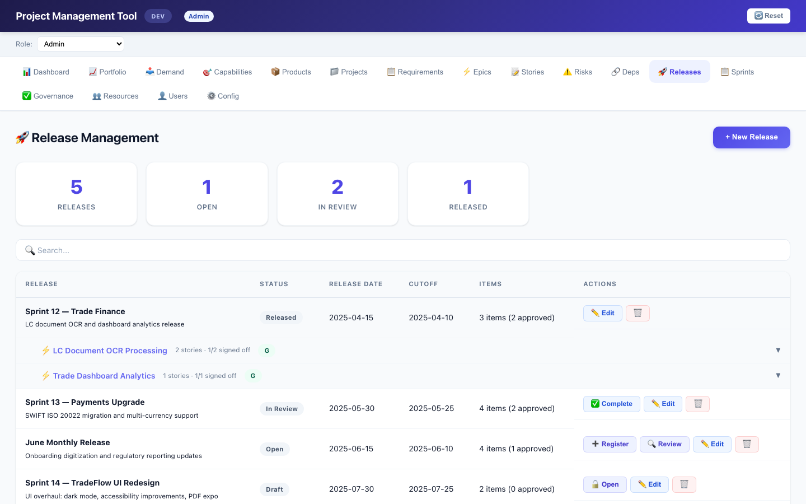
Release Management
11/16
• Releases grouped by Epic (two-level expand) • Register User Stories into releases • Signoff workflow per story (Pending → Approved/Rejected) • Release lifecycle: Draft → Open → In Review → Released • Dashboard navigation: click releases to jump
Project Management Tool — Training Guide

Slide 12
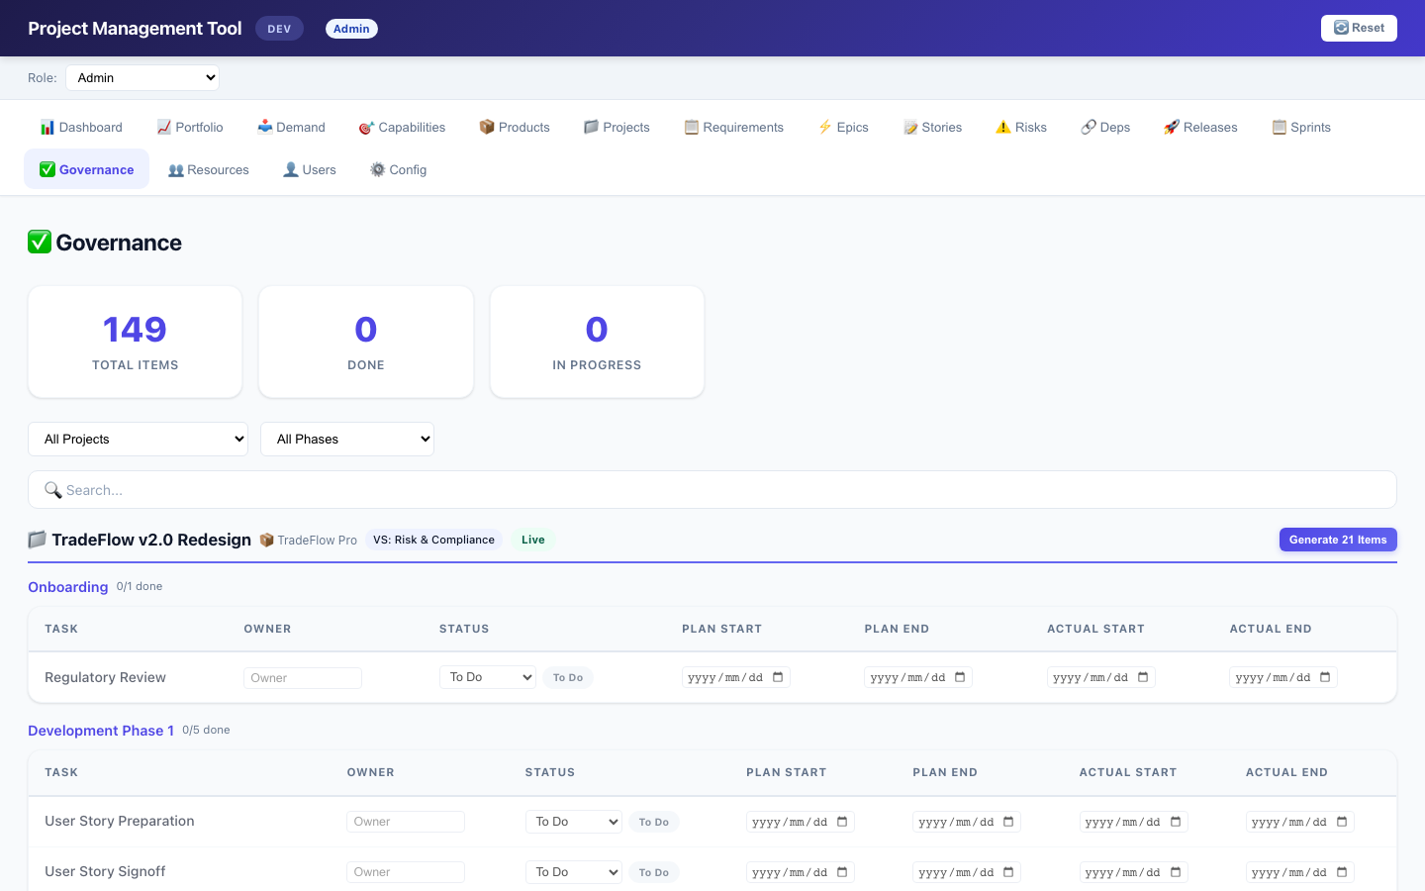
Governance Checklist
12/16
• Per-project checklist across pipeline phases • Configurable phases per value stream • CE: 7 phases (Engage→Analysis→...) • Default: 5 phases | OE: 4 phases | R&C: 6 phases • All items editable: auto-create checkpoint on edit • Status: To Do / In Progress / Done / N/A • Owner, plan/actual dates inline editable • Project filter + phase filter + search • Generate button to batch-create all items
Project Management Tool — Training Guide

Slide 13
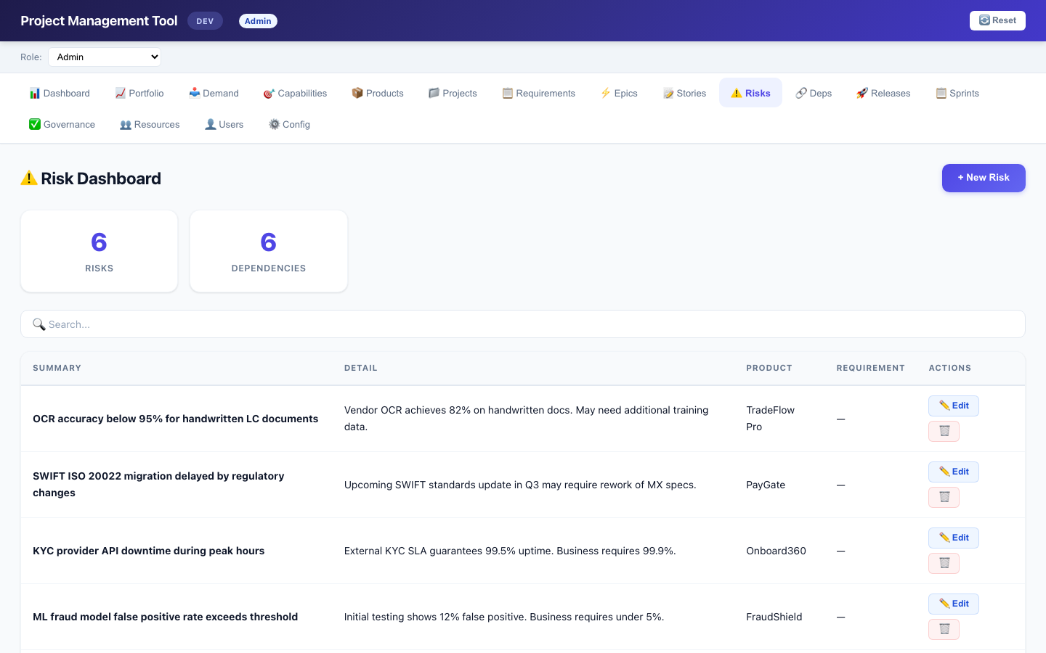
Risks & Dependencies
13/16
• Risks and Dependencies linked to Products • Optional Requirement link with cascading filter (select product → requirements filter dynamically) • Product-based (not project-based) • Separate views with CRUD operations
Project Management Tool — Training Guide

Slide 14
Configuration
14/16
• All dropdowns sourced from pm_config table • demand_flow: per-VS status progression • project_phase: per-VS pipeline phases • project_checklist: per-phase task definitions • user_role: role definitions • value_stream, team, department, etc. • Edit in-app via ⚙️ Config tab
Project Management Tool — Training Guide

Slide 15
Quick Reference
15/16
• Demand Workflow: demand_flow config in ⚙️ Config • Roles: 👤 Users tab, assign role + VS • Governance: ✅ Governance tab, auto-detect or explicit template • Sprint Board: 📋 Sprints, toggle 'Show completed' • Reset: 🔄 Reset button in header (clears localStorage)
Project Management Tool — Training Guide

Slide 16
Q&A
Thank You
16/16
Questions?
Project Management Tool — Training Guide

