Slide 1

TRENDLY – Smart
E-commerce Price Tracker
Presented by : Lushi Gre

Slide 2
INTRODUCTION
1
Online shopping is growing rapidly, but product prices change frequently across e-commerce sites.
Shoppers often miss out on the best deals due to lack of price tracking.
Trendly is a MERN stack–based web application that:
Tracks product prices automatically.
Stores complete price history.
Notifies users when prices drop or reach their target price.
Sandip University

Slide 3
2
OBJECTIVE
1. Provide Price Transparency:
Show complete price history charts for better decision-making.
2. Enable Smart Shopping:
Allow users to set target prices and get instant alerts.
3. Personalized Watchlist:
Manage multiple products in a user-friendly dashboard.
4. Real-time Notifications:
Send email alerts (future: push & WhatsApp) for price drops.
5. Market Insights:
Analytics on trending products, categories, and price drops.
6. Secure & Scalable System:
Built with MERN stack, JWT authentication, cron scheduling, and cloud deployment.

Slide 4
3
Key Features
1
Show complete price history charts for better decision-making.
2
Allow users to set target prices and get instant alerts.
3
Manage multiple products in a user-friendly dashboard.
4
Send email alerts (future: push & WhatsApp) for price drops.
5
Analytics on trending products, categories, and price drops.
6
Built with MERN stack, JWT authentication, cron scheduling, and cloud deployment.

Slide 5
4
System Architecture
Overview
Frontend: React.js, Tailwind CSS, Redux Toolkit, Framer Motion
Backend: Node.js, Express.js, REST APIs
Database: MongoDB + Mongoose
Auth & Security: JWT, Bcrypt
Scheduler & Alerts: Node-cron, Nodemailer
Tools: VS Code, GitHub, Postman
.

Slide 6
5
Why it’s Important
Saves Money 💰Users buy products at the right time and best price.
Saves Time ⏳No need to manually check multiple e-commerce sites.
Smart Shopping Decisions 📊Price history & analytics help users decide when to buy.
Real-time Alerts 🔔Users never miss important discounts with instant notifications.
Transparency 🔍Builds trust by showing genuine price trends instead of fake offers.
.

Slide 7
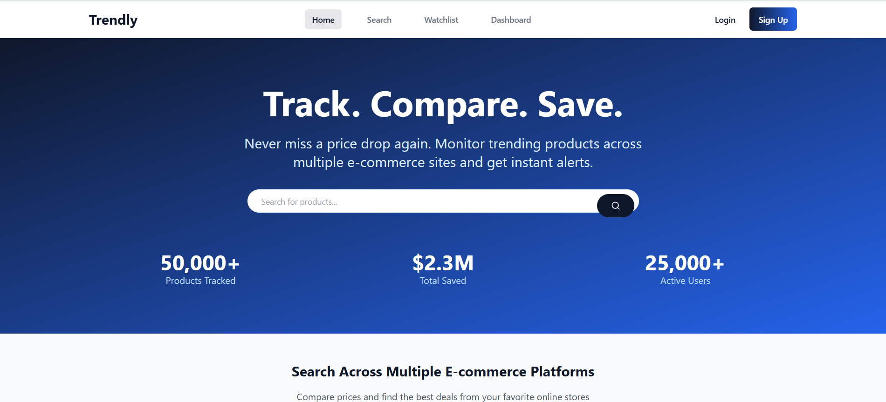
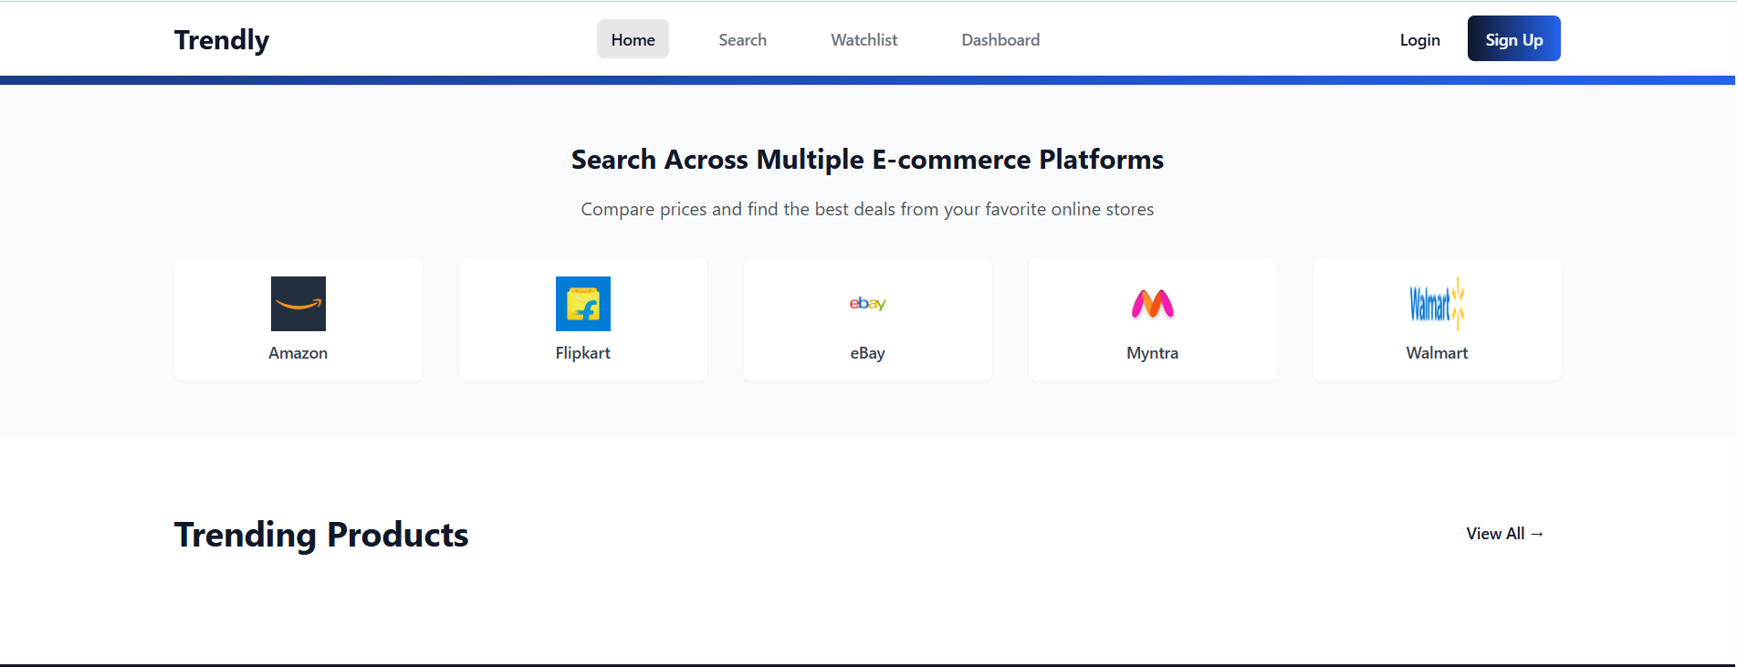
9
The home page is the entry point of the application.
At the top, it features a navigation bar with quick links: Home, Search, Dashboard, Watchlist, Login/Signup.
A prominent search bar in the center allows users to search products quickly.
Below the search bar, the page highlights key statistics such as:Total number of usersTotal products trackedMoney saved by the communityThe UI has a modern, minimal, and responsive design using TailwindCSS and Framer Motion animations.

Slide 8
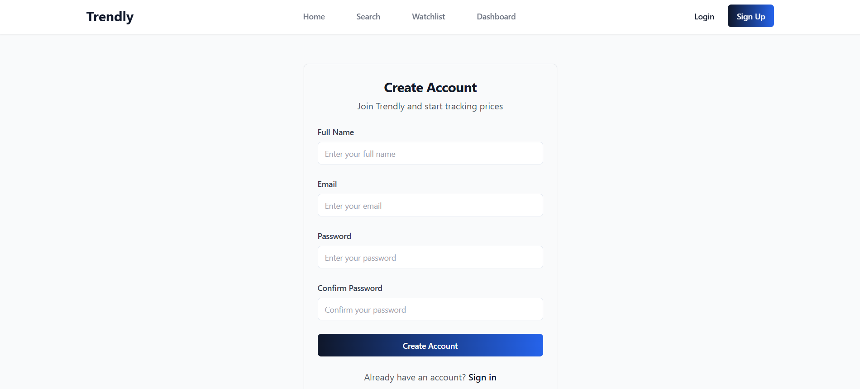
User Registration
6
Signup Page:
Users enter Full Name, Email, Password to register.
Passwords are hashed using bcrypt for security.
After signup, user gets access to personalized features.

Slide 9
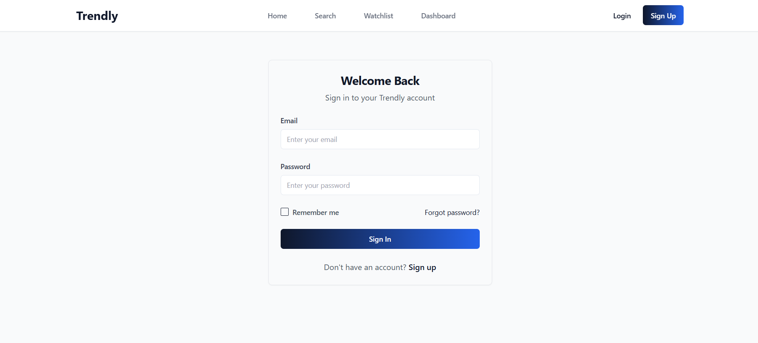
User Login Page
7
Login Page:
Secure login using JWT tokens.
Provides session-based authentication.
If login fails, error message is displayed.

Slide 10
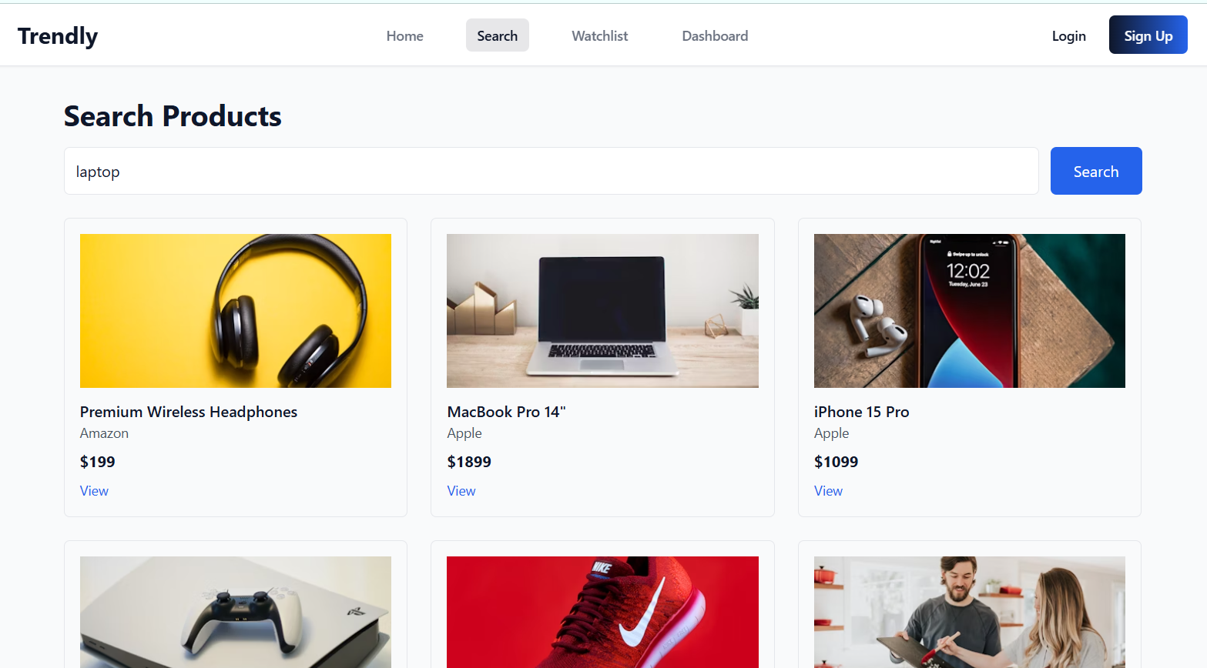
Product Search Page
7
The Search Page allows users to explore products from multiple e-commerce platforms.
Features include:Search Input Field: Users can type product names.
Filters & Sorting: Filter by category, price range, or popularity.
Trending Section: Shows most searched/tracked products.
Each product card displays:Product image, title, and current price“Add to Watchlist” button for tracking price dropsDirect link to original e-commerce site

Slide 11
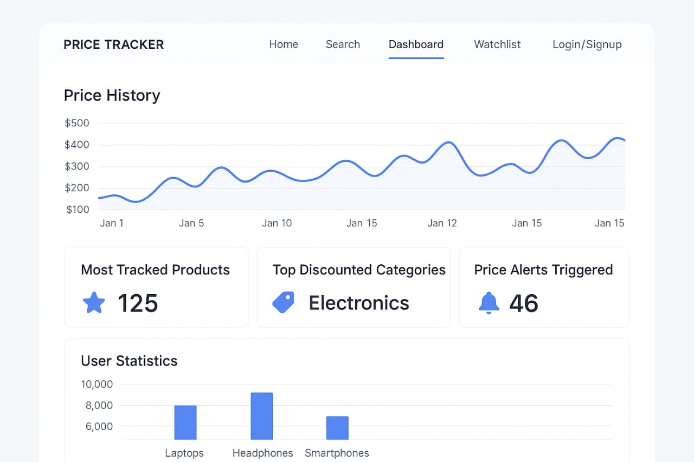
Dashboard Page
8
The Dashboard Page provides data-driven insights.
Features:Price History Graphs: Interactive line charts showing how product prices changed over time.
Analytics Widgets:Most tracked productsCategories with highest discountsNumber of price alerts
triggeredUser-Specific Insights: Personalized statistics based on user’s watchlist.Built using Chart.js / Recharts for interactive visualization.

Slide 12
CONCLUSION
10
Trendly provides a smart way for online shoppers to track product prices across e-commerce platforms.
The system offers price history visualization, watchlist management, and automated price-drop alerts.
Helps users make data-driven purchase decisions and save money.
Built using the MERN stack with modern UI/UX for a seamless experience.
Future scope: Push notifications & WhatsApp alertsAI-based trend predictionsBrowser extension & mobile app support

Slide 13
THANK YOU

