Slide 1

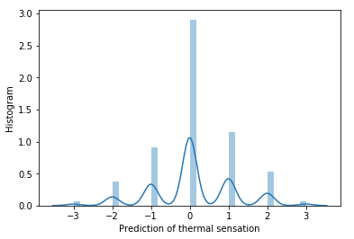
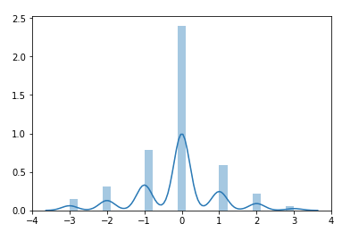
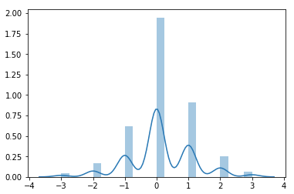
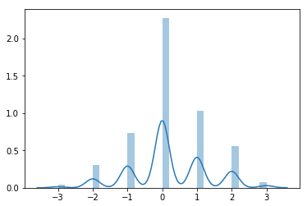
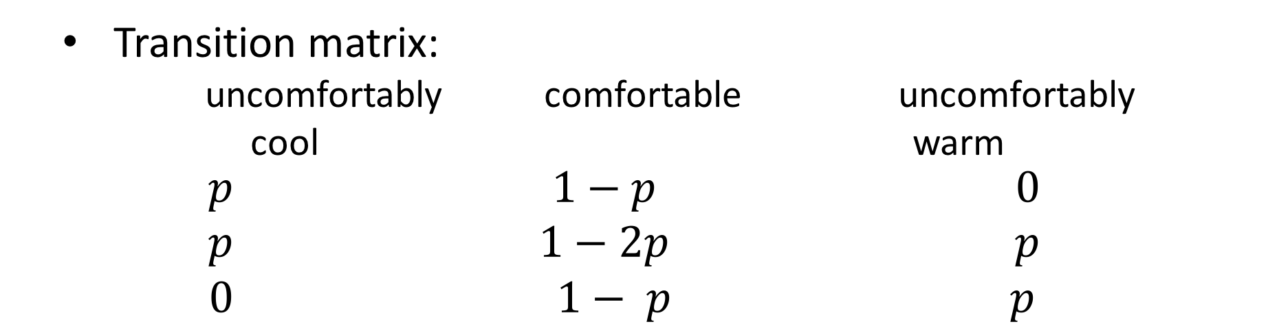
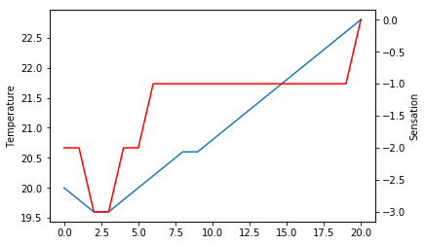
Adaptive thermal comfort-based HVAC control in real open plan office buildings
Siliang Lu¹, Weilong Wang², Chaochao Lin²,
¹ School of Architecture, ² Civil and Environmental Engineering
Introduction
Heating, ventilation and air-conditioning system plays a key role in shaping the building performances. The effective and efficient HVAC operations not only achieve energy savings but also create a more comfortable environment for occupant indoors. Moreover, compared to private office environment, open-plan office environment has become a trend in most of office buildings since it not only creates opportunities for employers to communicate with one another and improve productivity but also reduce construction cost. However, open-plan office building is also faced with problems like much too interruption and unsatisfactory shared indoor temperature and humidity. Since HVAC system aims to create comfortable thermal environment and improve energy performances of the building, it is of great importance to develop new paradigm of HVAC system framework so that everyone could work under their preferred thermal environment while the system could also achieve better energy performances.
Therefore, this project aims to study individual thermal comfort/sensation profile with subset of RP 884 database, which collected a total of 22000 sets of data from the real office environments across the world. Then, the thermal comfort profile will applied to design an adaptive HVAC controller with reinforcement learning.
Methodology
Preprocessing
  Feature selection
    Algorithm: random forest-based feature ranking
Results
ranking | feature | score
1 | clothing insulation | 0.237908
2 | indoor air temperature | 0.236746
3 | indoor relative humidity | 0.234287
4 | outdoor air temperature | 0.111386
5 | metabolic rate | 0.101274
6 | outdoor relative humidity | 0.078398
Variable's Code Name | Description of Variable and Units
Class: ash | ASHRAE Thermal Sensation Scale [-3, +3]
met | average metabolic rate of subject [met]
insul | clothing plus upholstery insulation [clo]
taav | average of three heights' air temperature [ºC]
rh | relative humidity [%]
dayav_ta | outdoor average of min/max air temp on day of survey [ºC]
dayav_rh | outdoor average min/max relative humidity on day of survey [%]
  Analysis of differences between individual thermal comfort
    Algorithm: GMM clustering with optimal K
  Development of individual thermal sensation prediction model
    Algorithm1: Kernel-based Support Vector Machine
    Algorithm2: Random Forest
    Algorithm3: Hidden Markov Model
      Viterbi’s algorithm
sensation distributions with 4 clusters
uncomfortably
cool
Algorithm | Accuracy of sensations
SVM | 34%
Random forest | 45.2%
HMM | 54%
Description of the subset of RP884 dataset
Size of the dataset: 5776 instances
Data collection methods:
The data was collected from real open plan offices by various sensor measurements and user survey feedback across the world.
Selected climate zones and locations:
comfortable
uncomfortably
warm
  Development of HVAC controller with the prediction from individual thermal sensation profile
    Algorithm: Value-iteration
    State space:
      thermal sensation [-3,+3] with the inputs of clothing insulation, indoor air temperature and relative humidity, outdoor air temperature and relative humidity and metaboic rates
    Actions:
      0.5 C warmer, 0.5 C cooler and no change
    Rewards:
      thermal sensation = -3 or 3, r=-5.
      thermal sensation = -2 or 2, r=-2.
      thermal sensatinon = -1 or 1, r=-1.
      thermal sensation = 0, r=5
temperature
thermal sensation
Location | Climate Zone
Grand Rapids | humid midlatitude
Ottawa Canada | humid midlatitude
Brisbane Australia | humid subtropcial
Sydney Australia | humid subtropcial
San Francisco Bay Area | mediterranean
san Ramon | mediterranean
Antioch | mediterranean
Auburn | mediterranean
Jakarta Indonesia | wet equatorial
Singapore wet equatorial | wet equatorial
RL controller based on thermal sensation prediction
Conclusion and Future Work
Even if different people have different sensations under similar conditions, the differences is limited.
The random forest model has the highest accuracy of predicting individual thermal sensations.
The prediction model can be applied to HVAC control with reinforcement learning so as to adapt the individual thermal comfort.

