Slide 1
Red, Yellow, Green
Case study by Lukas Sinkus

Slide 2
Agenda
Interpretation of the problem
The solution
Technologies
Code architecture
2 trade-offs
Further improvements
Scaling

Slide 3
The problem
No overview of the states of all equipment - states can only be seen by physically seeing a magnet on each piece of equipment
Not possible to correlate orders scheduled for equipment with the current state of the equipment
Analog order scheduling to equipment (assumption)
Analog resolution of orders (assumption)

Slide 4
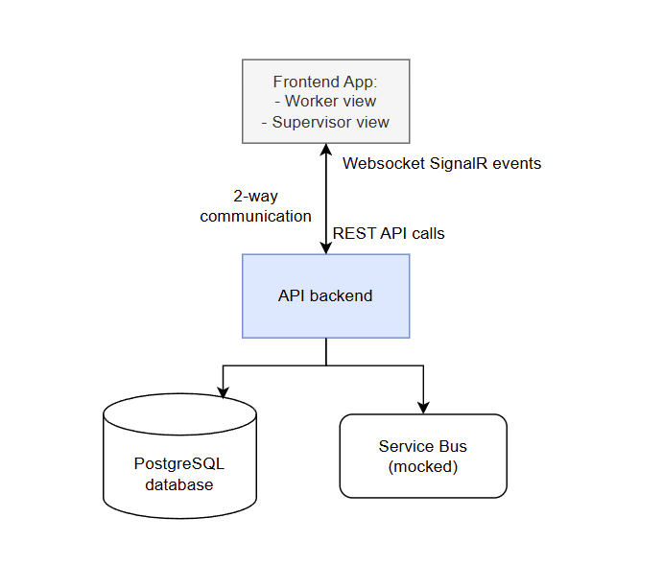
The solution
A 3-tier system with different UIs for the two actors: workers and supervisors
REST API for fetching / modifying data
Live updates to the client apps with SignalR websockets
Event driven architecture
PostgreSQL database
All components dockerized and deployable using a docker compose

Slide 5
The solution - Supervisor view
See all equipment and history for each piece of equipment state
Schedule orders to equipment
See all scheduled orders and correlate them to equipment states
Live updates:
  equipment state is changed
  order is completed

Slide 6
The solution - Worker view
An overview of all pieces of equipment and their states
A interface for changing the state of each equipment
An interface to see the currently scheduled order with the possibility to mark it as done
An interface to see the order backlog for each piece of equipment
Live updates on:
  Equipment state changes
  Newly created orders

Slide 7
Technologies
.NET10 backend
  Entity Framework
    Strongly typed queries
    Unit of Work pattern
    Code-first database schema
    Migration management
    Interceptor support for cross-cutting concerns, e.g.:
      Populating timestamps on modified entities
      Automatically filtering out soft-deleted rows
  SignalR - publishing events to clients
  MSTest + Testcontainers for API integration testing
react/typescript frontend

Slide 8
Code architecture
Command Query Separation - split queries and commands in code
  Code organization
  Small handlers
  Clear intent
  Can be used for scaling, e.g. replacing reads to read from a database read replica
Vertical Slice Architecture
  Organize code by feature
  Each feature contains E2E code:
    highly cohesive
    lowly coupled
    less complex
    Minimal boilerplate

Slide 9
Trade-off: Storage of equipment states
Log of states (Id, EquipmentId, State, Timestamp) with a FK on EquipmentId and DESC index on timestamp
Pro - light inserts
Con - current state has to be computed on each read, querying is harder
Log of states + store a FK reference to the current state on Equipment
Pro - light and simple query
Con - have to write to 2 tables on state insert
Con - inserting a circular reference ❌
✅ Log of states + store a reference without FK + value of current state on Equipment
Pro - even lighter / simpler query to filter equipment by state
Pro - avoid inserting a circular reference
Con - 2 table write on insert
Con - duplicated data
Con - lack of FK potentially compromises data integrity

Slide 10
Trade-off: UI events - cache invalidation vs in-place updates
Pros:
Simple - no need to add code for handling new data, invalidate the relevant cache keys and the app handles it
Data consistency - all relevant data is re-fetched so it’s sure to be up-to-date
Cons:
Extra network requests to fetch data that can be computed
Small updates may trigger a big reload, which adds load to the backend

Slide 11
Improvements
Add an actual service bus, such as RabbitMQ
Use API clients generated from the OpenAPI spec for frontend and integration tests

Slide 12
Scaling
Split the application into 2 processes that can be further scaled horizontally - API and MessageConsumer
  Caveat: event consumers that publish SignalR events need to run on the API container
Websockets have implications for horizontal scalability
  need to use sticky sessions and potentially other technologies (e.g. Redis Backplane) to scale out

Slide 13
Thank you

