Slide 1
Reinforcement
learning
Jorge Chueca
Luis Ríos
Javier Verón

Slide 2

¿What is RL?
Model-free machine learning.
An agent performs an action interacting with the environment.
A reward and a state is collected afterwards.
The derived policy is based on the state and the reward

Slide 3
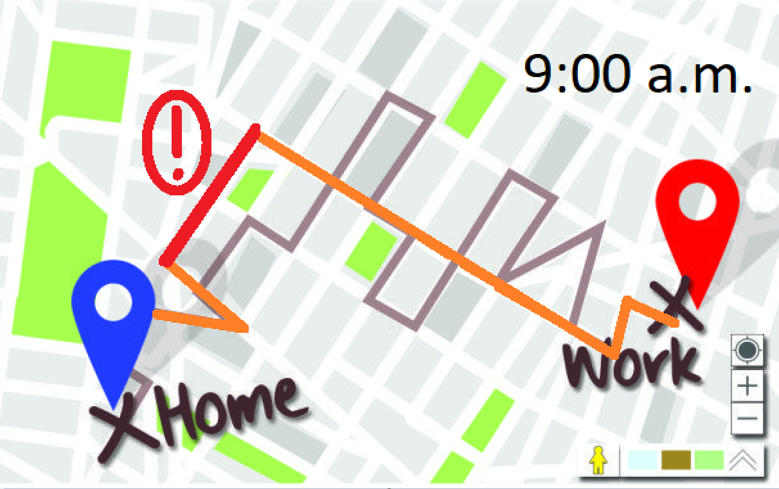
Model-free ML
An AI can derive an optimal policy from its interactions with the environment without needing the model of the environment itself.
5 | 5 | X
5 | 1 | 10
O | 10 | 10

Slide 4
Exploration vs Exploitation dilemma
The AI performs the question of whether it should:
Trust the learnt values of previous iterations and perform actions based on them.
Try other actions that might give a better reward.
1 100% | 1 100% | X
1 100% | 0 100% | 1 100%
O | 1.000 10% | 1 100%

Slide 5
The algorithms

Slide 6
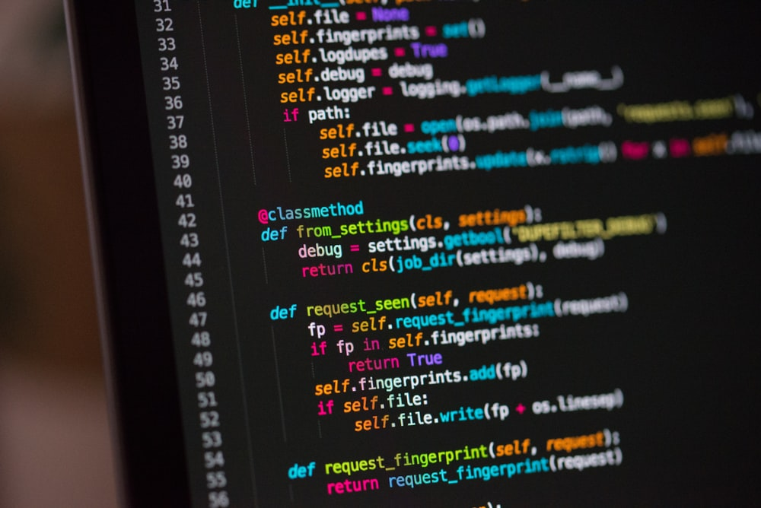
Monte Carlo Sample - means
The IA doesn’t know anything about the game unless it plays the game.
Once the AI plays the game records the data of rewards and states by introducing random inputs.
Every new game the AI calculates the mean of all the data collected and updates it’s knowledge.

Slide 7
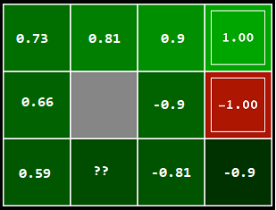
Monte Carlo
Although it seems a good algorithm it has some problems depending the program we are running, Imagine an endless game, also we can’t ensure that the IA visits all the possible states.

Slide 8
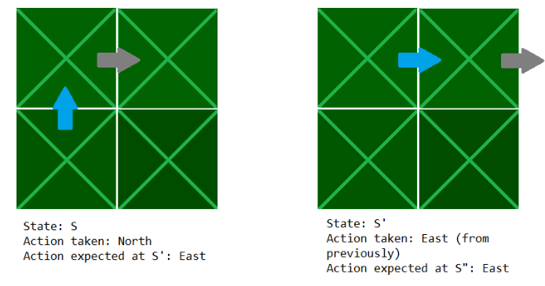
TD(n)
SARSA / Q-Learning
Best example is a GPS.
Similar to Monte Carlo but it doesn’t need to finish the game.

Slide 9
Q-Learning
Q-Learning is an algorithm in Reinforcement Learning for the purpose of strategy learning.
Q(s, a)

Slide 10

Loss Function?

Slide 11

Loss Function

Slide 12
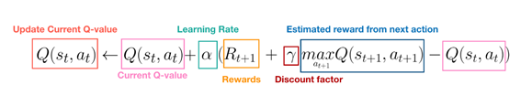
Bellman Equation

Slide 13
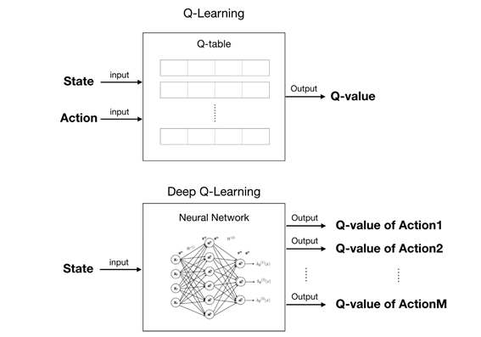
Why go deep?

Slide 14
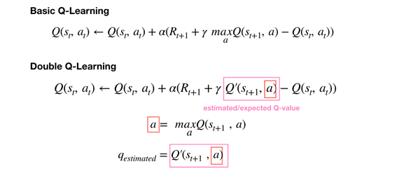
Double Q-Learning

Slide 15
Deep Q-Learning
Double Deep Q-Learning

Slide 16
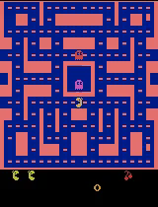
Without training

Slide 17
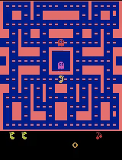
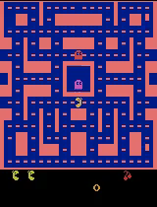
Deep Q
Double Deep Q
150k iter 10k explored

Slide 18
Sources
Jorge Chueca Luis Ríos Javier Verón
https://www.youtube.com/watch?v=qhRNvCVVJaA&start=438s
https://www.youtube.com/watch?v=wrBUkpiRvCA&t=517s
https://www.youtube.com/watch?v=mo96Nqlo1L8&start=484s
https://www.youtube.com/watch?v=0bt0SjbS3xc
https://www.youtube.com/watch?v=ILDLT97FsNM
https://www.youtube.com/watch?v=CXwvOMJujZk
https://medium.com/@qempsil0914/zero-to-one-deep-q-learning-part1-basic-introduction-and-implementation-bb7602b55a2c
https://medium.com/@qempsil0914/deep-q-learning-part2-double-deep-q-network-double-dqn-b8fc9212bbb2
https://towardsdatascience.com/deep-reinforcement-learning-tutorial-with-open-ai-gym-c0de4471f368
https://gym.openai.com/

