Slide 1
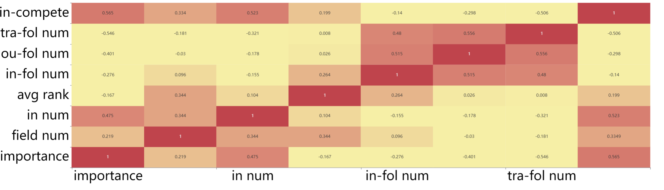

1
0

Slide 2
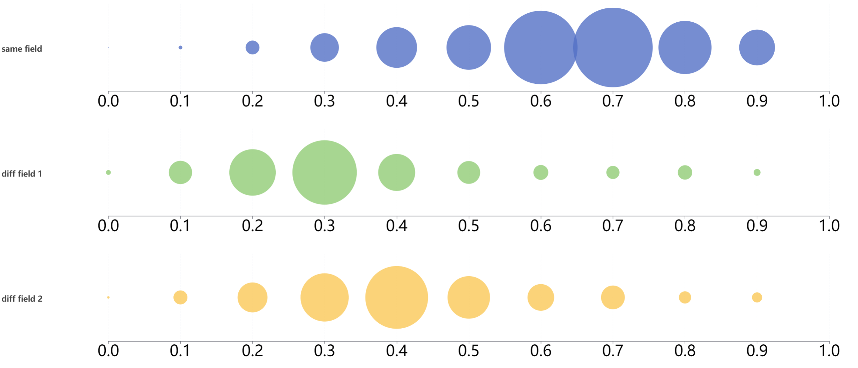


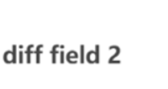

Slide 3
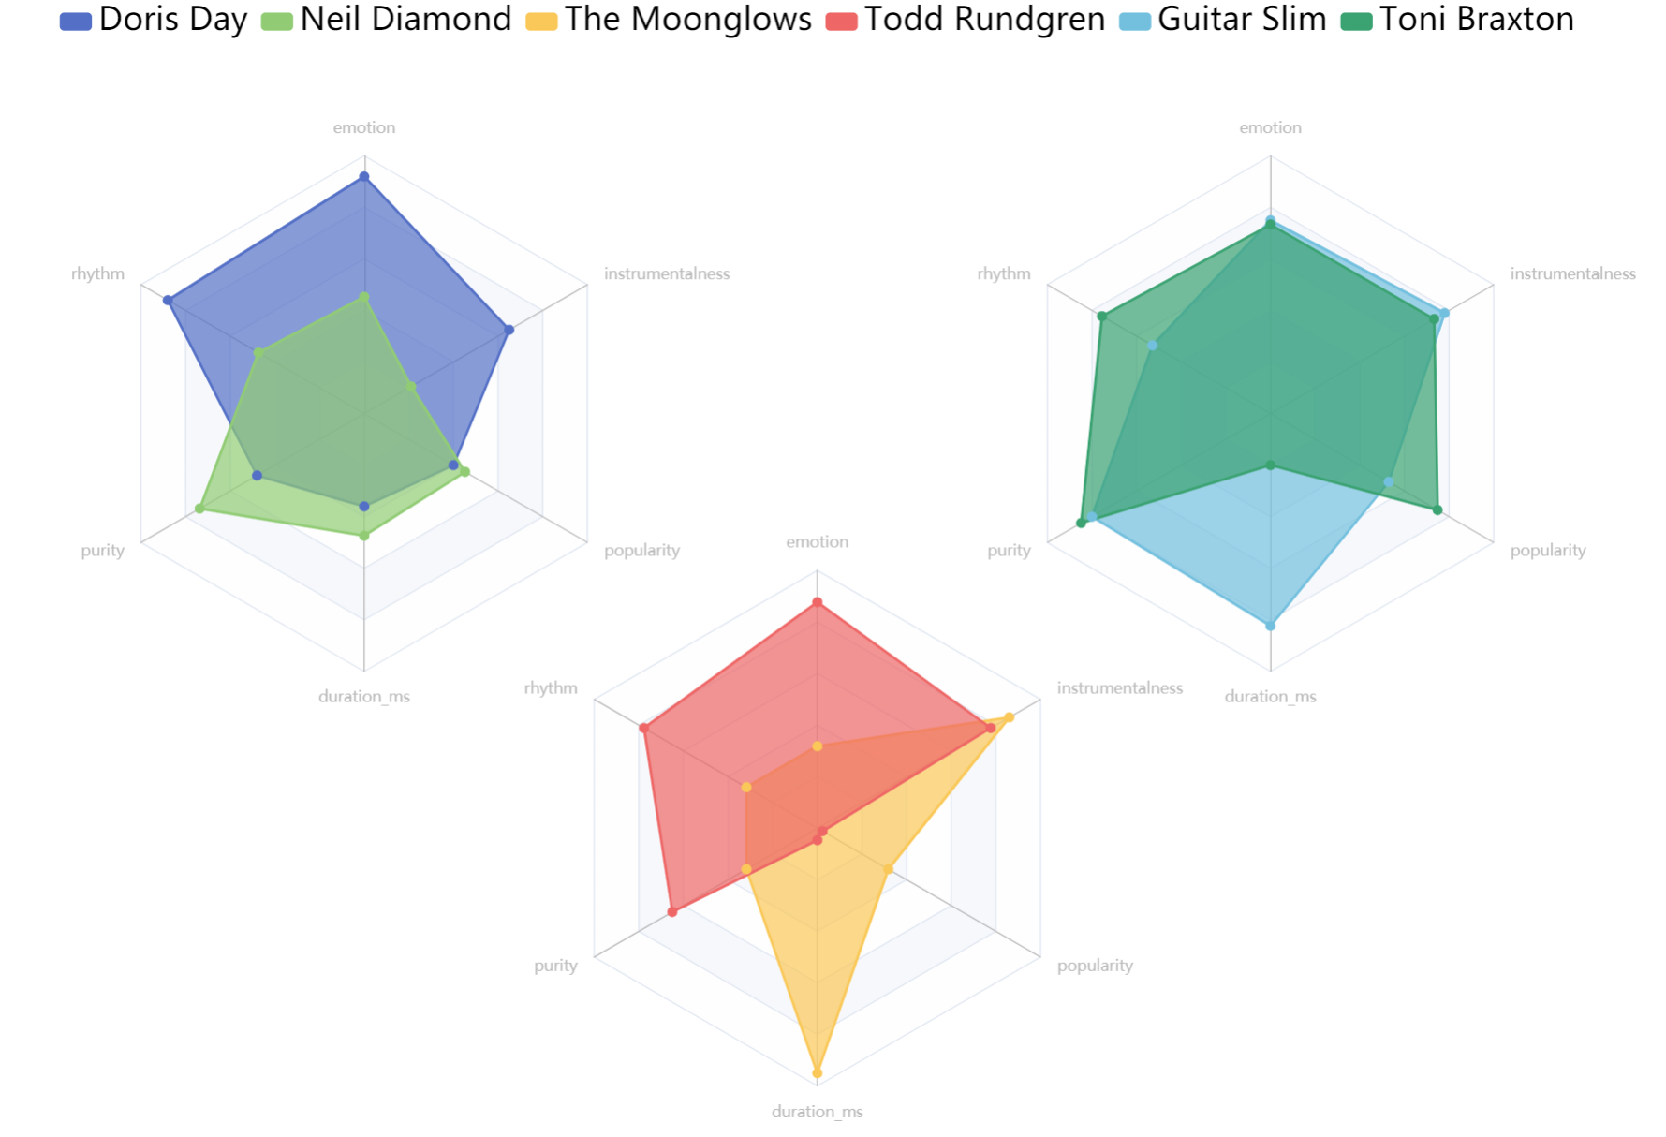



emotion
emotion
rhythm
instrumentalness
rhythm
instrumentalness
purity
popularity
emotion
purity
popularity
duration_ms
rhythm
duration_ms
instrumentalness
purity
popularity
duration_ms

Slide 4

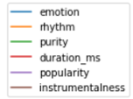
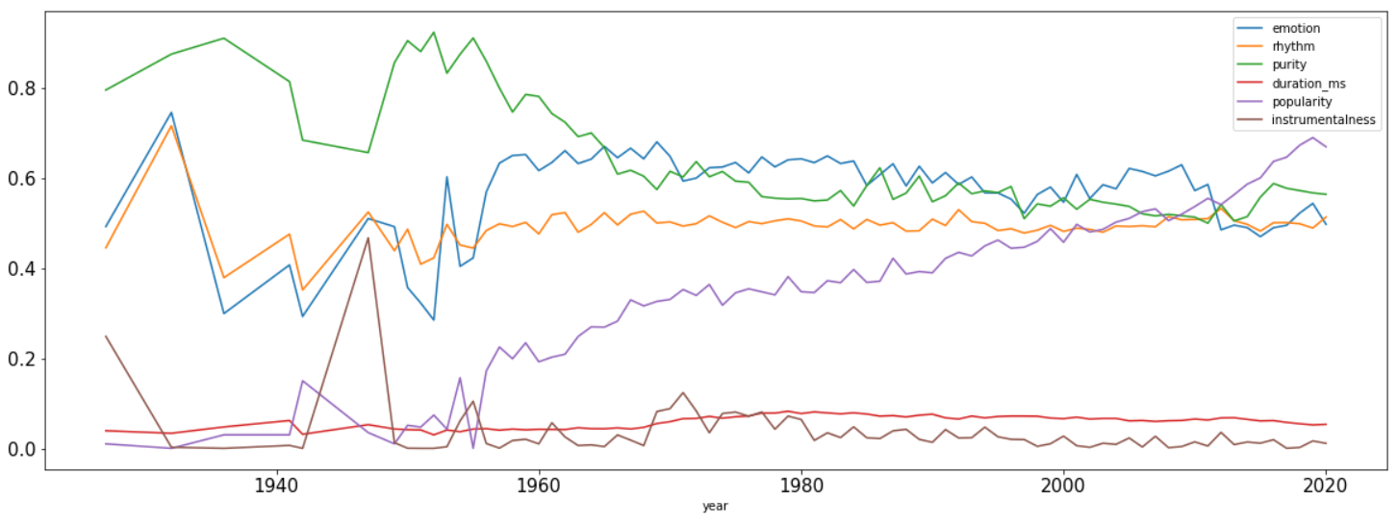


—pur —pop
—emo —dur
—rhy —ins
0.8
0.6
0.4
0.2
0
1940
1960
1980
2000
2020

Slide 5

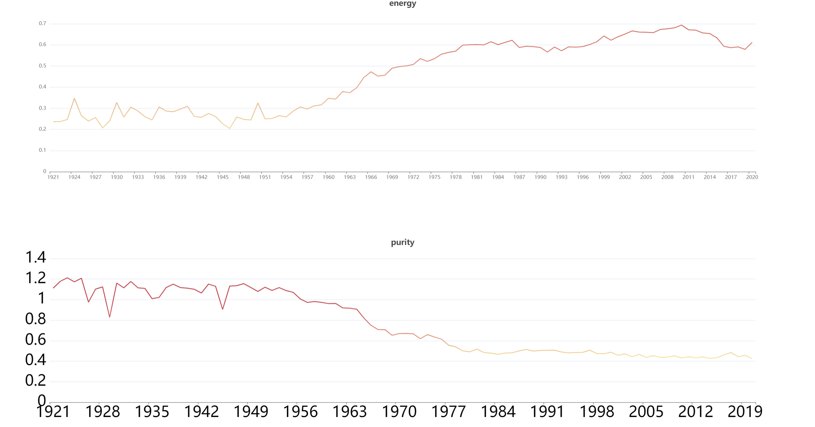



energy
0.7
0.5
0.3
0.1
1921
1935
1949
1963
1977
1991
2005
2019
purity
1.4
1
0.6
0.2
1921
1935
1949
1963
1977
1991
2005
2019

Slide 6



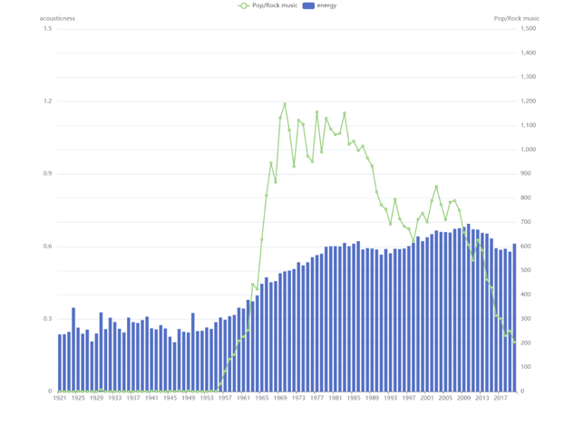
Energy ——pop
energy
Pop/Rock
1.5
1500
1.1
1100
0.7
700
0.3
300
1921
1941
1961
1981
2001
2020

Slide 7

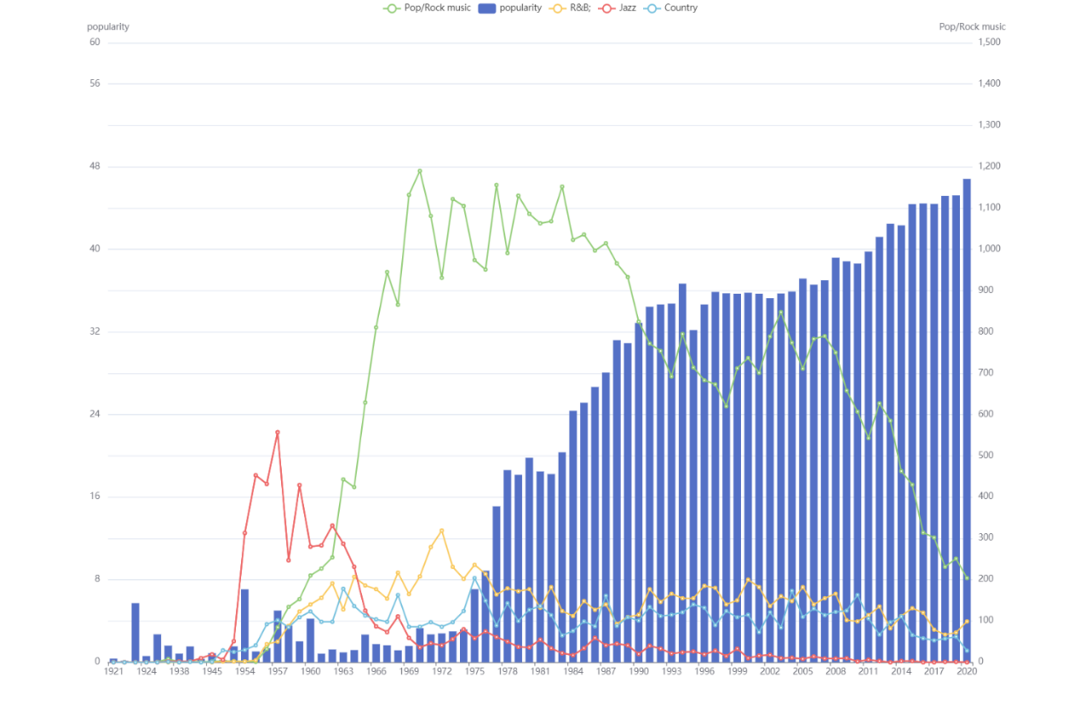
Energy —pop —jaz —R&B —COU
1.5
1500
1.1
1100
0.7
700
0.3
300
1921
1941
1961
1981
2001
2020

Slide 8
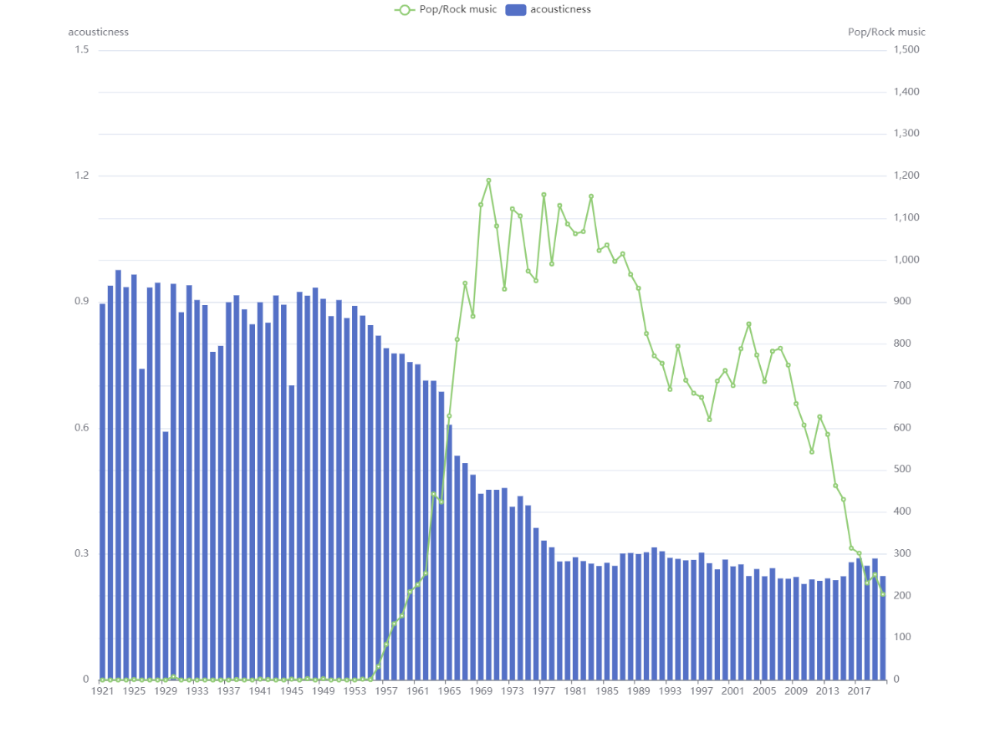

1.5
1500
acousticness ——pop
1.2
1200
0.9
900
0.6
600
0.3
300
1921
1941
1961
1981
2001
2020

Slide 9

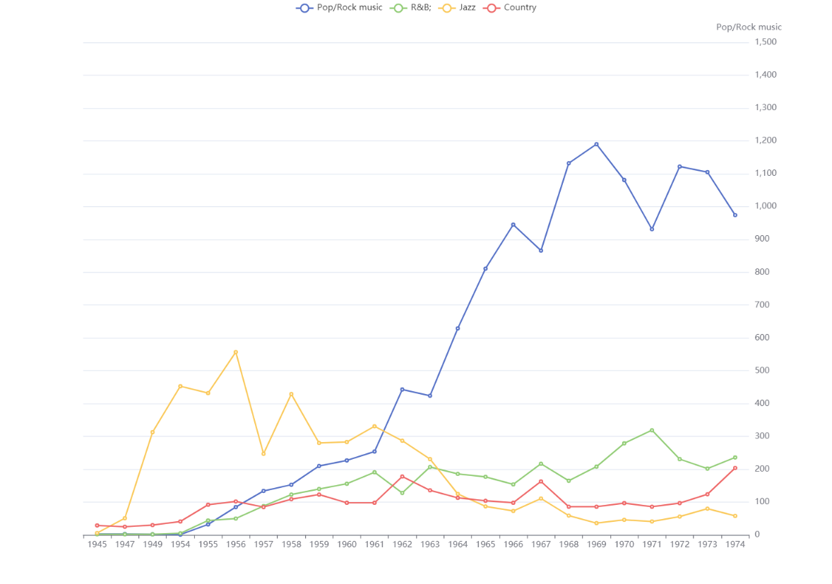
1500
—pop —jaz —R&B —COU
1200
900
600
300
1945
1956
1960
1960
1969
1974

Slide 10
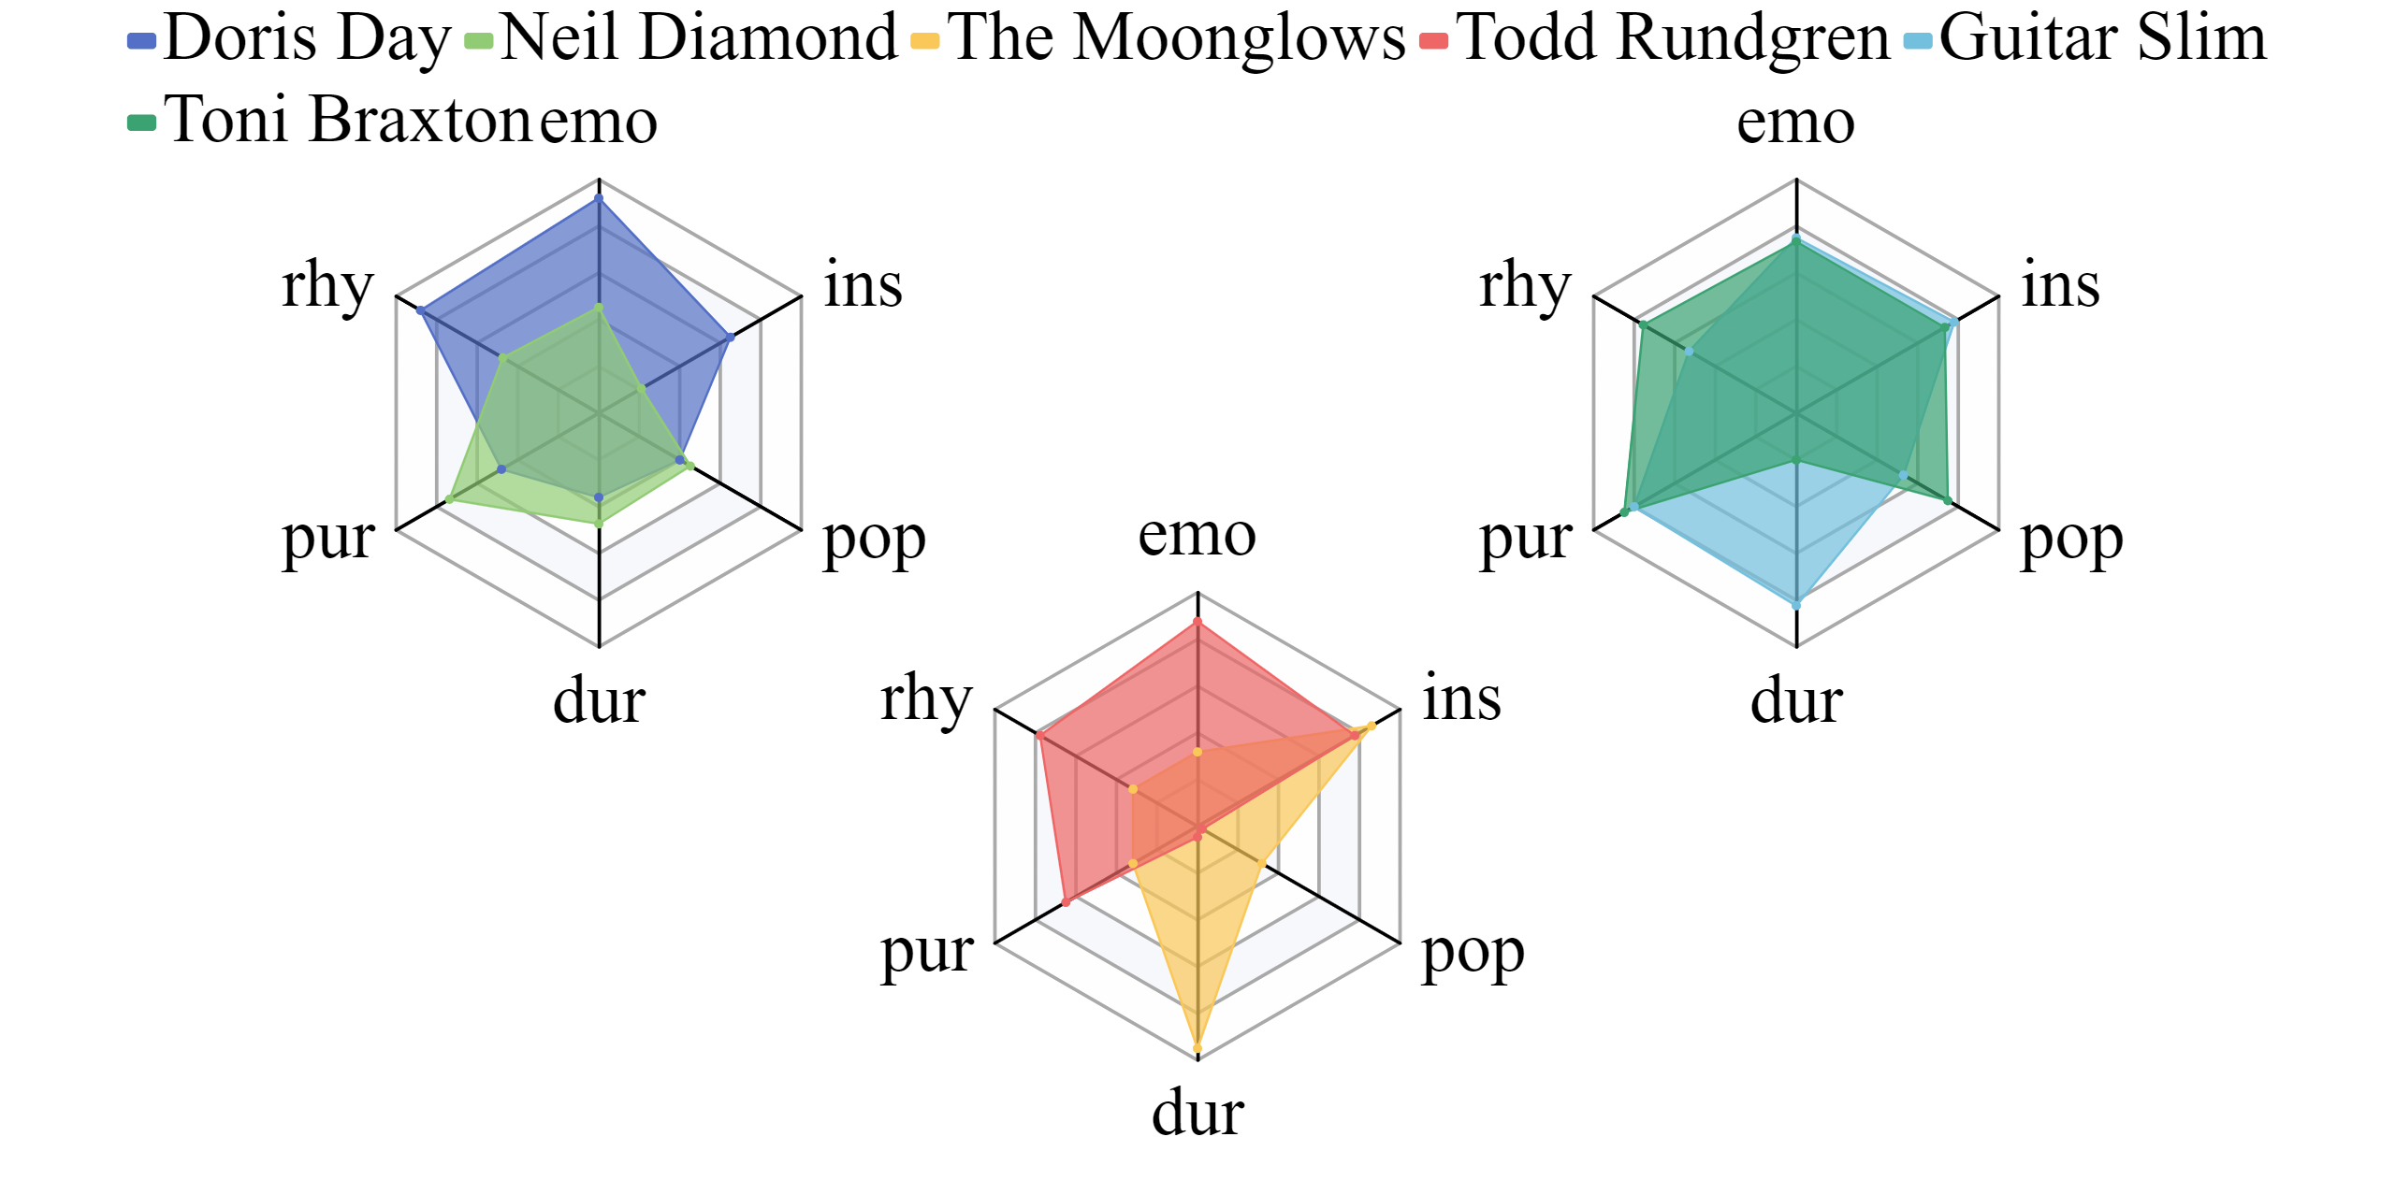


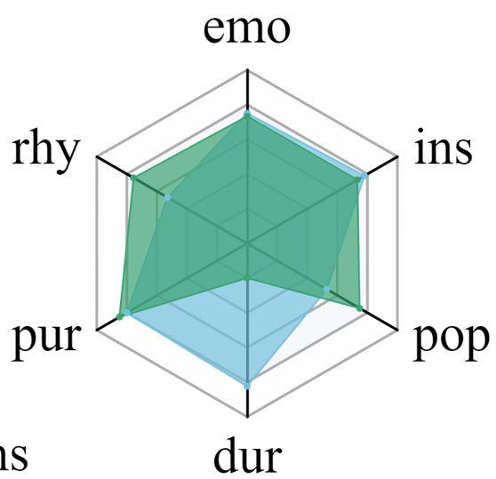
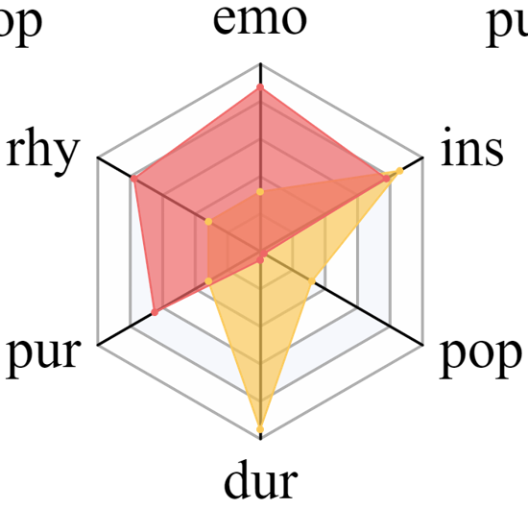
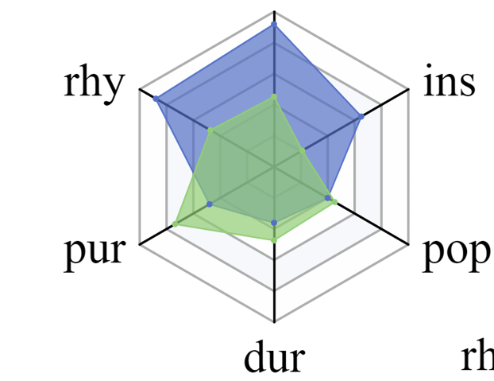


Slide 12


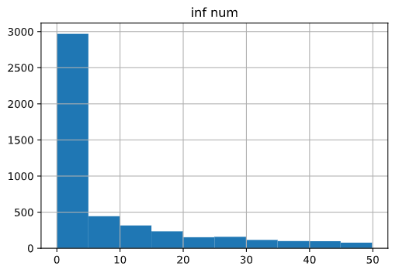
Inf num
3000
2500
2000
1500
1000
500
0
0 10 20 30 40 50

Slide 13

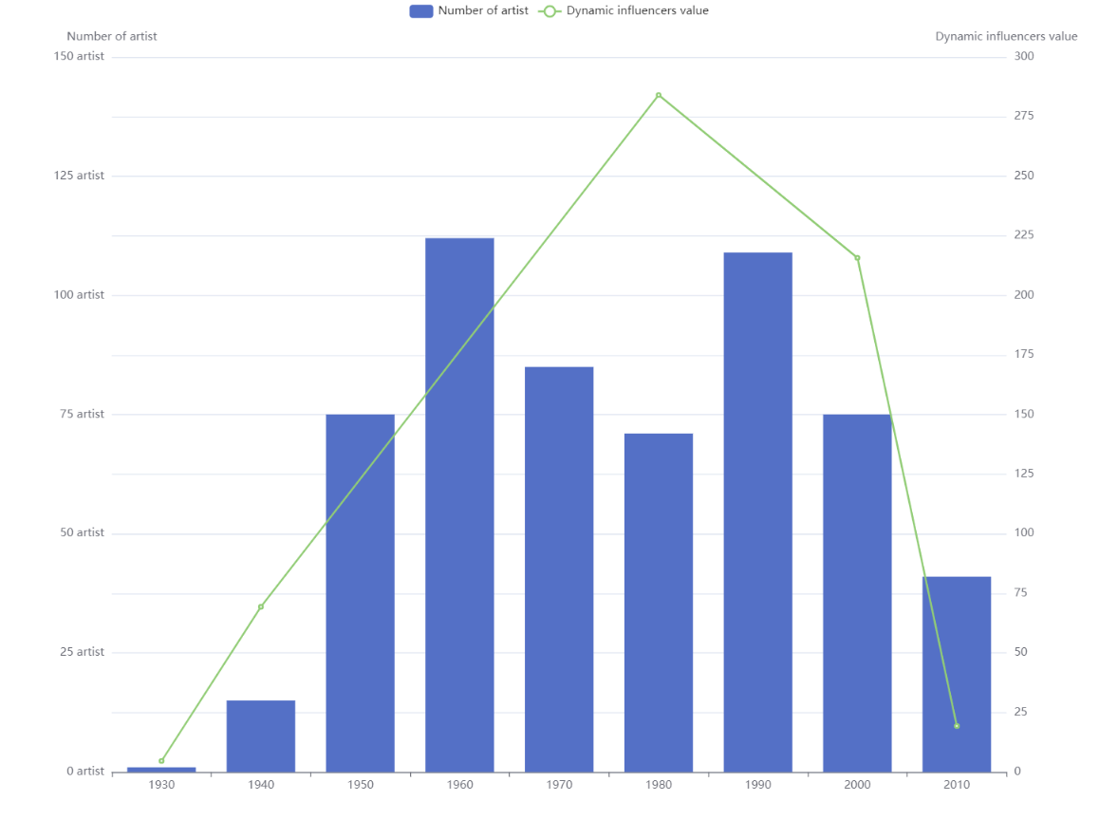



Num of artist — Dynamic inf value
150
125
100
75
50
25
300
250
200
150
100
50
1930 1950 1970 1990 2010

