Slide 1
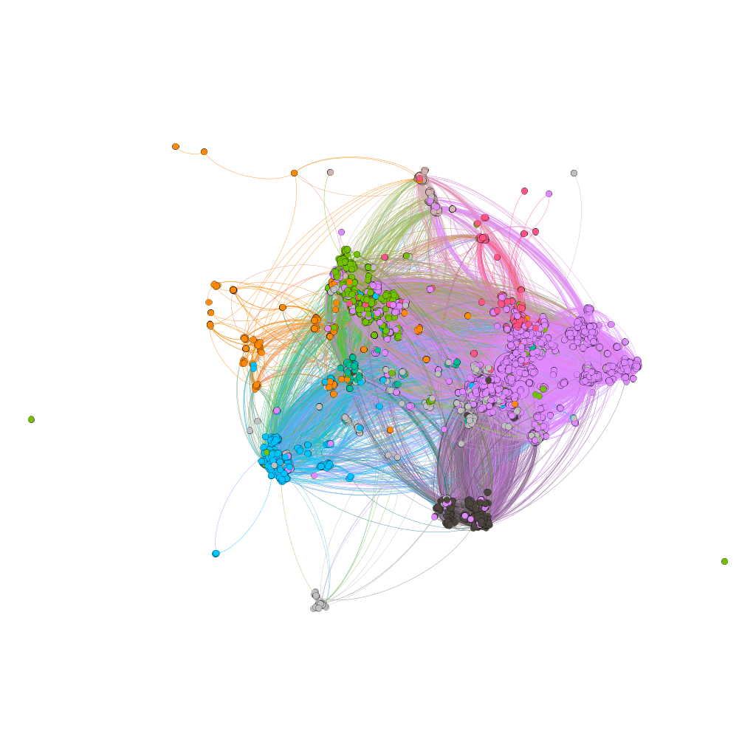
Reggae
Electronic
R&B
Latin
Pop/Rock
Country
Jazz
Others

