Slide 1
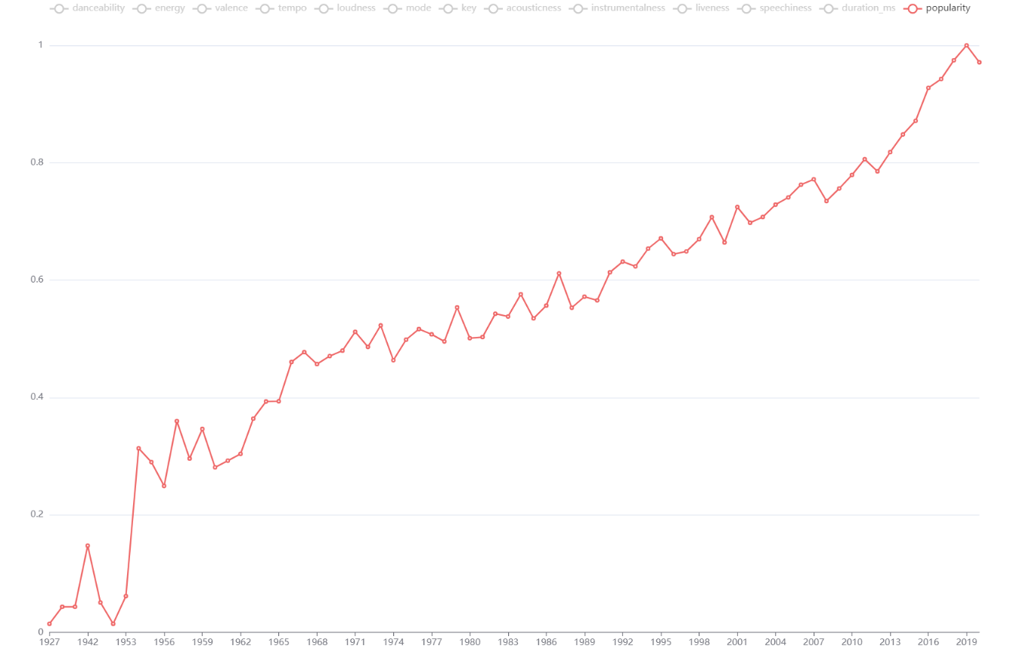
1
—— popularity
0.8
0.6
0.4
Motown R&B increases popularity further
0.2
The emergence of the first R&B artists
1927
1956
1965
1974
1983
1992
2001
2010
2019

Slide 2
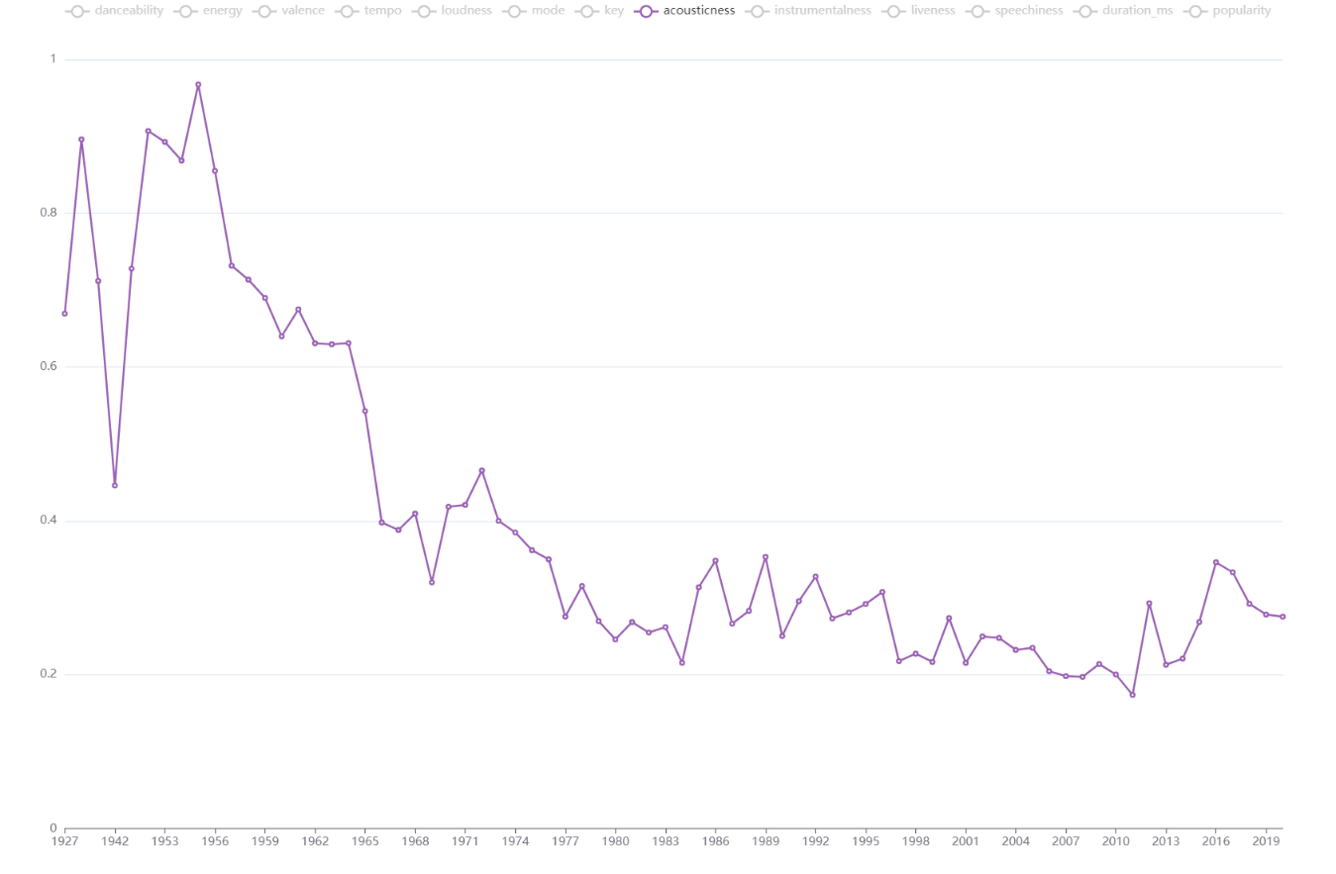
1
—— acousticness
Orchestral music reduces acousticness
0.8
0.6
Contemporary R&B reduces the acousticness
0.4
0.2
1927
1956
1965
1974
1983
1992
2001
2010
2019

Slide 3
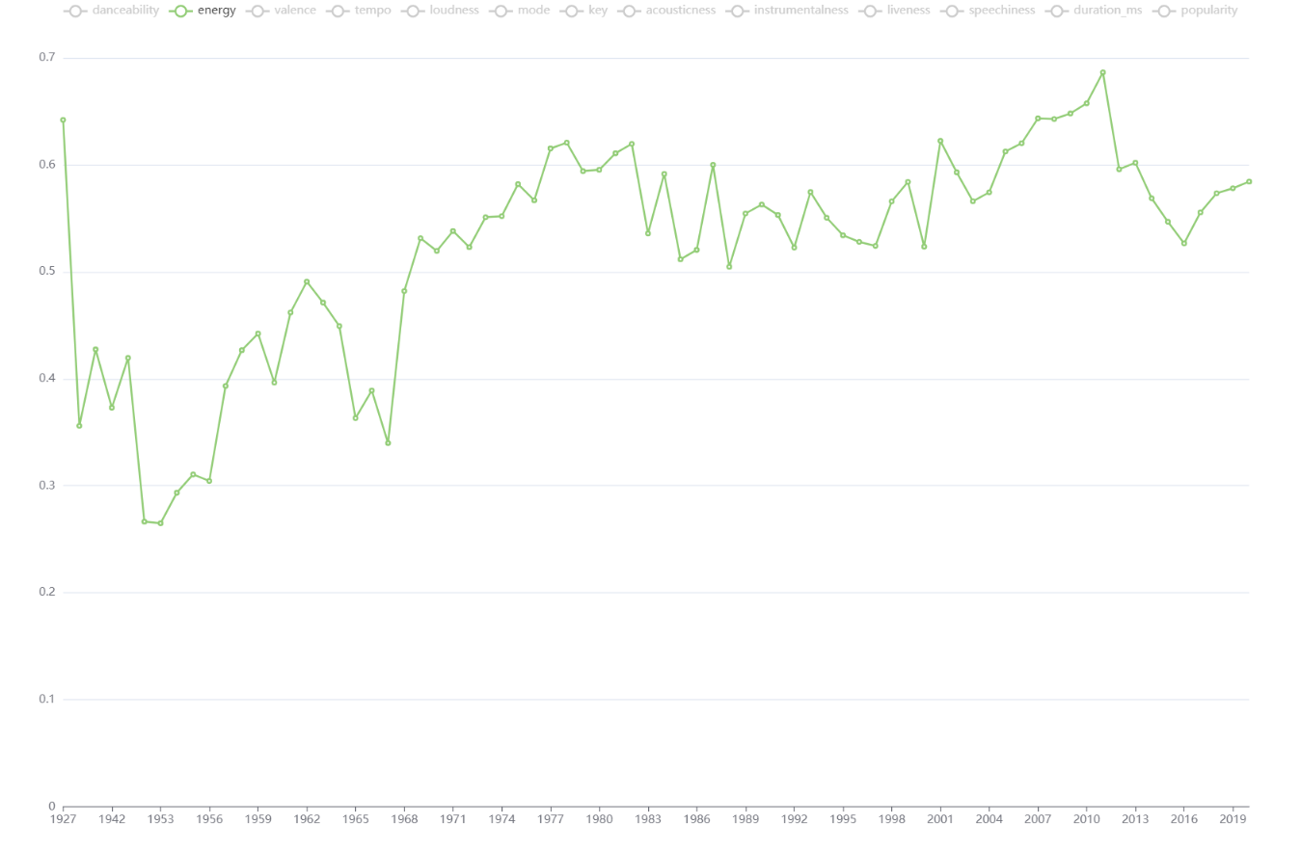
1
—— energy
0.8
Contemporary R&B makes the
energy value higher
0.6
0.4
Gospel music reduces energy
0.2
1927
1956
1965
1974
1983
1992
2001
2010
2019

Slide 4
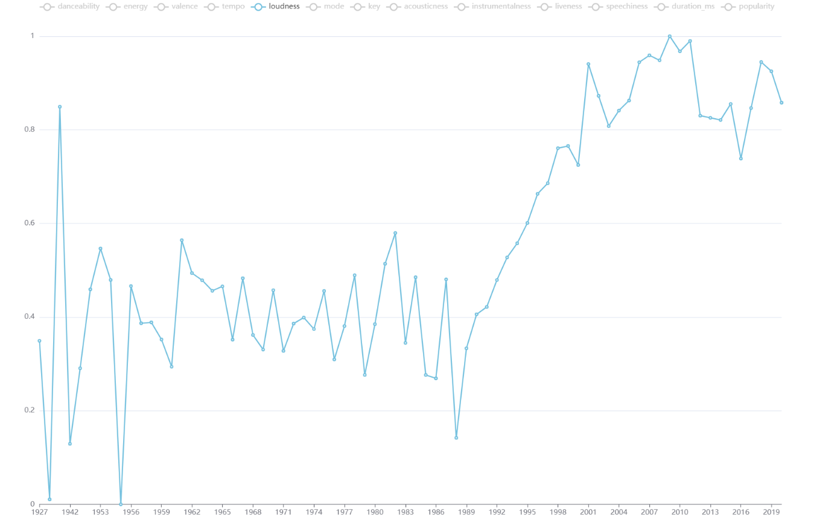
1
—— loudness
0.8
Contemporary R&B makes
the loudness value higher
0.6
0.4
0.2
1927
1956
1965
1974
1983
1992
2001
2010
2019

Slide 5
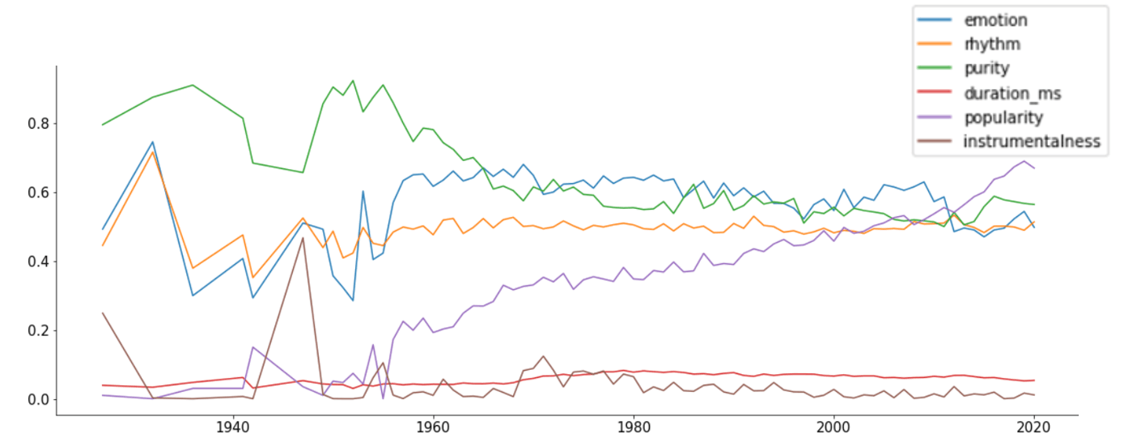

Slide 6
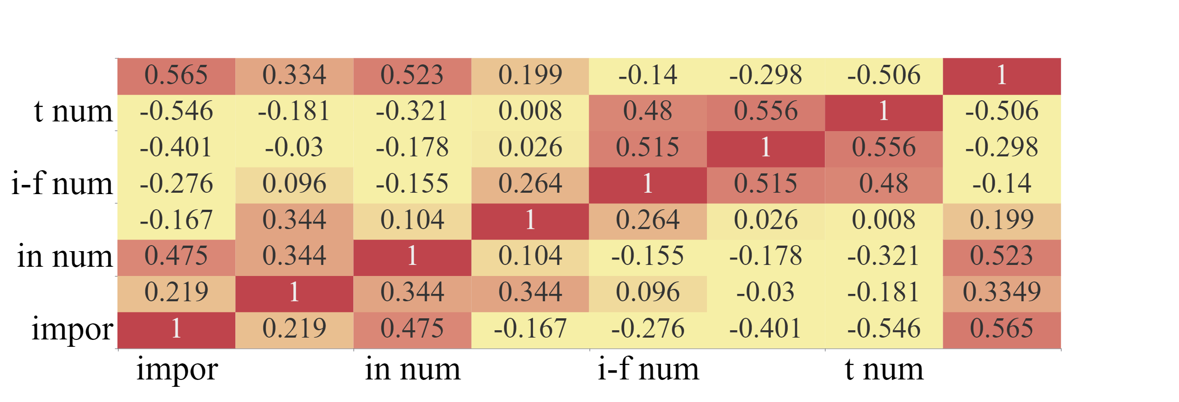


1
0

Slide 7

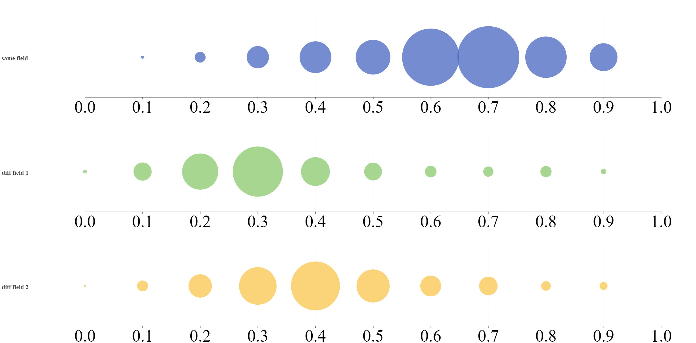


Same field
Diff field 1
Diff field 2

