Slide 1
Review
Ionospheric Calibration for the GFO Altimeter
Xiaoqing Pi
Byron A. Iijima
Anthony J. Mannucci
Mark J. Reyes
Jet Propulsion Laboratory, California Institute of Technology
July 20, 2000.

Slide 2
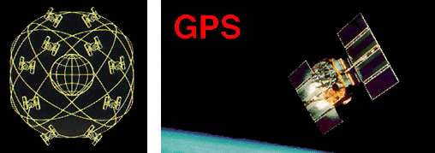
Outline
Objectives: Ocean altimeter calibrations
Technology: Remotely sensing the Earth’s ionosphere
using GPS
Resources: GPS satellites and the IGS global GPS
network
Methodology: Global ionospheric mapping (GIM)
Ionospheric calibration for the GFO mission:
  An automated GIM processor for GFO altimeter calibrations
  Daily deliveries of calibration data
  Accuracy assessment
Further development

Slide 3
TEC Data Sources: The IGS Global GPS Network
More than 300 permanent ground GPS stations are tracking 24~27 GPS satellites around the globe (the map shows selected sites) .
Dual-frequency (L-band) GPS observables are recorded every 30-seconds.
GPS data are collected in near real-time (NRT, hourly) or daily through Internet and phone lines, and archived at multiple centers.

Slide 4
Global Ionospheric TEC Map
Global snapshot of ionospheric TEC with a sub-hourly resolution
Driven by GPS data collected from the global network

Slide 5
Automated GIM Processor for Altimeter Calibrations

Slide 6
GFO Deliveries
Schedules
Daily delivery during May - August, 1999.
Daily deliveries since the middle of February, 2000.
Destinations
The Naval Oceanographic Office
NOAA
Products
Vertical TEC obtained from the GIM process along the satellite tracks.
The TEC error estimate based on the statistics of TEC difference between GIM and TOPEX data.
A backup (to be delivered if the GIM process fails): Vertical TEC obtained from the IRI95 empirical model.

Slide 7
Validation
Error Sources
Coarse coverage above oceans
Slant-to-vertical mapping
Data noise
  Ionospheric irregularities and scintillation
  Receiver malfunctioning
Challenge
Geomagnetic and ionospheric storms
Accuracy Assessment
Comparisons between GIM and independent ionospheric measurements (such as the TOPEX TEC) as well as empirical models
Statistical analysis to assess the accuracy of GIM over the oceans

Slide 8
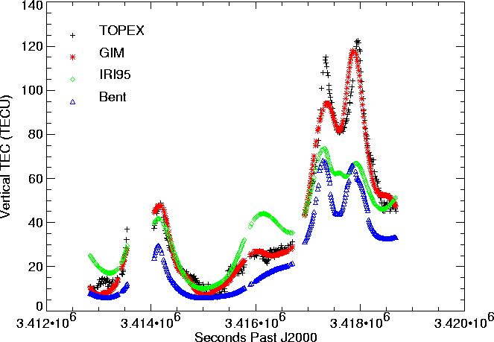
TEC Comparisons between TOPEX and GIM/Models
Date: 01/21/2000

Slide 9
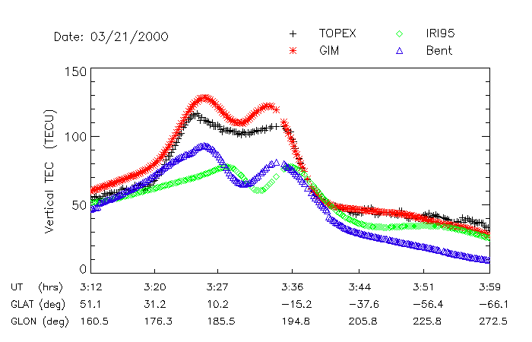
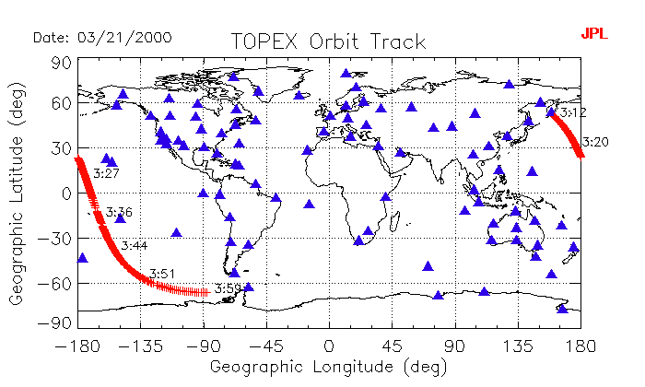
TEC Comparisons between TOPEX and GIM/Models

Slide 10
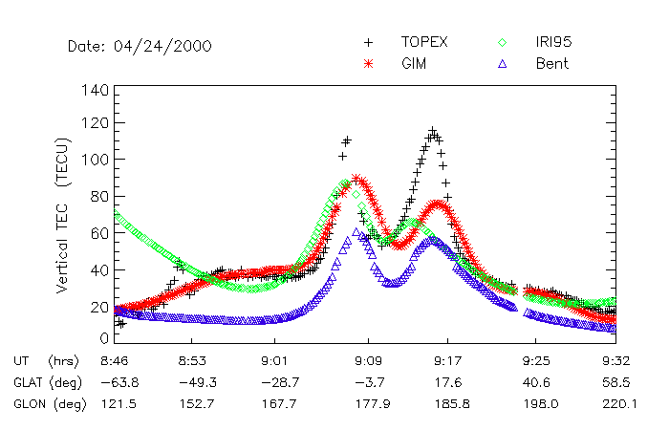
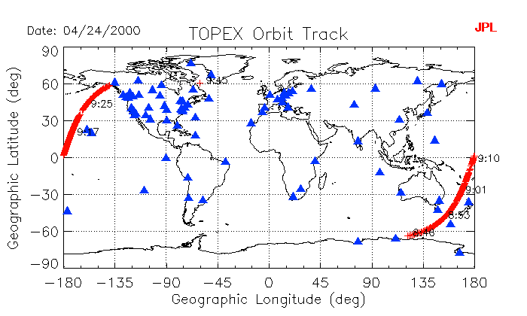
TEC Comparisons between TOPEX and GIM/Models

Slide 11
One-Day Histogram of Difference between Models and TOPEX
For 13.5 GHz signals (GFO): 1 cm = 4.5 TECU (1 TECU = 0.222 cm)

Slide 12
Daily Mean Difference between Models and TOPEX

Slide 13
Daily RMS of Difference between Models and TOPEX

Slide 14
Largest Daily Positive Difference between Models and TOPEX

Slide 15
Largest Daily Negative Difference between Models and TOPEX

Slide 16
Further Development
Measurements above oceans
  GPS receivers on ships?
  GPS ocean reflections
  Other types of measurements?
Global Assimilative Ionospheric Model (GAIM)
  Assimilate ionospheric data into physics-based models
  Take ionospheric dynamics into account
  Overcome data coverage problems

Slide 17
Ionospheric Data Assimilation
GPS - TEC
Data Processor
Observations
Data Selection
Ionosonde
Ne, h_{m}F₂, (v, U_{n})
Model Drivers
DMSP - UV, N_{e}, N_{n}
Forward Model
State
Prediction
Adjustment of State
and Drivers
Ionospheric Mappers
TEC, N_{e}, E, U_{n}, ...
Optimization

