Slide 1

The Health Care Workforce:
Key Trends, Challenges, and Strategies
Bram B. Briggance, Ph.D.
  UCSF Center for the Health Professions

Slide 2
Why Workforce Reform Is Cardinal
60-70% of health care is labor costs
Big part of any employment sector
10.5% of U.S. workforce (14,653,661)
It limits access, spurs cost increases, and directly affects quality
Crisis is looming for health workforce, but it has more to do with lack of innovation, than with shortage of workers

Slide 3
Part I.
Broad Trends Affecting the Health Care Workforce
Changing demographics
Shifting epidemiology
Economic disparity and cost
Technological innovations
Globalization
Change from supply to market driven health system

Slide 4
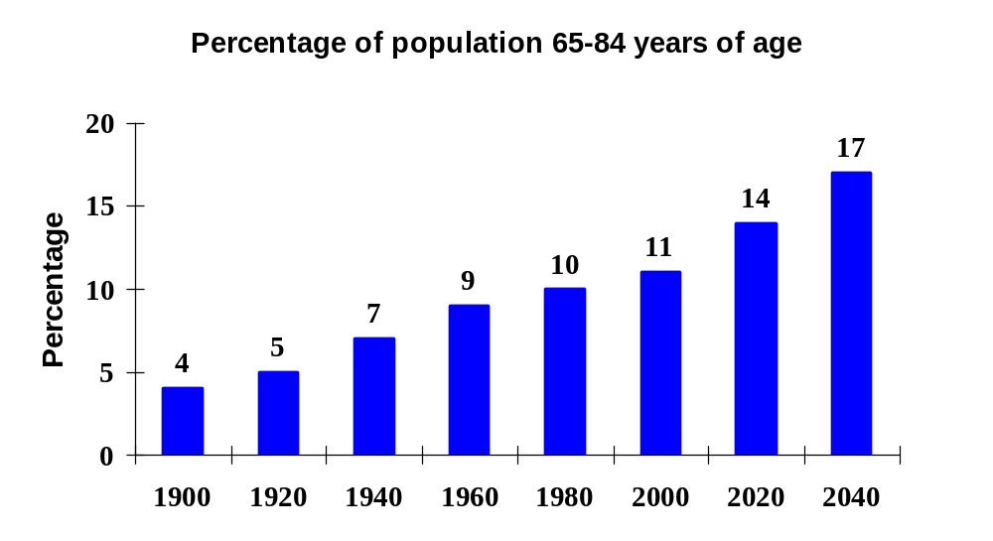
Demography ― Aging
➔Aging Population
Triple witching
Aging workforce
Fewer new workers
Care demands and needs of an aging population
…But the devil is in the details
Source: National Center for Health Statistics, 1993. Hyattsville, MD: Public Health Service, 1994. US Bureau of the Census, Historical Statistics of the US , Colonial Times to 1970, Washington DC, 1975.

Slide 5
Demography ― Aging
Issues
Impact on demand for health care
Rising cost of care
Adequate workforce
Intergenerational equity
Uneven across the nation
Source: Center for the Health Professions, 2003.

Slide 6
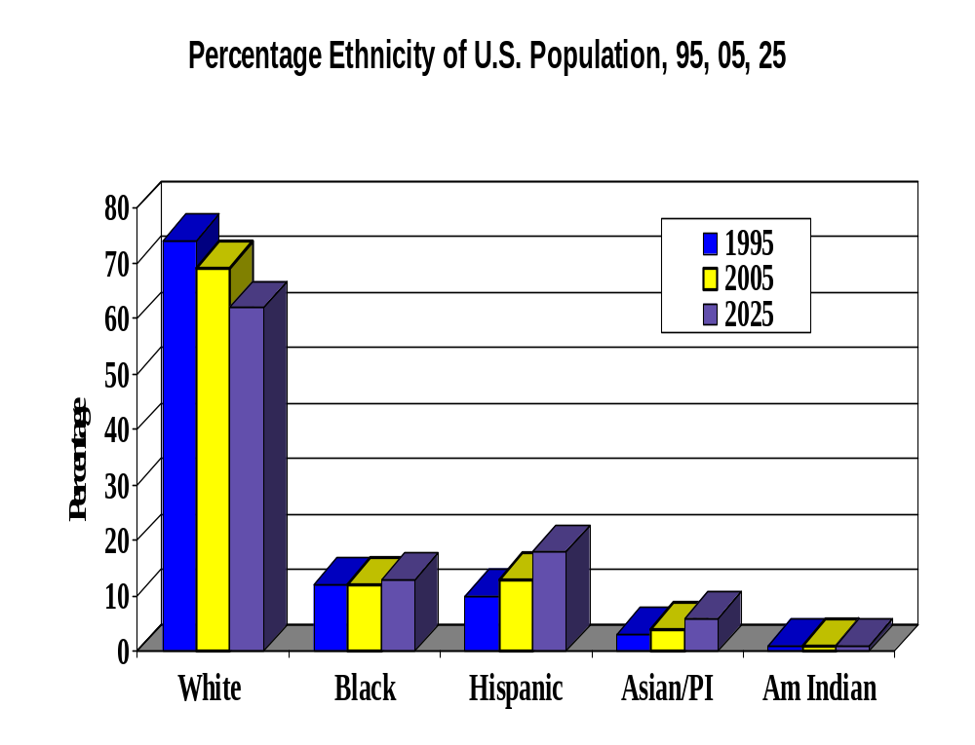
Demography ― Diversity
From a majority culture...
To diversity...
To multicultural.
SOURCE: CA Dept of Finance

Slide 7
Demography ― Diversity
Issues
From diversity to multiculturalism
  Health
  Leadership
Disparity in health outcomes
Culturally competent care
Distinctive market-consumer bias
New politics, and it won’t be what you think
Source: Center for the Health Professions, 2003.

Slide 8
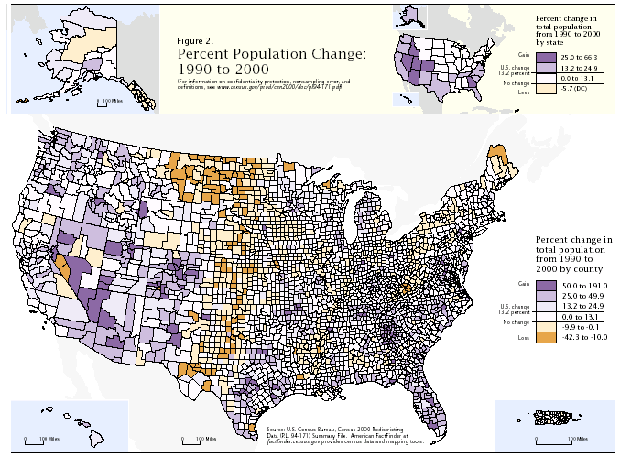
Demography - Distribution
10 largest states have 54% of population. 10 smallest have less than 3%.
Source: US Census Bureau, Population and Change, April 2001.

Slide 9
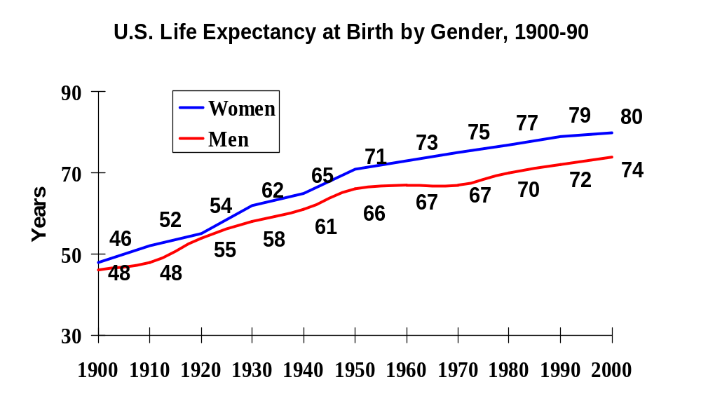
Epidemiology
A Generation Added in a Century
Source: National Center for Health Statistics, 1993. Hyattsville, MD: Public Health Service, 1994. US Bureau of the Census, Historical Statistics of the US , Colonial Times to 1970, Washington DC, 1975.

Slide 10
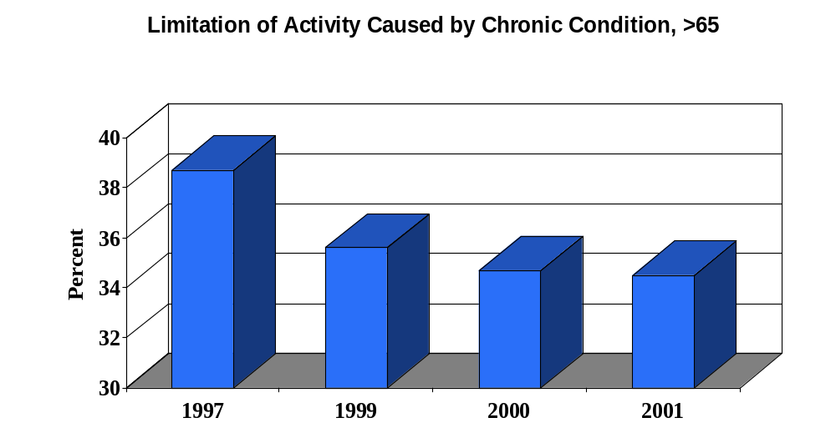
Epidemiology
SOURCE: Health US, 2003, USHHS, CDC,NCHCS, October 2003, 56.
Notes:
11
15
13

Slide 11
Trend: Epidemiology
Issues
Dominantly chronic
Expensively acute
Bipolar patterns of disease and health
Less and less to do with health care
Compression of morbidity
Source: Center for the Health Professions, 2003.

Slide 12
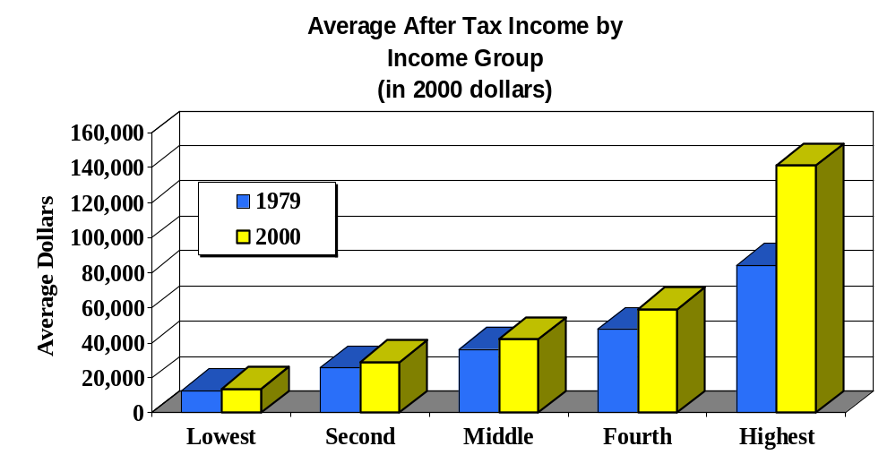
Economic Disparity
68.3%
% Change
15.1%
24.1%
13.3%
8.7%
SOURCE: Congressional Budget Office, Center on Budget and Policy Priorities, September 23, 2003.
Notes:
11
15
13

Slide 13
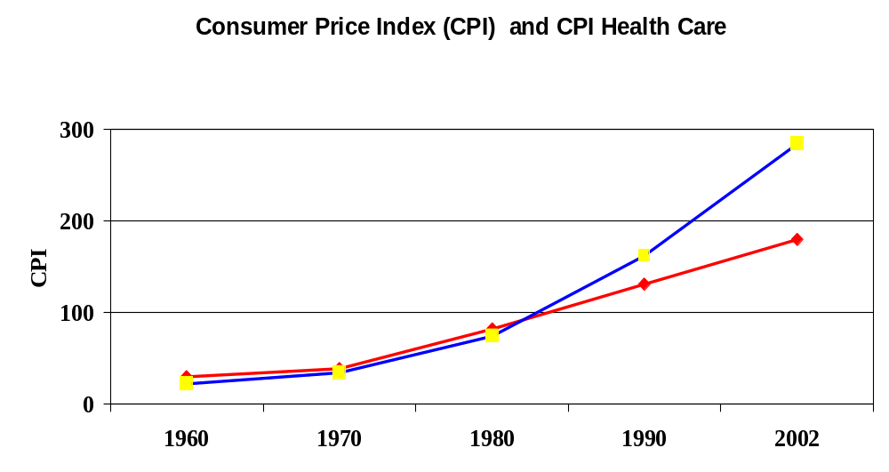
Cost
Health Care
All Items
SOURCE: Health US, 2003, USHHS, CDC,NCHCS, October 2003, 113.
Notes:
11
15
13

Slide 14
Economic Disparity
Issues
Larger and larger number cannot afford health care
Incumbents in health care become wealthier
Health policy and markets driven to serve those that have, rather than need
Impact back on patterns of health and outcomes
Source: Center for the Health Professions, 2003.

Slide 15
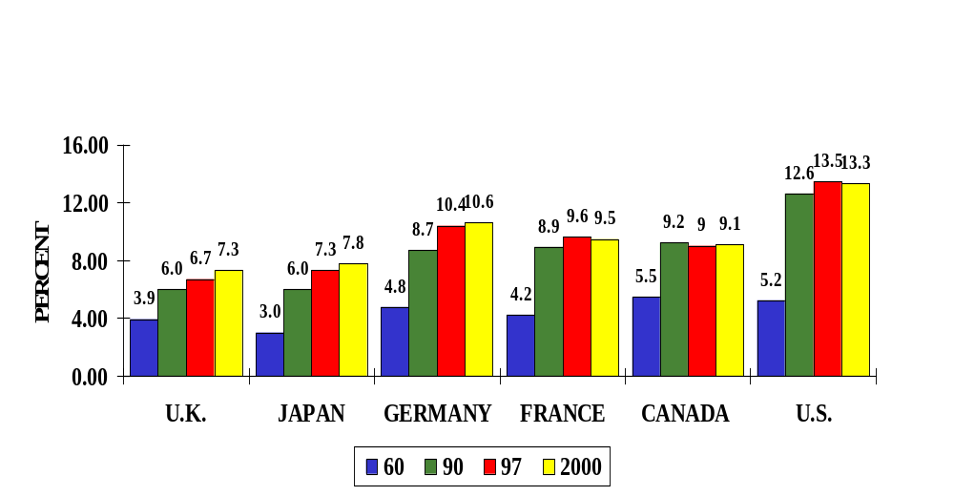
Globalization
Cost
Percent GDP Health Care, 1960, ‘90, ‘97, 2000
SOURCE: “OECD Health Data 98: A Comparative Analysis of Twenty-Nine Countries.” Paris: Organization of
Economic Cooperation and Development, 1998. Health US, 2003, USHHS, CDC, NCHCS, October 2003, 14.
Notes:
4
6

Slide 16
Globalization
Issues
Employment and coverage shrinking
Loss of traditional manufacturing job base
Health workforce and work globalized
Competitiveness with other service economies
Source: Center for the Health Professions, 2003.

Slide 17

Technology
Next generation of technology promises to reduce cost, move care to ambulatory settings, and improve outcomes.
Increase cost
Decrease cost
Imaging
Transplant
Open heart
Lung reduction
Statin drugs
Protease inhibitors
Photodynamic therapy
Amino bisphosphonate drugs
Source: Center for Disease Control, Health US.
Notes:
2
3
Downs, JR, Clearfield M, Weis, S, Whiney E, Shaprio, DR, Beere, PA, Langendorfer A, Stein EA, Kruyer W, Gotto AM, Primary Prevnetionof Acute Coronary Events with Lovastation in Men and Women with Average Cholesteril Levels, JAMA 279:20 (May 27, 1998): 1615-1622.

Slide 18
Technology ― Biotech
U.S. owns 85% of intellectual property in biotechnology
Only “industrial policy” followed consistently by both political parties
Consumer demand and expectation growing
Morph from biotech to care management technology
How the Market Is Betting:
Market Capitalization
Biotech, pharmaceuticals, equipment = $1,300B
Rest of health care = $169B
Over 1,300 New Biotech Companies
Over 200,000 Jobs

Slide 19
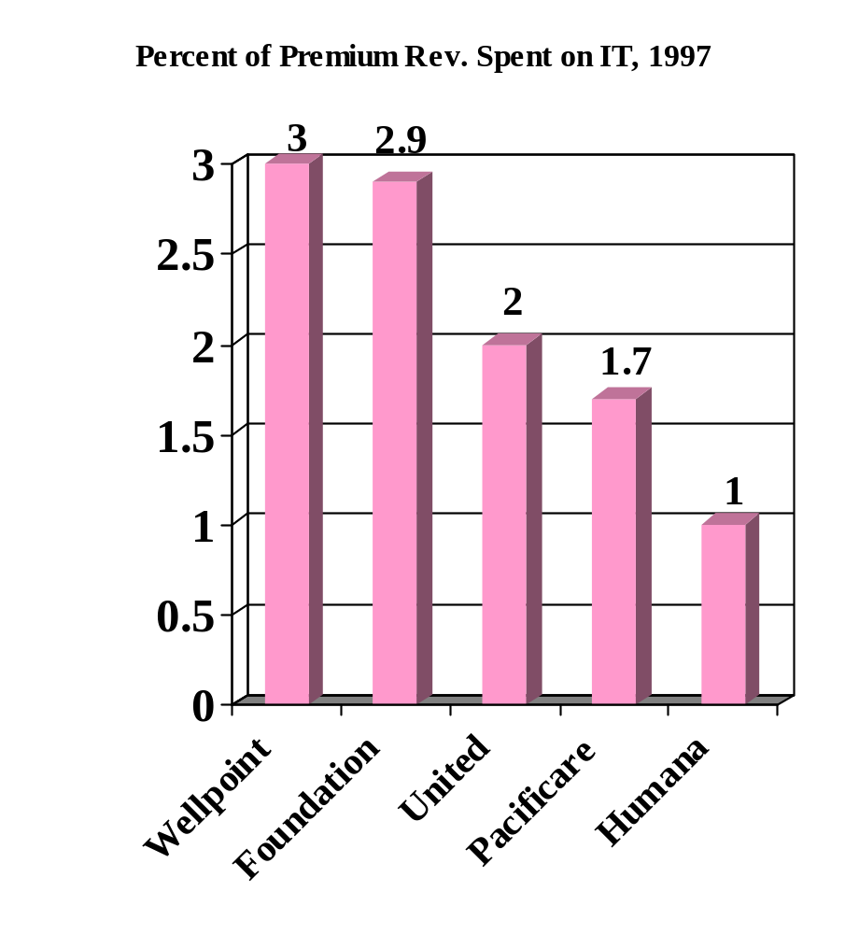
Knowledge Business
Technology ― IT
⇨ Information
33 million admissions
4.8 billion claims
505 million outpatient visits
1.7 billion prescriptions filled
Healthcare Infirmities, December 1995, p15.
MCW, March 30, 1998,

Slide 20
Technology ― IT
Issues
Capitalization
Driving value and consumer purchase
Grafting expensive technology on top or rotten process
Privacy
Only way to aggregate value of population, behavior, environment, and genome
Source: Center for the Health Professions, 2003.

Slide 21
Market-Driven Health
Values
From Supply Based to Demand Driven
Cost
Consumer satisfaction
Quality
Demand

Slide 22
Market Pressures
New challenge:
Changes needed:
How to balance the tradition of individualism with the needs of:
  Population health
  System outcomes
  Broader social needs
  Desire to balance equity and choice
  Public understanding and expectation
  Legal framework
  Financing system
  Provider expectations
  Funded and deployed public system

Slide 23
Consumer
Issues
Wants choice ….but at what price?
Increasingly willing to buy value… quality, access, and cost
Needs are more segmented than care systems acknowledge… build it and they will come
Inevitable exposure to more costs … will look for help to address

Slide 24
Part II.
A Glance at Three Challenges
Continued disequilibrium in health care
The war for talent
Unimaginative scopes of practice and professional models

Slide 25







Continued Disequilibrium in Health Care
Total system costs are a huge burden
Cost
Enormous range in definition of quality
Variation
Over/or undersupply of care providers, hospitals, insurers.
Capacity
Duplication
Substitutable inputs
Access
+15% uninsured

Slide 26
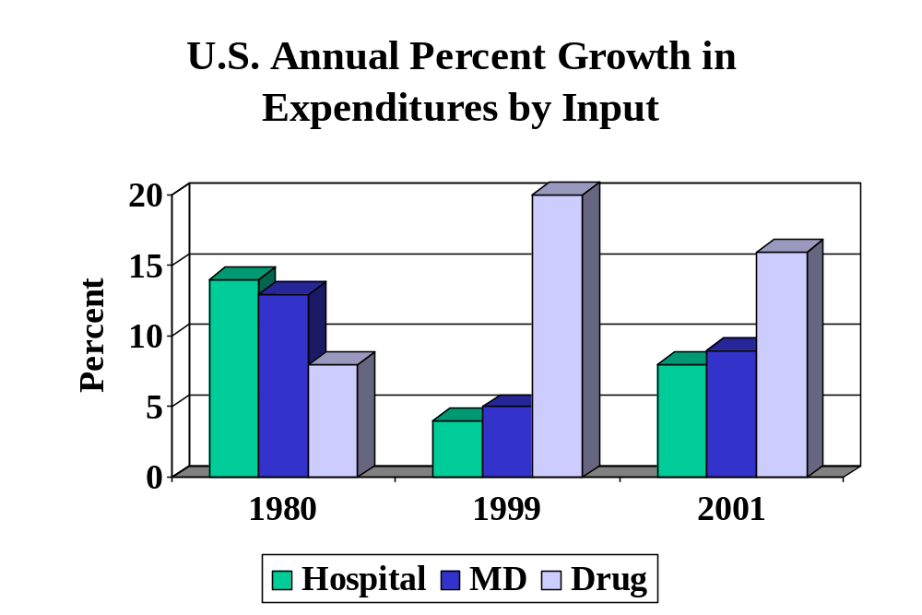
Continued Disequilibrium in Health Care
Source: HHS, CMS, www.cms.hhs.gov/statistics/nhe/default.asp

Slide 27
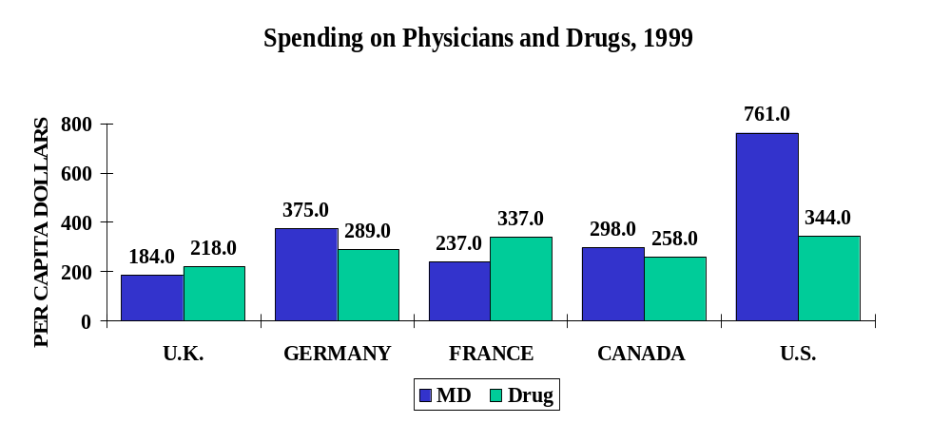
Continued Disequilibrium in Health Care
Source: OECD, Health Reports, 2001.

Slide 28
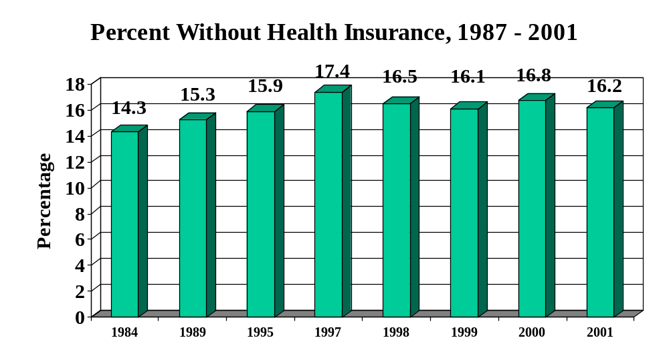
Continued Disequilibrium in Health Care
Source: CDC, NCHS, Health United States, 2003, p331.

Slide 29
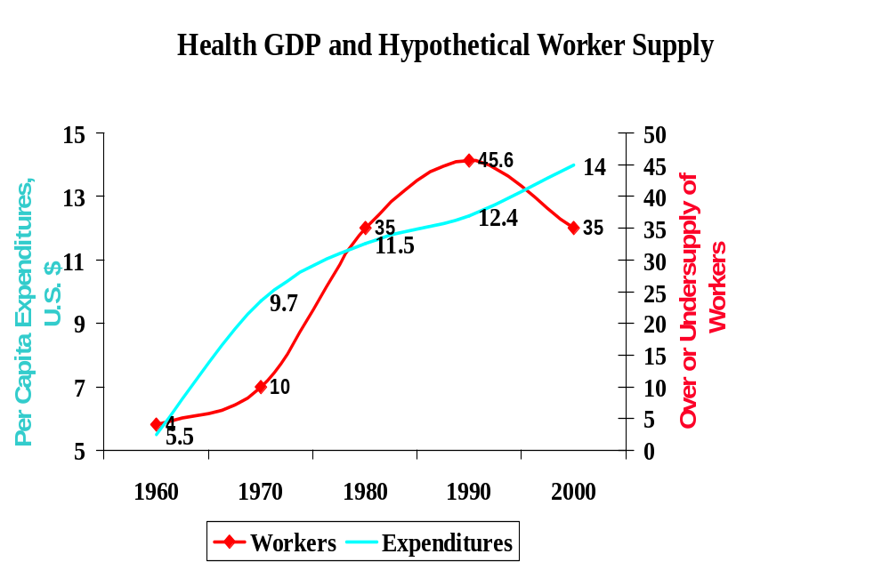
War for Talent

Slide 30
How Did This Emerge?
Past
Constantly expanding health system
Agreement on mission and structure
Clear and shared patterns of action
Little accountability ― cost or quality
Benefits of stability
Transition from simple and independent to complex and highly interdependent

Slide 31

What is driving the issue?
Stressed care delivery system and institutions
  Tighter resources
  Lack of direction
  Greater demands
    Technology
    Quality
  Job cuts
  Uncertainty
  Inability to adapt and change rapidly
  Half-born revolution

Slide 32
What is driving the issue?
Changing nature of work
  Faster
  Flatter
  Flexible
Trends
Market economy
Technology
Globalization
Changing values

Slide 33

What is driving the issue?
Changing demographics
  Race/ethnicity
  Aging population
New values
  Women in labor market
  Gen-X workers

Slide 34
New Values
Next Generation
Worker Desires
Service oriented
Anti-institutional
Not hierarchical
Flexible, change welcoming
Diversity
Technology
New skills
Community of work
Hospital Image
Staff is on strike, laid-off, or “angels of mercy”
Large, cold, unresponsive institutions
Work is stressful, highly structured, and un-fun
Tied to a professional career, not open to change

Slide 35
Unimaginative scopes of practice and professional models are absolutely crippling!!!

Slide 36
Beware Professional Interests:
Policy history is guided by the interests of individual professions
Population health concerns are secondary
Partnerships are accepted reluctantly
Guild mentality pervades everything
The future of health care should NOT be determined by internecine struggles
Most are subject to the same demographic, social, and economic pressures

Slide 37

Environment
Professions (Science)
Advances society by application of knowledge
Seeks exclusive control of system
Can become myopic and reductionist
Can become self-interested
Many are reactionary
Community (Consumers)
Seeks publicly defined social outcomes
Values consumer satisfaction
Seeks to balance cost of care with real and opportunity costs
Values informed but autonomous decision making

Slide 38

Environment (cont.)
Markets (Profit)
Allocate resources efficiently if not brutally
Driven by potential profits, entrepreneurial zeal
Considerable market failure
May generate unpalatable externalities
Effective in many social enterprises, but suspect in health care
Policy (Cost)
Corrects market failure
Focuses on cost reduction
Seeks to distribute justice by expanding care
Uses expert knowledge, run through a political ringer
Slow and reductionist

Slide 39
Transition Dynamics in Health Care
Can our professional models survive?
Cost unaware ---------------------- Cost accountable
Technologically driven ---------- Humanely balanced
Institution based ------------------ Community focused
Professional ------------------------ Managerial
Individual -------------------------- Population
Acute -------------------------------- Chronic
Treatment -------------------------- Management/prevention
Individual provider -------------- Team
Competition ----------------------- Cooperation
Disaggregated ---------------------- Integrated
Source: Pew Health Professions Commission, 1991,1993.
Notes:
3
4
2

Slide 40
We Need to Re-Examine
Professional Models
Scopes of practice
Specialist – generalist relationship
Organization of professional governance
Financing of care services
Training and specialization
New skill acquisition
Continuing competence

Slide 41
Strategy #1: Be Bold
Make sure what you do is…
Transformational in nature, nothing else worth doing
An agenda worth advancing
Drawn from core competencies and assets
Developed with clear and honest assessment of environment
Given adequate time to develop, mature, and be realized
Creating context for subsequent work

Slide 42
Strategy #2: Assume Responsibility
Make workforce a fundamental strategic issue
Integrate solutions with communities served
Mine what exists within present system
Assume partnerships will be necessary and create them!

Slide 43
Strategy #3: Foster Innovation
Act, Evaluate, Act Again
Build programs that can experiment and learn
Enlarge data collection, analysis, dissemination, BUT…
Don’t wait for a complete picture to develop, it will never happen
Experimentation is often much more efficient than research
Remember to calculate the cost of nonperformance

Slide 44
Strategy #4: Be Jeffersonian
The strength of the fabric of American culture is diversity and diffusion of power ― harness it
Call attention to emerging local issues
Convene diverse stakeholders to problem solve at local level
Invest in leadership development at all levels and across professions and institutions

Slide 45
Strategy #5: Create Opportunity
Perhaps the most important health issue is…
Economic Disparity
Perhaps the most important health
workforce issue is…
K-12 Education

Slide 46
Parting Shots
Most change is PSYCHOLOGICAL
Partnerships are ABSOLUTELY necessary
Important that we NOT enfranchise the status quo

Slide 47
Center for the Health Professions,
University of California,
San Francisco
We are here to help.
For more information, please contact:
Bram B. Briggance, Ph.D.
UCSF Center for the Health Professions
3333 California Street, Suite 410
San Francisco, CA 94118
415/476-8181
HTTP://FUTUREHEALTH.UCSF.EDU
bbb@itsa.ucsf.edu

