Slide 1
EDM Update
John Sinclair
ORNL

Slide 2
EDM Update
Minor feature additions
  Limits
  New env vars
  Optional widget attributes
  Modifications that support conversion tools
Bugs fixes
Qt Port

Slide 3
Qt Port
Qt?
Benefits
Porting tasks
Progress

Slide 4
Qt
Trolltech's platform independent application development framework
  GUI toolkit and widget library
  File I/O
  Socket I/O
  Dynamic Linking

Slide 5
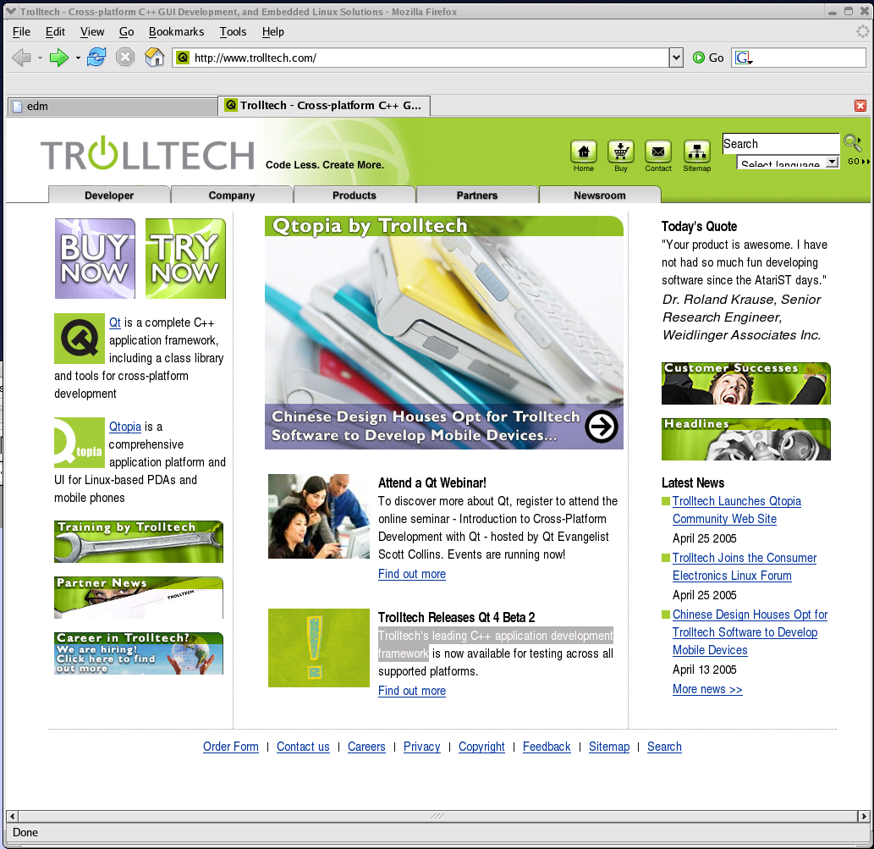

Slide 6
Benefits
Runs on Windows
New widget potentials
Possible future scripting capability
Qt-embedded?

Slide 7
Porting Tasks
Fonts
Colors
Support objects
  Dialogs
  Menus
  Color Palette
Display engine
Widgets
File I/O, socket I/O, and dynamic linking

Slide 8
Progress
Fonts
Colors
Support objects
  Dialogs
  Menus
  Color Palette
Display engine
Widgets
File I/O, socket I/O, and dynamic linking

Slide 9
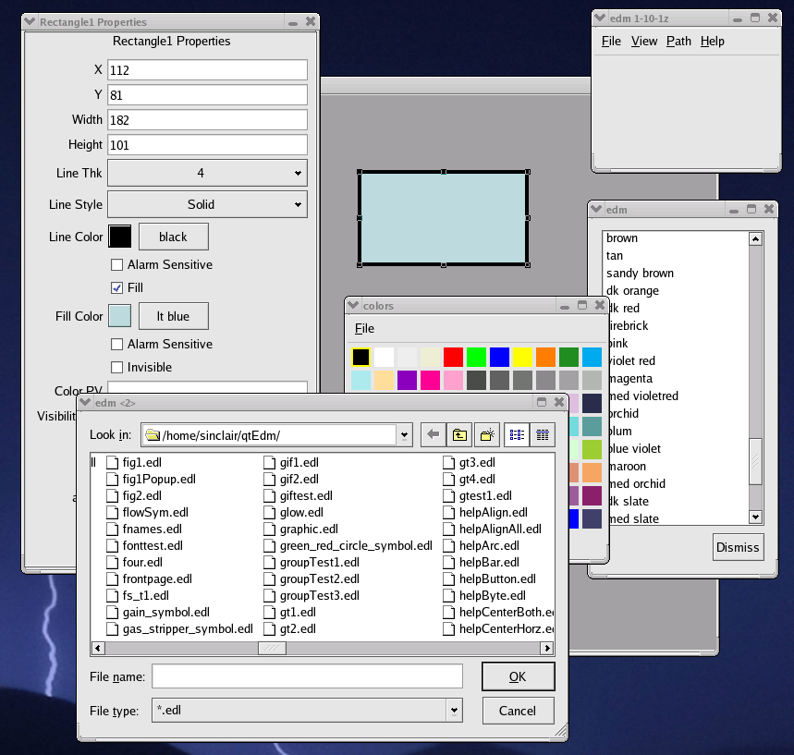

Slide 10
New Name?
Does the new EDM need a new name?

Slide 11
New Name?
Qt
Windows

Slide 12
qtEdm

Slide 13
cutedm

Slide 14
windm

Slide 15
winDoom

Slide 16
edm

