Slide 1
Coordinated Universal Time (UTC) and the Future of the Leap Second
Robert A. Nelson
Satellite Engineering Research Corporation
Dennis D. McCarthy
US Naval Observatory
Civil GPS Service Interface Committee
September 13, 2005

Slide 2
Historical Measures of Time
Universal Time
  Time based on the angular rotation of the Earth on its axis
Ephemeris Time
  Time based on the revolution of the Earth around the Sun
Atomic Time
  Time based on the hyperfine transition of the cesium 133 atom

Slide 3
Universal Time (UT)
Time measured by the rotation of the Earth on its axis with respect to the Sun
UT = mean solar time reckoned from midnight on the Greenwich meridian
Traditional definition of the second used in astronomy
Mean solar second = 1/86 400 mean solar day

Slide 4
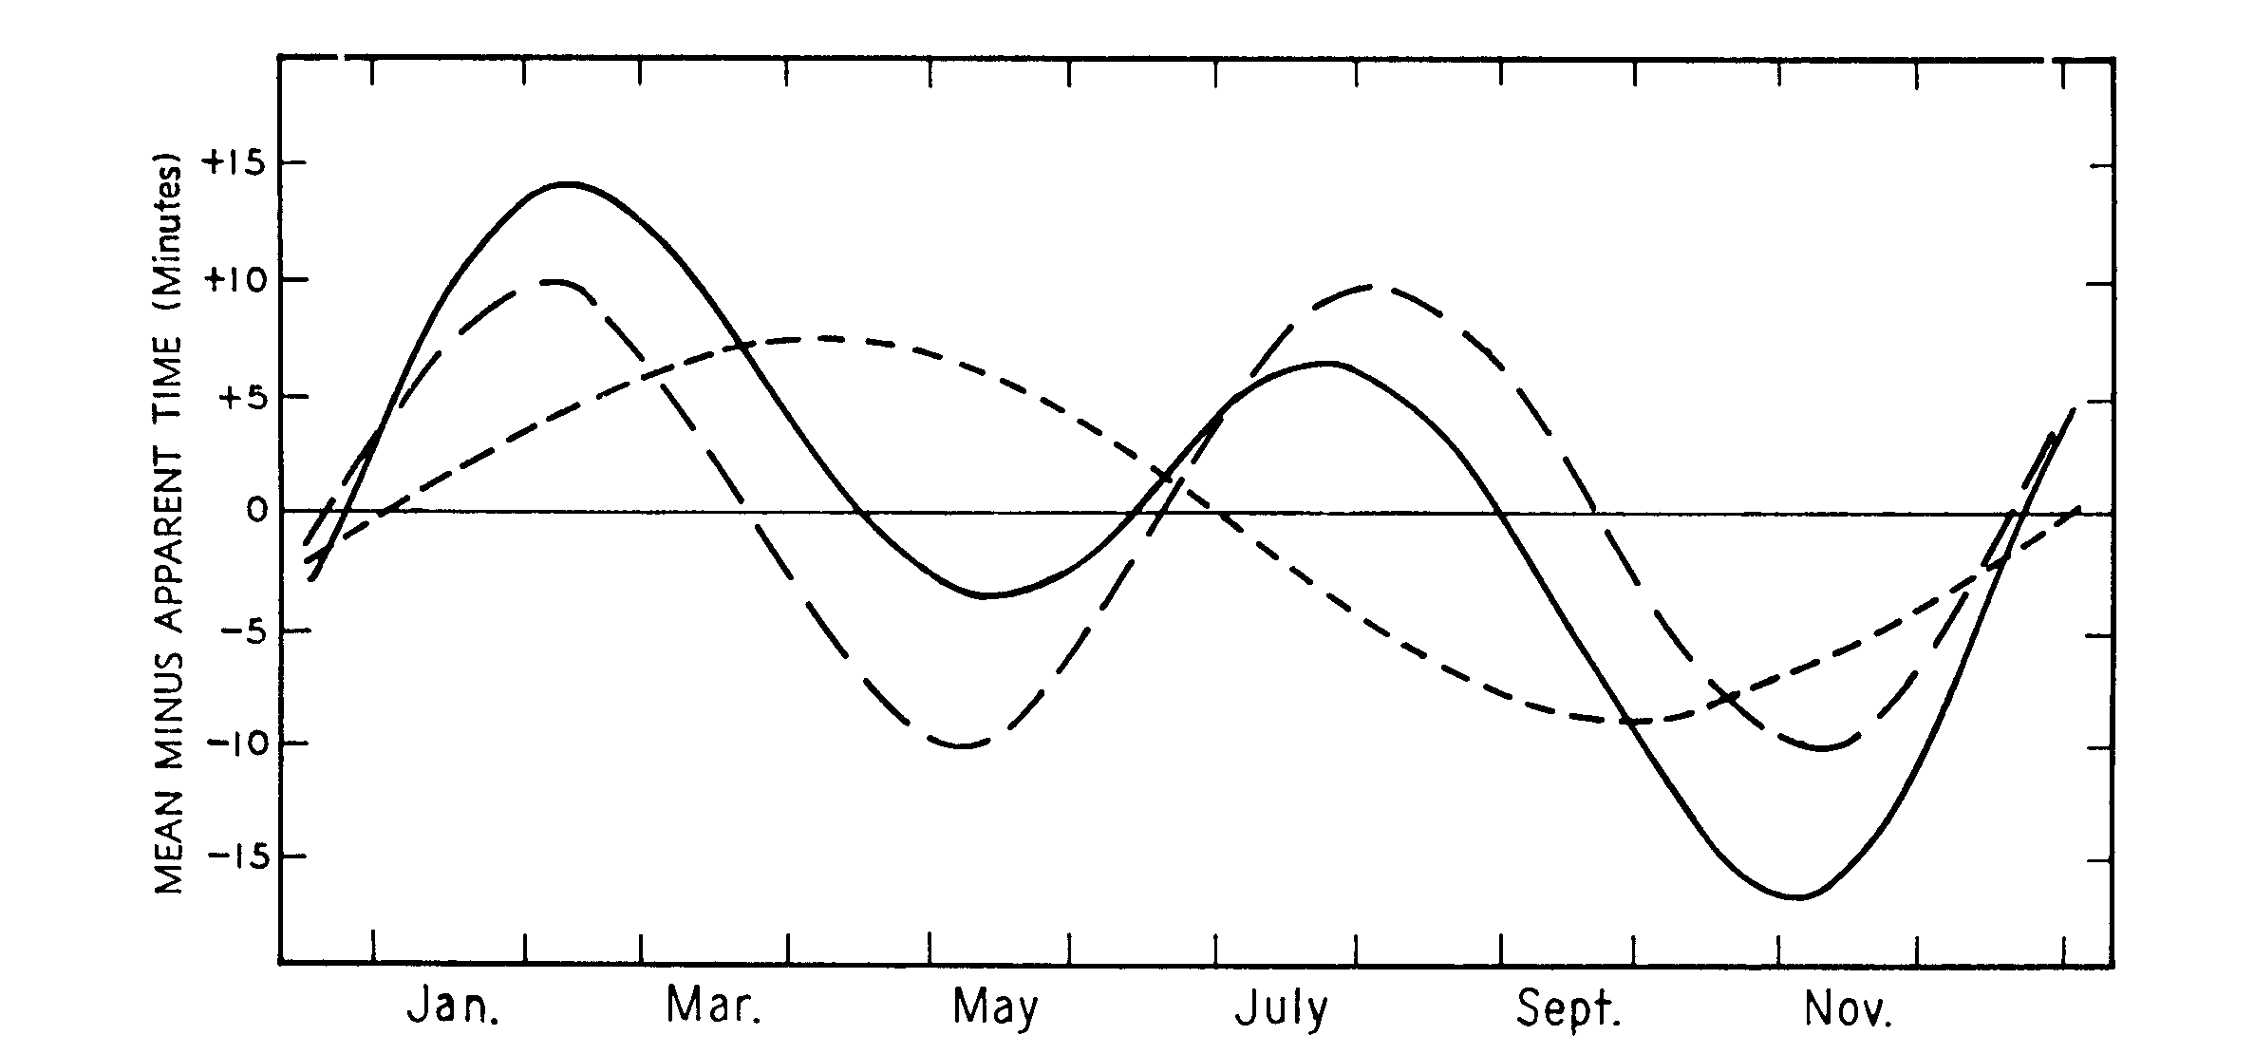
Mean time vs. apparent time
combined effect
inclination effect
eccentricity effect
After B.M. Oliver, “The Shape of the Analemma,” Sky and Telescope, July, 1972, 20 - 22
Difference between mean time and apparent time is called the “equation of time”
  Mean noon precedes apparent noon by 14.5 minutes on February 12
  Apparent noon precedes mean noon by 16.5 minutes on November 3
Mean solar time (clock time)
  Mornings (sunrise to mean noon) are half hour shorter than afternoons in February
  Afternoons (mean noon to sunset) are half hour shorter than mornings in November

Slide 5
Variations in the Earth’s rotation
UT is not uniform
Variations in the Earth’s rotation (Length of Day)
  Steady deceleration (well established by early 20th century)
  Periodic variations (detected in 1930s)
  Random decade fluctuations (measured in 1950s)
Conservation of angular momentum
  As the Earth’s rotation decreases, the Moon moves farther away

Slide 6
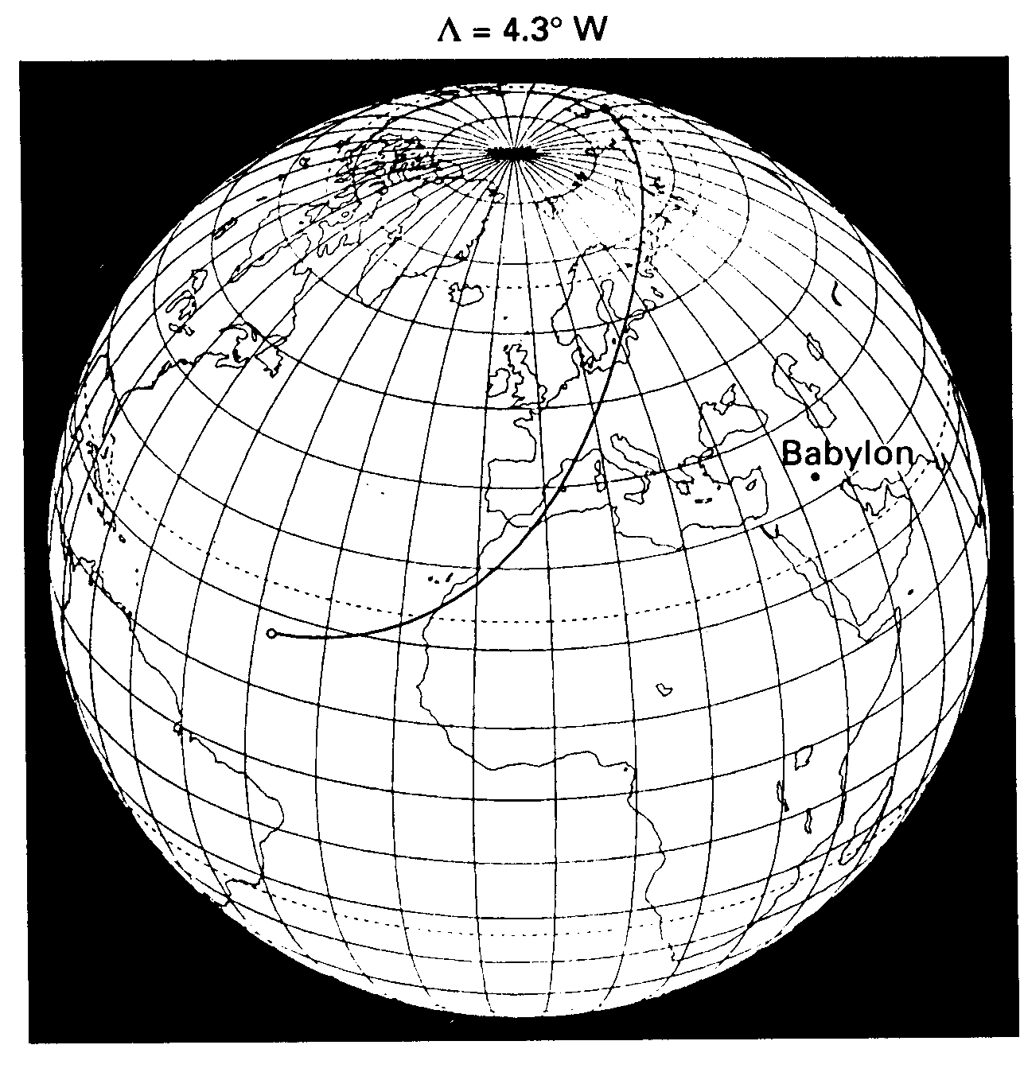
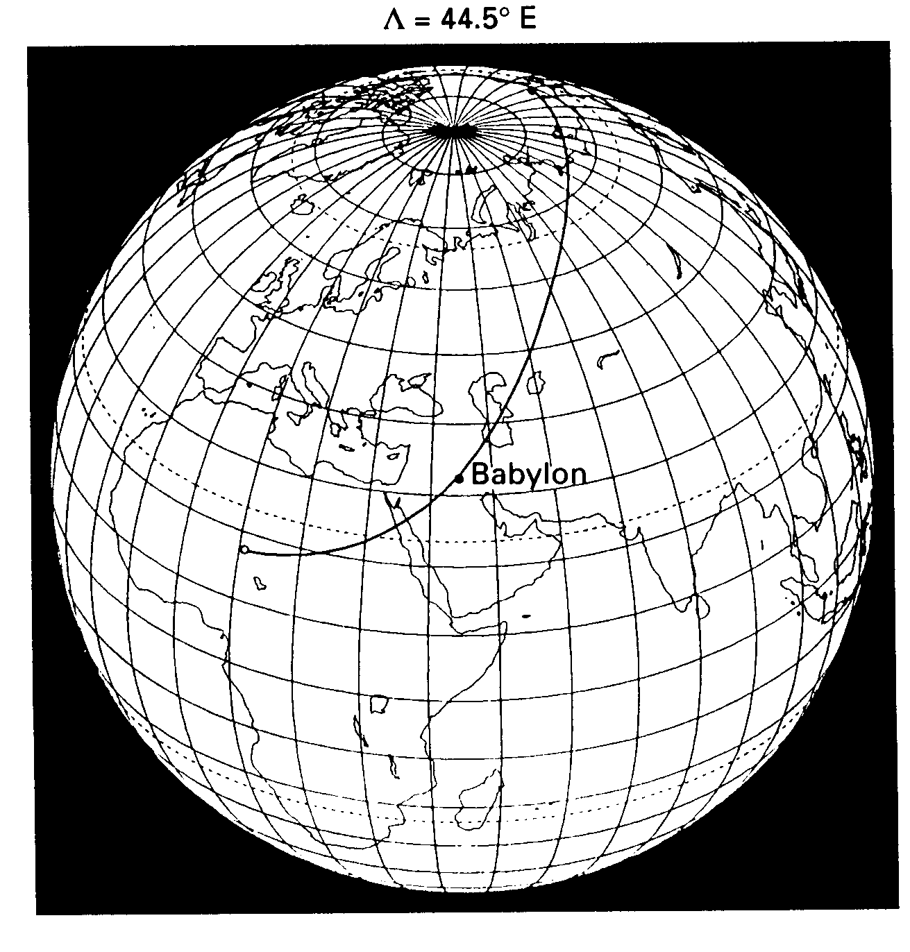
Eclipse of 136 BC observed from Babylon
ΔT = 0
ΔT = 11 700 s = 3.25 h
Reference: F.R. Stephenson, Historical Eclipses and Earth’s Rotation (Cambridge, 1997), p. 66

Slide 7
Forms of Universal Time (UT)
UT1
  True measure of the Earth’s rotation angle in inertial reference system
  Defined in terms of Greenwich Mean Sidereal Time (GMST)
UT2 (no longer used)
  UT1 corrected for the seasonal variation (± 30 ms)

Slide 8
Ephemeris Time (ET)
Uniform measure of time determined by the orbital motions of the celestial bodies
ET is defined as the time that brings the observed positions into accord with the theoretical positions as determined using the Newtonian theory of gravitation
Revolution of the Earth about the Sun represented by Newcomb’s Tables of the Sun. Geometric mean longitude of the Sun for the epoch January 0, 1900, 12 h UT
where T is ET elapsed since 1900 in Julian centuries

Slide 9
Definition of Ephemeris Second
Definition of the SI second adopted by the CIPM in 1956 and ratified by the 11th CGPM in 1960
Ephemeris second = the fraction 1/31 556 925.9747 of the tropical year 1900
Newcomb assumed that UT1 is uniform in calculating his formula for the mean longitude of the Sun. However, the Earth’s rotation has been slowing due to tidal friction at the rate of approximately 1.4 ms/d/cy over the past 1000 years
Observations analyzed by Newcomb ranged in date from 1750 to 1892 with a mean epoch of approximately 1820
Ephemeris second = mean solar second of approximately 1820

Slide 10
Atomic definition of the second
Definition of the SI second adopted by the 13th CGPM in 1967
Second = duration of 9 192 631 770 periods of radiation corresponding to the transition between the two hyperfine levels of the ground state of the cesium-133 atom
Second of atomic time = second of Ephemeris Time (ET)

Slide 11
International Atomic Time (TAI)
TAI is a coordinate time scale defined in a geocentric reference frame with the
SI second as realized on the rotating geoid as the scale unit
Uniform time measured by frequency of cesium-133 hyperfine transition
Unit interval = SI second
Continuous atomic time scale determined by Bureau International de l’Heure (BIH)
since 1958, now maintained by Bureau International des Poids et Mesures (BIPM)
TAI = UT2 on January 1, 1958 0 h
Named TAI in 1971

Slide 12
Terrestrial Time (TT)
Terrestrial Time (TT) is defined by atomic clocks on the surface of the Earth
TT has same rate as TAI with unit interval of the SI second
Maintains continuity with Ephemeris Time (ET)
TT has origin of January 1, 1977 0 h
Practical realization of TT
TT = TAI + 32.184 s
Constant offset is the difference between ET and UT1 at the epoch of TAI
Theoretical equivalence of time measured by quantum mechanical atomic
interaction and time measured by gravitational planetary interaction
TT = ET

Slide 13
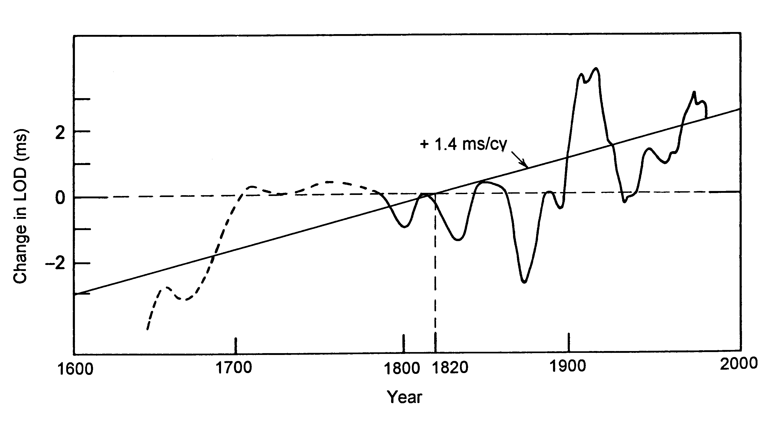
Length of Day Since 1600
decade fluctuations
trend over past 1000 years
After F.R. Stephenson and L.V. Morrison, Phil. Trans. R. Soc. London A313, 47 – 70 (1984)

Slide 14
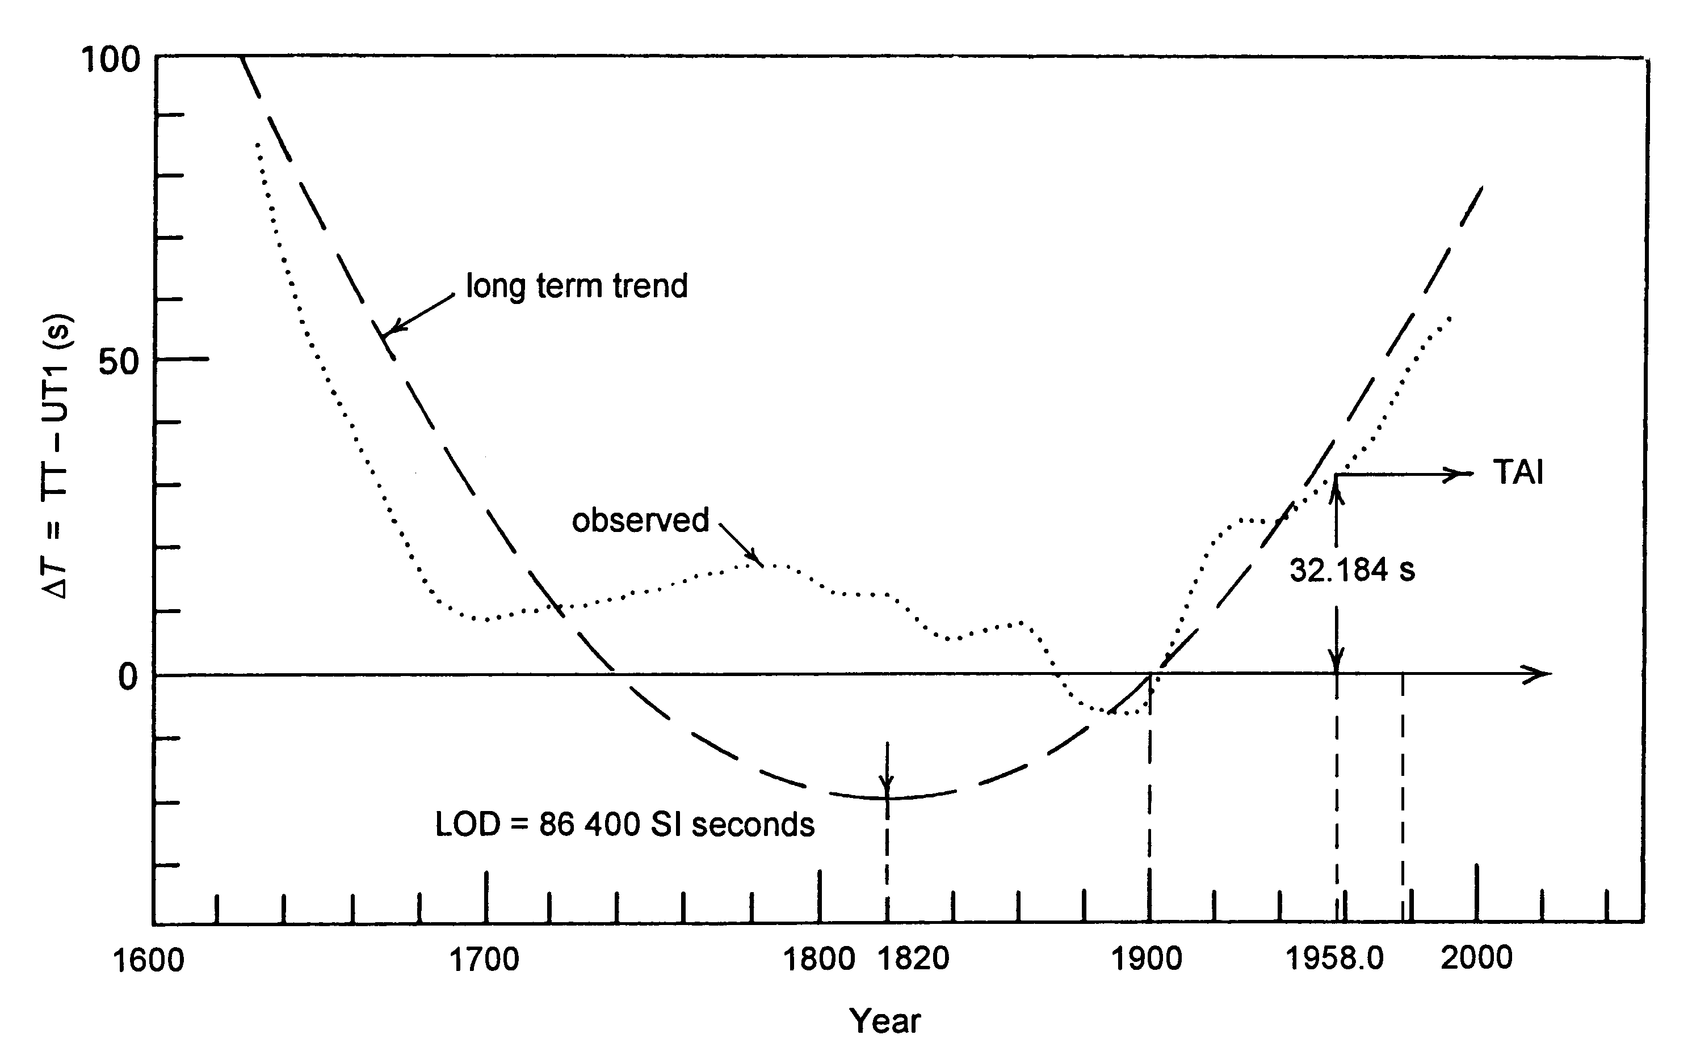
ΔT since 1600
TT
ET
1977.0
After F.R. Stephenson and L.V. Morrison, Phil. Trans. R. Soc. London A351, 165 – 202 (1995)

Slide 15
Coordinated Universal Time (UTC)
Coordination of worldwide atomic time and frequency radio transmissions
by BIH began in 1961
Reference frequency of 9 192 631 830 Hz for cesium based on second of ET
Details of UTC system were formalized by International Radio Consultative
Committee (CCIR) of International Telecommunication Union (ITU) in 1962
Name Coordinated Universal Time (UTC) adopted by IAU in 1967
From 1961 to 1972 UTC contained both frequency offsets and fractional
(less than 1 s) steps to maintain agreement with UT2 within about 0.1 s
In 1972 present UTC system was adopted, with 1 s (leap second) steps
but no frequency offsets to maintain agreement with UT1 within 0.9 s
Definition of UTC is a compromise to provide both the SI second and an
approximation to UT1 for celestial navigation in same radio emission

Slide 16
Duration of time scale units
Second of ET = Second of UT1 averaged over the 18th and 19th centuries
Second of TT or TAI = SI second = Second of ET
Thus the SI second represents the second of UT1 in the early
19th century (mean solar second of approximately 1820)
LOD has been increasing at rate of about 1.4 ms/d/cy
Present LOD is about 86 400.025 SI seconds (modified by short term fluctuations)
Difference of 2.5 ms from SI day of exactly 86 400 SI seconds
accumulates to about 1 second in a year
For broadcast UTC time signals, accumulated excess in LOD initially compensated
by frequency offsets and fractional steps, now compensated by leap second steps

Slide 17
UTC frequency offsets
(Relative frequency offset in units of 10⁻¹⁰⁾
0
International offset
Offset referred to the BIH atomic time (1965)
-100
-130
-150
-150
-300
1958 1960 1962 1964 1966 1972
Courtesy of E.F. Arias, B. Guinot, and T.J. Quinn, ITU-R SRG Colloquium on the UTC Time Scale
(Torino, Italy, May 28 – 29, 2003)

Slide 18
Evolution of UTC time steps
(n) number of time steps
1 s
100 ms (8)
50 ms (1)
20 ms (29)
1957 1962 1963 1967 1972
Courtesy of E.F. Arias, B. Guinot, and T.J. Quinn, ITU-R SRG Colloquium on the UTC Time Scale
(Torino, Italy, May 28 – 29, 2003)

Slide 19
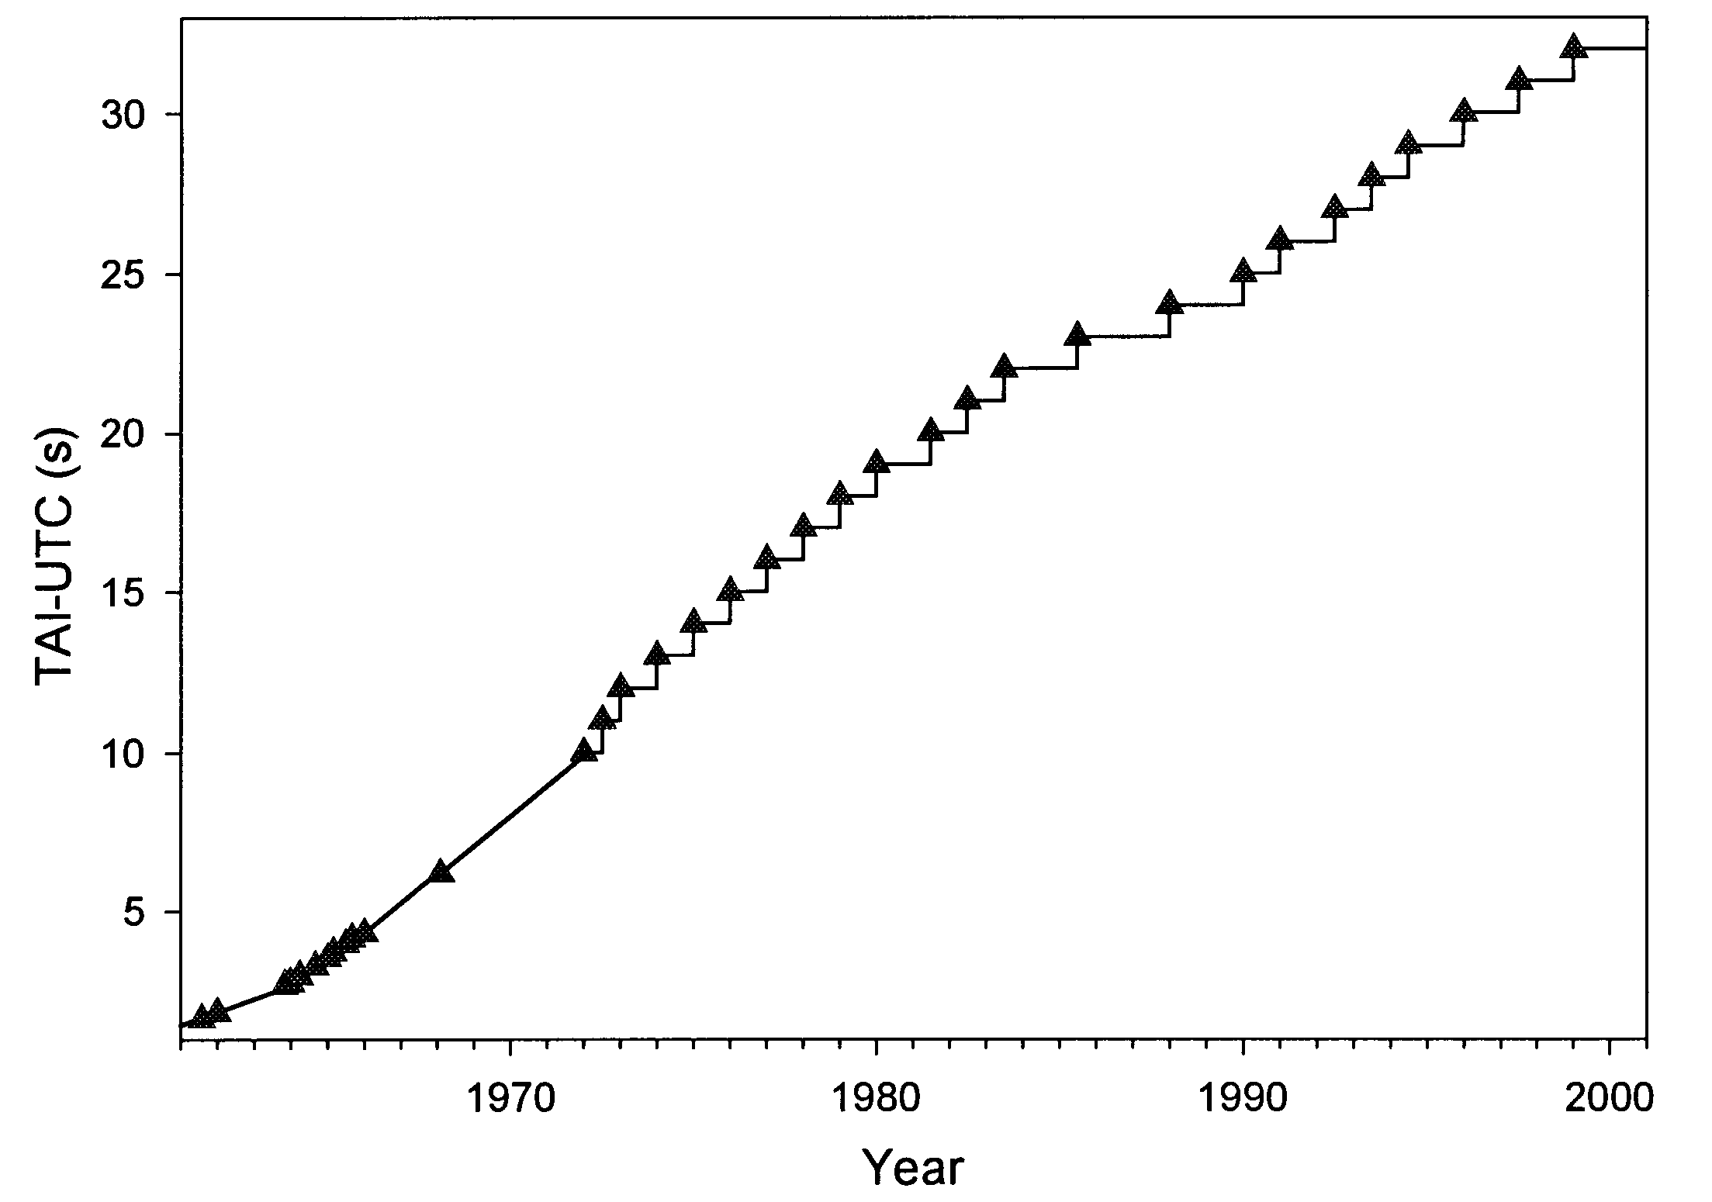
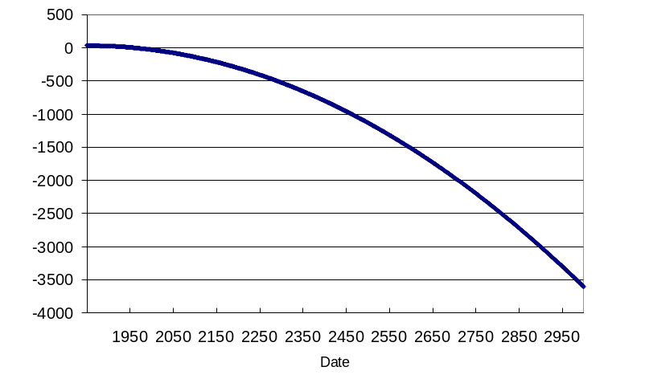
UTC since 1961
In 1972 ΔT = 42.23 s. Thus TAI – UTC set = 10 s
22 leap seconds have been added since 1972
Presently TAI – UTC = 32 s
slope = (2.1 ± 0.05) ms per day
UT1 − uniform time without leap seconds
Difference after 50 years = 1 minute
Difference after 100 years = 2.5 minutes
Difference after 1000 years = 1 hour
Elimination of leap seconds would have no practical effect on customary social conventions
Courtesy of E.F. Arias, B. Guinot, and T.J. Quinn, ITU-R SRG Colloquium on the UTC Time Scale (Torino, Italy, May 28 – 29, 2003)

Slide 20
Data for UT1
When it was introduced in 1972, UTC was still the most readily available worldwide system for independent determination of position
The development of GPS and the wide availability of satellite navigation systems has diminished the need for a broadcast approximation to UT1
UT1 does not represent time as commonly defined today; instead it is an angle used to determine the Earth’s orientation in space.
The International Earth rotation and Reference system Service (IERS) produces weekly bulletins in printed and electronic formats with daily updates that provide the current value of UT1 – UTC along with predictions. These data provide to astronomers knowledge of UT1 many orders of magnitude more accurately than what is obtainable on the gross assumption that UT1 is the same as UTC.
Currently the error in substituting UTC for UT1 can be as much as 900 milliseconds. Improvements in telescope pointing software made possible by using IERS data could be implemented as part of routine upgrade maintenance. The IERS maintains web sites with this information and is planning on making the data even more accessible in the future.

Slide 21
Legal definition of civil time
Since 1988 international timekeeping has been governed by the International Bureau of Weights and Measures (BIPM) under the authority of the General Conference on Weights and Measures (CGPM).
Both the CGPM and the ITU recognize UTC as the basis of civil time and as the scientific equivalent of Greenwich Mean Time (GMT) or mean solar time. The CGPM and ITU are treaty organizations to which most industrialized nations belong, including the US and the UK.
British political opposition to eliminating leap seconds from UTC because GMT is established in its domestic laws is unfounded. Ironically, the Greenwich Observatory no longer exists and the British Broadcasting Company derives its time signal from the realization of UTC that is obtained from the GPS, which is maintained by the US Naval Observatory.

Slide 22
GPS System Time (GPS Time)
No leap seconds
Origin is midnight of January 5/6, 1980 UTC
Steered to within 1 μs of UTC(USNO), except no leap seconds are inserted
Relationships with TAI and UTC (within statistical error)
  GPS Time = TAI – 19 s = constant
  GPS Time = UTC + 13 s presently

Slide 23
Issues
Problems with current system
  communications
  time stamping
  proliferation of non-standard time scales
Impact of keeping or changing present system
  Many people envision major problems in the future
    Integral steps in civil time
    Need for multiple leap seconds per year in the future
  Others depend on the difference UTC - UT1 being less than one second; they will need to upgrade their systems if leap seconds are eliminated
    Astronomical observatories
    Geolocation systems
Important policy issues
  Philosophy of whether or not to eliminate leap seconds from UTC
  Problem is really the expense of making changes in current software being used by observatories, satellite systems, geolocation systems
  If leap seconds were eliminated, what would be appropriate deadline
  What is the role of GNSS time scales in international timekeeping

Slide 24
International discussions
UTC is international standard for civil time
Time distributed by GNSS has become a de facto means to obtain UTC globally
Leap seconds in UTC encourage the use of alternative time scales that are continuous
Discussions are under way to possibly modify UTC by eliminating leap seconds
  ITU-R SRG Colloquium on the UTC Time Scale (Torino, Italy, May 28 – 29, 2003)
  CCTF (April 2004)
  ITU WP 7A (currently)

Slide 25
Conclusions
Continued use of current definition of UTC with leap second steps presents potential difficulties in complex timekeeping systems
Leap second planned for end of 2005 (the first since 1998) will be an important case study
The GPS will continue to disseminate UTC, regardless of whether it is redefined. It will continue to be an international standard for time.

