Slide 1
Security Awareness Campaign
Sandia National Laboratories
Adele Montoya
S&S Education & Training Project Lead
Ann Marie Griego
Security Awareness Coordinator

Slide 2
Security Awareness & Lessons Learned (SEALL) Team
Membership – Team comprised of representatives from the majority of security programs (e.g., cyber, foreign interactions, personnel security, SIMP, OPSEC, Export Controls, CMPC, electronic security, etc.) as well as representatives from SNL/CA, HR, LIWG, SORT, Corporate Training, and the Security Stand-down Team.
Charter
  Promote integration and effectiveness of security awareness activities that reinforces Sandia’s corporate security culture.
  Reinforce that security is second nature in how we conduct business.

Slide 3
Security Goal
For the workforce, consciously or subconsciously, to make the right security moves/actions and decisions (= DESIRED PERFORMANCE)
Security Education – Providing basic security knowledge through:
One time Initial and Comprehensive Security Briefings
Annual SEC-100
Security Training – Training Sandia’s members of the workforce to the level of proficiency and competence commensurate with their security roles and responsibilities.
Security Awareness - Applying a “two-pronged” approach to achieve:
1. Ongoing re-enforcement/reminders of security basics to engrain these basics and achieve a security “mindset” (culture)
2. Alerting workforce in a timely manner to specific undesired security performance issues and trends with goal of “righting” performance.

Slide 4
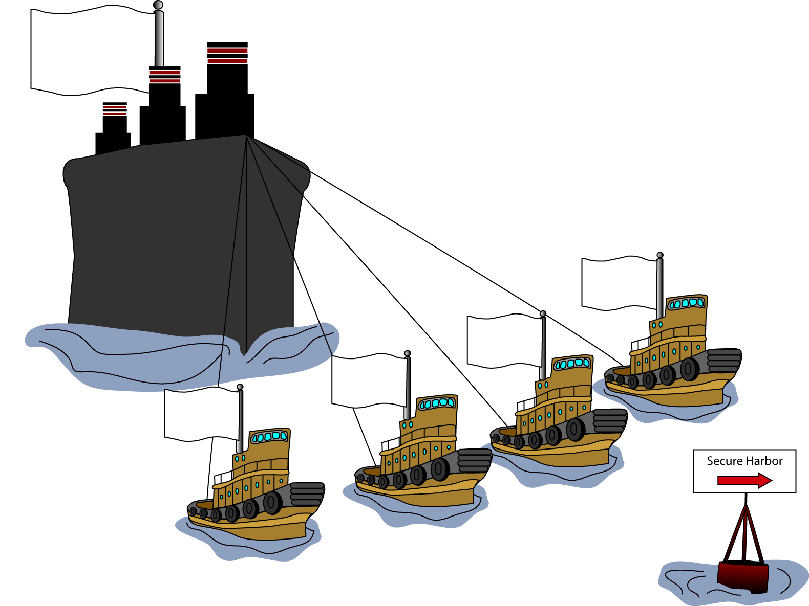
Security
Culture
2004 Security Awareness Campaign
  4Rs:
  Right security information, to the
  Right audience, at the
  Right time, through the
  Right mechanisms
How
When
Who
What

Slide 5

New Logo/Motto

Slide 6
Security Awareness Campaign Subcommittees
Kickoff
New Members of the Workforce
Management Toolbox
Security-related Topics

Slide 7
Kickoff Theme – “Cinco de Mayo”
Ambiance | Festive
Colors | Red, Green, White
Music | Mariachis, Classical Guitar
Food | Salsa, Biscochitos, etc.
Drink | Margaritas (just kidding, Securitas)

Slide 8
Kickoff Presentations
Ron Detry, VP & Chief Security Officer GUEST SPEAKERS: Joe Ruffini Lette Birn Wayne Morris Special Event: The “OPPIES” | Welcome & Importance of Security Surviving in a World of Information & Terror 9/11 and the Pentagon Identity Theft and YOU Awareness Film Awards (Bloopers Included)

Slide 9
Displays, Demonstrations, & Giveaways
All Security organizations—including Homeland Security, Counterintelligence, Cyber Security, Export Control and others—will be represented by exhibits.
Demonstrations:
–Locking and Monitoring of Safes
–Decontamination Foam
–“Bat Mobile”
Giveaways

Slide 10
Communications
Sandia Daily News
Lab News Articles
Website
Electronic Message Board
Teleprompter Messages
Porcelain Press
Secretarial Newsletter
Division/Center Newsletters
E-mails to Directors/Managers
Flyers
Flyers, e-mails to Facility Security Officers/
offsite consultants

Slide 11
Video Links to Satellite Locations
SNL/CA Auditorium
Video links to SNL Remote Sites
Conference Centers in other SNL/NM areas
Sandia video to all monitors
Streaming to the desktops

Slide 12
New Members of Workforce
VP Ron Detry is making a “Welcome” video clip that stresses the importance of security at SNL. Video will be shown as part of New Hire orientation.
Partnering with Human Resources to enhance training currently provided to new Members of the Workforce.
Developing manager checklists for new employees.
Developing workbooks as required.

Slide 13
Management Security Tool Box
Goal – To build an effective tool box that is:
    Easy to find.
    Easy to use.
    Information and tools.

Slide 14
Security-related Topics
Regular “Brown Bag” Dialog Sessions
Guest Speakers
Awareness/Training Modules

