Slide 1


Femtoscopy in p+p vs heavy-ions in STAR
Zbigniew Chajęcki
The Ohio State University
for the STAR Collaboration

Slide 2
Outline and motivation
Multidimensional analysis in STAR
R(√S_{NN}, m_{T}, b, N_{part}, A, B, PID)
Beyond „simple” geometry – physics of spacetime dynamics (m_{T})
Vary spatial scales (b, Npart, A, B)
Scaling variable? (Which „geometrical quantity” drives the radii?)
p+p ➔ Au+Au
Onset of bulk behaviour?
New (changing) physics? ____________________________________________________
Low-multiplicity collisions
  Shape analysis of correlation function
the same experiment, collision energy, detector acceptance !

Slide 3
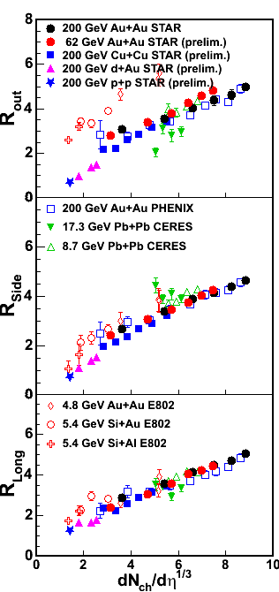
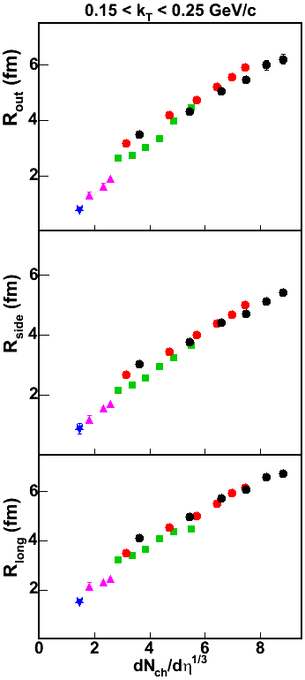
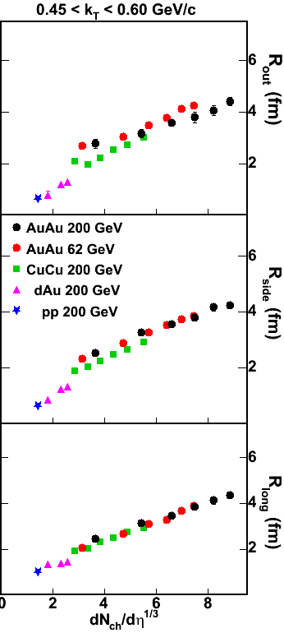
„Universal” scaling ?
RHIC/AGS/SPS Systematics
STAR DATA
(pp,dAu,CuCu,AuAu@62GeV - prelim.) QM06
Pion HBT radii from different systems and at different energies scale with
(dN_{ch}/dη)^{1/3}
<k_{T}>≈ 400 MeV (RHIC) <k_{T}>≈ 390 MeV (SPS)
Radii scale
with multiplicity
Forget A,B,√s, N_{part}...
dN/dη determines HBT radii,
at all m_{T} (!!!!)
Is it trivial?
Lisa, Pratt, Soltz, Wiedemann, RNPS (2005) 55:357

Slide 4
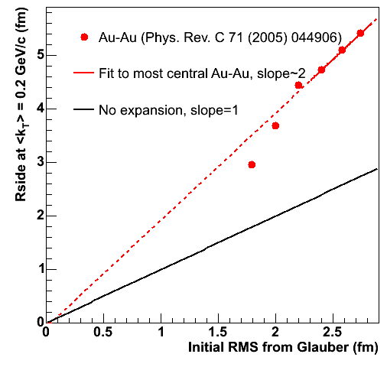
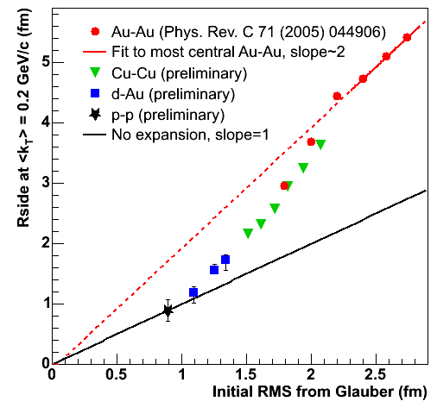
System expansion: Initial vs Final Size
STAR Collisions at 200GeV only
Smooth expansion of the system from p+p to Au+Au
… but not trivial
AuAu: system expands
pp (dAu): no or less expansion
  Proton initial size = 0.89 fm
  from e-scattering

Slide 5
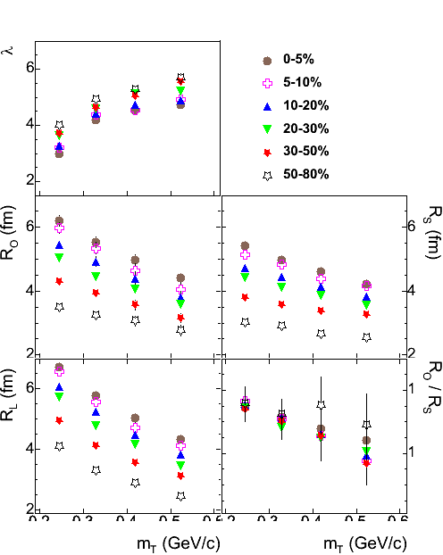
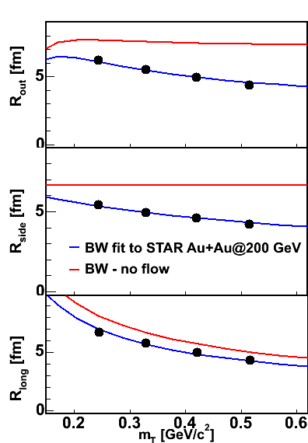
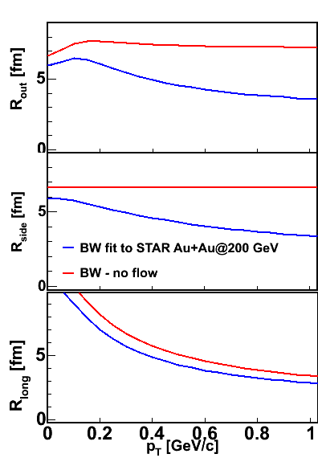
Transverse mass dependence in Au+Au
STAR, Au+Au@200GeV, PRC 71 (2005) 044906
0.
0.
0.
.2
0.2
0.3
0.4
0.5
0.2
0.3
0.4
0.5
0.6
In Au+Au p_{T} (m_{T}) dependence attributed to collective expansion
of the source
Calc. with Blast-Wave -
Retiere, Lisa, PRC 70 (2004) 044907

Slide 6
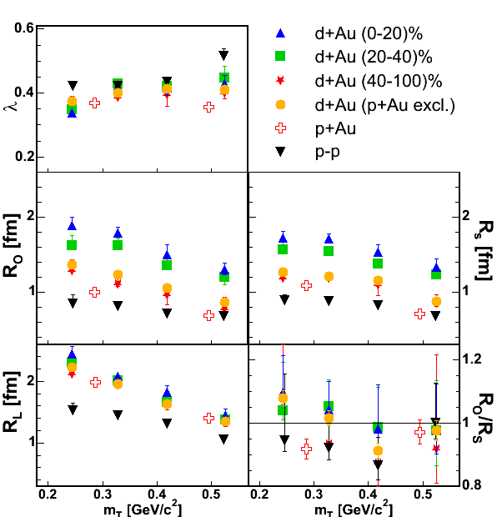
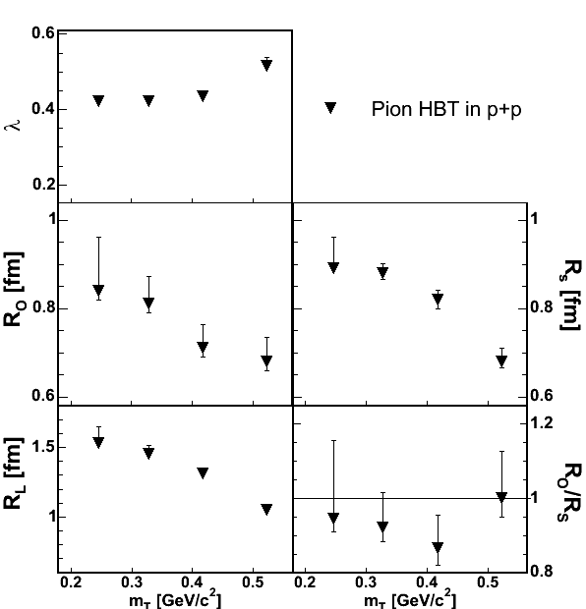
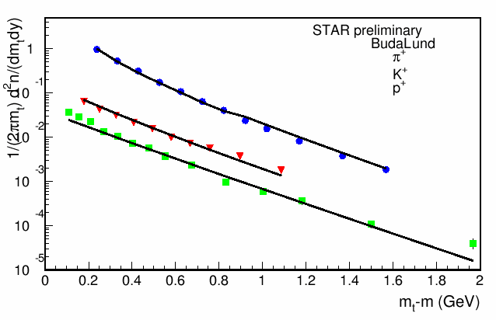
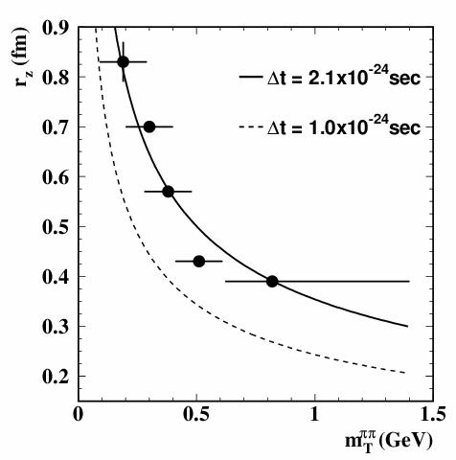
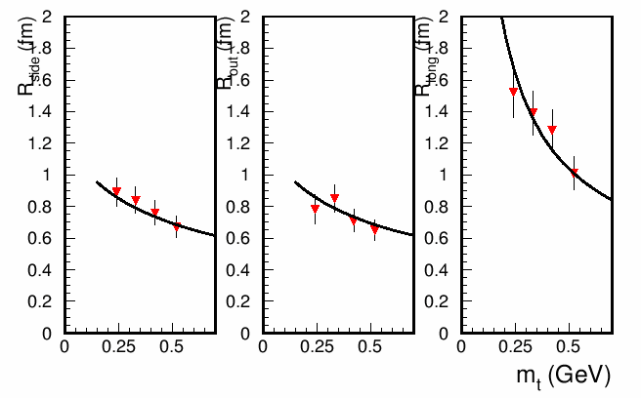
Transverse mass dependence: p+p, d(p)+Au
4. Hydrodynamical expansion in pp?
1. String fragmentation
Note y-scale change!
p+p: HBT radii decrease with increase of m_{T}
  m_{T} dependence in elementary collisions has been observed e.g. in OPAL, DELPHI, E735
STAR preliminary
flow not expected in such
a small system as p+p
see e.g. Shuryak: hep-ph/0405066
Csorgo et al.: m_{T} dependence of HBT radii in pp is not generated by the transverse flow, but by the transverse temperature inhomegeneities of hadron-hadron collisions due to the freezing scale –
hep-ph/0406042
2. Resonance contribution
3. Heisenberg uncertainty
4.Hydrodynamical expansion in pp?
1/(2πm_{T})d²n/(dm_{T}dy)
d+Au : R_{side} sensitive to the size of a smaller nucleus
(d+Au vs p+Au)
m_{T}-m (GeV)
d+Au : Rlong doesn’t change with centrality
R_{SIDE}
R_{OUT}
R_{LONG}
DELPHI - e⁺e⁻ annihilation
p+p treated as a bulk system!
G. Alexander, hep-ph/0302130

Slide 7
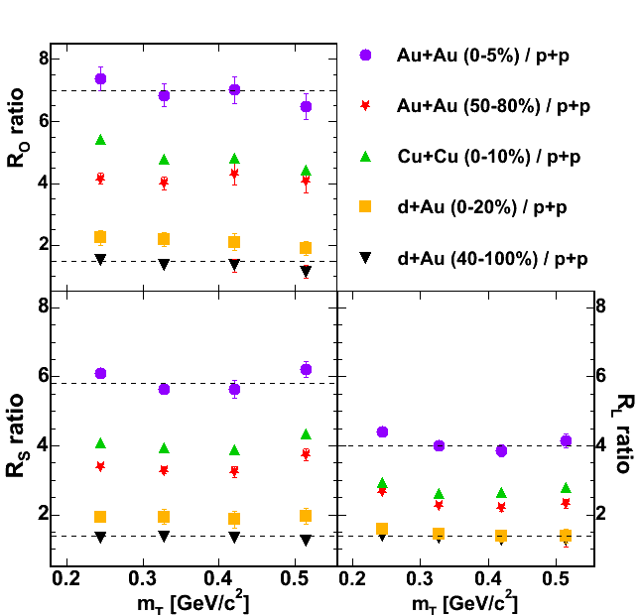
Surprising („puzzling”) scaling
Ratio of (AuAu, CuCu, dAu) HBT
radii by pp
All p_{T}(m_{T}) dependences of HBT radii observed by STAR scale with pp although it’s expected that different origins drive these dependences
HBT radii scale with pp
Scary coincidence
or something deeper?
pp, dAu, CuCu - STAR preliminary

Slide 8
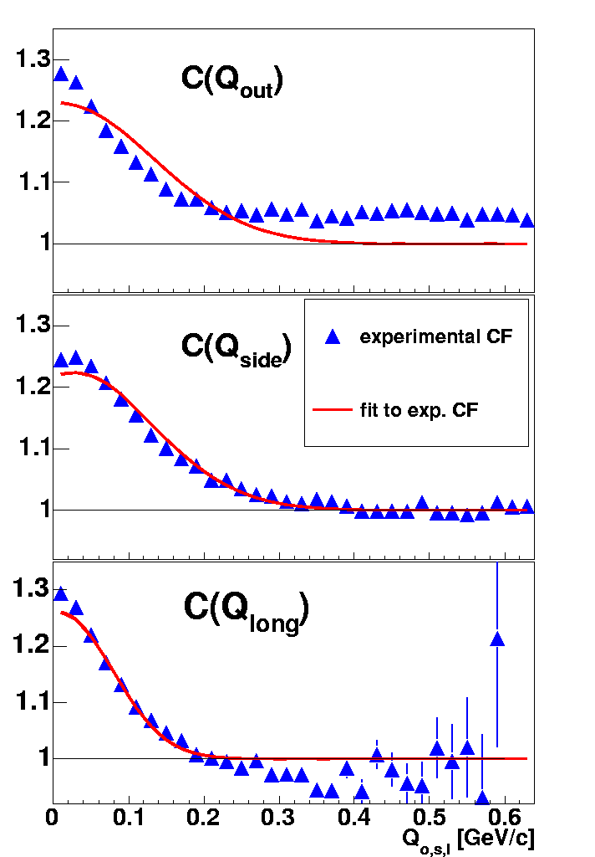
Non-femtoscopic correlations in low mult.collisions
d+Au:
peripheral collisions
1D projections of 3D CF
the tail of the CF should go to unity for large Q !
Do the projections provide us enough information about the shape of the CF?
No, to make a projection one has to constrain non-projected Q-components ➔ part of the information about 3D space is lost
Can we get more detailed information about the shape of the CF?
Yes, Spherical Harmonic Decomposition
Q_{x}< 0.08 GeV/c
Z.Ch., Gutierrez, Lisa, Lopez-Noriega, nucl-ex/0505009
Pratt and Danielewicz, e.g. nucl-th/0501003

Slide 9
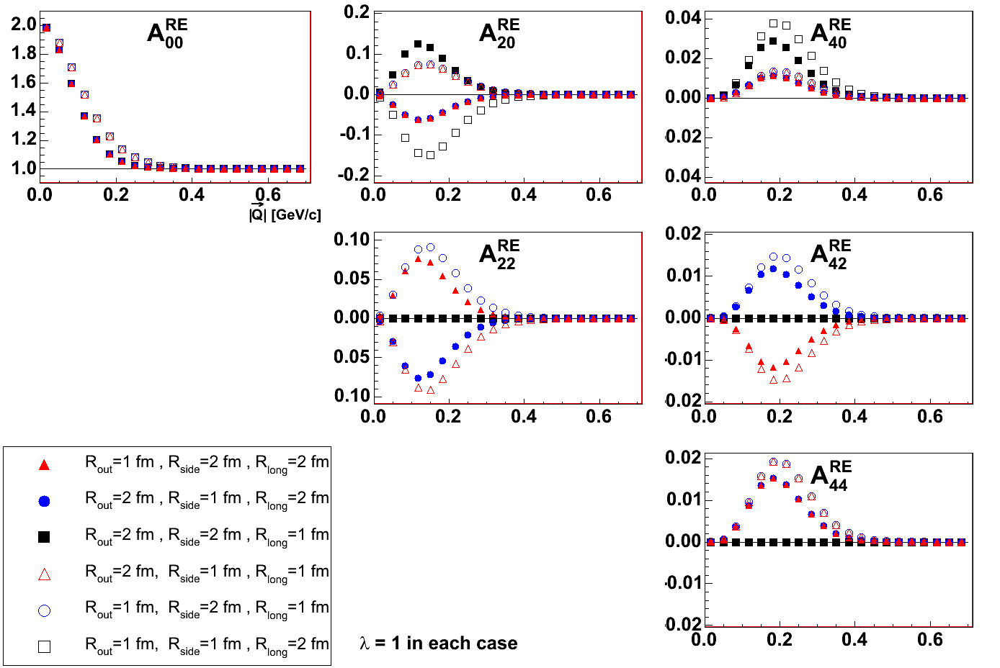
Decomposition of CF onto Spherical Harmonics
R_{L} < R_{T}
.
R_{L} > R_{T}
Simple, Gaussian source calculations
R_{O} < R_{S}
R_{O} > R_{S}

Slide 10
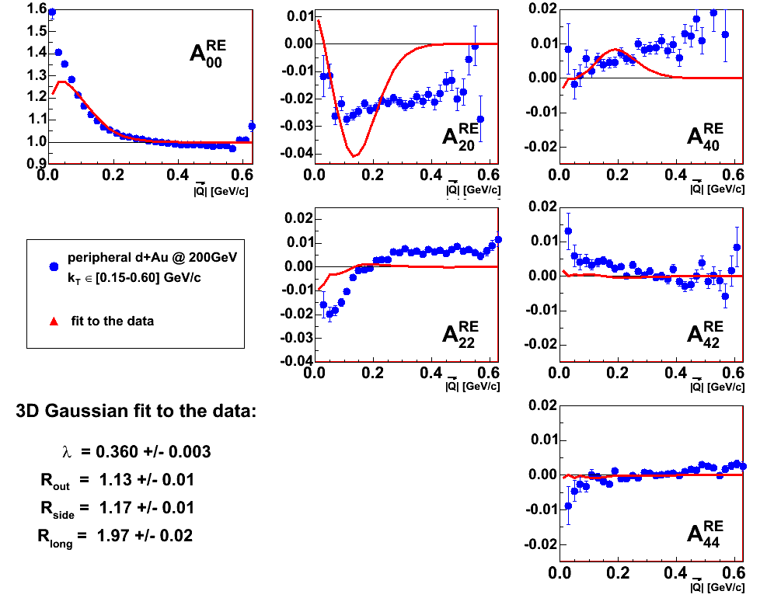
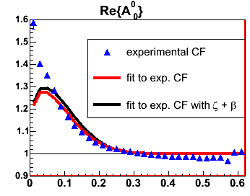
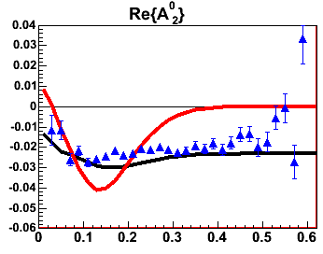
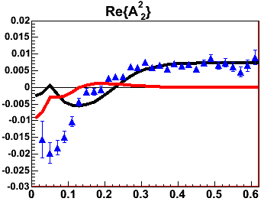
Decomposition of CF onto Spherical Harmonics
STAR d+Au@200GeV:
peripheral collisions
d+Au : peripheral collisions
β
|Q|
|Q|
ζ
|Q|
Q_{x}< 0.08 GeV/c
Z.Ch., Gutierrez, Lisa, Lopez-Noriega, nucl-ex/0505009,
Z.Ch., nucl-ex/0510014

Slide 11
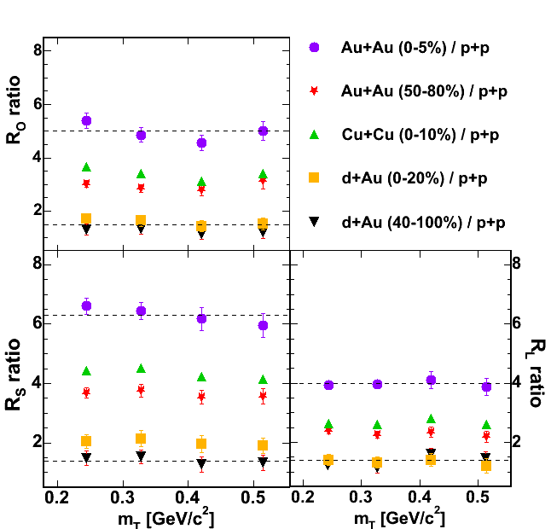
Scaling (fit w/ baseline param.)
STAR preliminary
Ratio of (AuAu, CuCu, dAu) HBT
radii by pp
Fit w/o baseline parameterization
NEW fit w/ baseline parameterization

Slide 12
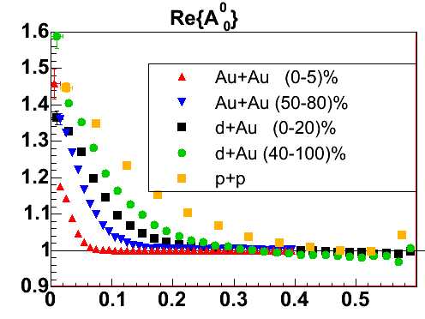
Baseline in p+p, d+Au and Au+Au
Q_{TOT} [GeV/c]
Q_{TOT} [GeV/c]
Some coefficients don’t vanish for large Q
Bias from zero is larger for more peripheral
collisions
This problem is getting more significant for small
systems (pp & dAu)
It can be due to
  an experimental artifact ?
  long range correlations (e.g. jets) ?
  problem with momentum conservation ?
  or ?
Q_{TOT} [GeV/c]

Slide 13
Summary
m_{T} dependence of HBT radii for Au+Au, Cu+Cu, d+Au and p+p seems to be the same although it’s expected to have different origins
„universal scaling” of HBT radii with dNch/dη^{1/3} from RHIC to AGS/SPS
System expands x2 in Au+Au collisions and no or little expansion is p+p
Importance of non-femtoscopic correlations in low multiplicity collisions
  Decomposition of CF in terms of spherical harmonics
    new efficient diagnostic tool
    Use symmetry of the Q-space
    Pratt and Danielewicz [nucl-th/0501003] : connection of one-to-one CF and spatial anisotropies
    More on these analyses:
    STAR: PRC 71 (2005) 044906, nucl-ex/0505009, nucl-ex/0510014, nucl-ex/0511035

Slide 14
.
SUPPORT SLIDES

Slide 15
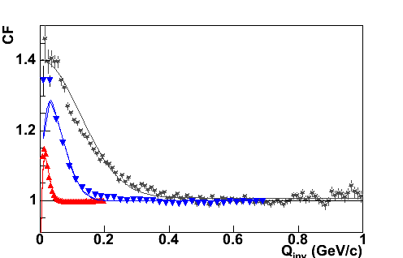
Pion Interferometry in STAR
p+p
d+Au
Au+Au
the same experiment, collision energy, detector acceptance !
Width of the correlation function ~ 1/R R_{AuAu} >> R_{dAu} > R_{pp}

Slide 16
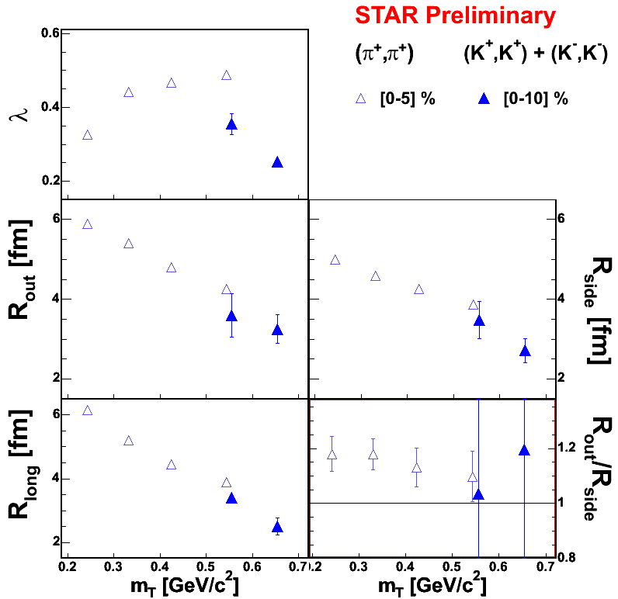

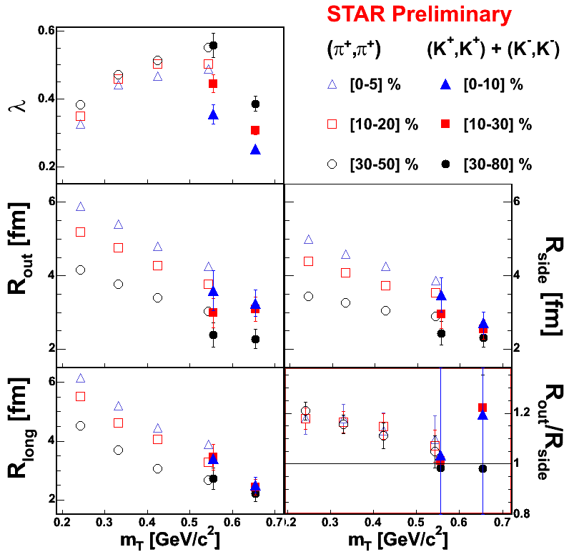
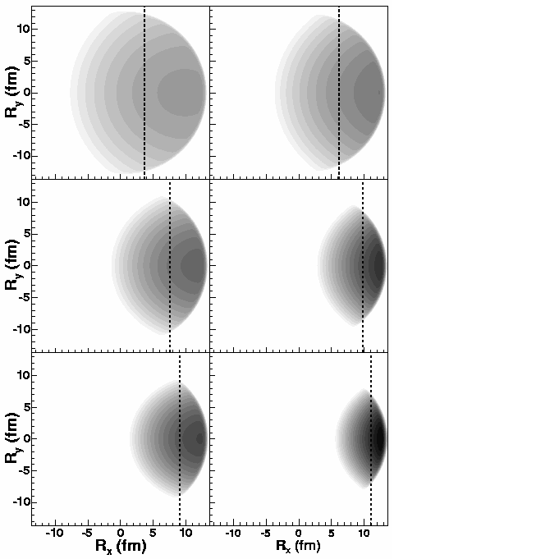
Consistency check on flow – kaons
Au+Au 62GeV – STAR preliminary
β_{x}=0.907
β_{x}=0.974
π
K
p

Slide 17
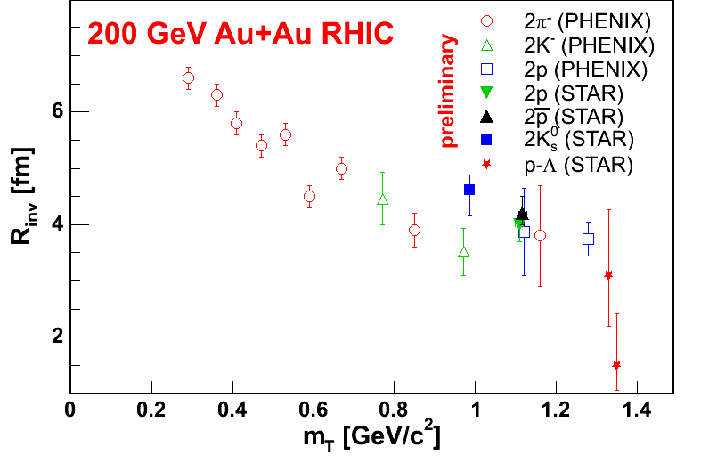
More confirmation
STAR preliminary

Slide 18
Decomposition of CF onto spherical harmonics
Z.Ch., Gutierrez, Lisa,
Lopez-Noriega, nucl-ex/0505009
Cartesian-space (out-side-long) naturally encodes physics, but is poor/inefficient representation
Recognize symmetries of
Q-space -- decompose by spherical harmonics!
Direct connection to source shapes [Danielewicz,Pratt: nucl-th/0501003] – decomposition of CF on cartesian harmonics
~immune to acceptance
full information content at a glance
[thanks to symmetries]
φ : [0,2π]
θ : [0,π]
Q_{LONG}
Q
θ
Q_{OUT}
φ
Q_{SIDE}

Slide 19

Some properties of A_{lm} coefficients
A_{lm} = 0 for l or m odd – identical particle correlations
(for non-id particles, odd l encodes shift information)
A₀₀(Q) ≈ one-dimensional “CF(Qinv)” (bump ~ 1/R)
A_{lm}(Q) = δ_{l,0} where correlations vanish
A_{l≠0,m}(Q) ≠ 0 → anisotropy in Q space
Im[A_{lm}] = 0

Slide 20
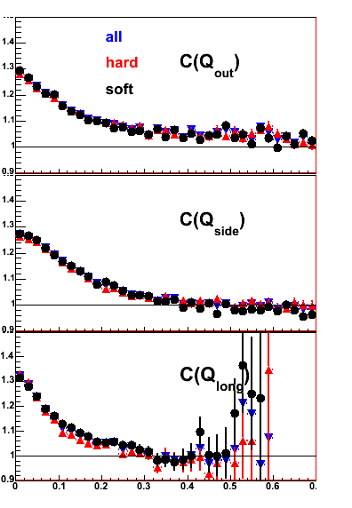
Long-range correlations : JETS ?
Jets as a origin of
the baseline problem ??
The idea was to try to eliminate pions coming from jet fragmentation from data sample. It can be done by applying an event cut which accepts only events that have no high-pt tracks.
HBT analyses where done for three classes of events
all - all events accepted – as a reference
soft – only events without high-p_{T} tracks
( highest-p_{T} < 1.2 GeV/c was chosen)
hard - only events with least one
track with p_{T} > 2 GeV/c

Slide 21
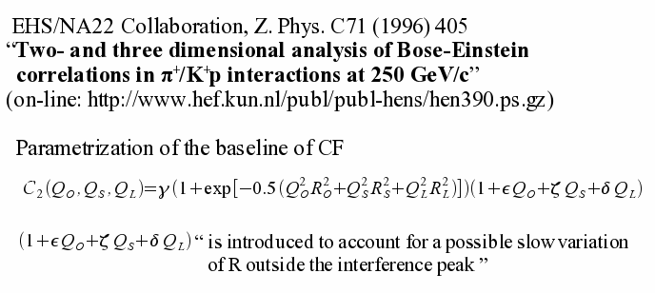
NA22 parametrization of CF
?

Slide 22
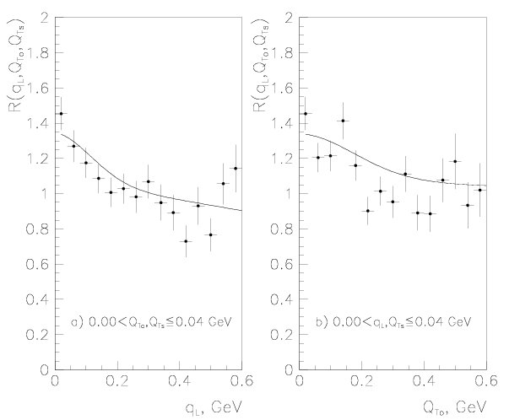
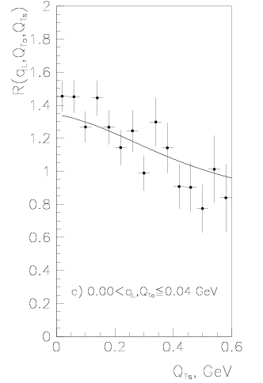
NA22: 1D projections of 3D CF
NA22, Z. Phys. C71 (1996) 405

Slide 23
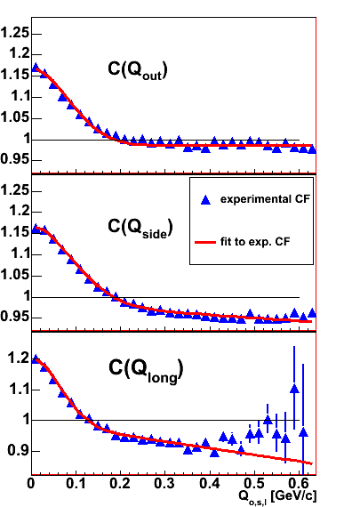
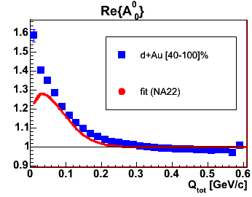
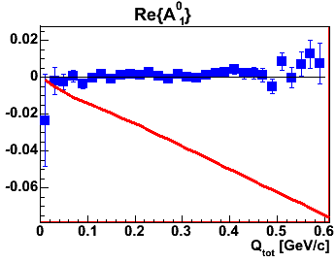
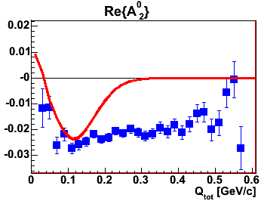
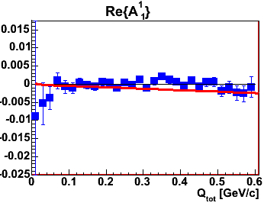
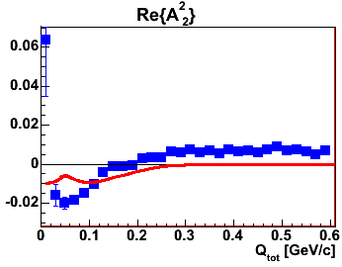
NA22 parametrization of CF
STAR preliminary
d+Au peripheral collisions
NA22 fit
d+Au peripheral collisions

