Slide 1
MeSH®
Region-wide Webconference
March 18, 2008

Slide 2
AGENDA
The Basics
Why was I excited about Skin Care?
Qualifiers or Subheadings
Using MeSH®
MeSH Database or Browser

Slide 3
What is MeSH®?
National Library of Medicine's controlled vocabulary thesaurus
Sets of descriptors are arranged in hierarchical and alphabetical structures
Used for indexing articles from 4,800 of the world's leading biomedical journals for MEDLINE/PubMED®

Slide 4
Parts of Mesh
Descriptors (24,000+)
Main Headings
Geographic Headings
Check Tags
Publication Types
Qualifiers (83)
Supplementary Chemicals (170,000)
http://www.nlm.nih.gov/mesh/presentations/EAHIL_krakow_2007_sep/mesh_overview/index.htm

Slide 5
Parts - continued
Check tags – A group of Medical Subject Headings (MeSH) which indexers are expected to consider (“check” for) routinely for every article indexed.
Publication Type - The type of material that the article represents. It characterizes the nature of the information or the manner in which it is conveyed.

Slide 6
Why was I excited about Skin Care?

Slide 7
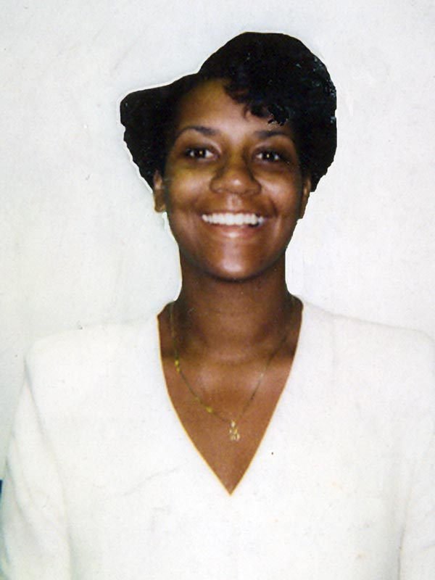
A young librarian’s journey
The year – 1993
Place – rural North Carolina
My first professional librarian job and only my second library job!
Elhill training months away in Chapel Hill

Slide 8
Skin Care
Therapeutics
Hygiene
Oral Hygiene
Skin Care
Therapeutics
Acoustic Stimulation
…
Cosmetic Techniques
Dermabrasion
…
Hygiene
Scope note - Maintenance of the hygienic state of the skin under optimal conditions of cleanliness and comfort. Effective in skin care are proper washing, bathing, cleansing, and the use of soaps, detergents, oils, etc. In various disease states, therapeutic and protective solutions and ointments are useful. The care of the skin is particularly important in various occupations, in exposure to sunlight, in neonates, and in pressure ulcer.
Notes:
It’s not medicine
The definition is not the same as it is in the real world
It is a part of clinical care – not too small to know about.

Slide 9

Subheadings/Qualifiers
Therapy
Diet Therapy
Drug Therapy
Nursing
Prevention & Control
Radiotherapy
Rehabilitation
Surgery
Transplantation

Slide 10
Be not afraid of greatness, some are born great, some achieve greatness, and some have greatness thrust upon them.
William Shakespeare’s Twelfth Night

Slide 11
Born Great
AE – adverse effects
TH – therapy
DI – diagnoses
NU - Nursing

Slide 12
Achieved Greatness
CI – Chemically Induced
TU – Therapeutic Use
VE – Veterinary
SN – Statistics & Numerical Data

Slide 13

Greatness thrust on them
PK – Pharmacokinetics
ET – Ethnology
IN – Injuries
CN - Congenital

Slide 14
What is your favorite overlooked subheading?

Slide 15
Using MeSH®
Bring a search into focus
Too many results
Results are not exactly right
Find the invisible
Topics too new to have a MeSH term
Topic too complex to express one term

Slide 16
Bringing into Focus
Hyperlipidemia – 50,000+ citations
Hyperlipidemia & drug therapy – 14,000+
Hyperlipidemia, drug therapy, & prognosis – 1600+
Hyperlipidemia/drug therapy as the major topic and prognosis as a Mesh term – 900

Slide 17
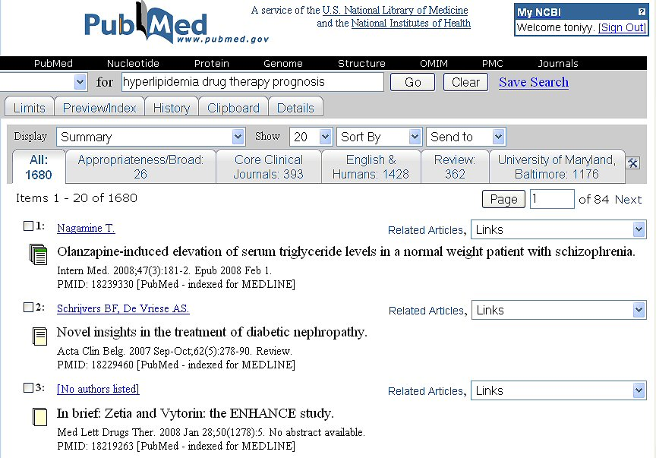

Slide 18
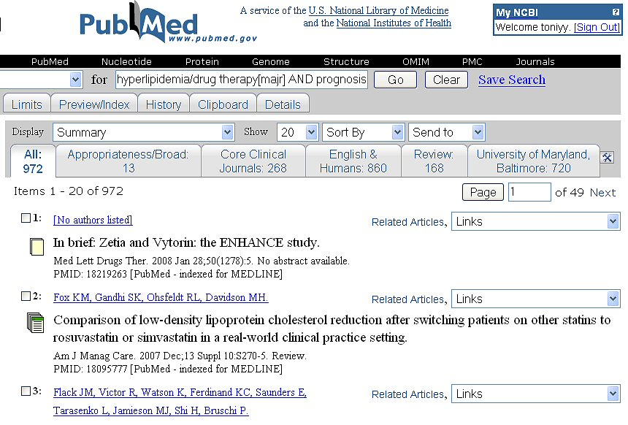

Slide 19
Finding the Invisible
If you search for Left ventricle pacing, this is how your search will be translated:
"heart ventricles"[TIAB] NOT Medline[SB]
OR "heart ventricles"[MeSH Terms]
OR left ventricle[Text Word]
AND pacing[All Fields]

Slide 20
Lost in Translation
The key information is forgotten in the first two terms.
“Pacing” wasn’t matched up with a MeSH term even though “cardiac, pacing artificial” is a recognized term

Slide 21

How can we use MeSH to makeover this search?

Slide 22
MeSH
Database vs. Browser

Slide 23
What’s the difference?
Database
Browser
Description: Entrez database of NLM controlled vocabulary used for indexing articles for MEDLINE/PubMed. MeSH terminology provides a consistent way to retrieve information that may use different wording for the same concepts.
Description: Medical Subject Heading look-up tool

Slide 24
Where to find it?
Database
Browser
List of databases
Alphabetic listing
Entrez link listed under “Select Resource” on right side of web page
From PubMed
List of databases
Alphabetic listing
Library Catalogs and Services
Especially for Librarians

Slide 25
Special Features
Database
Browser
Seamless interaction between PubMed/ Medline and MeSH database
Easy of use for building a search strategy
Easy browsing of tree structure
Descriptor Data includes annotation
Multiple formats for viewing data

Slide 26


Slide 27
Additional Resources
PowerPoint presentation overview of MeSH® - http://www.nlm.nih.gov/mesh/presentations/EAHIL_krakow_2007_sep/mesh_overview/index.htm
Web site for additions, changes and deletions in MeSH- http://www.nlm.nih.gov/mesh/introduction2008.html
Web site for information about Indexing Initiative – http://ii.nlm.nih.gov/
MLA-accredited courses on MeSH®
MeSH for Searchers by E. Diane Johnson, University of Missouri, Columbia
NLM Training: PubMed by NLM or NTCC staff

