Slide 1

Top Weather Events of 2007
By Sam Shamburger
NWS Lake Charles Forecaster

Slide 2
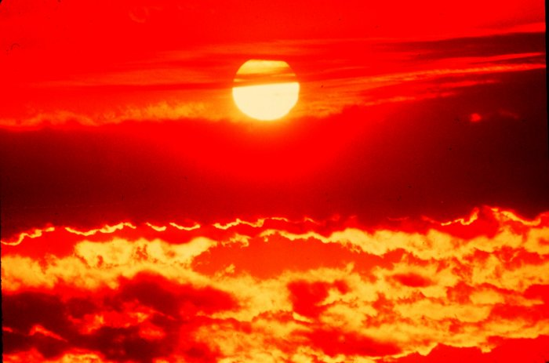
#10
UNUSUAL DECEMBER HEAT
December 8-12, 2007
5 days of record high temperatures in 80s,
record warm minimum temperatures in 60s & 70s
Alexandria tied all-time December record high of 83° on four different days

Slide 3
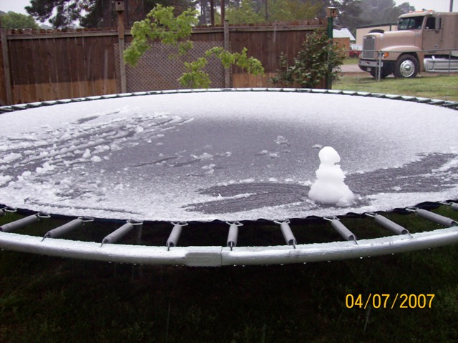
#9
EASTER WEEKEND WINTER STORM
April 7, 2007
Light sleet observed across nearly entire area
Mixture of sleet and snow with light accumulations across Lakes Region of Southeast Texas & Central Louisiana
Temperatures generally remained above freezing
First April winter weather observed
across the region in 70 years

Slide 4
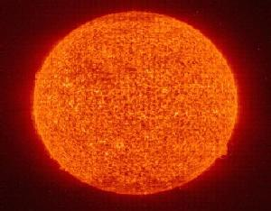
#8
AUGUST 2007 HEATWAVE
August 10-14, 2007
Five days of record high temperatures in 100s,
record warm minimum temperatures in 70s & 80s
Warmest temperatures across area since September 2000

Slide 5
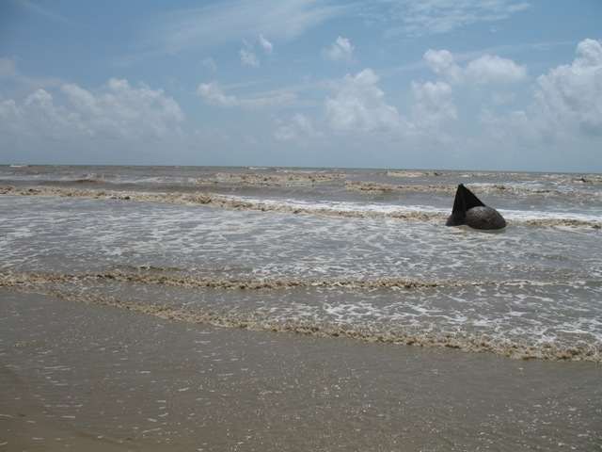
#7
EFFECTS OF TROPICAL STORM ERIN & HURRICANE DEAN
August 16 & August 22, 2007
Moderate to high waves along coastal areas
High tides caused overwash of coastal roadways
School and road closures along coast

Slide 6
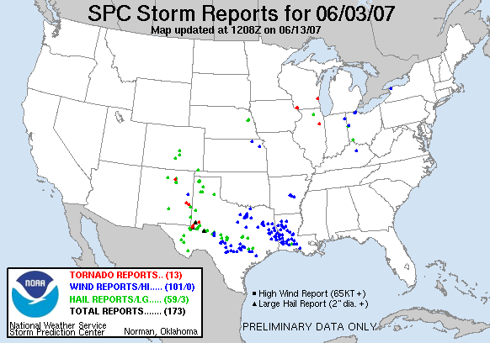
#6
LATE SPRING SEVERE SQUALL LINE
June 3, 2007
Line of severe thunderstorms caused
widespread wind gusts of 40 to 70 mph
Numerous trees & power lines down across entire area
Isolated areas of hail up to quarter size
Power out for several days across interior Southeast Texas

Slide 7
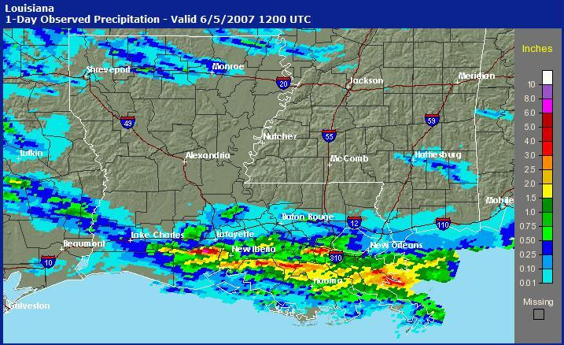
#5
NORTHERN VERMILION PARISH FLOODING
June 4, 2007
Training thunderstorms produced narrow area of 10 to 15 inches of rainfall near Maurice
At least 50 homes flooded, with numerous area roadways underwater

Slide 8
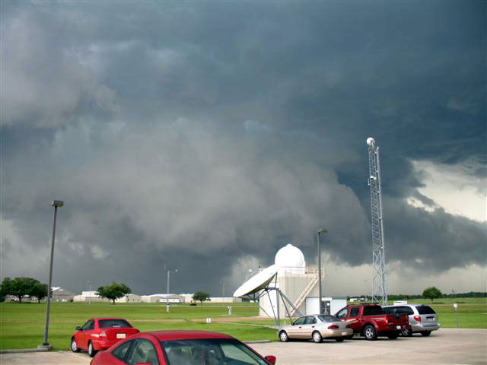
#4
LAKE CHARLES HAILSTORM
June 4, 2007
Severe thunderstorm began south of Lufkin & traveled southeast for 150 miles
Numerous reports of hail & wind damage along its path
At least $500,000 in damage from golfball-size hail &
winds up to 80 mph across Calcasieu Parish
Worst known hailstorm in history of Lake Charles

Slide 9
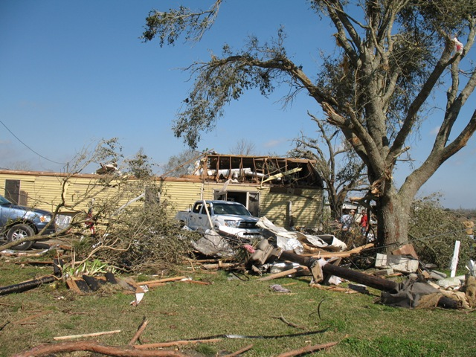
#3
ACADIANA TORNADOES
February 13, 2007
4 Tornadoes affected South-Central Louisiana from 12am - 2am
Among first tornadoes rated using new Enhanced Fujita Scale
Two Tornadoes rated EF0, with one EF1 & one EF2
Over 100 homes damaged or destroyed by all four tornadoes
Damage totals around $1.5 million dollars
Breaux Bridge Tornado strongest in our region since 11/23/04

Slide 10
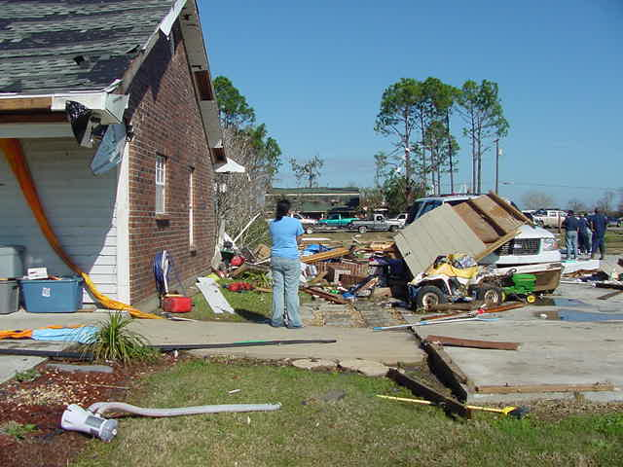
#2
NEW IBERIA TORNADO
January 4, 2007
Tornado rated strong F1 on Fujita Scale, with 15 mile path
Moved northeast at 50 mph across eastern New Iberia
2 people were killed, 15 people injured
Around $1.5 million in damage

Slide 11
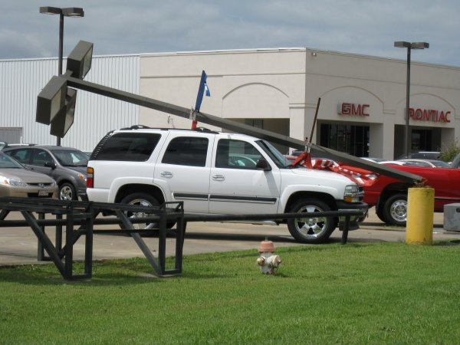
#1
HURRICANE HUMBERTO
September 13, 2007
First hurricane to affect area since Hurricane Rita
Landfall east of High Island, TX with biggest impacts to Jefferson & Orange counties
Wind gusts measured up to 85 mph in several locations across Jefferson County
Storm surge of up to 5 feet along coast
Considerable inland flooding with rainfall totals up to 11 inches
Damage totals around $60 million

Slide 12
Contact Information
Sam Shamburger, Forecaster
NWS Lake Charles
Email: Sam.Shamburger@noaa.gov
Phone: 337-477-5285

