Slide 1
Movement of MC Data using SAM & SRM Interface
Manoj K. Jha (INFN- Bologna)
Gabriele Compostella, Antonio Cuomo, Donatella Lucchesi,, Simone Pagan (INFN – Padova)
Doug Benjamin (Duke University)
Robert Illingworth (Fermilab)
3rd February, 2009
CDF Offline Meeting, Fermilab

Slide 2
Overview
Present MC Prod. Model
Proposed Model
Test Framework
Integration within CAF
Description: on the WN
Getting File on User’s Desktop
Future Plan

Slide 3

Present CAF MC Prod. Model
WN
CAF Head Node
exe tar ball
File servers @ FNAL
Presently, CDF is relying on rcp tool for transfer of output from WN to destination file servers. It leads to
Worker nodes are sitting idle just because another WN is transferring files to the fileservers.
Loss of output from the WN in most of the cases.
Wastage of CPU and network resources when CDF is utilizing the concept of opportunistic resources.
No mechanism to deal with the sudden arrival of output from WN at file servers. Especially, happens during the conference period.
Overloading of available file servers in most of the cases.
Users have to resubmit the job.
No catalogue of MC produced files on user basis.
User Desktop

Slide 4
Proposed Model
WN
CAF Head Node
SE@WN
SAM
Station
exe tar ball
User Desktop
A SE will be attached to each CAF head node.
SE acts as a cache of a SAM station. Physical location of station is unimportant. Since SE is managed by SRM.
Output from WN will be temporarily collected in the SE closer to WN.
Transfer or wait time for MC output data on WN will be considerably reduced due to large bandwidth between WN and its SE.

Slide 5
Proposed Model
WN
CAF Head Node
SE@WN
SAM
Station
exe tar ball
SAM
Station
User Desktop

Slide 6
Proposed Model
WN
CAF Head Node
SE@WN
SAM
Station
exe tar ball
SAM
Station
SAM
Station
User Desktop
SE@FNAL
SAM
Station

Slide 7
Test Framework
Hardware:
CAF: CNAF Tier –I
SE: dCache managed SRMs
500 GB of space at Gridka, 10 channels per request
1 TB of space at UCSD, 50 channels per request
SAM station:
station “cdf-cnafTest” at “cdfsam1.cr.cnaf.infn.it”
station “canto-test” at “cdfsam15.fnal.gov”
Setup:
A cronjob submits a job of variable no. of segments every 10 minutes at CNAF CAF. Maxmium segments per job is 5.
Each segment creates a dummy file of random size which vary between 10 MB to 5 GB.
A cron process running at station “cdf-cnafTest” for creation of datasets from the files in SRM closer to WN (Gridka).
Another cron job running at station “canto-test” for transfer of dataset between two stations.

Slide 8
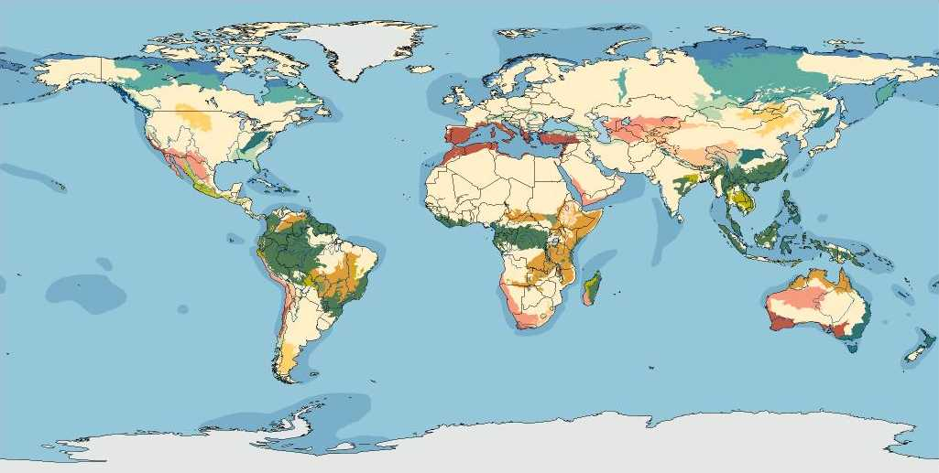



Test Framework
SRM @Gridka
Closer to WN
SAM
Station “cdf-cantotest””
User@FNAL
SAM
Station “cdf-cnafTest”
CNAFCAF
SRM @UCSD
Destination

Slide 9
Description: On the WN
User will submit the jobs using the present CDF Analysis Framework (CAF).
By file name, all the output and log files produced by the users will be unique. One option is to add CAF name, JID and section number in the user’s provided file name.
If SAM station is available on the WN, output and log files will be declared to SAM. Otherwise, it will be declared at the dataset creation time.
Minimum information for creation of metadata will be created on demand. Option also exists for a user to provide specific dimensions in the metadata so that he/she can query the list of files which matches certain criteria.
Entries in metadata depend on list of tags through which a user can create a list of files from already produced MC files. For ex., a user would like to have all the files which corresponds to a certain userid or group (higgs, top, qcd, ) or creation date, etc. This is a subject of discussion and input is required from MC production people.

Slide 10
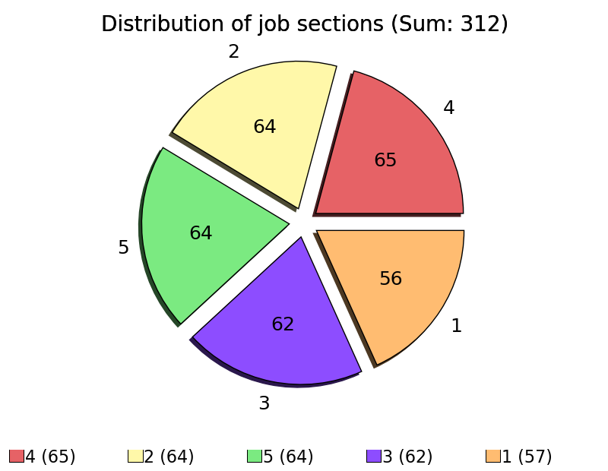
Distribution of no. of job sections
No. outside the circle represents no. of section being submitted in a single job
No. inside the circle represents total no. of section being submitted for the test framework.
For ex: A job with 1 section had been submitted 56 times, with 2 sections 64 times and so on.
File Type | File Size
A | 10 MB < size < 100 MB
B | 100 MB < size < 1 GB
C | 1GB < size < 3 GB
D | size > 3 GB

Slide 11
Description: On the WN
A pre define storage element (SE) SURL managed by SRM will be known to each CAF. This predefined SE can also be opportunistic one. Proposed model has the ability to manage the space on SE which has been allotted through fixed lifetime space tokens.
At the completion of job on the WN:
User’s proxy available from the CAF head node will be used for grid authentication purpose.
A “JID” folder on the SE will be created. Its path will be like “SURL/JID”
All the output and log files from a user’s job will be transfer to the above JID folder using the available SRM tool on the WN. One can use either the Fermi SRM or LCG tools for transferring of files from WN to SE managed by SRM.
Inform the user regarding the job completion process.

Slide 12
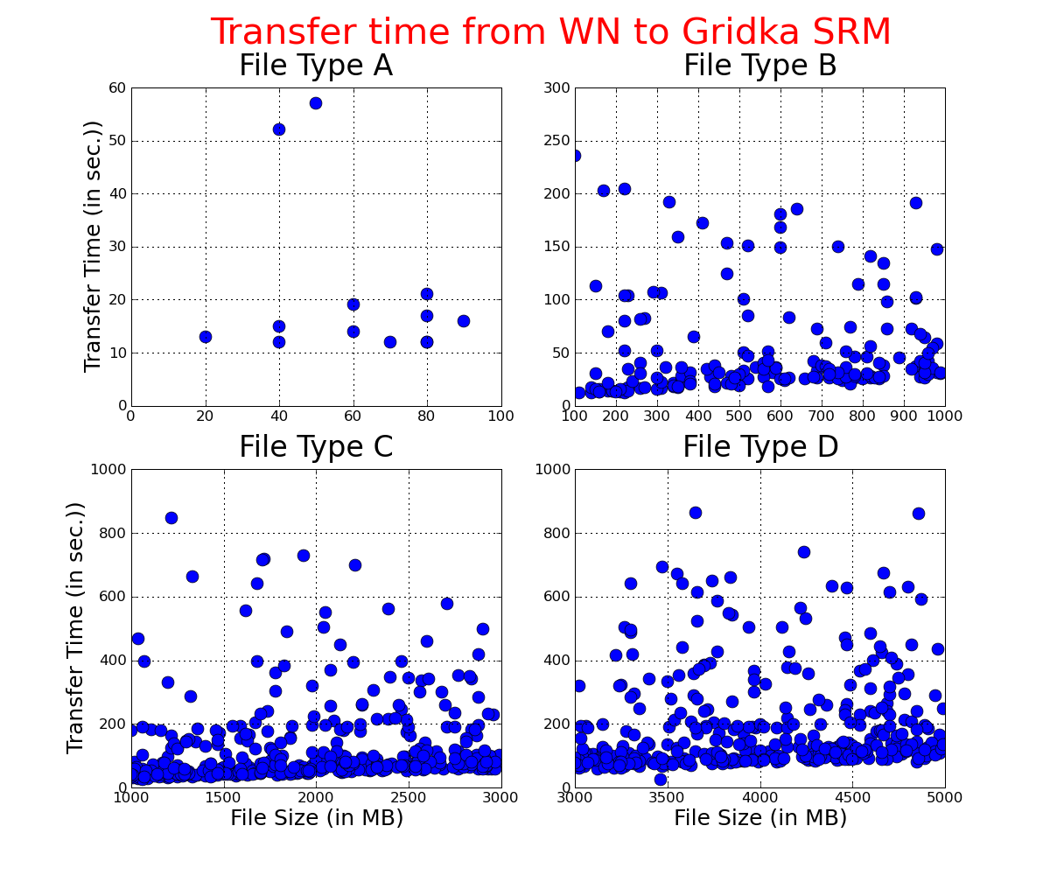
Transfer Time from WN to its closer SRM

Slide 13
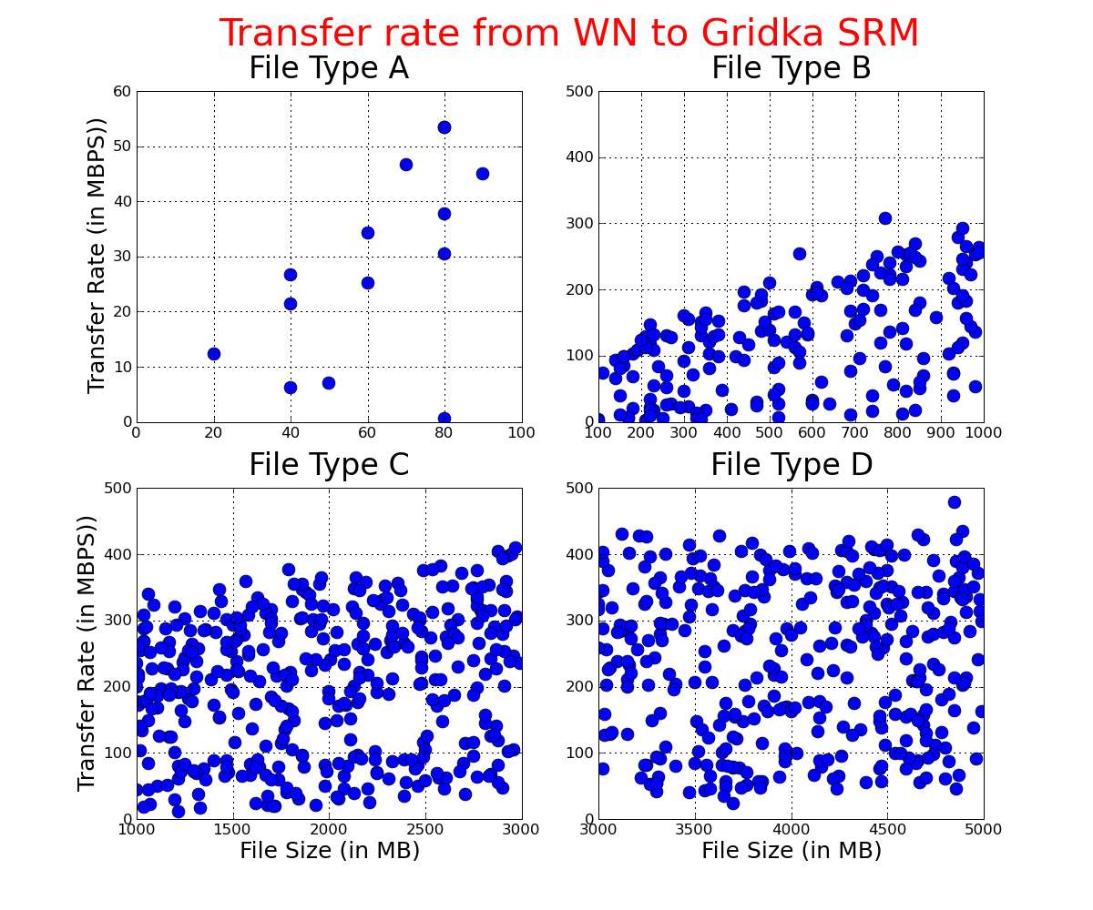
Transfer rate from WN to its closer SE

Slide 14
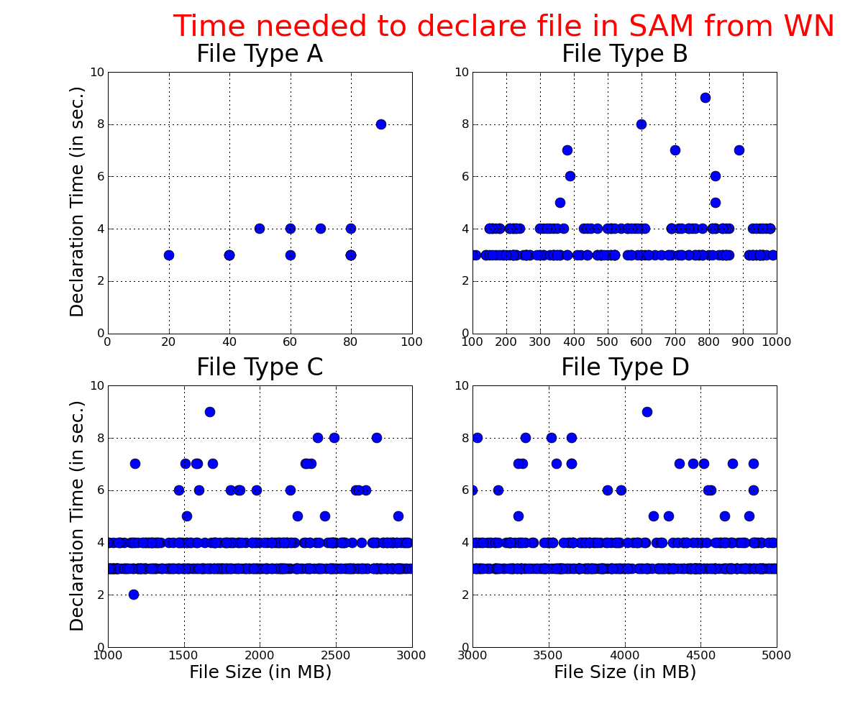
File Declaration Time from WN

Slide 15
Description: Near the SE closer to WN
A predefined SE will act as cache of a SAM station.
Service certificate of station will be used for authentication purpose.
A cronjob will run on the station’s pc which check:
Existence of new JID folder (say 123456) in the SE
Check status of JID “123456” from the CAF head node.
If finished, it will go to the next step. Otherwise go to the next JID folder.
Create a list of files for output and log files. Now the following steps will be executed individually for each output and log files list.
Create a file which stores the list of file names. This is needed in case of SRM operation failure.
Check whether the file has been declared in SAM or not. If not, declare the file in SAM using the minimum metadata information.
Move the files to SAM upload folder

Slide 16
Description: Near the SE closer to WN
Create a dataset from list of files stored on the local disk of PC. Created in above step (a). Dataset name should be unique. One option is to use the JID and CAF name in the dataset name.
In the present case, dataset for output and log files are “FILE_CNAFCAF_123456” and “LOG_CNAFCAF_123456”
Aware the created dataset to SAM
SAM will create a space for the created datasets. If sufficient space don’t exists, older files will be deleted from the station cache.
It is necessary to have sufficient cache space of station so that new dataset gets transfer to destination station cache before its deletion from the CAF station cache.
Update log files
Remove the JID folder “123456”
Inform user (Not necessarily required).
Repeat the above steps for next JID folder.

Slide 17
Dataset Type
Dataset Type | Dataset Size
A | 10 MB < size < 1 GB
B | 1GB < size < 3 GB
C | 3 GB < size < 10 GB
D | size > 10 GB

Slide 18
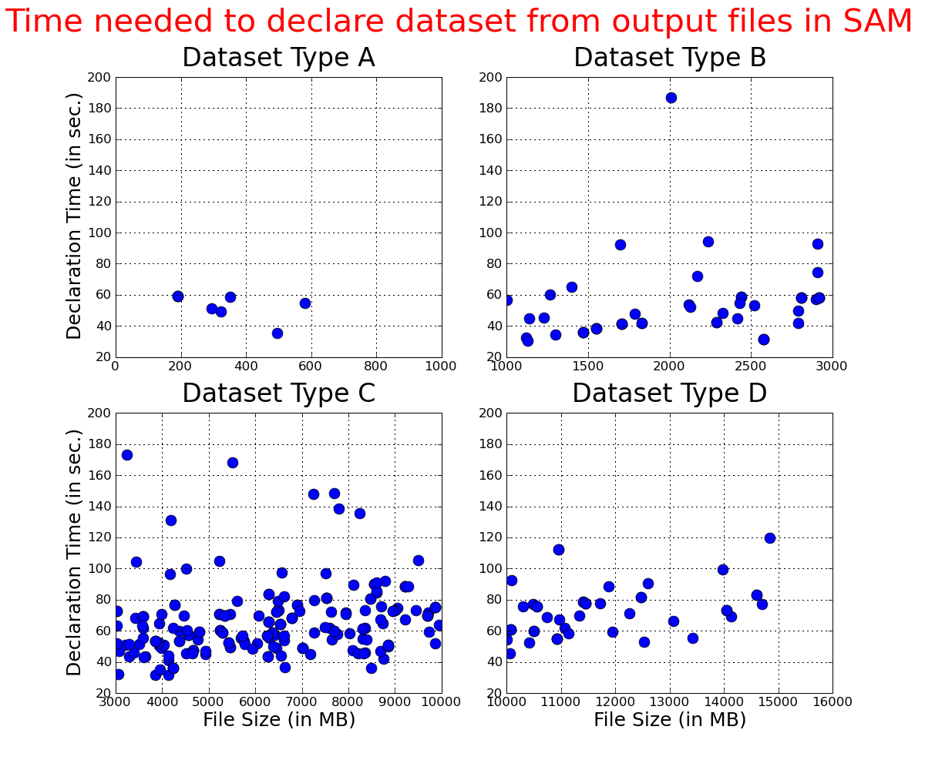
Output File Dataset Creation Time

Slide 19
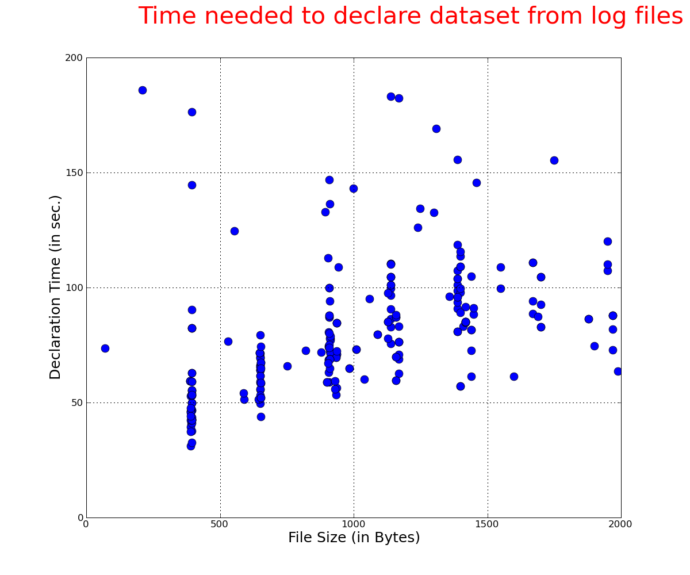
Log File Dataset Creation Time

Slide 20
Description: Near the SE closer to destination site
Due to non availability of SRM at Fermilab for CDF, the destination site is UCSD in the present case.
SE will act as cache of another SAM station.
A process will run on station’s pc which:
Prepare a list of dataset entry in SAM database which has been created during a specific time period. Presently, we have taken one day before and after of the present time.
Pick a dataset from the above list. Create a list of files which constitute the dataset.
Check the location of file. If the location of file contains the “destination node”, it means file is available at the destination SE. Otherwise download the dataset to the cache of the destination station.
Update log file.
Go to the next dataset and repeat the above steps.

Slide 21
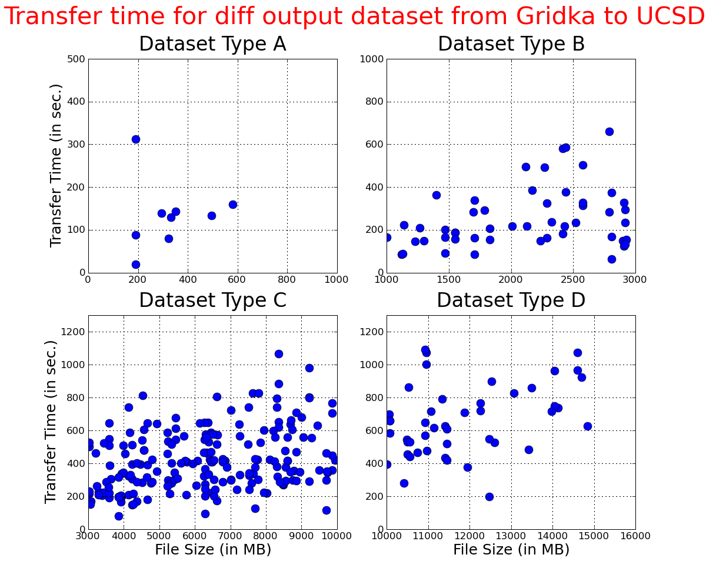
Distribution of Transfer Time for Output Dataset

Slide 22
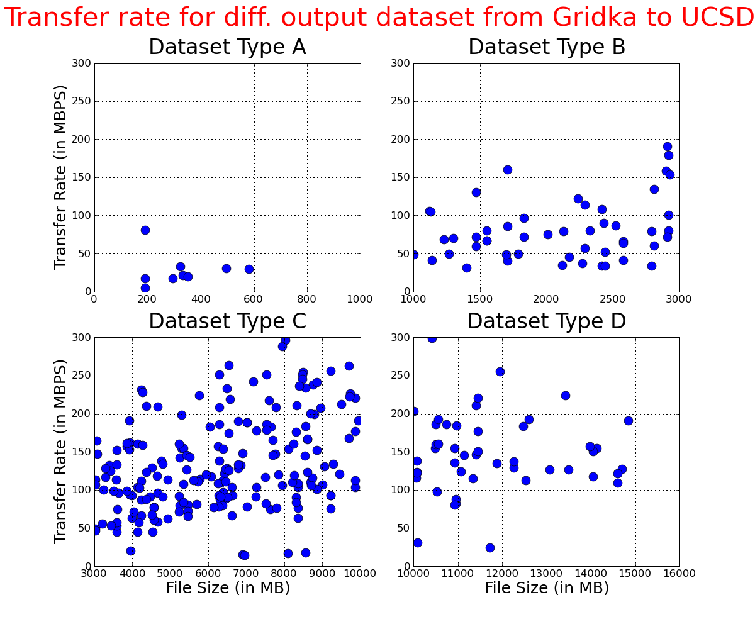
Distribution of Transfer Rate for Output Dataset

Slide 23
Getting files on User’s Desktop
Requirements on user’s desktop:
A SAM station environment with its service certificate installed .
Fermi SRM client “srmcp”
File query:
User’s will know the dataset name in advance corresponding to a JID. Since dataset name will follow a fix syntax.
User’s can query the list of files which matches dataset using the sam command “sam list files --dim=“<datasetName>
File location:
Command “sam locate <fileName>” tells the location of file name.
Getting file on desktop:
Command “sam get dataset –defName=<datasetName> --group=test –downloadPlugin=srmcp “
Presently, setting up the station for doing the above test.
Request has been made for the service certificate of new station “cdf-srmtest”
A wrapper script can be written such that above changes will be transparent to users.

Slide 24
Future Plan
Used same flavor of SRMs at source and destination sites in the present setup.
Our next goal is to use diff. flavor of SRMs for source and destination sites.
SToRM to dCache
Waiting for the support of service certificate in StoRM
BestMan to dCache
Got some space in the SE managed by BestMan at University of Nebraska
For more robust test, we need more sam account for setting up the station for new SE.
We are in touch with LCG and OSG people for getting SE closer to WN.
Like at CNAF, we have couple of Tera Bytes of space on SE
OSG people has given assurance for arranging SE managed by SRM closer to their computing sites.
But, everything depends on availability of SE managed by SRM at FNAL. Is CDF will have their dedicated SRM at FNAL or they will use the opportunistic one ? We would like to know the opinion from CDF offline group leaders.

Slide 25
Acknowledgement !
We would like to thank Frank Wuerthwein and Abhishek Singh Rana (from UCSD), Thomas Kuhr (from Karlsruhe), Brian Bockelman ( from Nebraska), Jon Bakken (from FNAL), for providing resources on SRMs !

