Slide 1

Enhanced Direct Photon Production in 200 GeV Au+Au in PHENIX
Stefan Bathe for PHENIX, WWND 2009

Slide 2
Enhanced (wrt p+p) Direct Photon Production in 200 GeV Au+Au in PHENIX
Stefan Bathe for PHENIX, WWND 2009

Slide 3
Enhanced (wrt p+p) (mid pt) Direct Photon Production in 200 GeV Au+Au in PHENIX
Stefan Bathe for PHENIX, WWND 2009

Slide 4
Stefan Bathe for PHENIX, WWND 2009

Slide 5
Also: Lowest pT ever measured for direct photons in p+p
Stefan Bathe for PHENIX, WWND 2009

Slide 6
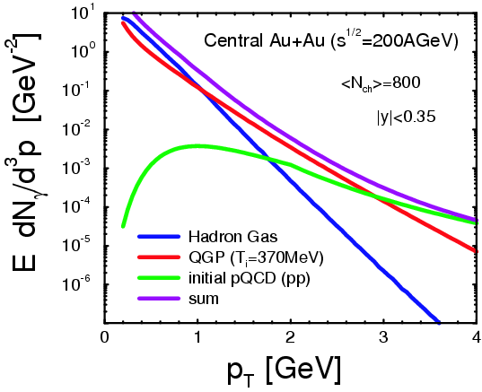
Introduction
Turbide, Rapp, Gale,
Phys. Rev. C 69 (014903), 2004
Indications for high-density, thermalized medium at RHIC
Expect thermal radiation
Thermal photons from partonic phase
predicted to be dominant source of direct photons for 1<pT<3 GeV/c in Au+Au

Slide 7
Turbide, Rapp, Gale,
Phys. Rev. C 69 (014903), 2004

Slide 8
Experimental Challenge
Turbide, Rapp, Gale,
Phys. Rev. C 69 (014903), 2004
Challenge: photon spectrum dominated by decay photons
Conventional method:
Measure inclusive photons with EMCal
Reconstruct π⁰, η from correlated photon pairs
γ_{direct} = γ_{inclusive}-γ_{decay}
Decay photons
(schematic)

Slide 9
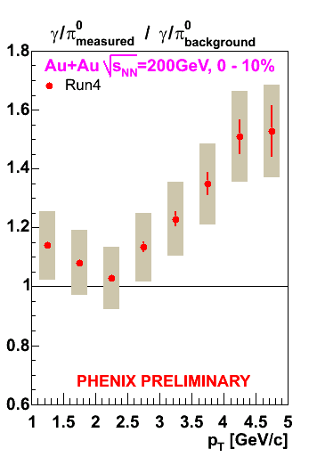

Limit of Conventional Method
Conventional method works well at high p_{T}
But limited at low p_{T} where thermal photons expected
S/B ≈ Sys. Error ≈ 10%
⇒reduce background!

Slide 10
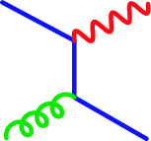
Internal Conversion Method
Any source of high-E photons emits virtual photons γ∗
γ∗ convert to low-mass e⁺e⁻
Compton
q
γ
g
q

Slide 11

Internal Conversion Method
Any source of high-E photons emits virtual photons γ∗
γ∗ convert to low-mass e⁺e⁻
e⁺
Compton
Compton
γ∗
γ
e⁻
q
q
g
g
q
q

Slide 12
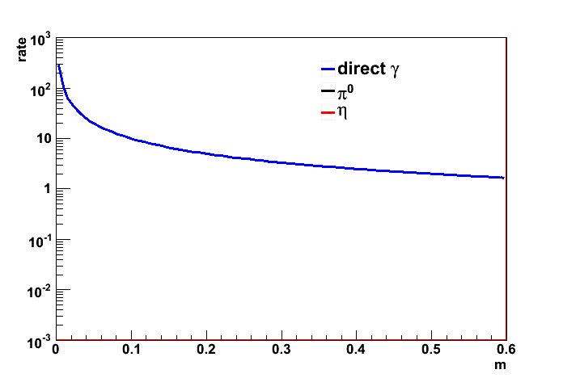
Internal Conversion Method
Any source of high-E photons emits virtual photons γ∗
γ∗ convert to low-mass e⁺e⁻
e⁺
Compton
Compton
γ∗
γ
e⁻
q
q
g
g
q
q

Slide 13
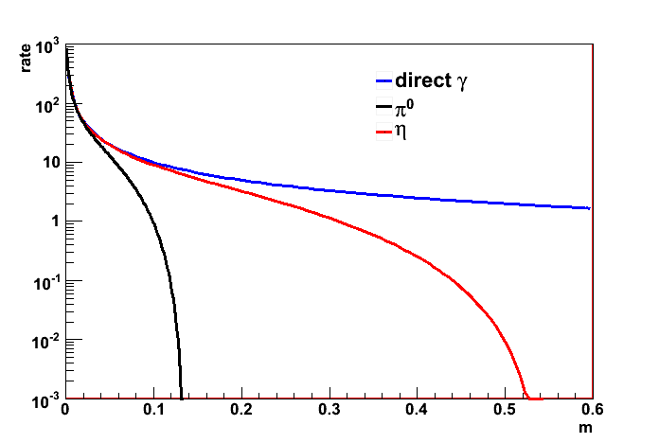
Internal Conversion Method
Any source of high-E photons emits virtual photons γ∗
γ∗ convert to low-mass e⁺e⁻
e⁺
Compton
Compton
γ∗
γ
e⁻
q
q
g
g
q
q

Slide 14
Internal Conversion Method
Any source of high-E photons emits virtual photons γ∗
γ∗ convert to low-mass e⁺e⁻
e⁺
Compton
Compton
γ∗
γ
e⁻
q
q
g
g
q
q
Exploit cut-off =>
S/B enhanced to 50%!

Slide 15
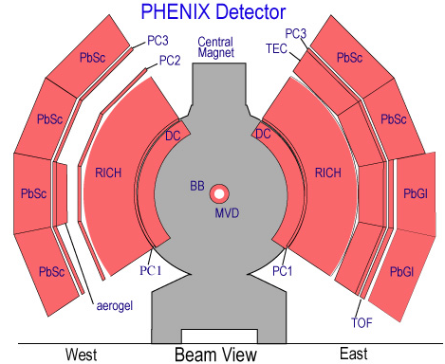
Detector And Data Set
Particles
e⁺e⁻ pairs, m<300 MeV
1<p_{T}<5 GeV
Collision systems and energy
200 GeV Au+Au, 2004, 0.8e9 events (4.9 pb⁻¹ p+p equivalent)
200 GeV p+p, 2005, 2.25 pb⁻¹
Detector
PHENIX Central Arms
|Δη|<0.35, 2xπ/2
Conversion: 0.4% radiation length
π
γ
e⁻
e⁺

Slide 16
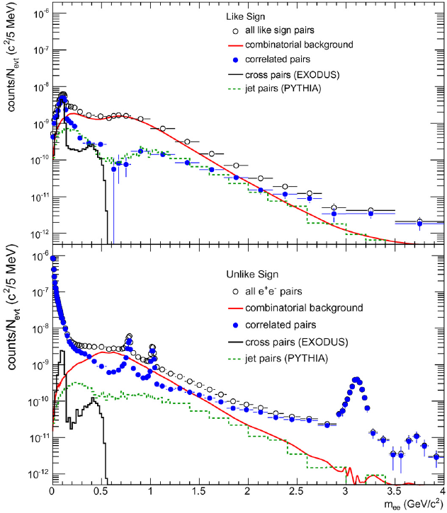

Signal-Background Pair Separation
Material conversion pairs removed by cut on orientation in magnetic field
Combinatorial background removed by mixed events (0.25% syst. uncertainty in Au+Au)
p+p at √s = 200GeV
inclusive p_{T}
uncorrected
PHENIX, Phys. Lett. B 670 (2009) 313

Slide 17
Signal-Background Pair Separation
Material conversion pairs removed by cut on orientation in magnetic field
Combinatorial background removed by mixed events (0.25% syst. uncertainty in Au+Au)
additional correlated background:
cross pairs from decays with four electrons in final state
particles in same jet (low mass)
or back-to-back jet (high mass)
well understood from MC
p+p at √s = 200GeV
inclusive p_{T}
uncorrected
γ
e⁻
e⁺
π⁰
e⁺
e⁺
π⁰
e⁻
π⁰
γ
e⁻
PHENIX, Phys. Lett. B 670 (2009) 313
γ

Slide 18
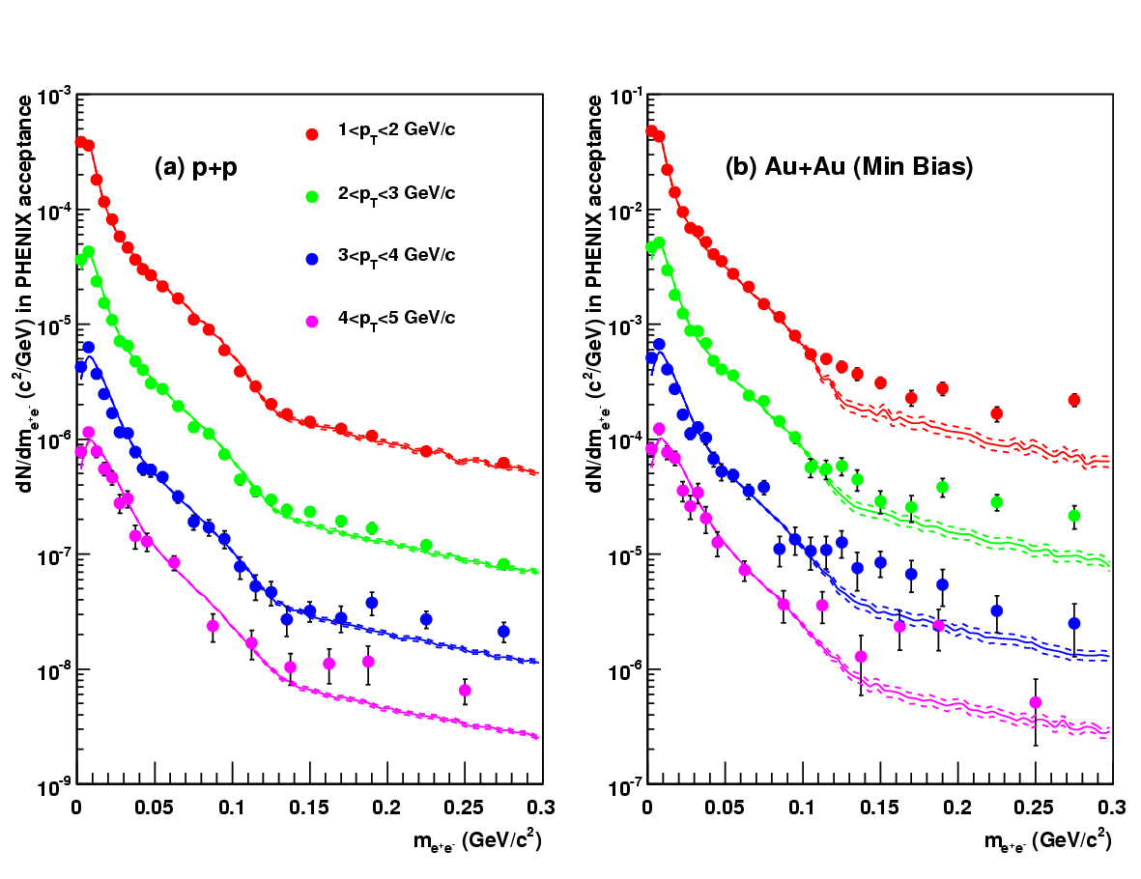
Direct Photon Signal
PHENIX, arXiv:0804.4168v1 [nucl-ex]
Corrected mass spectra (points)
Compared to “cocktail” of hadronic decays (lines)
Cocktail normalized to data for m<30 MeV
“knee” at 100 MeV from π⁰ cut-off
80% background reduction

Slide 19
Direct Photon Signal
p+p consistent w/ bckgrnd
for lowest p_{T}
PHENIX, arXiv:0804.4168v1 [nucl-ex]
Corrected mass spectra (points)
Compared to “cocktail” of hadronic decays (lines)
Cocktail normalized to data for m<30 MeV
“knee” at 100 MeV from π⁰ cut-off
80% background reduction
Small excess
at higher p_{T}
for m>m_{π0}

Slide 20
Direct Photon Signal
p+p consistent w/ bckgrnd
for lowest p_{T}
Au+Au much larger excess
at all p_{T}
PHENIX, arXiv:0804.4168v1 [nucl-ex]
Corrected mass spectra (points)
Compared to “cocktail” of hadronic decays (lines)
Cocktail normalized to data for m<30 MeV
“knee” at 100 MeV from π⁰ cut-off
80% background reduction
Small excess
at higher p_{T}
for m>m_{π0}
Indicates enhanced production
of virtual photons

Slide 21
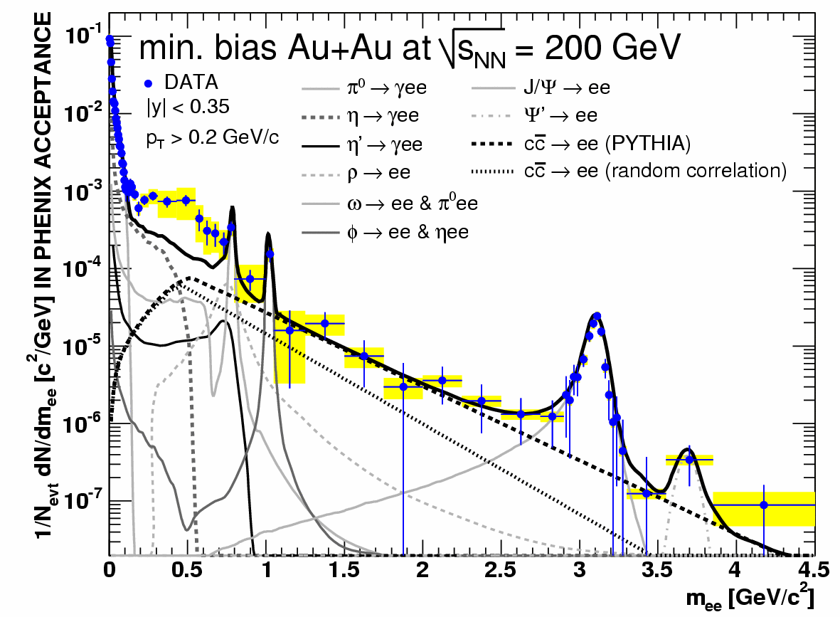
Direct γ vs. Low-Mass Enhancement
PHENIX, arXiv:0706.3034v1 [nucl-ex]
Low mass enhancement seen in Au+Au
Inclusive p_{T}, region II

Slide 22
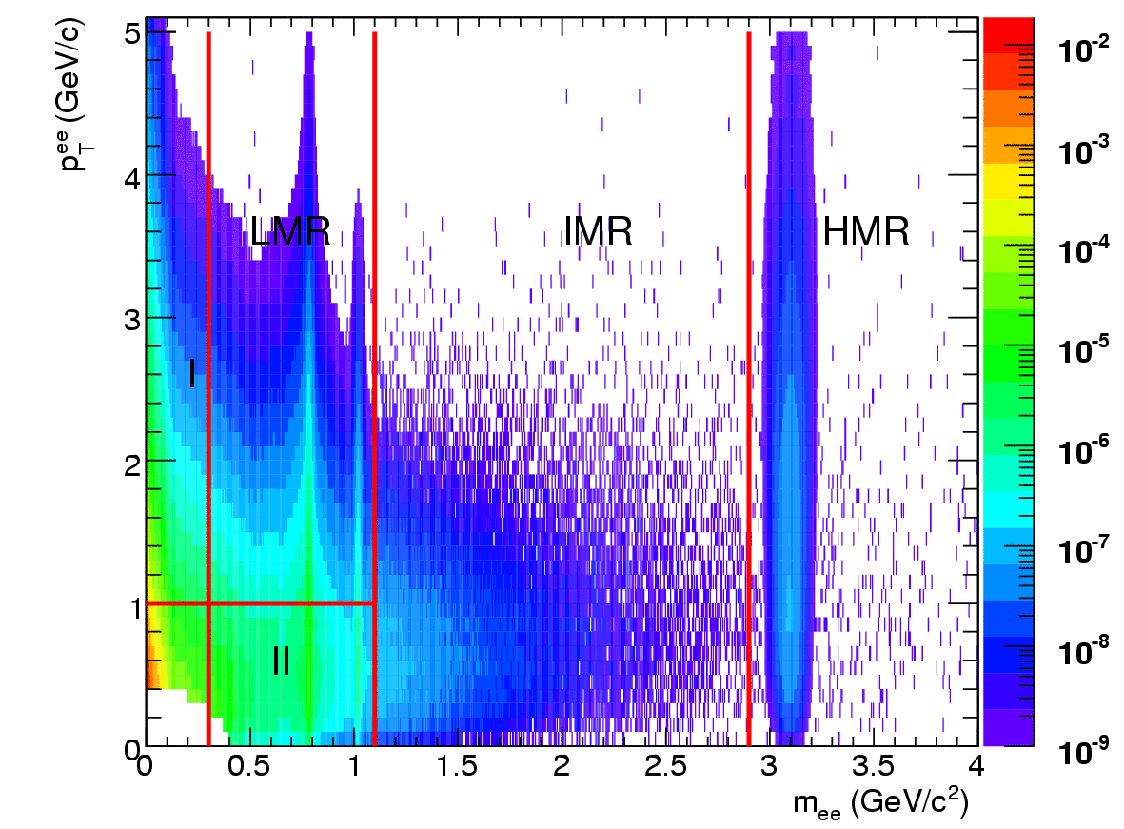
Direct γ vs. Low-Mass Enhancement
schematic
PHENIX, arXiv:0706.3034v1 [nucl-ex]
Kinematic region II:
Expected to be dominated by hadronic gas phase
Kinematic region I:
Quasi-real virtual photons
Low mass enhancement seen in Au+Au
Inclusive p_{T}, region II

Slide 23
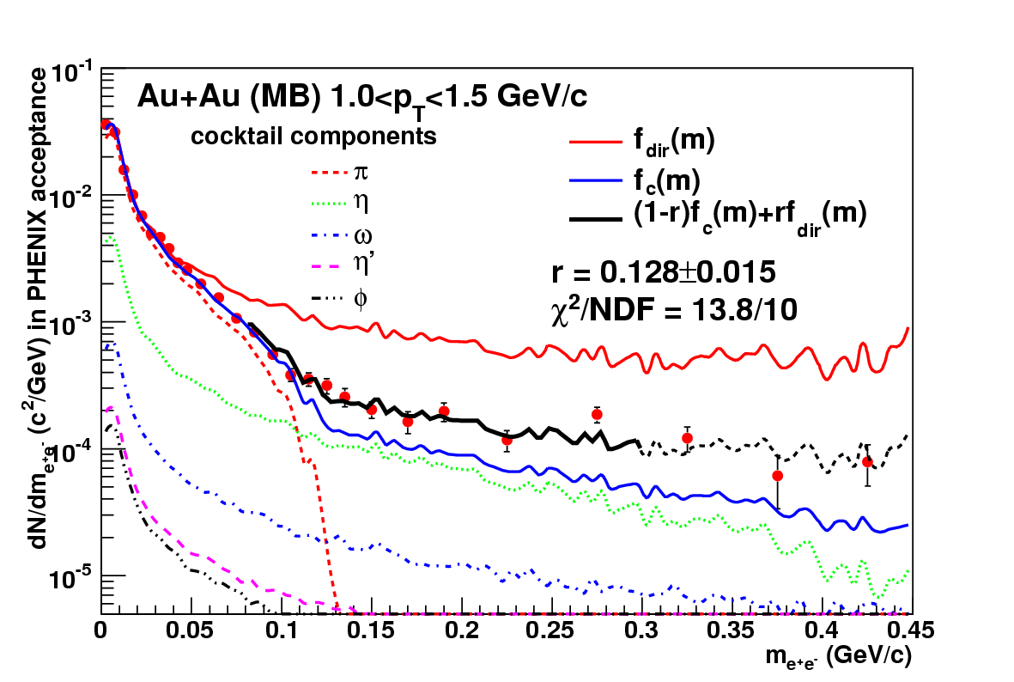
Extracting Direct γ Signal
Two-component fit
f_{c}: shape of cocktail
f_{dir}: shape of direct photon
r: fit parameter
f_{c}, f_{dir}: separately normalized to data for m<30 MeV
PHENIX, arXiv:0804.4168v1 [nucl-ex]

Slide 24
Extracting Direct γ Signal
Reminder:
Two-component fit
f_{c}: shape of cocktail
f_{dir}: shape of direct photon
r: fit parameter
f_{c}, f_{dir}: separately normalized to data for m<30 MeV
PHENIX, arXiv:0804.4168v1 [nucl-ex]

Slide 25
Extracting Direct γ Signal
Two-component fit
f_{c}: shape of cocktail
f_{dir}: shape of direct photon
r: fit parameter
f_{c}, f_{dir}: separately normalized to data for m<30 MeV
PHENIX, arXiv:0804.4168v1 [nucl-ex]

Slide 26
Extracting Direct γ Signal
Normalization
m<30 MeV
Fit
80<m<300 MeV
Two-component fit
f_{c}: shape of cocktail
f_{dir}: shape of direct photon
r: fit parameter
f_{c}, f_{dir}: separately normalized to data for m<30 MeV
PHENIX, arXiv:0804.4168v1 [nucl-ex]
normalization preserves meaning of r
as real direct photon fration
r entirely determined in fit region
where S/B enhanced by factor 5

Slide 27
Extracting Direct γ Signal
Normalization
m<30 MeV
Fit
80<m<300 MeV
Two-component fit
f_{c}: shape of cocktail
f_{dir}: shape of direct photon
r: fit parameter
f_{c}, f_{dir}: separately normalized to data for m<30 MeV
PHENIX, arXiv:0804.4168v1 [nucl-ex]
normalization preserves meaning of r
as real direct photon fration
Data follow expected shape for direct photons
r entirely determined in fit region
where S/B enhanced by factor 5

Slide 28
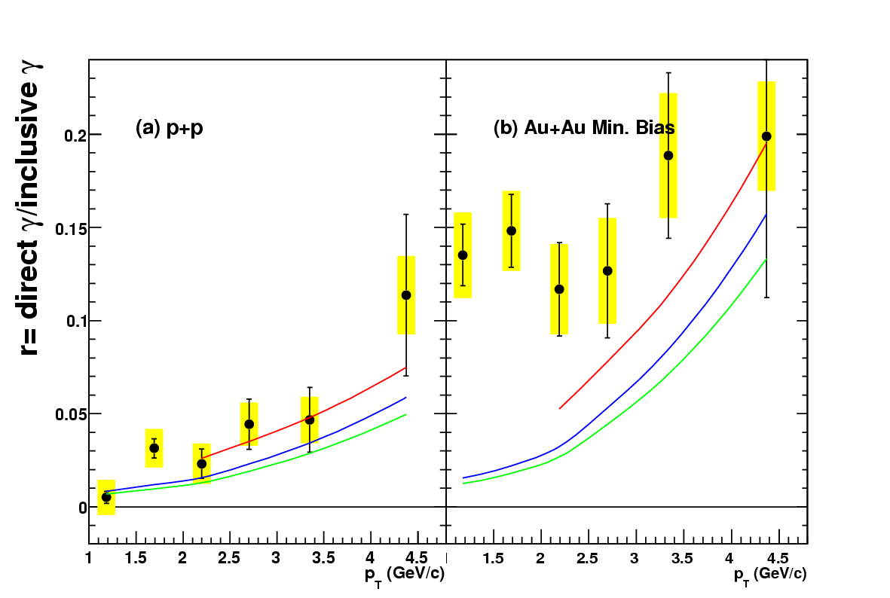
Direct Photon Fraction
Direct photon fraction compared to NLO pQCD (lines, three scales)
p+p
consistent with pQCD
Au+Au:
enhanced above pQCD
PHENIX, arXiv:0804.4168v1 [nucl-ex]

Slide 29
Direct Photon Fraction
Direct photon fraction compared to NLO pQCD (lines, three scales)
p+p
consistent with pQCD
Au+Au:
enhanced above pQCD
Systematic uncertainties
shape difference measured
η/π⁰ ratio largest source of uncertainty: 7% (17%) pp (AuAu)
Other sources contribute only few % as cocktail normalized to data (no absolute measurement)
PHENIX, arXiv:0804.4168v1 [nucl-ex]

Slide 30
Direct Photon Yield p+p
Convert r into direct γ yield
Ratio of γ/e⁺e⁻ for m<30 MeV same for any source
Syst. uncertainty of γ_{incl} 14%
From e⁺e⁻ pair acceptance

Slide 31
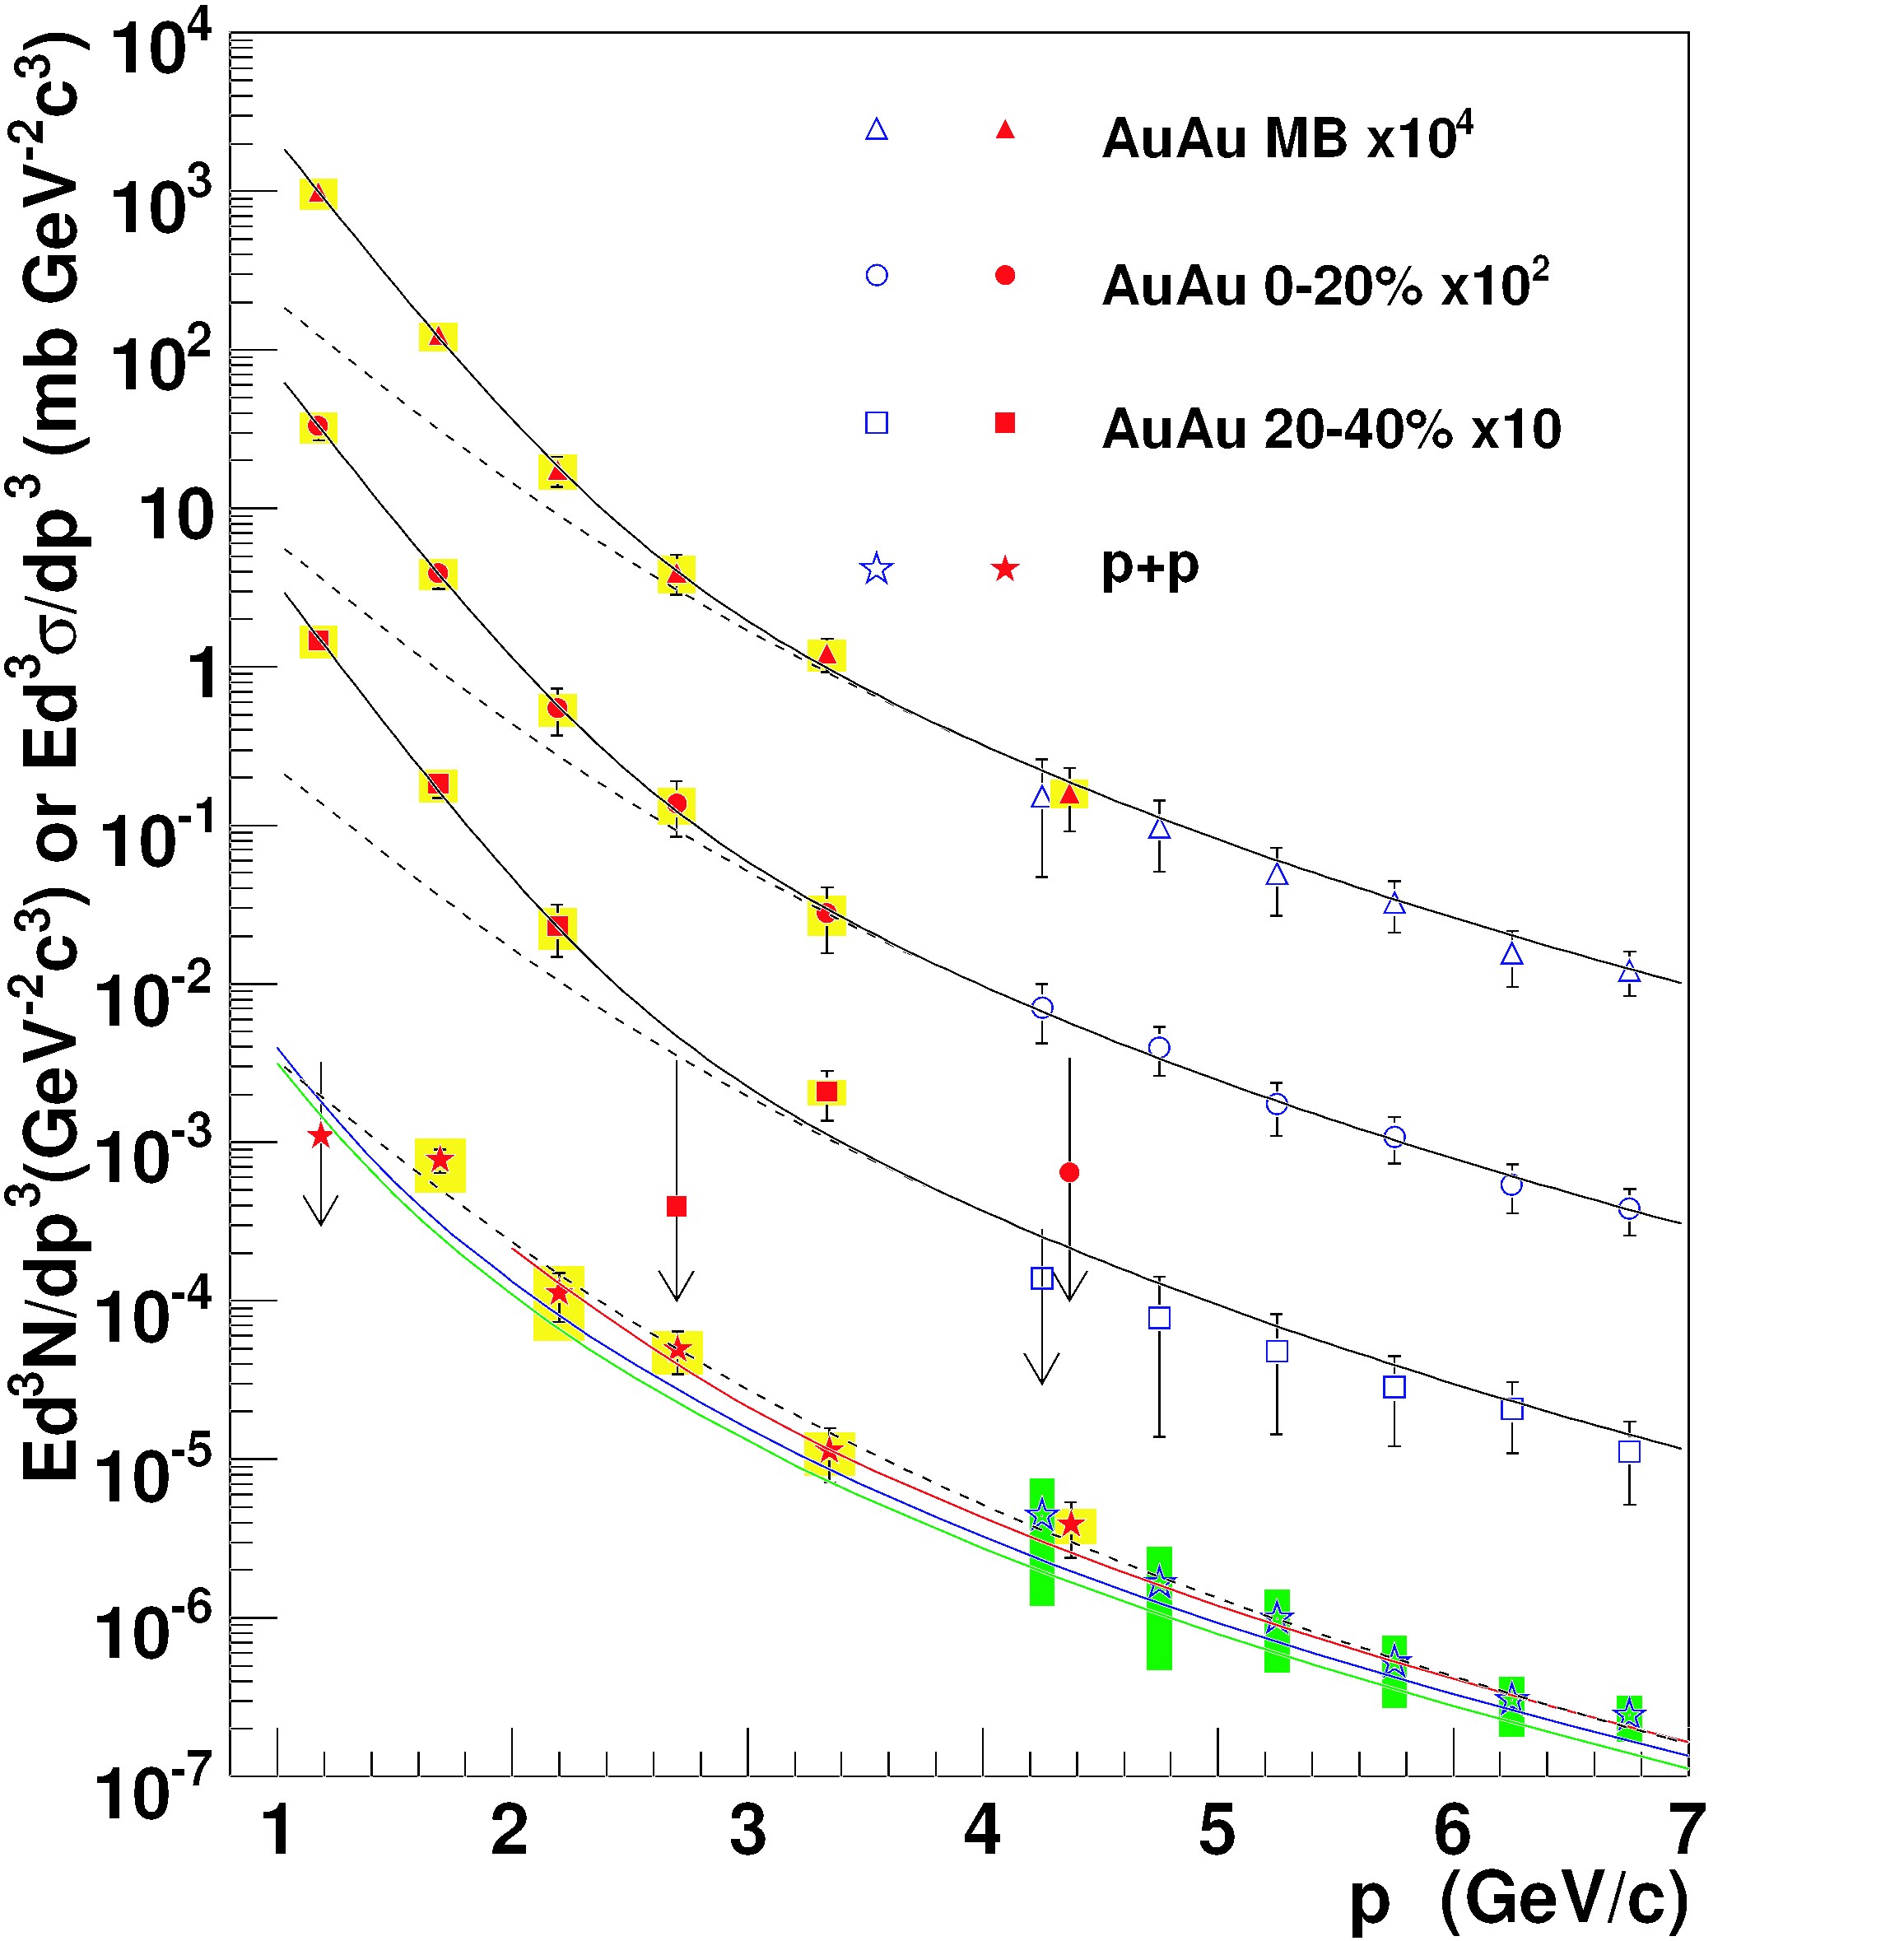
Direct Photon Yield p+p
Convert r into direct γ yield
Ratio of γ/e⁺e⁻ for m<30 MeV same for any source
Syst. uncertainty of γ_{incl} 14%
From e⁺e⁻ pair acceptance
ICA
EMC
pQCD
Mod. Power Law
PHENIX, arXiv:0804.4168v1 [nucl-ex]
T

Slide 32
Direct Photon Yield p+p
Convert r into direct γ yield
Ratio of γ/e⁺e⁻ for m<30 MeV same for any source
Syst. uncertainty of γ_{incl} 14%
From e⁺e⁻ pair acceptance
p+p
pQCD consistent with data for p_{T}>2 GeV
Well described with modified power law:
ICA
EMC
pQCD
Mod. Power Law
PHENIX, arXiv:0804.4168v1 [nucl-ex]
T

Slide 33
Excursion
Significance of modified power law

Slide 34
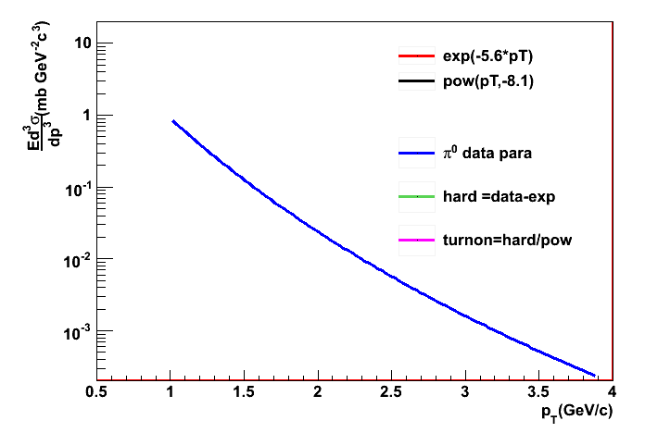
Onset of Hard Scattering
Example : π⁰ production
Data parameterized by
π⁰ : PHENIX PRL 98, 172302 (2007)

Slide 35
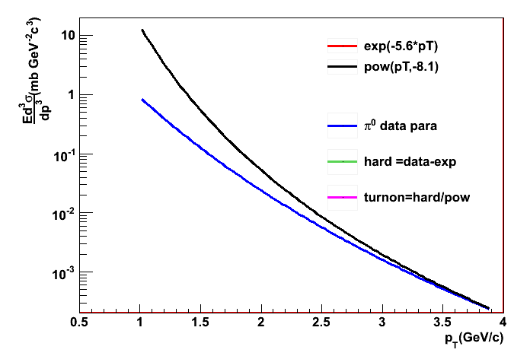
Onset of Hard Scattering
Example : π⁰ production
Data parameterized by
power law at high p_{T}
π⁰ : PHENIX PRL 98, 172302 (2007)

Slide 36
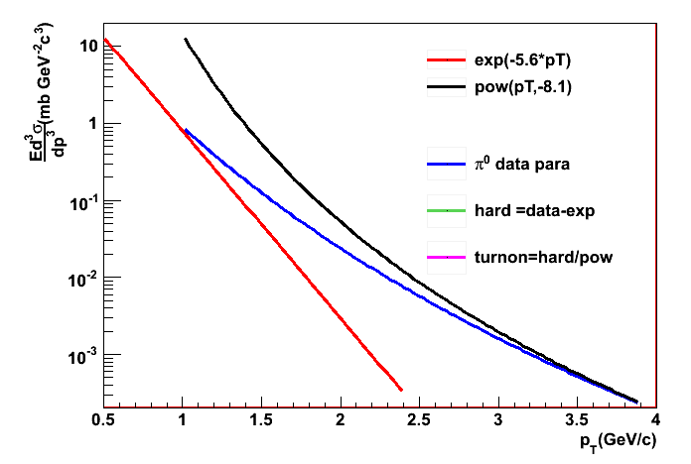
Onset of Hard Scattering
Example : π⁰ production
Data parameterized by
power law at high p_{T}
exponential at low p_{T}
Woods-Saxon transition
exponential dies out at high p_{T}
Power law diverges at low p_{T}
π⁰ : PHENIX PRL 98, 172302 (2007)

Slide 37
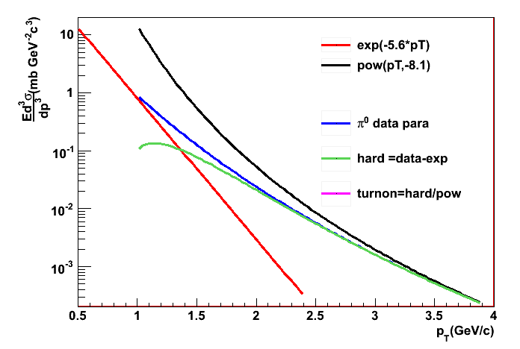
Onset of Hard Scattering
Example : π⁰ production
Data parameterized by
power law at high p_{T}
exponential at low p_{T}
Woods-Saxon transition
exponential dies out at high p_{T}
Power law diverges at low p_{T}
Power law must break down
π⁰ : PHENIX PRL 98, 172302 (2007)

Slide 38
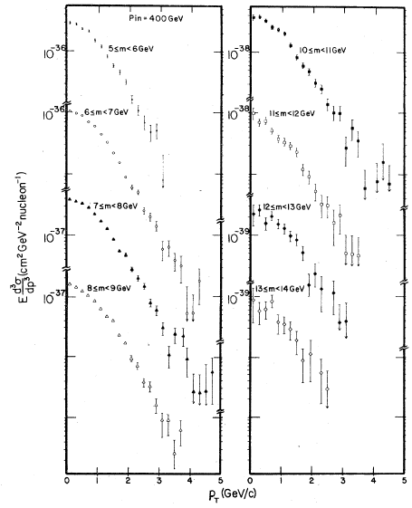
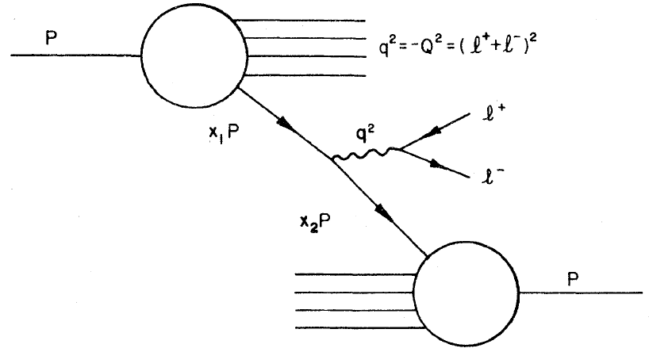
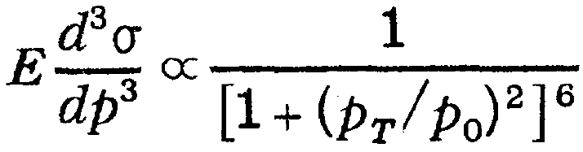
Hard Scattering in Drell-Yan
Dimuons from 400 GeV
incident protons
A.S. Ito et al.,
PRD123, 604 (1981)
Drell-Yan cleaner than direct g
No strongly interacting particle in vertex
Well described by modified power law

Slide 39
Hard Scattering in Drell-Yan
Dimuons from 400 GeV
incident protons
A.S. Ito et al.,
PRD123, 604 (1981)
Drell-Yan cleaner than direct g
No strongly interacting particle in vertex
Well described by modified power law

Slide 40
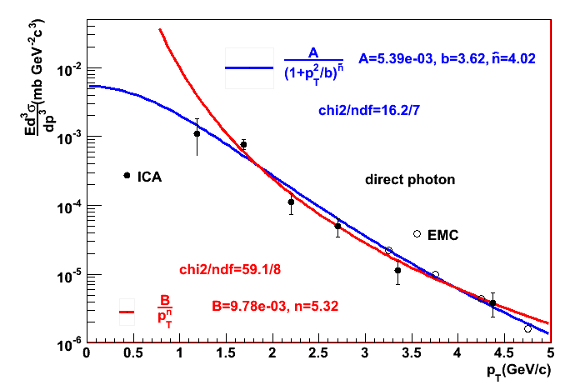
Modified vs. Unmodified Power Law
Fit p+p direct γ from 1<p_{T}<5 GeV
both ICA and EMC
Modified power law better fit
200 GeV p+p direct γ
Statistical uncertainties only
Data points: PHENIX, arXiv:0804.4168v1 [nucl-ex]

Slide 41
End of Excursion
Back to data

Slide 42
Direct Photon Yield Au+Au
Au+Au enhanced above
(= p+p)
for 1<pT<3 GeV
Fit with
+ Expo
T_{AB} x ModPowLaw
PHENIX, arXiv:0804.4168v1 [nucl-ex]
T

Slide 43
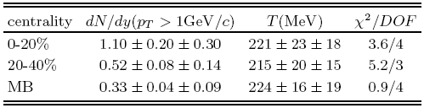
Direct Photon Yield Au+Au
Au+Au enhanced above
(= p+p)
for 1<pT<3 GeV
Fit with
Enhancement consistent with exponential
+ Expo
T_{AB} x ModPowLaw
PHENIX, arXiv:0804.4168v1 [nucl-ex]
T

Slide 44
Direct Photon Yield Au+Au
Au+Au enhanced above
(= p+p)
for 1<pT<3 GeV
Fit with
Enhancement consistent with exponential
+ Expo
If p+p fit with pure power law
T→T+24 MeV (central)
T_{AB} x ModPowLaw
PHENIX, arXiv:0804.4168v1 [nucl-ex]
T

Slide 45
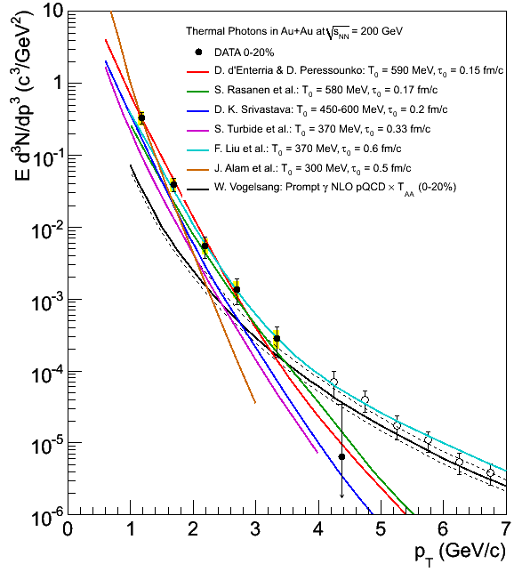
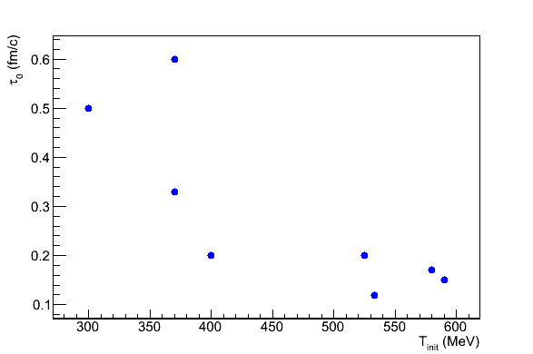
Model comparison
Au+Au = pQCD + exp.
→T = 221 ± 23 (stat) ± 18 (sys)
Initial temperatures and times from theoretical model fits to data:
0.15 fm/c, 590 MeV (d’Enterria et al.)
0.17 fm/c, 580 MeV (Rasanen et al.)
0.2 fm/c, 450-660 MeV (Srivastava et al.)
0.33 fm/c, 370 MeV (Turbide et al.)
0.6 fm/c, 370 MeV (Liu et al.)
0.5 fm/c, 300 MeV (Alam et al.)
D.d’Enterria, D.Peressounko, Eur.Phys.J.C 46 (2006)
From data: T_{ini} > 220 MeV > T_{C}
From models: T_{ini} = 300 to 600 MeV
τ₀ = 0.15 to 0.6 fm/c

Slide 46
Summary
Measured e⁺e⁻ pairs
m<300 MeV
1<pT<5 GeV
p+p and Au+Au
p+p
small excess over hadronic background
Au+Au
much larger excess
Treated excess as internal conversion of direct photons
Extracted direct photon yield

Slide 47
Summary
Measured e⁺e⁻ pairs
m<300 MeV
1<pT<5 GeV
p+p and Au+Au
p+p
small excess over hadronic background
Au+Au
much larger excess
Treated excess as internal conversion of direct photons
Extracted direct photon yield
p+p
Lowest p_{T} ever measured for direct photon in p+p
Consistent with NLO pQCD
But indicates turn-over
Au+Au
Spectrum shape above T_{AA} scaled p+p exponential
T=221+-23+-18MeV
Consistent with hydro models
T_{init}=300-600 MeV
τ₀=0.6-0.15fm/c
Analysis ongoing for d+Au

