Slide 1
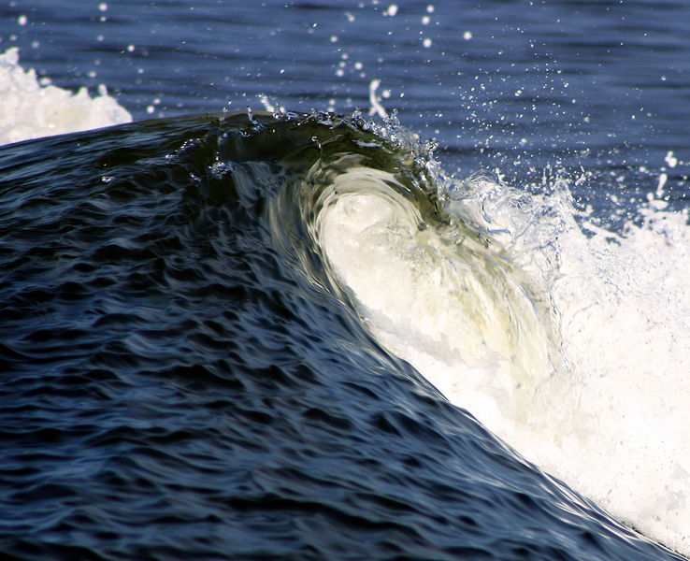
Nonlinear effects in internal waves

Slide 2
Wave steepness
Linear wave: h0<1/m
2h₀
λ/2
2h₀
Steep wave: h0m>1.
Regions of overturned isopycnals

Slide 3
Connection between high Froude number and wave breaking for surface waves
Uw > C
C + Uw
Initial interface height
Subsequent interface height
C - Uw
If Uw/C is large, then wave shape is modified so that wave surface overturns.

Slide 4
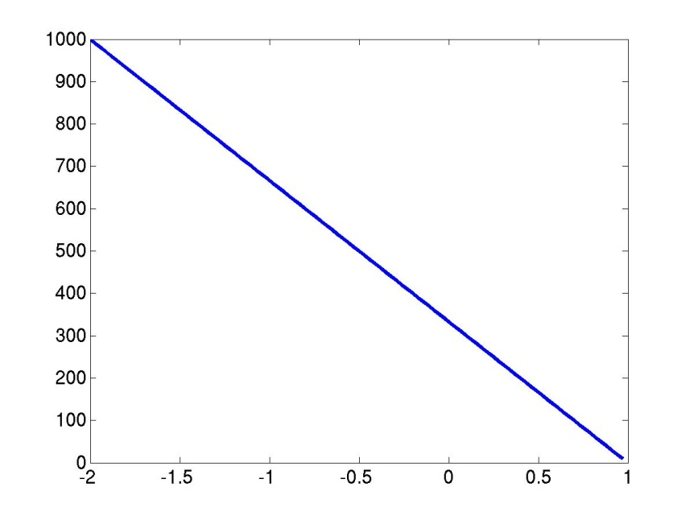
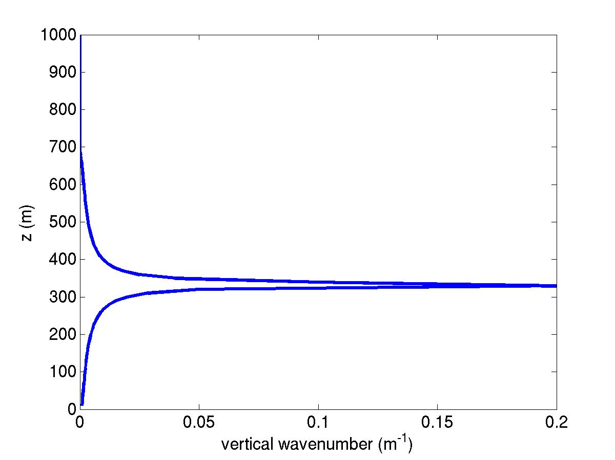
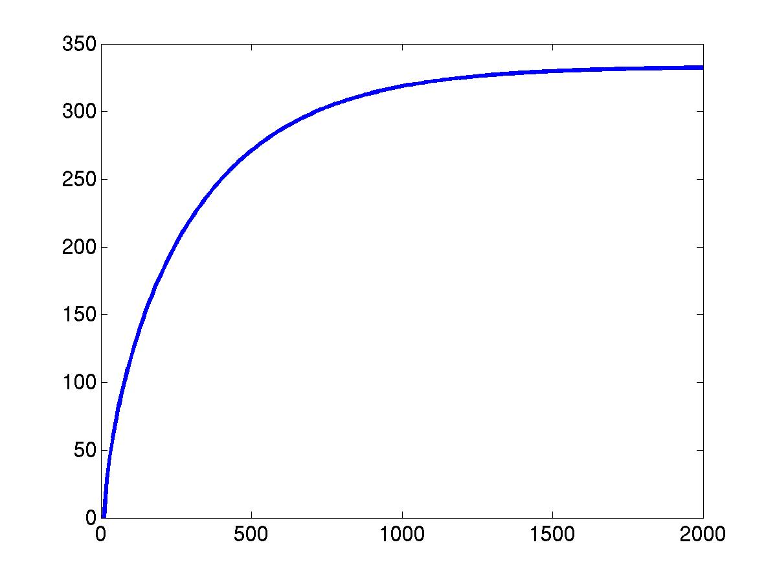
Nonrotating critical level example
Velocity profile
Vertical wavenumber
Z(m)
U m/s
Wave characteristic
when U = Cp,
i.e. U=0.
Z(m)
X(m)

Slide 5
Overturning isopycnals at a critical level (U = 0)
Dornbrack and Durbeck, 1998, numerical simulation

Slide 6
Large amplitude topography
U
Fr = U/(Nh)
h

Slide 7
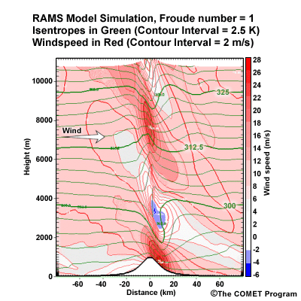
Effect of finite amplitude topography: Fr = 1
Blue region shows reverse flow in region of overturned isentropes.

Slide 8
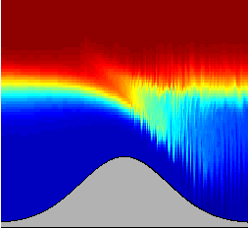
Hydraulic control
Topographic obstacle accelerates flow, reduces d, so that transition to supercritical flow occurs.
Mixing occurs in supercritical region.
d
(Numerical simulations, Legg)

Slide 9
Parametric Subharmonic Instability
Initial conditions
Winters et al, 2004 numerical simulations
Subsequent evolution – generation of waves at twice initial frequency

Slide 10
PSI of internal tide at 21 degrees
KE spectra as function of
frequency
Horizontal wavenumber
Vertical wavenumber
Red = 2days, green = 22 days, blue = 65 days
MacKinnon and Winters, 2006. Numerical simulations.

Slide 11
Garrett-Munk spectrum
Frequency spectrum
Vertical wavenumber spectrum
(taken from Lvov et al, 2005)

Slide 12
Comparison of observations and wave-turbulence model for spectra
(Lvov et al, 2005)

Slide 13
What have we learned?
Nonlinearity in gravity waves can be characterised by wave steepness s=hm, or wave froude number Fr=U/C.
Highly nonlinear waves are associated with overturned isopycnals, leading to mixing.
Breaking waves can be produced at critical layers, and large amplitude topography.
Nonlinear wave-wave interactions allow waves at new k,ω to be generated.
Parametric Subharmonic Instability is a resonant wave-wave interaction where the new wave has half the frequency of the original wave, especially important when ω0=2f.
Nonlinear wave-wave interactions are responsible for the continuous Garrett-Munk spectrum observed in the ocean.

