Slide 1
Introduction
Presenter: Steve Hunter
Topic:
Overview of caBIG QA Process

Slide 2
Overview
caBIG QA Process
Goals of QA Process
Diagram of Project flow
QA’s involvement chronologically:
Before Test Execution
During Test Execution
After Test Execution
Questions?

Slide 3
Goals of QA Process
caBIG QA Process
Ensuring quality in:
Product – all outward facing deliverables
Process – method of producing the product
How we do it:
Test the product
QA throughout SDLC

Slide 4
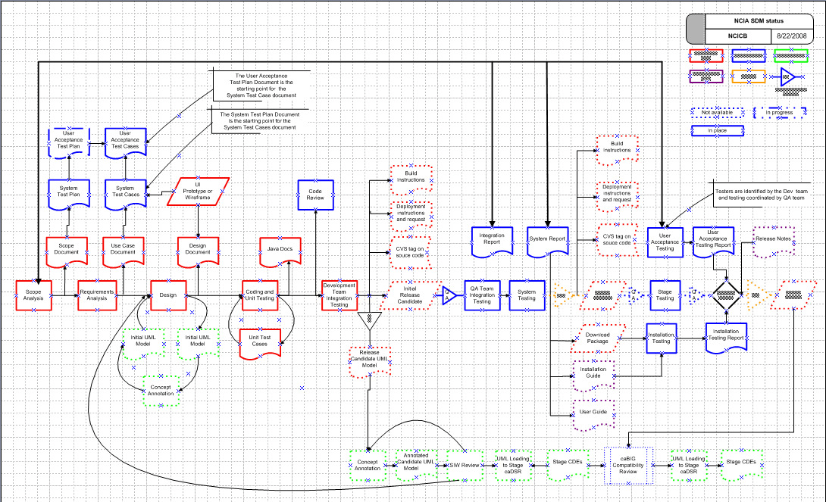
Diagram of Project Flow
caBIG QA Process
Notes:
Download SDM file (requires Visio):
https://gforge.nci.nih.gov/docman/view.php/271/4752/NCICB%20SW%20Development%20Methodology%20-%20App%20template.vsd

Slide 5
Before Test Execution
User Acceptance Test Plan
System Test Plan
Approach
Features to be tested
Features not to be tested
Responsibilities
Resources required
Schedule
Risks and contingencies
System Test Plan
Scope Document
User Acceptance Test Plan
Same as above

Slide 6

Before Test Execution
Use Case/Requirement Review
Use Cases
Criteria
Complete
Correct
Unambiguous
Consistent
Non-compound
Sends an email to appropriate individuals.
Sends an email to appropriate individuals.

Slide 7
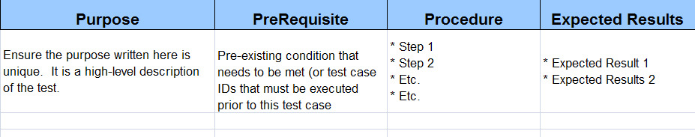
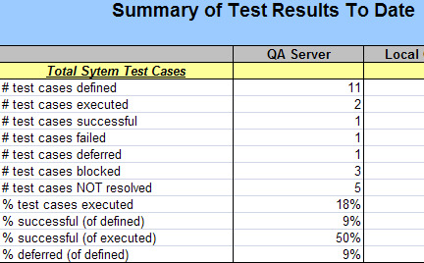
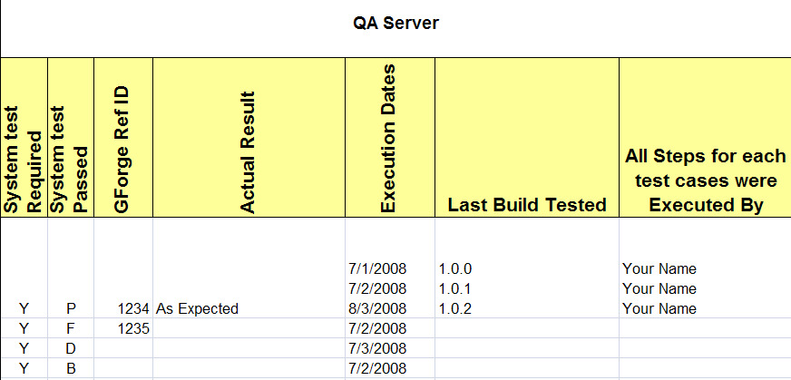
Before Test Execution
User Acceptance Test Cases
System Test Cases
Use Case Document

Slide 8
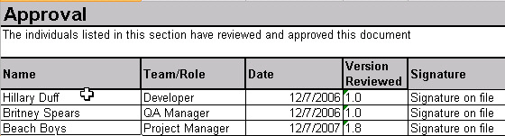
Before Test Execution
Reviews
Code Review
Document | Reviewer
Scope | PM, Product Manager
Test Plan | PM, QA Manager, other QA
Design | DEV, External DEV, Gov. sponsor
Requirements | QA, DEV, End Users
Test Cases | DEV, QA Manager, PM
Code Review | DEV

Slide 9

Diagram of Project Flow
caBIG QA Process

Slide 10
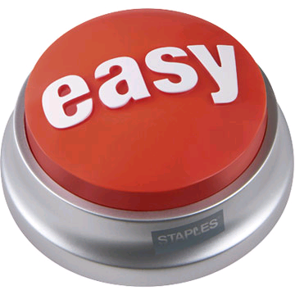

During Test Execution
Build and Deployment
Old Way
New Way - Automation
CVS Tag
QA Builds to the QA Tier
Build Document
Deployment Document

Slide 11
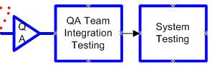
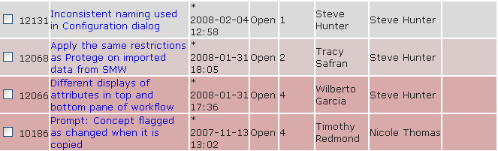
During Test Execution
Execute the Test Plan
Execution of Integration and System Testing
Post Defects in GForge Bug tracker
Triage defects
Cog 3
Cog 2
Cog 1
DEV team fixes defect
QA Verify fixes
Regression Test

Slide 12
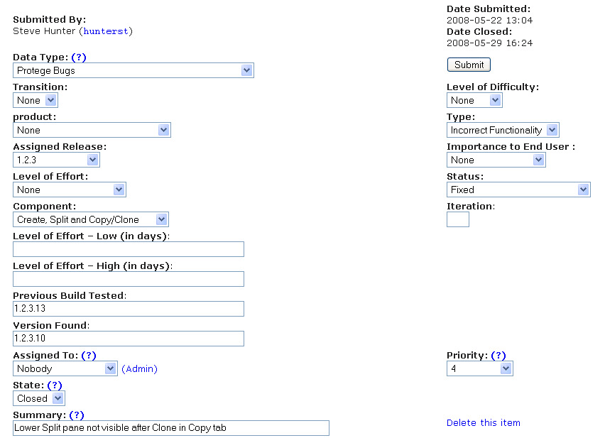
During Test Execution
Defect Tracking with GForge

Slide 13
Diagram of Project Flow
caBIG QA Process

Slide 14
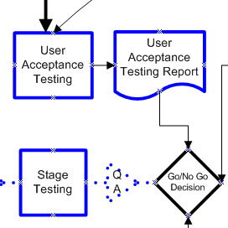




After Test Execution
Stage
Permission to proceed to Stage
Stage is built and deployed
Smoke Test Stage tier
Production
Same as above
User Acceptance Testing
End Users
QA
Team

Slide 15
Diagram of Project Flow
caBIG QA Process
Questions

