Slide 1
EECS 499 Project 1
Image Tracking
Su Lu
04/05/2016

Slide 2
Contents:
1. Background
2. Experiment setup
3. Particle filter implementation
4. Result
5. Improvement

Slide 3
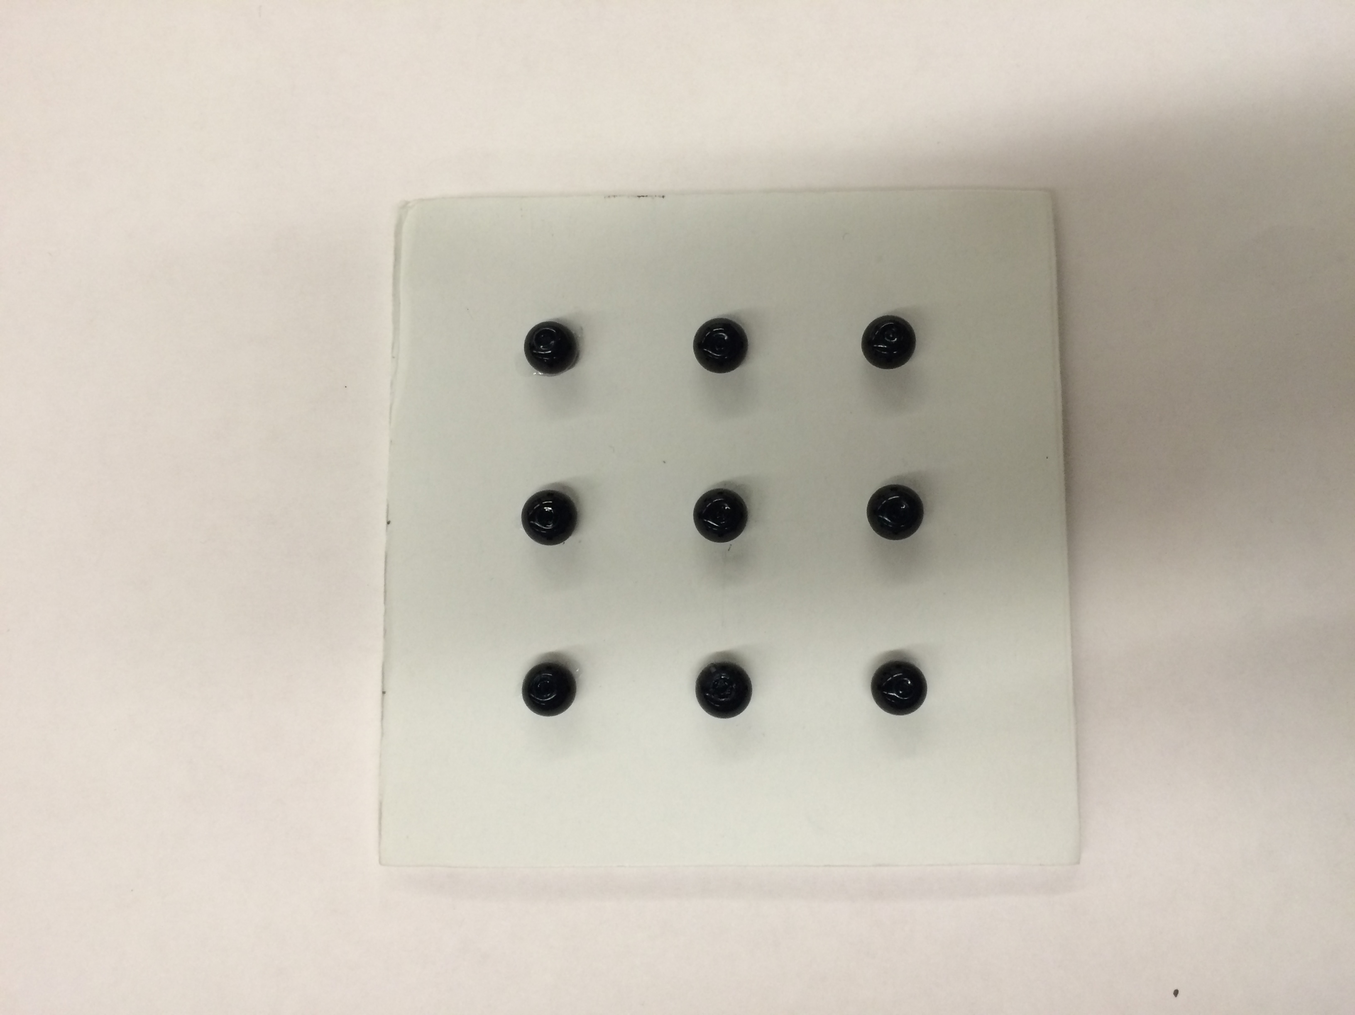
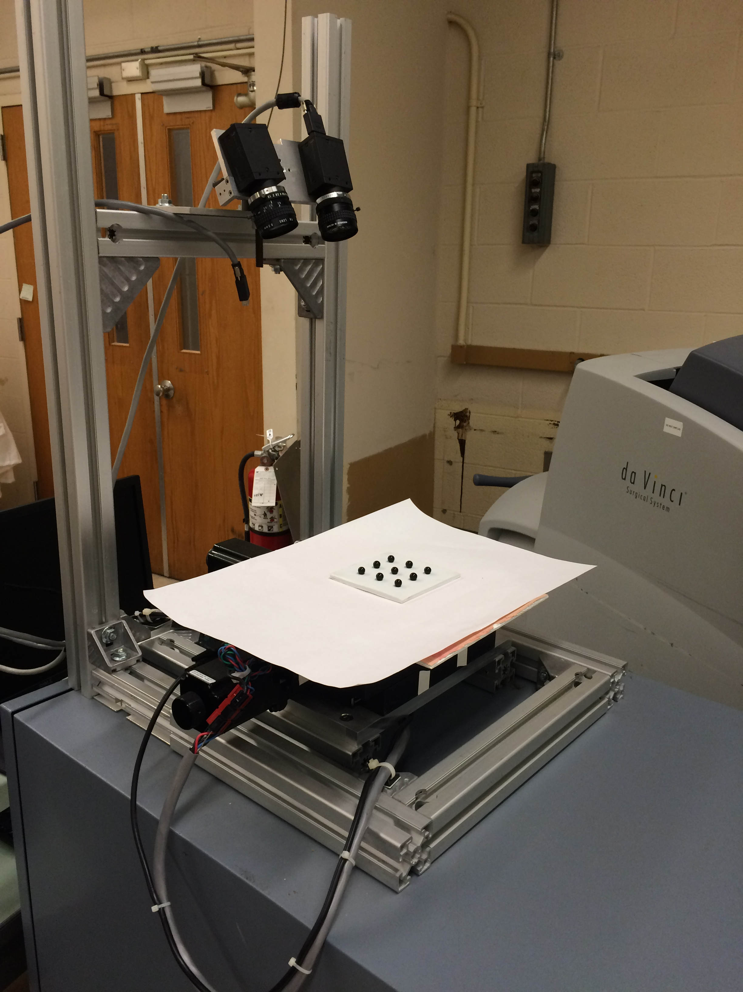
Experiment setup

Slide 4
Background
Automatic suturing system on daVinci Robot
Estimation of object deformationS
Simplified 6-Dof rigid body motion (plate motion)
Tracking plate motion by capturing beads motion (fiducials)
ROS implementation

Slide 5
Particle filter implementation
State X_{t}: 6-Dof (x, y, z, rot_{x}, rot_{y}, rot_{z}) expressed by transformation matrix from body to camera frame G_{cb}
Measurement Z_{t}: Camera Image
Control U_{t}: Matrix exponential e^{Vst}.
  - V_{s} randomly generated spatial velocity
Each particle represented a hypothesized transformation matrix G_{cb} or an image with 9 beads

Slide 6
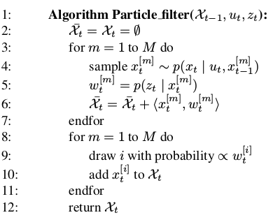
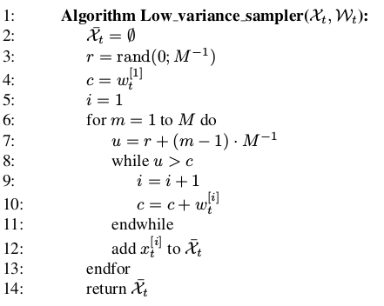
line 4:
Eigen::Affine3d particle_trans_mat_update = beadsGenerator.getNewTransformationMatrix(particles_set[i], delta_time);
line 5:
cv::matchTemplate(g_frame_in, expected_bead_pos_image, weight, CV_TM_CCOEFF_NORMED);
line 8 – 11: Using low variance sampler

Slide 7
Results
Failed to tracking random rigid body motion
Possible reasons:
1. Number of particles too less (current 1000), need more?
2. Initial particles guess not correct?
3. Re-sample frequency, currently depend on delta time between loop, better to re-sample at fixed frequency 5s or 10s?

Slide 8
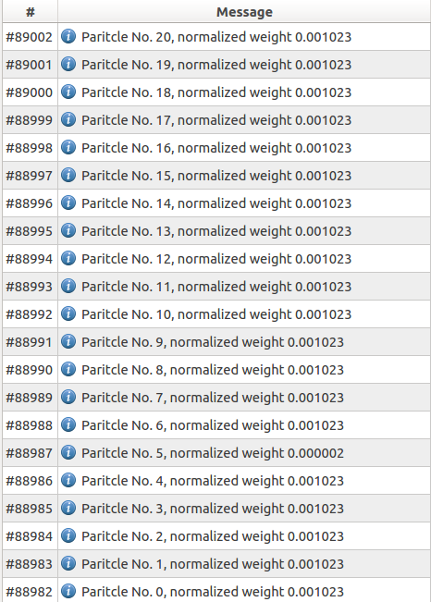

Slide 9
Improvements
Tracking tissue deformation by particle filter
Accurate Motion model by robot joint motion
FEM Implementation to estimate soft tissue deformation

