Slide 1
Numerical Results
Simulation Data on burger market entry and exit model
Short panel data
Long panel data
Partial observability
Real Data on Canada burger market
Inflation rate indicator
Two agent POSG or COSG
Five agent POSG or COSG
Gdp indicator
Linear regression analysis
Five agent POSG
Five agent complete model in literature
Counterfactual Analysis
Inflation rate indicator (without population, income, property value)
Two agent POSG or COSG
Five agent POSG or COSG
Gdp indicator influence
Inner competitive
Out Competitive

Slide 2
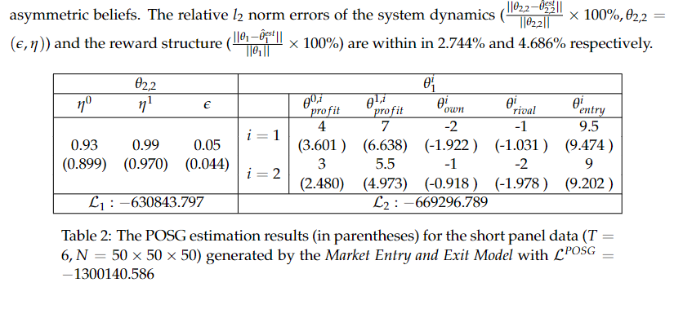
Simulation Data on burger market entry and exit model
Short panel data

Slide 3
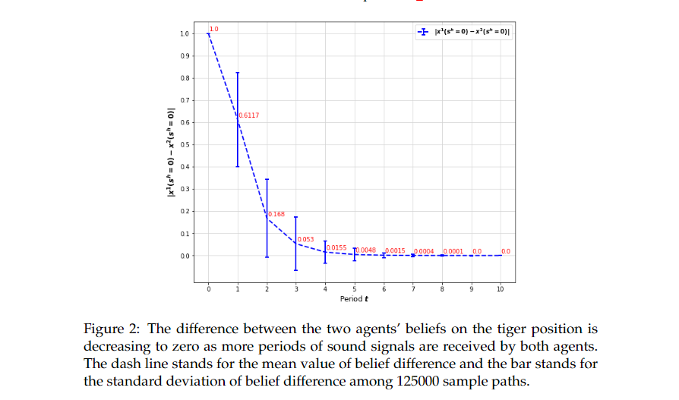

Slide 4
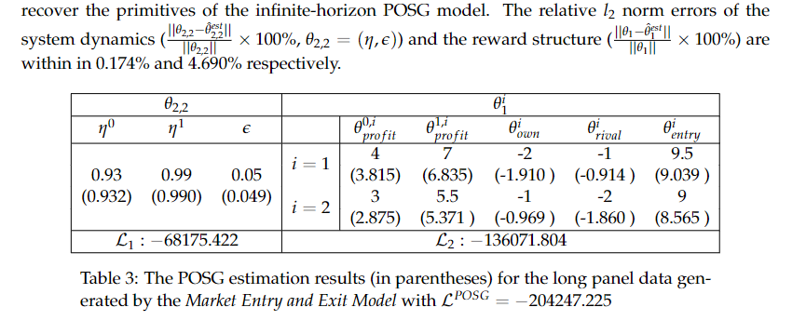
Simulation Data on burger market entry and exit model
Long panel data

Slide 5
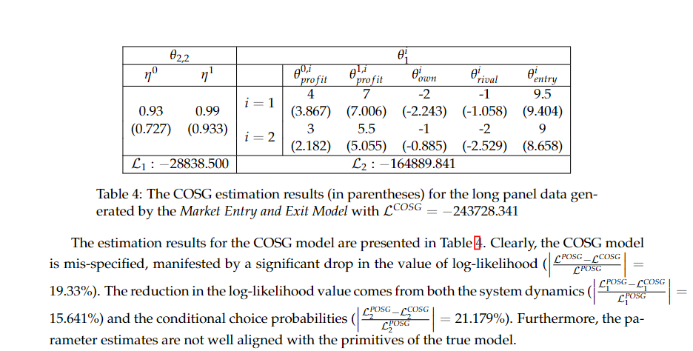
Simulation Data on burger market entry and exit model
Partial observability

Slide 6
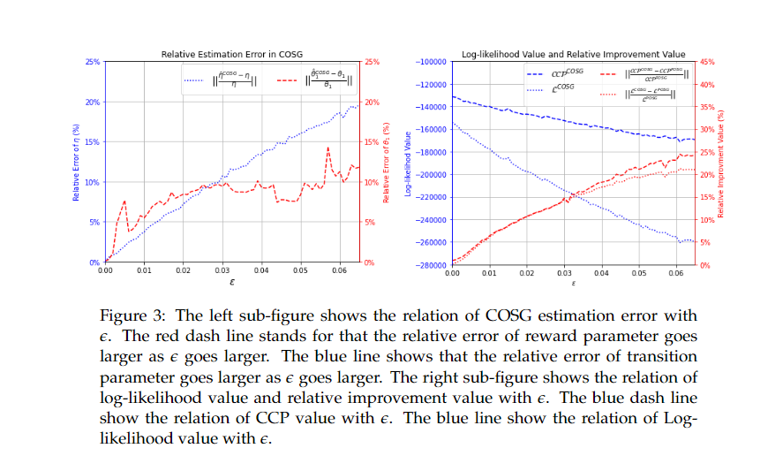

Slide 7
Need to do next: the plots of MSE

Slide 8
Real Data on Canada burger market
Inflation rate indicator
Need to do next: recover results and MSE plots for both two agent and five agent POSG and COSG model with population, income, property value

Slide 9
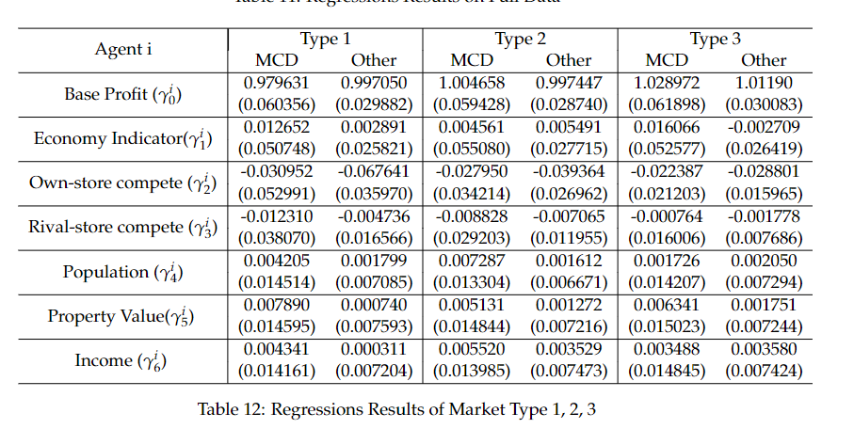
Real Data on Canada burger market
Gdp indicator – Linear regression analysis double check five agents or two agents

Slide 10
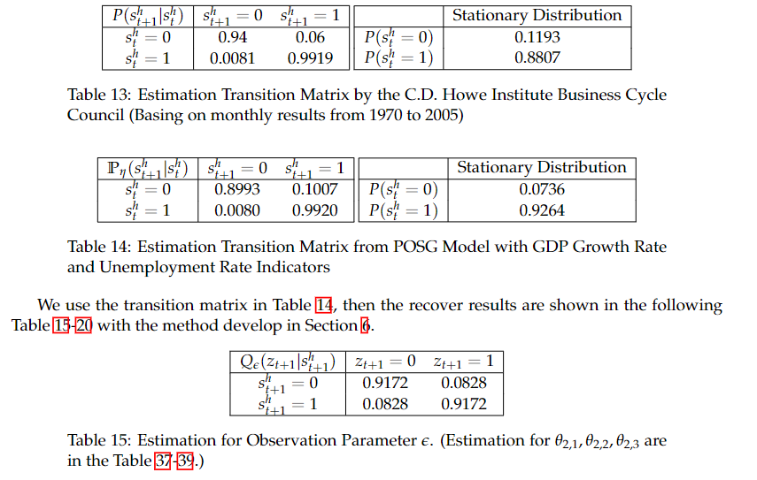
Real Data on Canada burger market
Gdp indicator – Five agent POSG clearify the definition of market type

Slide 11
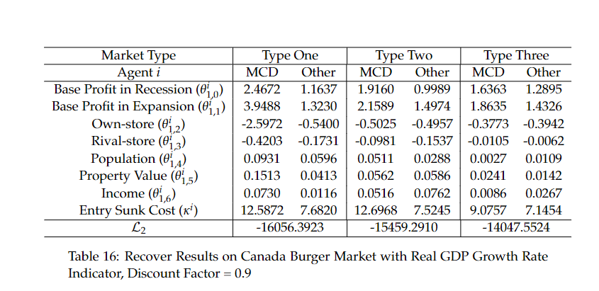

Slide 12
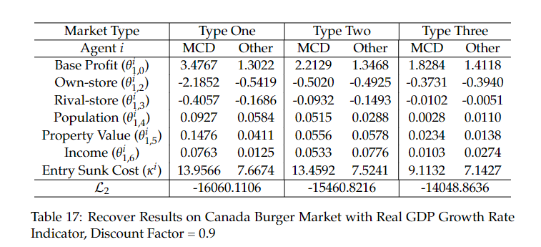
Real Data on Canada burger market
Gdp indicator – Compete model in literature

Slide 13
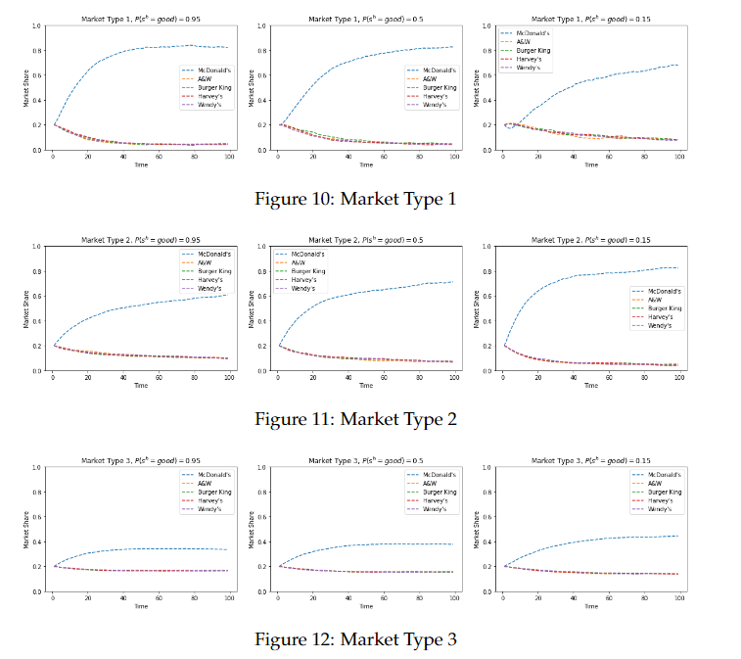

Slide 14
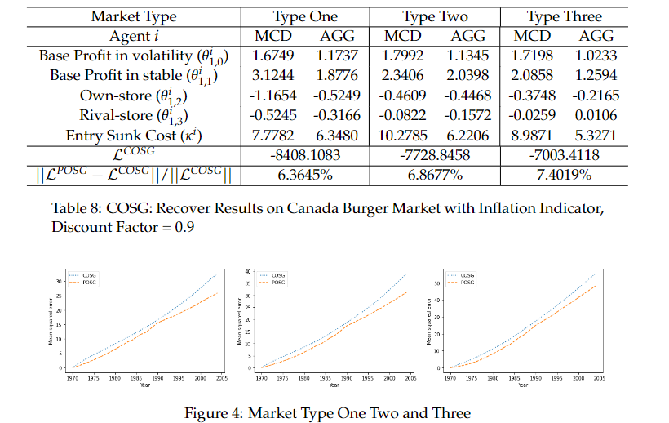
Counterfactual Analysis
Inflation rate indicator (without population, income, property value)
Two agent POSG or COSG comparison on log-likelihood, MCD treat other agents as an aggregate agent

Slide 15
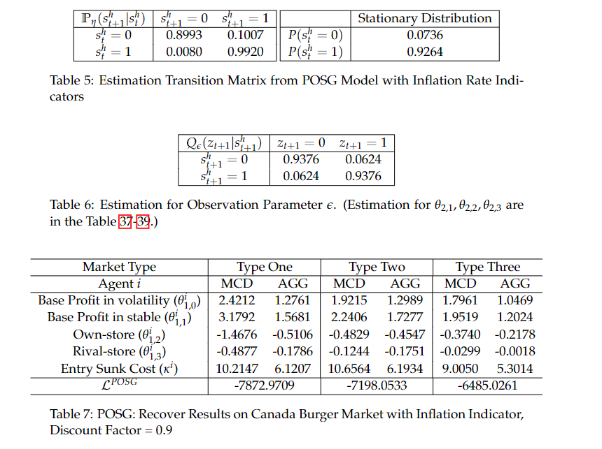

Slide 16
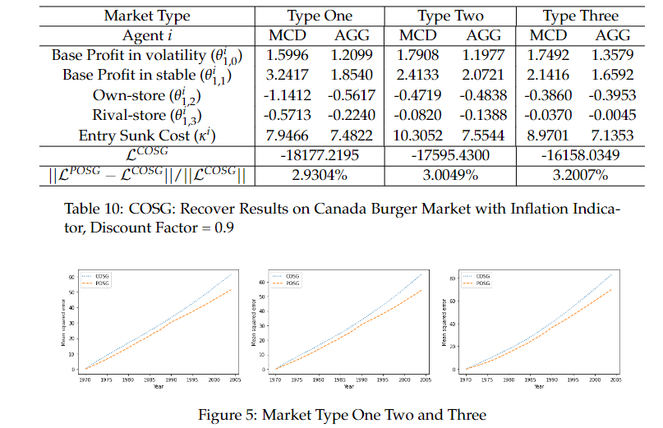
Counterfactual Analysis
Inflation rate indicator (without population, income, property value)
Five agent POSG or COSG

Slide 17
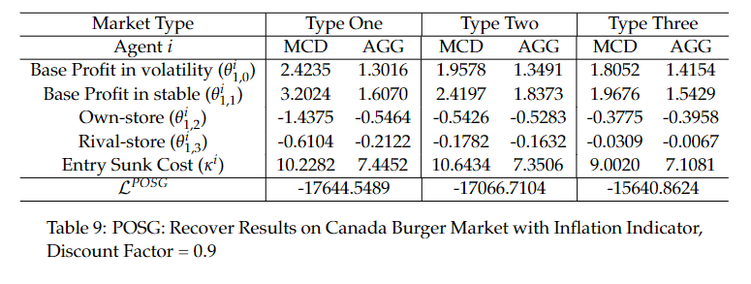

Slide 18
