Slide 1
Outline
Numerical Results Update
Future Timeline
Questions

Slide 2
Numerical Results
Simulation Data on burger market entry and exit model
Short panel data
Long panel data
Partial observability
Real Data on Canada burger market
Inflation rate indicator
Two agent POSG or COSG
Five agent POSG or COSG
Gdp indicator
Linear regression analysis
Five agent POSG
Five agent complete model in literature
Counterfactual Analysis
Inflation rate indicator (without population, income, property value)
Two agent POSG or COSG
Five agent POSG or COSG
Gdp indicator influence
Inner competitive
Out competitive

Slide 3
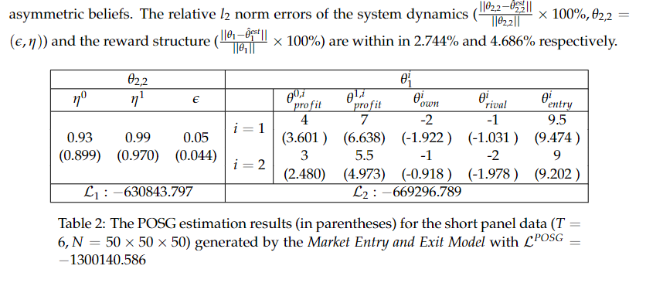
Simulation Data on burger market entry and exit model
Short panel data

Slide 4
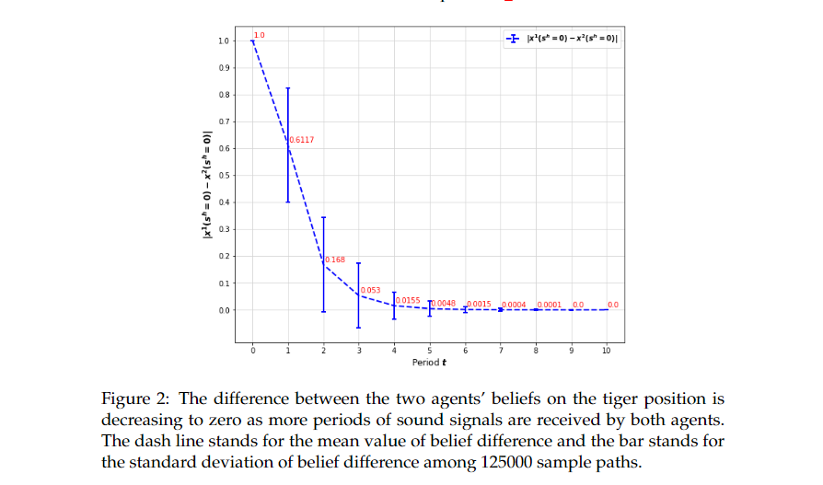

Slide 5
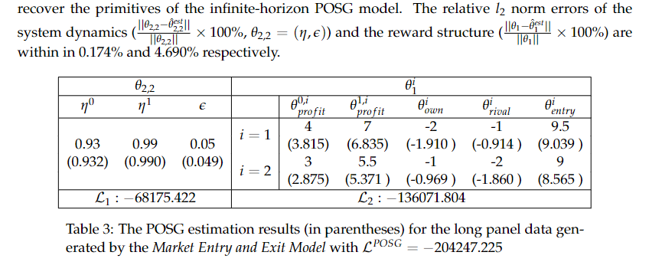
Simulation Data on burger market entry and exit model
Long panel data

Slide 6
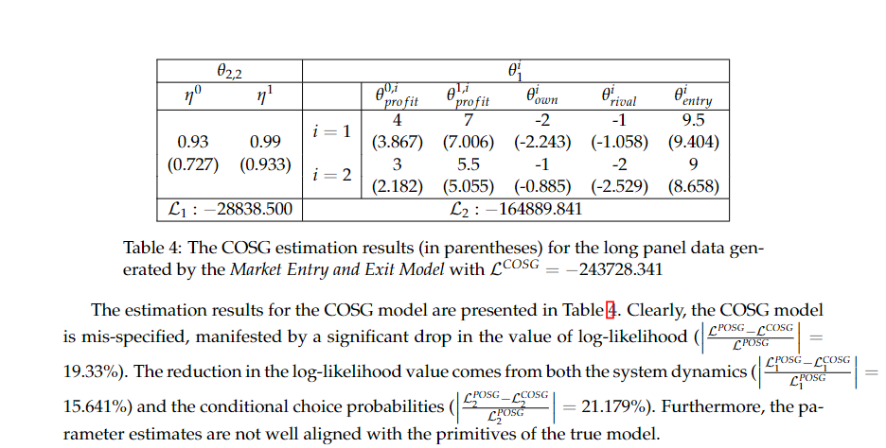
Simulation Data on burger market entry and exit model
Partial observability

Slide 7
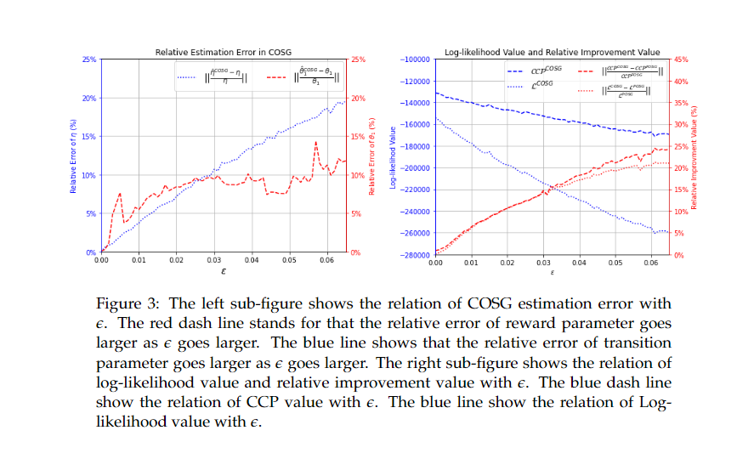

Slide 8
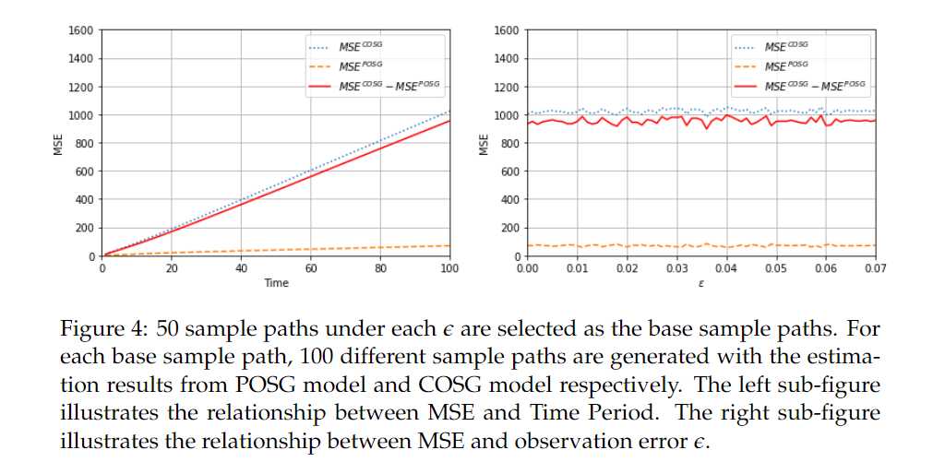
the plots of MSE

Slide 9
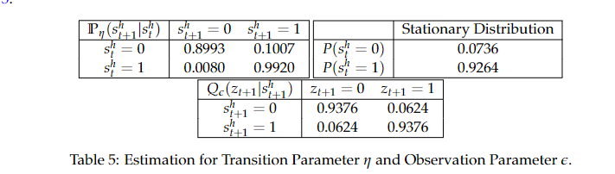
Real Data on Canada burger market
Inflation rate indicator
recover results and MSE plots for both two agent and five agent POSG and COSG model with population, income, property value

Slide 10
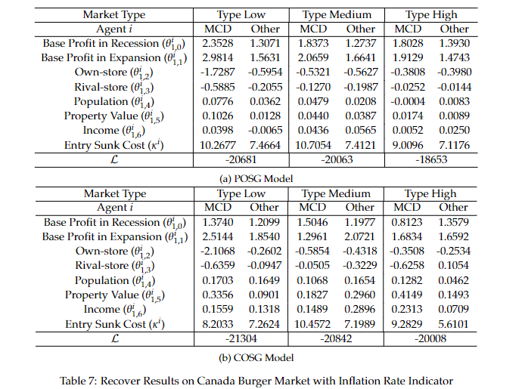
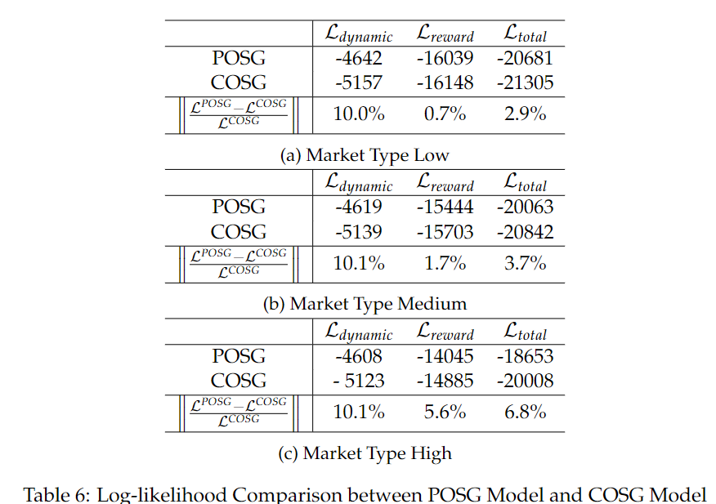
Real Data on Canada burger market
Inflation rate indicator -- Five Agents

Slide 11
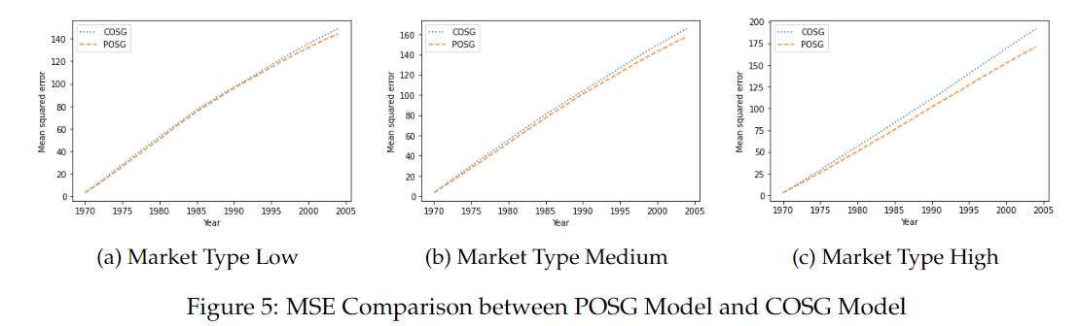
Real Data on Canada burger market
Inflation rate indicator -- Five Agents

Slide 12
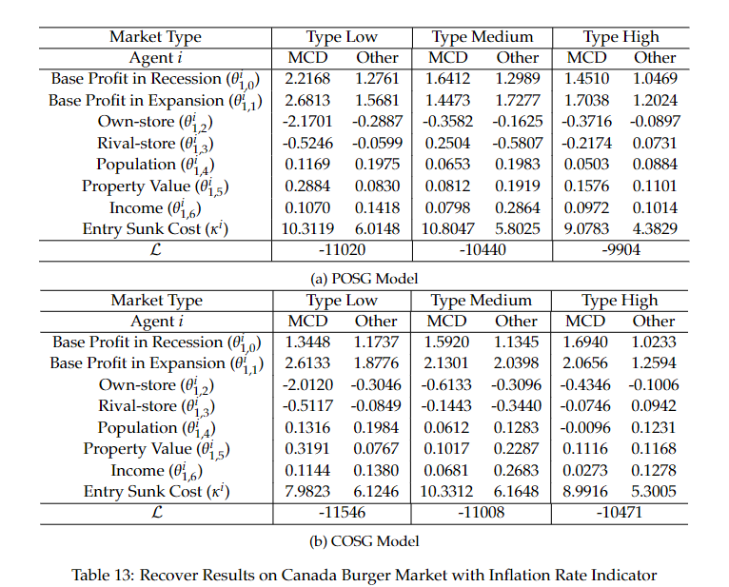
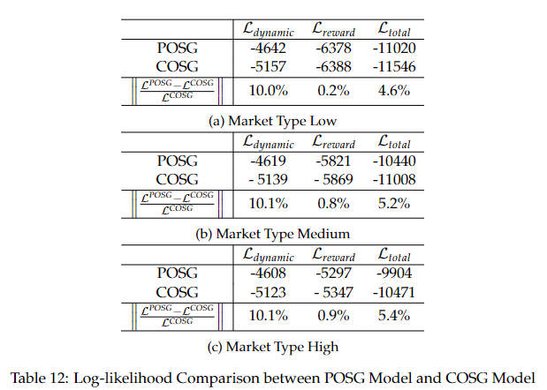
Real Data on Canada burger market
Inflation rate indicator -- Two Agents

Slide 13
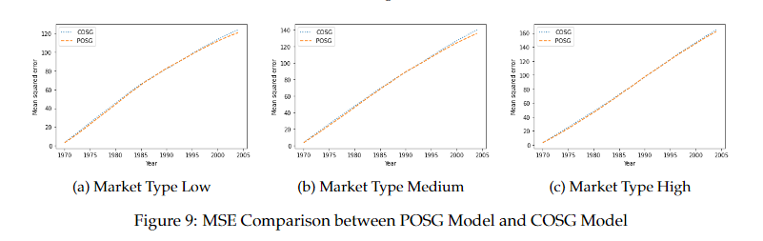
Real Data on Canada burger market
Inflation rate indicator -- Two Agents

Slide 14
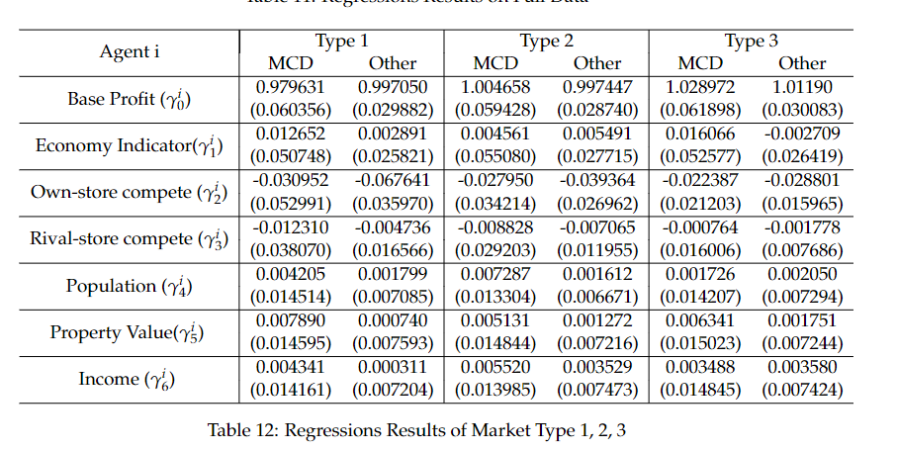
Real Data on Canada burger market
Gdp indicator – Linear regression analysis (five agents)

Slide 15
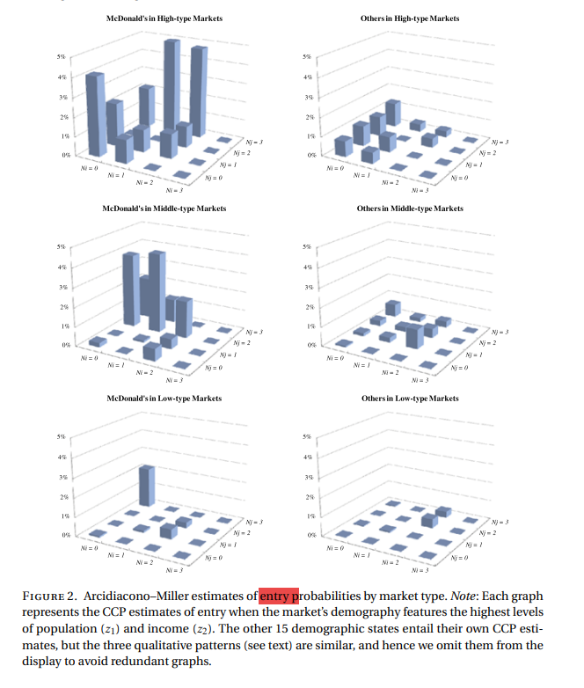
Real Data on Canada burger market
Gdp indicator – Five agent POSG
email : I’m interested in your work. Thank you for doning the good work. I have a question what is the economical meaning of the market type. Is it mean the more profitable market type?
clearify the definition of market type

Slide 16
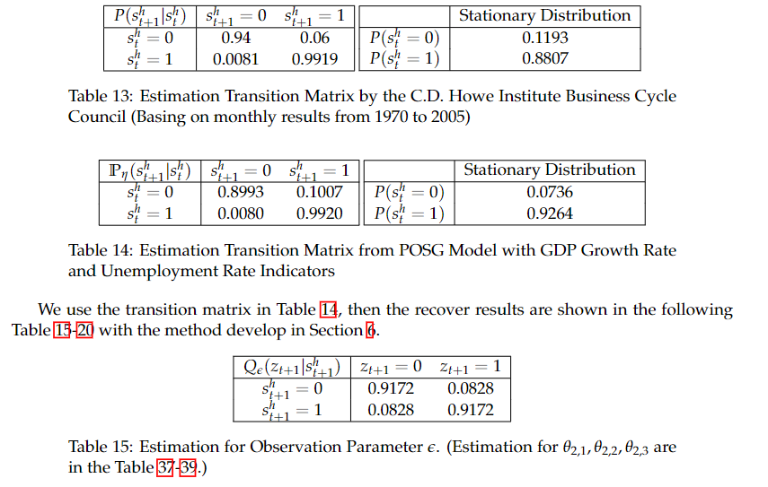
Real Data on Canada burger market
Gdp indicator – Five agent POSG

Slide 17
Real Data on Canada burger market
Gdp indicator – Five agent POSG

Slide 18
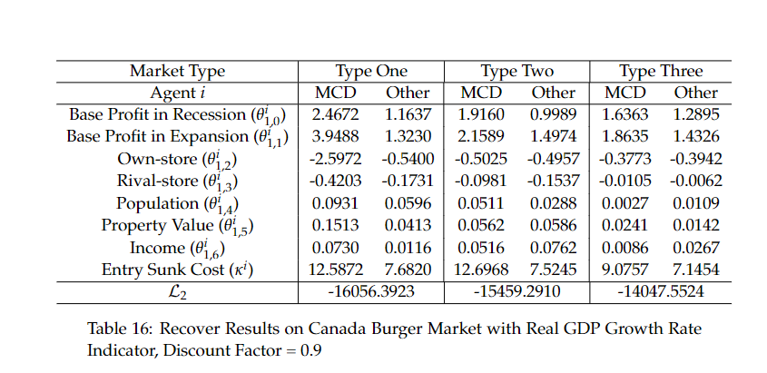

Slide 19
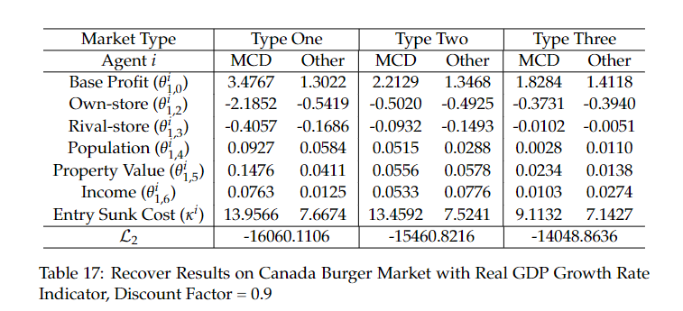
Real Data on Canada burger market
Gdp indicator – Compete model in literature
Double check the 0.15 to delete the point

Slide 20
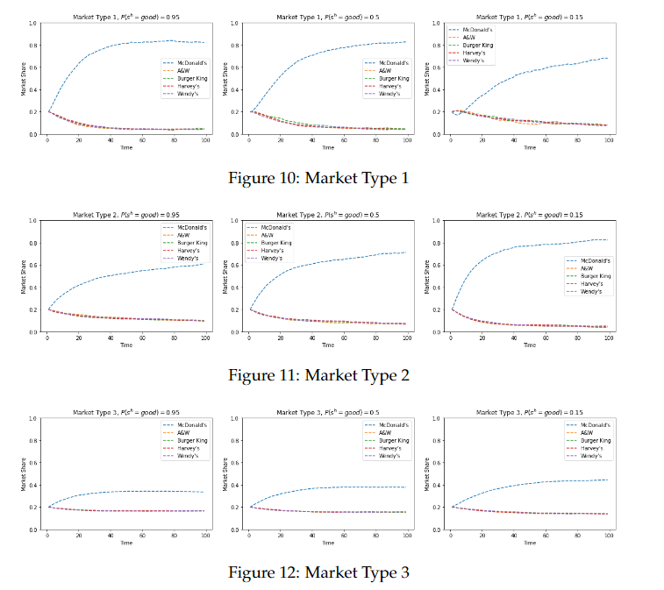

Slide 21
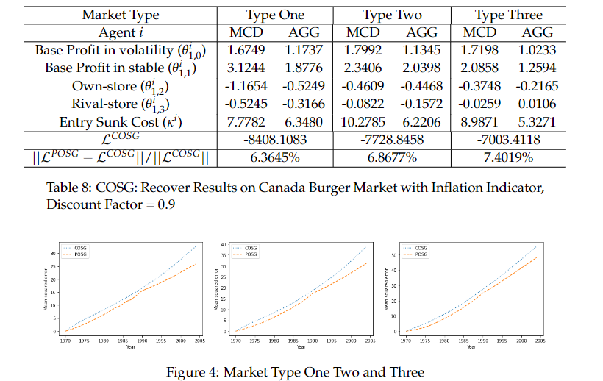
Counterfactual Analysis
Inflation rate indicator (without population, income, property value)
Two agent POSG or COSG comparison on log-likelihood, MCD treat other agents as an aggregate agent, market share plots, do some PCA or delete the model heare

Slide 22
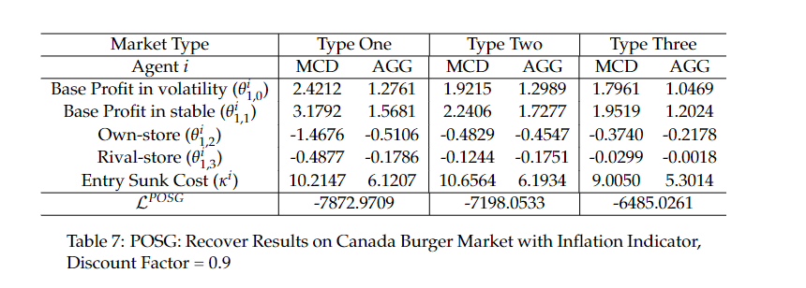

Slide 23
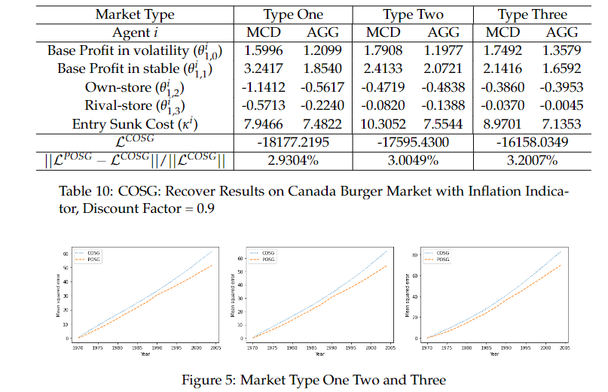
Counterfactual Analysis
Inflation rate indicator (without population, income, property value)
Five agent POSG or COSG

Slide 24
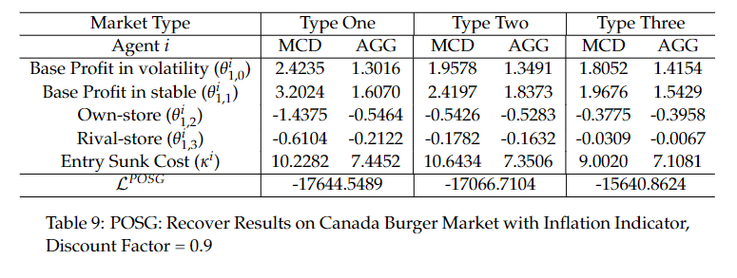

Slide 25
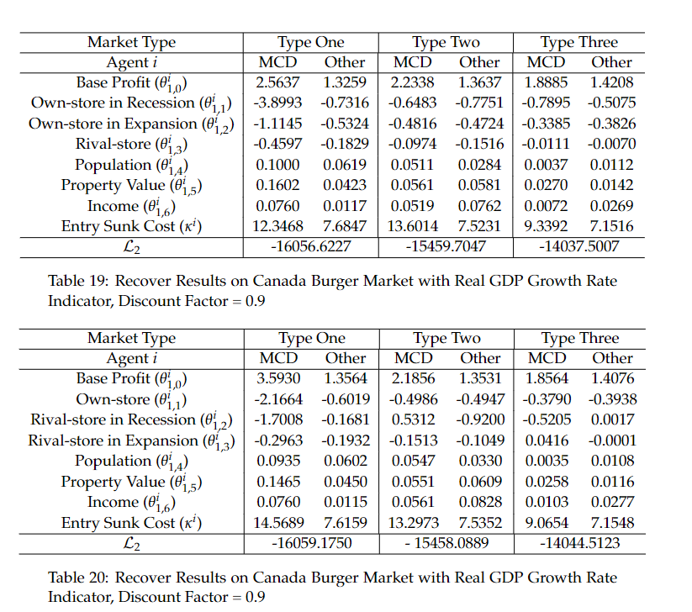
Counterfactual Analysis
Gdp indicator influence on own store competition

Slide 26
Counterfactual Analysis
Gdp indicator influence on rival store competition

Slide 27
Numerical Results
Next Week: Any other questions on numerical results?
Polish section 6 (today)
PCA + experiment (data based distribution)
The Week after next week
Edit the draft
Calculate the std results (Monte Carlo Method)
Organized the draft

Slide 28
Questions
Target Journal: I can learn the writing style from?
Revision Management science/POM/MS/OM
Target Conference: Reinforcement Learning Conference?

