Slide 1
Numerical Results
Section 6: Simulation Data on burger market entry and exit model
Short panel data
Long panel data
Partial observability
Section 7: Real Data on Canada burger market
Inflation rate indicator
Five agent POSG or COSG
Comparison: Two agent POSG or COSG
Gdp indicator
Linear regression analysis
Five agent POSG Model
Counterfactual Analysis: complete model in literature

Slide 2
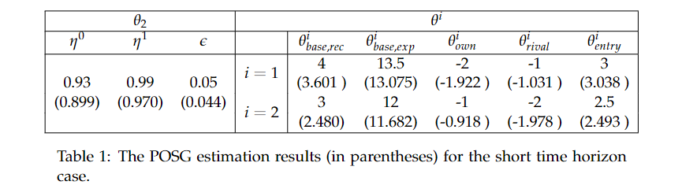
Simulation Data on burger market entry and exit model
Short panel data

Slide 3
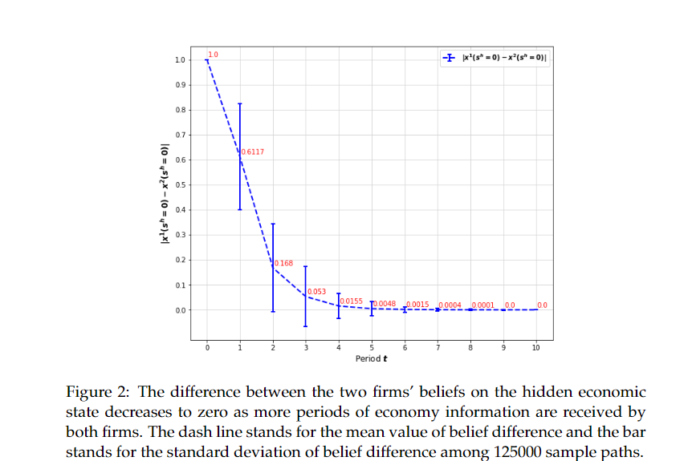

Slide 4
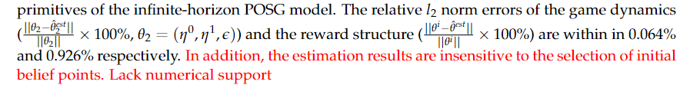
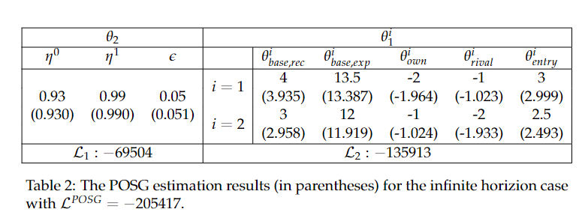
Simulation Data on burger market entry and exit model
Long panel data

Slide 5
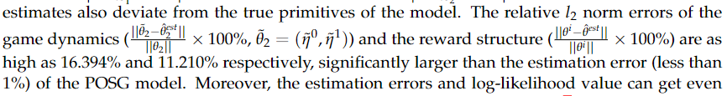
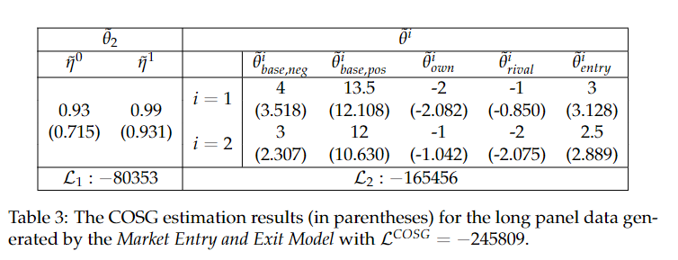
Simulation Data on burger market entry and exit model
Partial observability

Slide 6
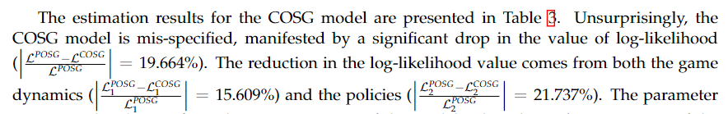
Simulation Data on burger market entry and exit model
Partial observability

Slide 7
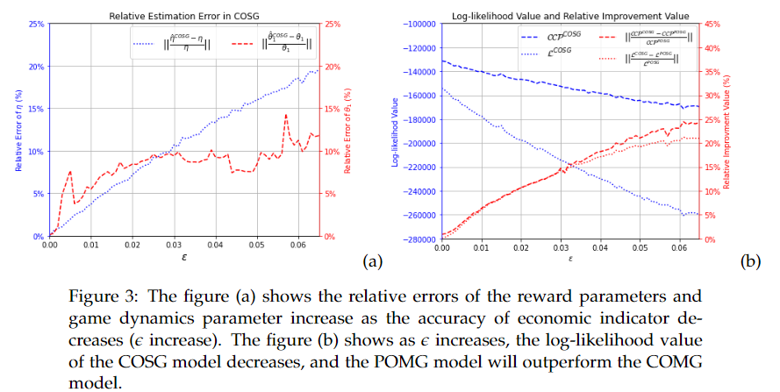

Slide 8
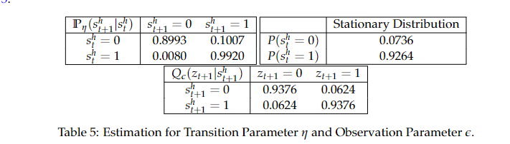
Real Data on Canada burger market
Inflation rate indicator
recover results and MSE plots for both two agent and five agent POSG and COSG model with population, income, property value

Slide 9
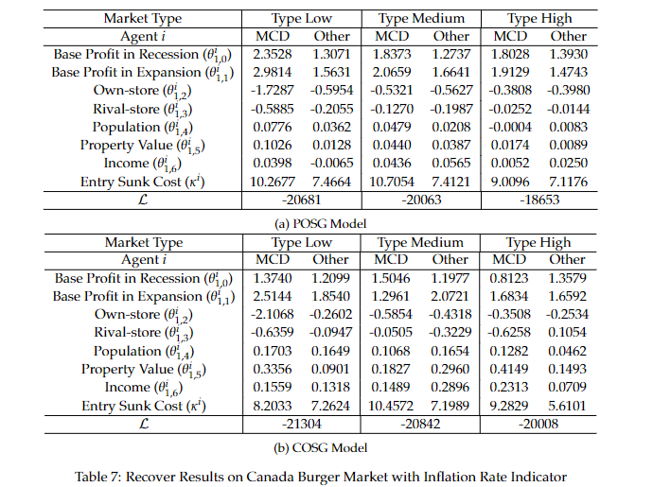
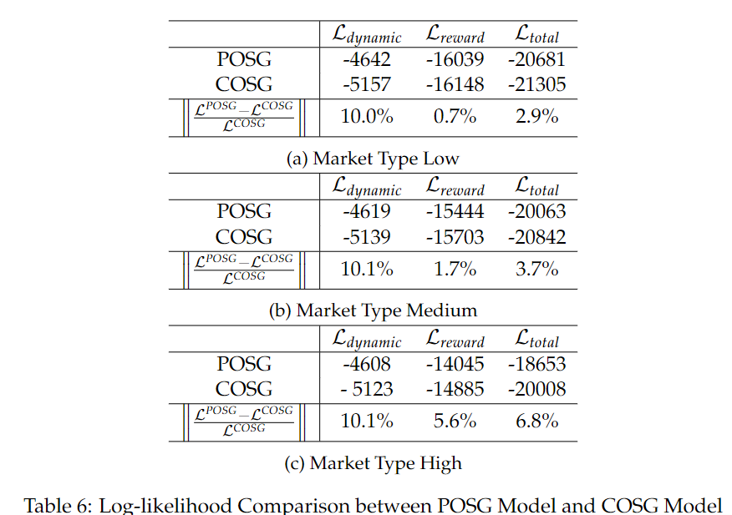
Real Data on Canada burger market
Inflation rate indicator -- Five Agents

Slide 10
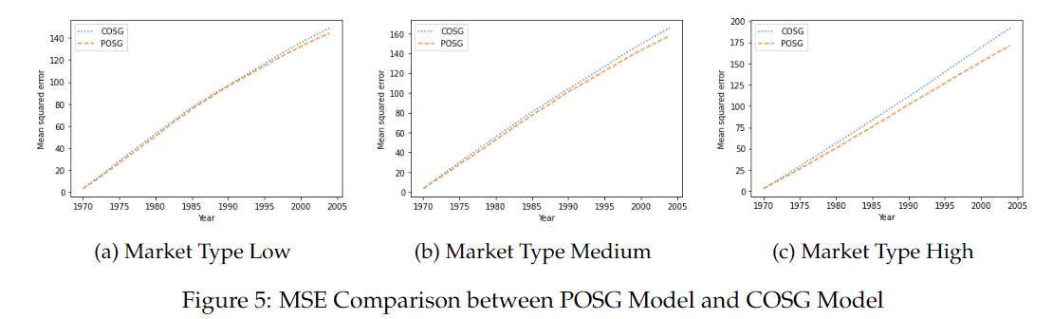
Real Data on Canada burger market
Inflation rate indicator -- Five Agents

Slide 11
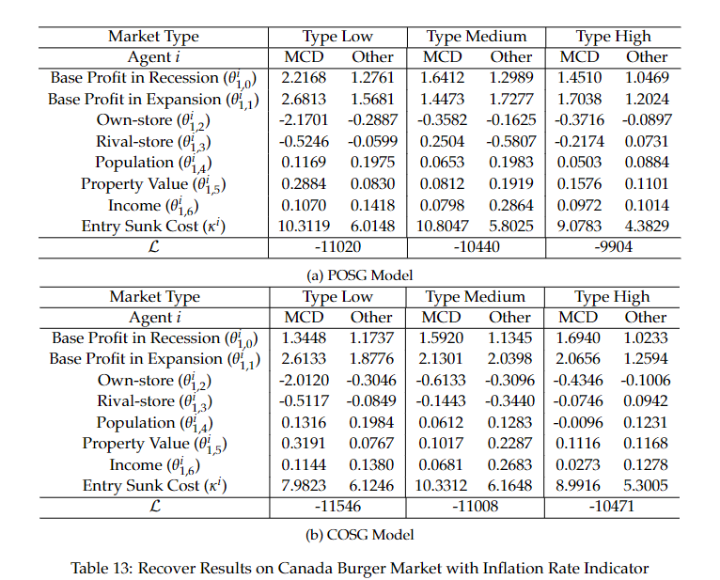
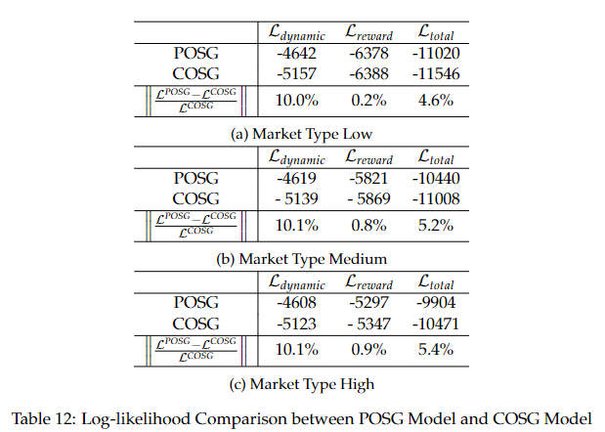
Real Data on Canada burger market
Inflation rate indicator -- Two Agents

Slide 12
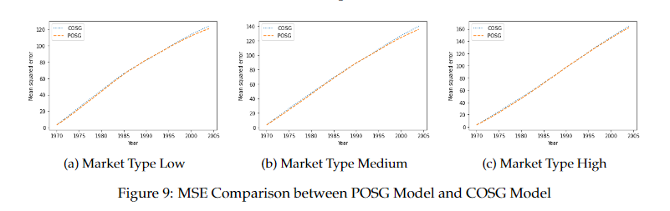
Real Data on Canada burger market
Inflation rate indicator -- Two Agents

Slide 13
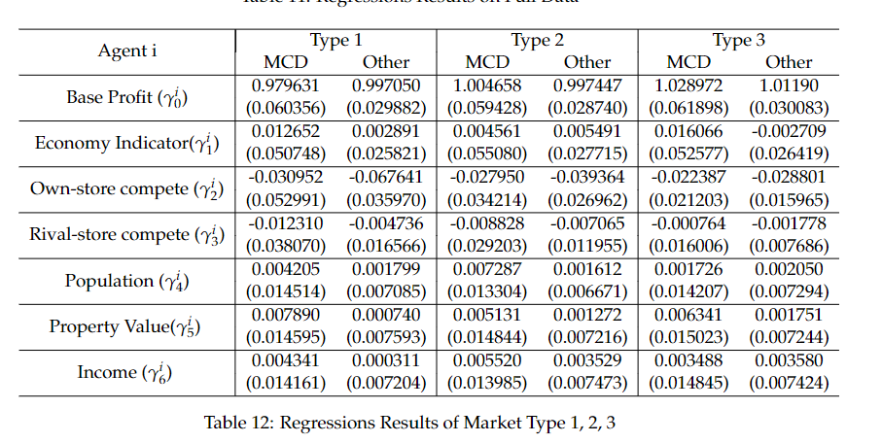
Real Data on Canada burger market
Gdp indicator – Linear regression analysis (five agents)

Slide 14
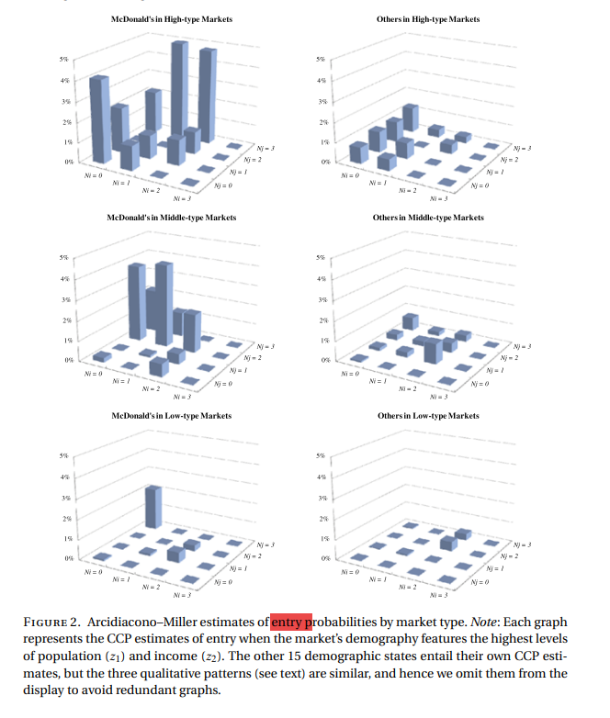
Real Data on Canada burger market
Gdp indicator – Five agent POSG
The definition of market type: profitability related

Slide 15
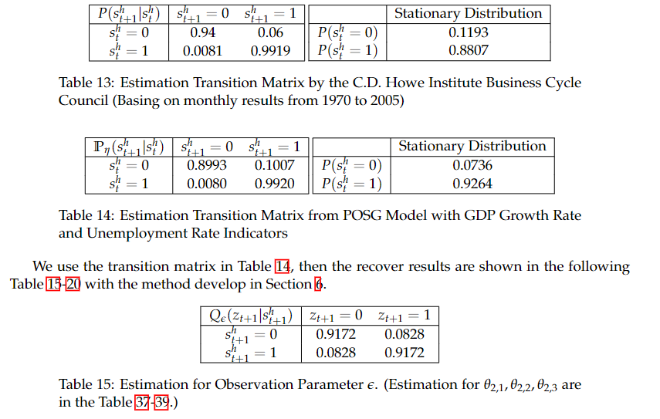
Real Data on Canada burger market
Gdp indicator – Five agent POSG

Slide 16
Real Data on Canada burger market
Gdp indicator – Five agent POSG

Slide 17
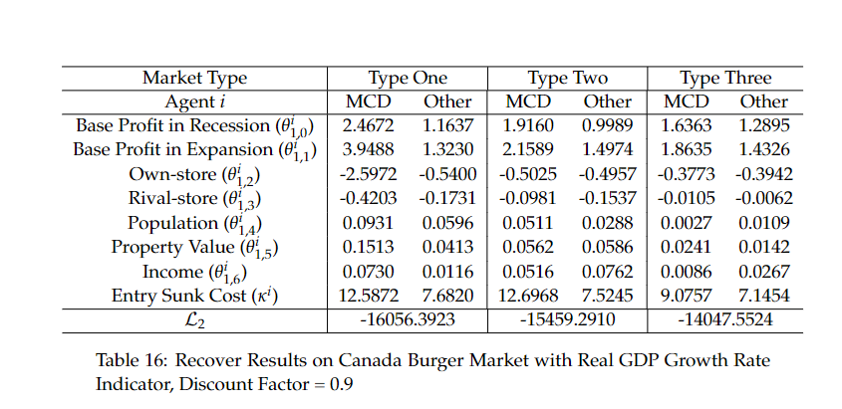

Slide 18
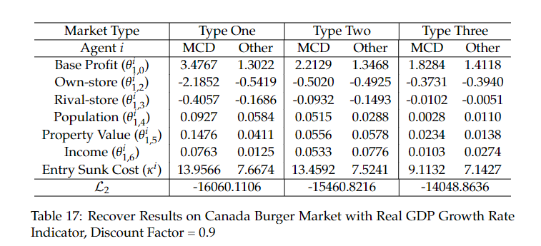
Real Data on Canada burger market
Gdp indicator – Compete model in literature

Slide 19
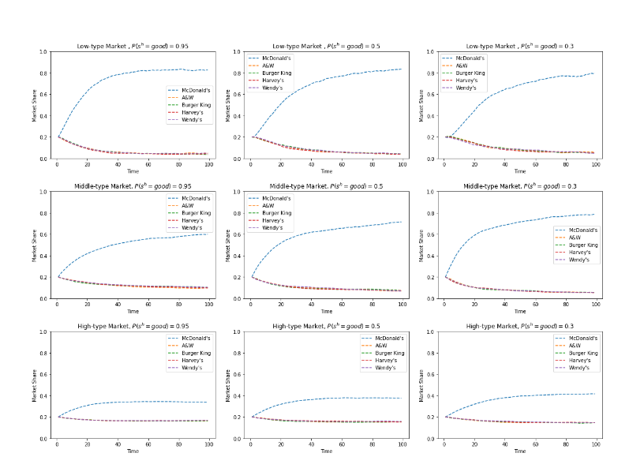

Slide 20
