Slide 1
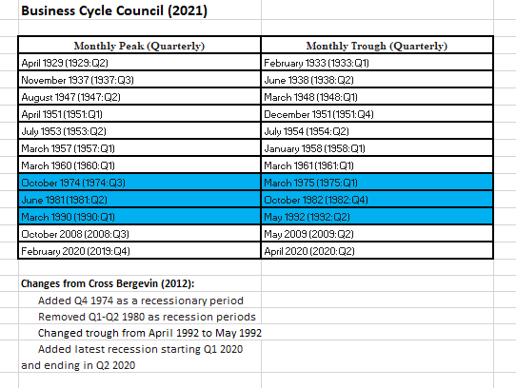

Slide 2

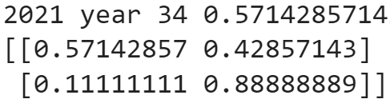
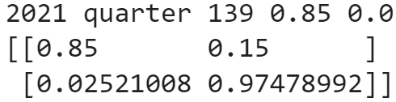

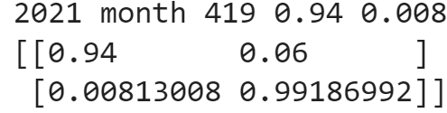

Slide 3



Extend Yearly Data to Quarterly Data
Fixed Transition
GDP Indicator & Inflation Rate Indicator
GDP (Observation)
Inflation (Observation)

Slide 4
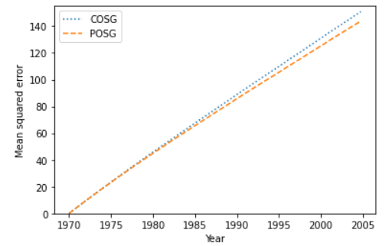
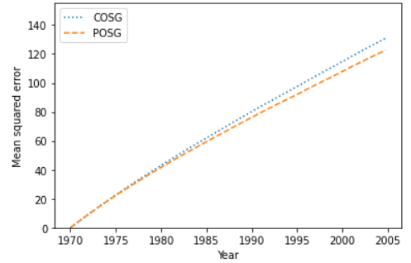
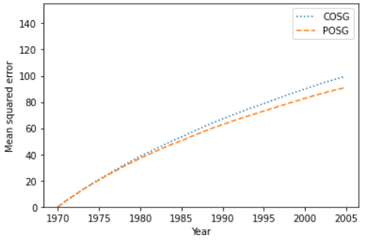
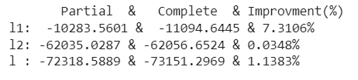


Extend Yearly Data to Quarterly Data
Fixed Transition
Inflation Indicator

Slide 5
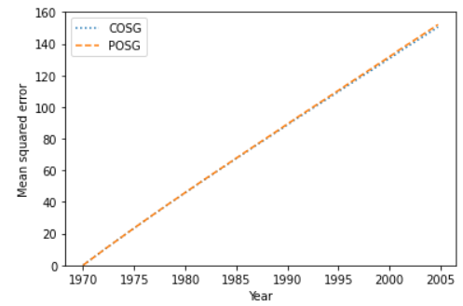
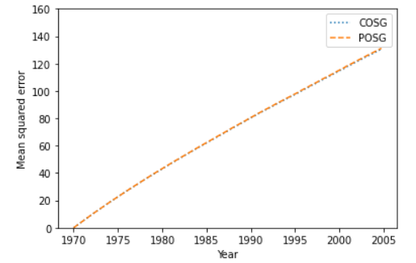
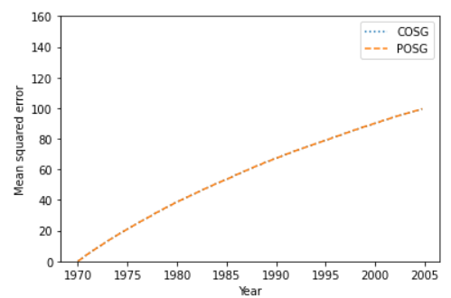
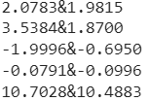
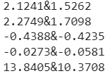
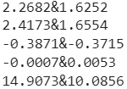
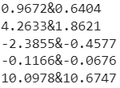
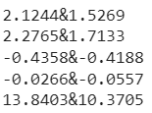
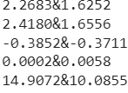



Extend Yearly Data to Quarterly Data
Fixed Transition
GDP Indicator
POSG
Low Mid High
MCD & Other MCD & Other MCD & Other
Base Profit (recession)
Base Profit (expansion)
Own Compete
Rival Compete
Entry Cost
COSG
Low Mid High
MCD & Other MCD & Other MCD & Other
Base Profit (recession)
Base Profit (expansion)
Own Compete
Rival Compete
Entry Cost

Slide 6
Four Choice POSG -- Similar Results
Inflation + Income –observation error is high/ significant level (baseline)
best improvement in:
Comparison (Second)
log-likelihood POSG and COSG 7% (dynamic),1%(total) or 4%(total+ global alg. ) –back up
AIC 12000(POSG), 12200 (COSG)
mse for action in multi-period prediction (figure)
goodness of fit (First)
highest F1-score 0.7—precision 0.9, recall 0.6
mse for action in 1-period prediction
mean value for 1-period action prediction
Mean value for 1-period number of stores (+plots)
GDP
Inflation + Income + Population + Property Value
GDP + Income + Population + Property Value

Slide 7
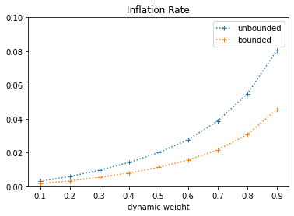
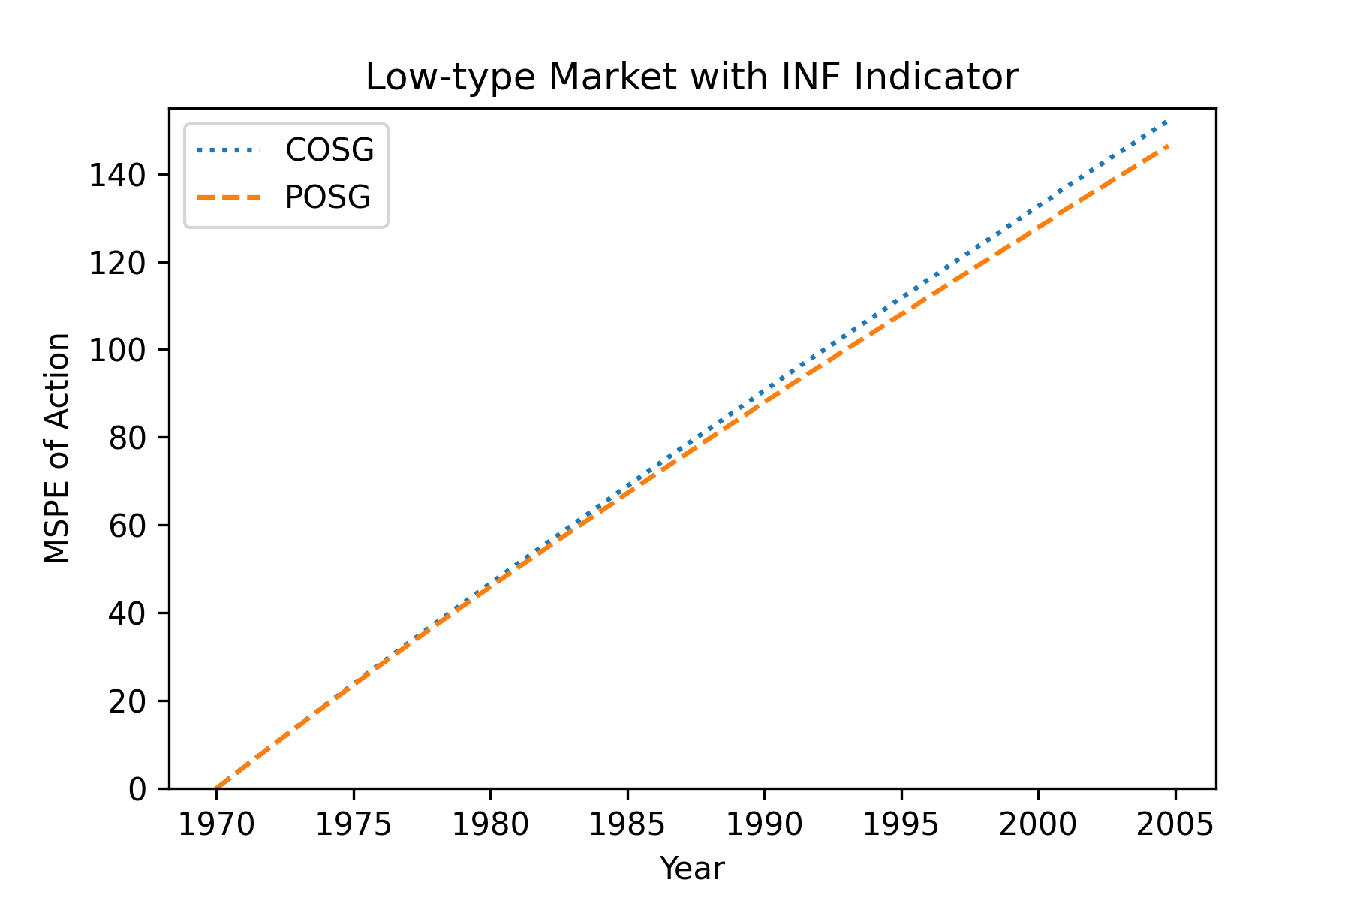
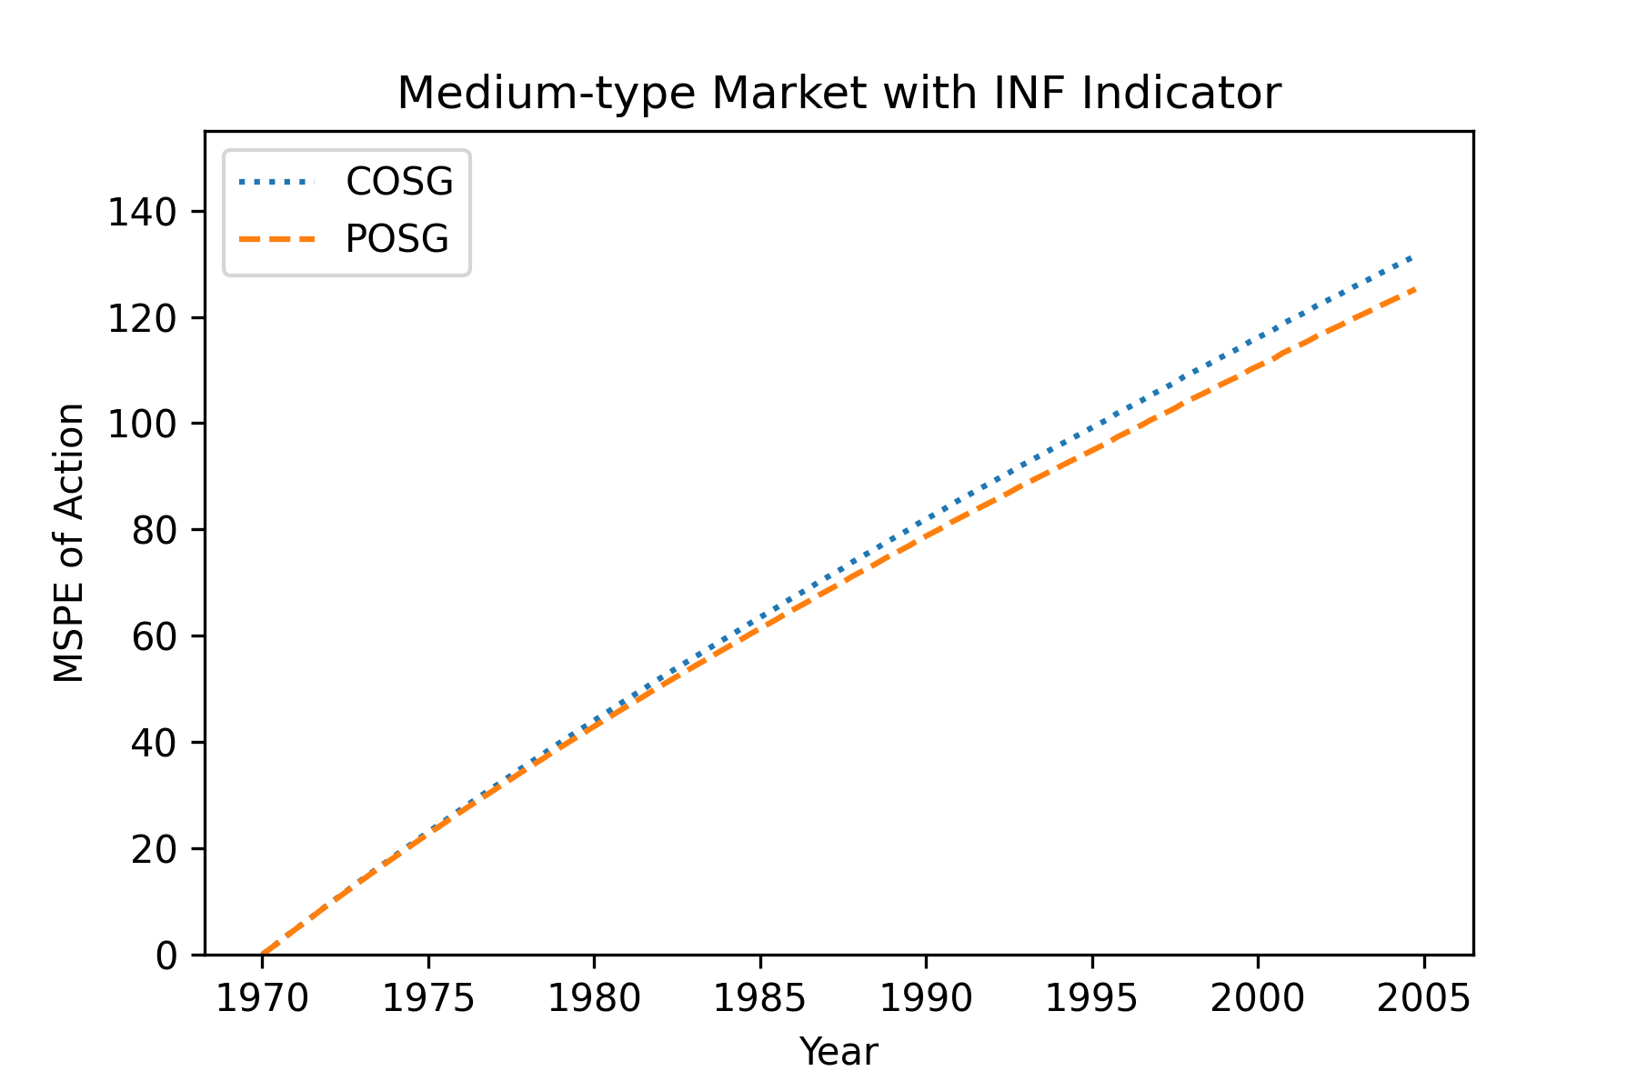
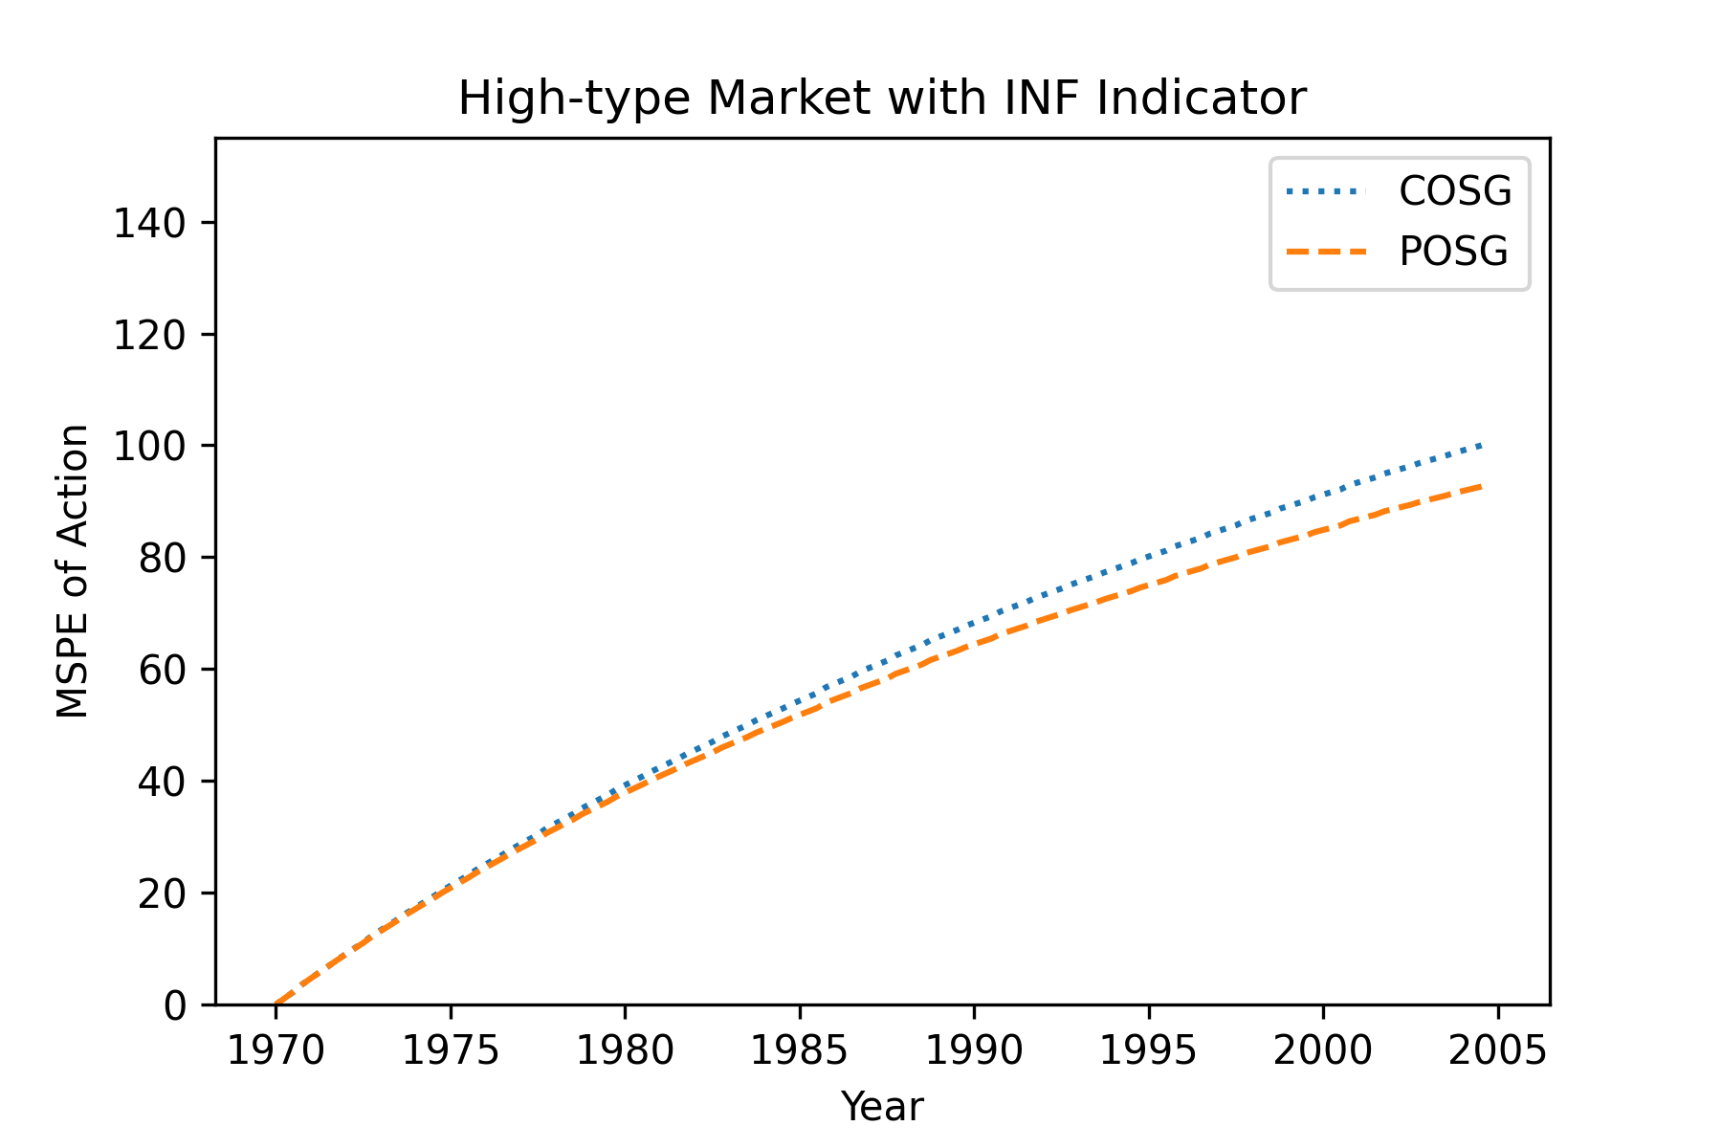
Comparison of model (multi-period prediction MSE)
Low
Medium
High

Slide 8
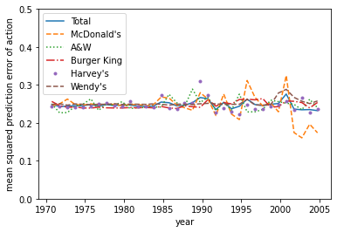
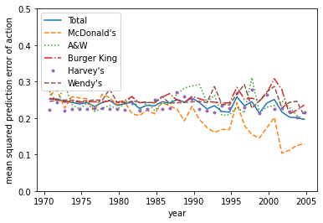
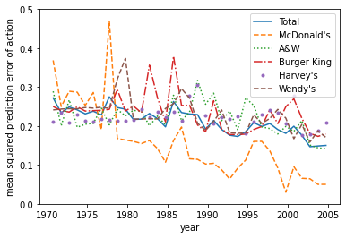
Goodness of Fit (One-Period Prediction MSE)
Low
Medium
High

Slide 9
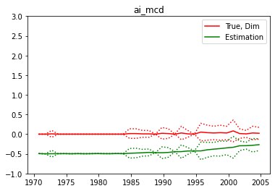
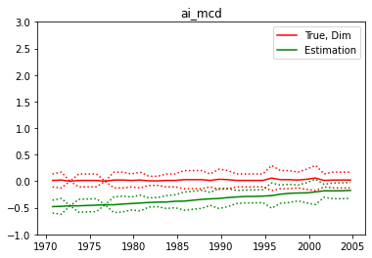
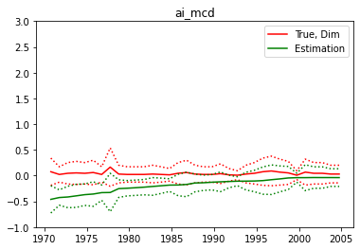
Goodness of Fit (One-Period Prediction) -- Real Data Amplitude (McDonald’s)
Low
Medium
High

Slide 10
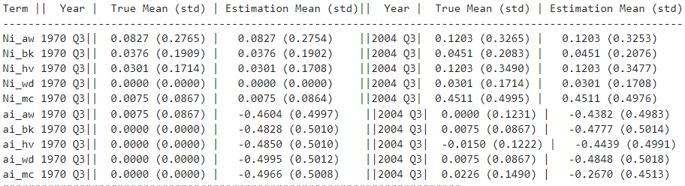
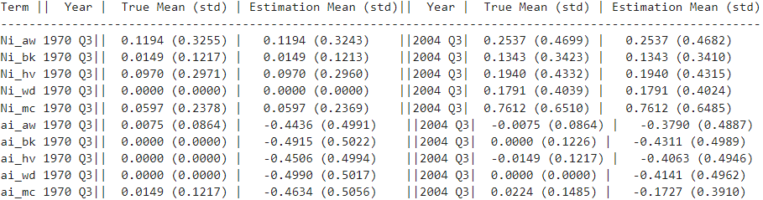
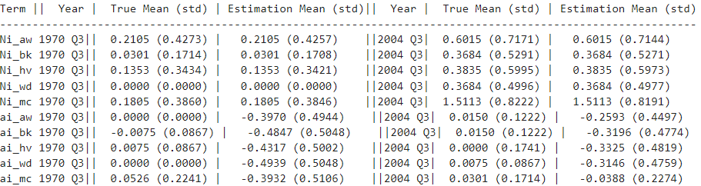
Goodness of Fit (One-Period Prediction MSE)
Low
Medium
High

Slide 11
Goodness of Fit (One-Period Prediction Correlation) -- Too bad
High ---- less than 0.1, very weak correlation

