Slide 1
2 agents collaborate game with hidden states
(A toy model)

Slide 2
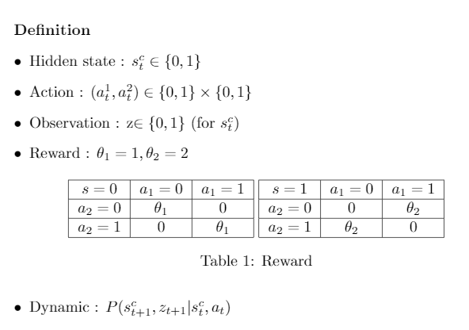

Slide 3


Slide 4
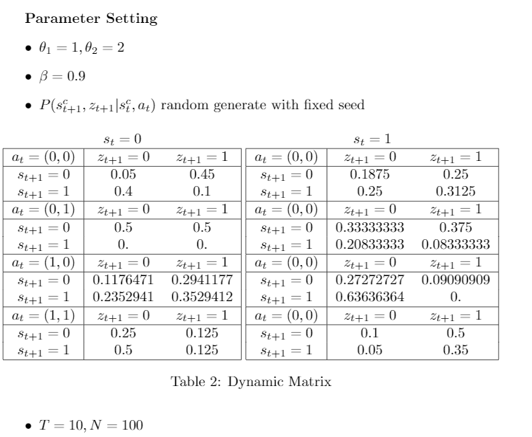

Slide 5
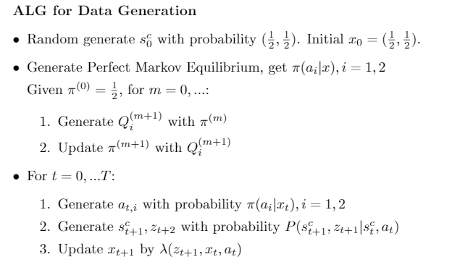

Slide 6


Slide 7
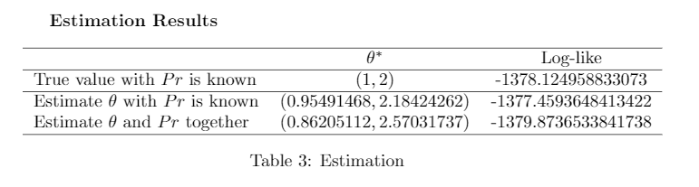
Issue: Identification
Next Step: Check identification results for complete observation case and generalize to hidden state case

